Slide 1
Artificial Intelligence for Predicting Indonesia Industrial Classification Code
The 28th Meeting of the Wiesbaden Group on Business Registers
Annisarahmi Nur Aini Aldania and Irma Damayanti

Slide 2
Classification
AI for Classification
Outline
Data
Methodology
Results
Conclusion

Slide 3
What is Classification?
CLASSIFICATION
a supervised machine learning method where the model tries to predict the correct label of a given input data
Data train
New data
X1 (age) | X2 (height) | Health status
26 | 180 | A
46 | 189 | B
48 | 170 | B
48 | 156 | C
Classification Model
X1 | X2 | Health status
31 | 179 | ?
54 | 165 | ?
48 | 188 | ?
50 | 172 | ?
Multiclass classification → more than two predicted classes/ labels
→ example: industrial classification

Slide 4
Industrial Classification
Rule or principle for classifying economic activities into certain classes or categories
Indonesia → Indonesia Industrial Classification Code (KBLI)
To determine the KBLI code of an establishment, there are questions about "main activities" and "main products" on the BPS - Statistics Indonesia questionnaire. The main activity is an approach to knowing the economic activities. Meanwhile, the main product is an approach to knowing the products produced from the main activity.
Input:
Output:
Main Activities:
KBLI Structure | Code
Section | I
Division | 56
Group | 562
Classes | 5621
Subclasses | 56210
Catering services
Subclasses
56210
A business
Main Product:
Foods and drinks

Slide 5
Artificial Intelligence for Classification
branch of computer science which enables computers to mimic human behavior
Artificial Intelligence
Machine Learning
branch of AI, with the goal is to “learn” to perform tasks based on examples (called training data) without explicit instruction
branch of ML that is based on artificial neural network architectures
Deep Learning
This research uses machine learning: Double Random Forest and deep learning: fine-tuned IndoBERT to classify establishment into 2020 KBLI subclasses. Input: the establishment’s main activities and main products. The model formed is evaluated using accuracy and F1 Score.

Slide 6
Machine Learning for Classification
Ensemble Tree
Classification Tree
n = 100
A: 40
B: 60
Aggregating many decision trees, improvements prediction accuracy
Bagging, Random Forest and Boosting
Age $<$30
Age $≥$30
n = 55
A: 20
B: 35
n = 45
A: 20
B: 25
Height >175 cm
Height <= 175 cm
Double Random Forest
n = 10
A: 5
B: 5
n = 35
A: 15
B: 20
Data
Weight > 75 kg
Weight <=75 kg
n = 4
A: 3
B: 1
n = 6
A: 2
B: 4
Final Prediction: Majority Vote

Slide 7
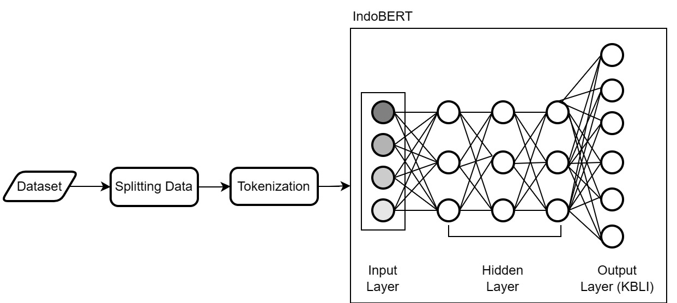
Deep Learning for Classification
The complex architecture of deep learning means that models built using deep learning require a lot of training data and resources.
One solution without building a model from scratch is to use a pre-trained language model (PLM).
PLM is a language model trained on a large dataset but remains agnostic to the specific problem to be used. There are many PLM representations; one that performs well in many specific tasks is BERT [9].

Slide 8
Data
Establishment data from the 2016 economic census.
Variables → main activities, main products, and five-digit KBLI codes.
Limited to the establishment in DKI Jakarta Province, and only two sections (G and I) with 16 five-digit KBLI code subclasses will be used.
An expert will manually code the establishment into the 2020 KBLI to ensure the data has the right KBLI

Slide 9
Data
Table 1 Section, KBLI, and Code Description
Section | KBLI | Description | Freq
G | 47111 | Retail Trade of Various Kinds of Goods, Mainly Food, Drinks or Tobacco in Minimarkets/ Supermarkets/ Hypermarkets | 215
 | 47112 | Retail Trade of Various Kinds of Goods, Mainly Food, Drinks or Tobacco not in Minimarkets/ Supermarkets/ Hypermarkets (traditional) | 4077
 | 47213 | Vegetable Retail Trade | 357
 | 47214 | Retail Trade in Livestock Products | 189
 | 47215 | Retail Trade in Fishery Products | 228
 | 47711 | Clothing Retail Trade | 1690
 | 47712 | Retail Trade in Shoes, Sandals and Other Footwear | 361
 | 47713 | Clothing Complementary Retail Trade | 182
 | 47714 | Retail Trade in Bags, Wallets, Suitcases, Backpacks and others | 225
Section | KBLI | Description | Freq
I | 56101 | Restaurant | 1136
 | 56102 | Food Stores | 1857
 | 56103 | Food Stalls | 355
 | 56104 | Mobile Food Service Activities | 1414
 | 56303 | Café | 143
 | 56304 | Beverage Stalls | 109
 | 56306 | Mobile Beverage Service Activities | 312
 |  | Total | 12850

Slide 10
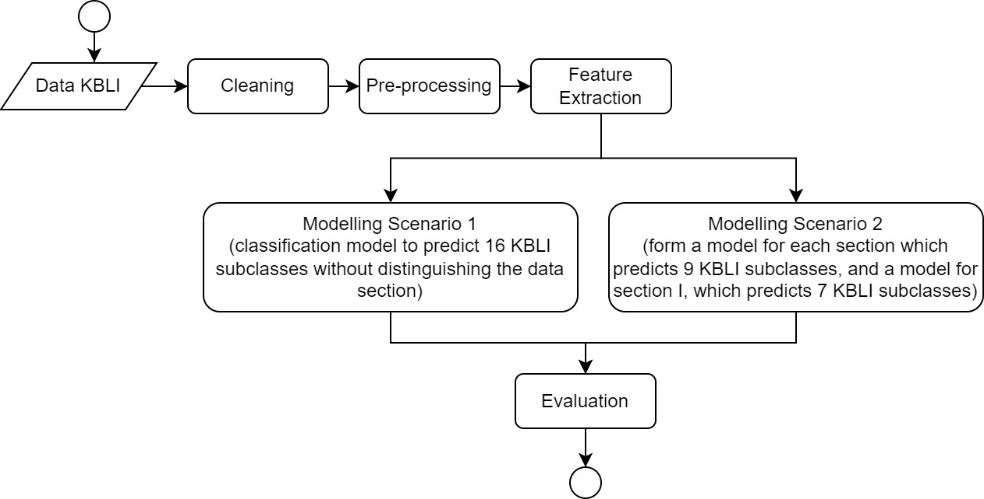
Methodology
Illustration of Analysis Procedure

Slide 11
Methodology
Pre- processing data
Concatenate the main activity description details and the main product description into new details
X1: PENYEDIAAN MINUMAN KELILING (MOBILE BEVERAGE SERVICE ACTIVITIES )
X2: POPICE
Input: PENYEDIAAN MINUMAN KELILING POPICE
Lowercasing
Stop word removal
Stemming
Input: sedia minum keliling popice
Feature Extraction → FastText

Slide 12
Results
Table 3 Accuracy and F1-Score
 | Section | Model | Accuracy | F1Score
Scenario 1 | All | DRF | 0.95 | 0.87
 |  | IndoBERT | 0.96 | 0.92
 | G | DRF | 0.95 | 0.68
 |  | IndoBERT | 0.95 | 0.60
 | I | DRF | 0.93 | 0.72
 |  | IndoBERT | 0.96 | 0.71
Scenario 2 | All | DRF | 0.96 | 0.91
 |  | IndoBERT | 0.98 | 0.95
 | G | DRF | 0.97 | 0.93
 |  | IndoBERT | 0.98 | 0.96
 | I | DRF | 0.96 | 0.89
 |  | IndoBERT | 0.97 | 0.94

Slide 13
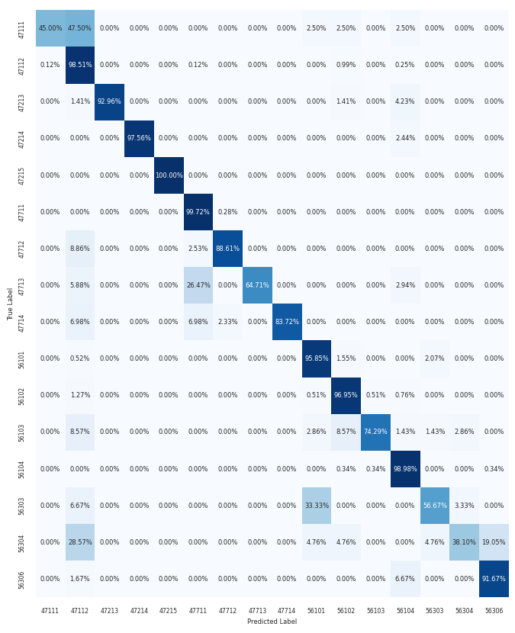
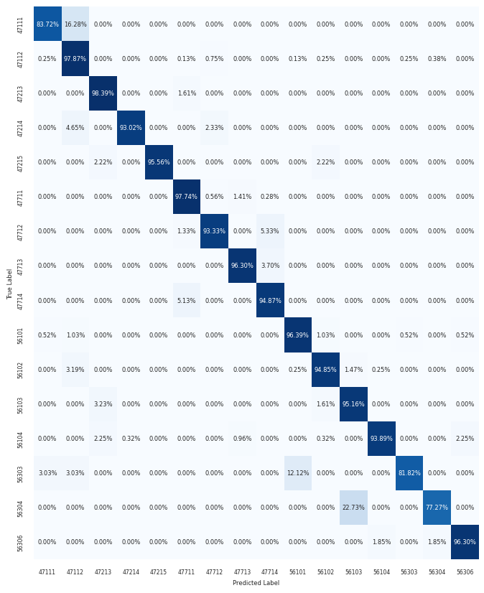
Results
Figure 5 Confusion matrix from scenario 1: (a) DRF, (b) IndoBERT
(a)
(b)

Slide 14
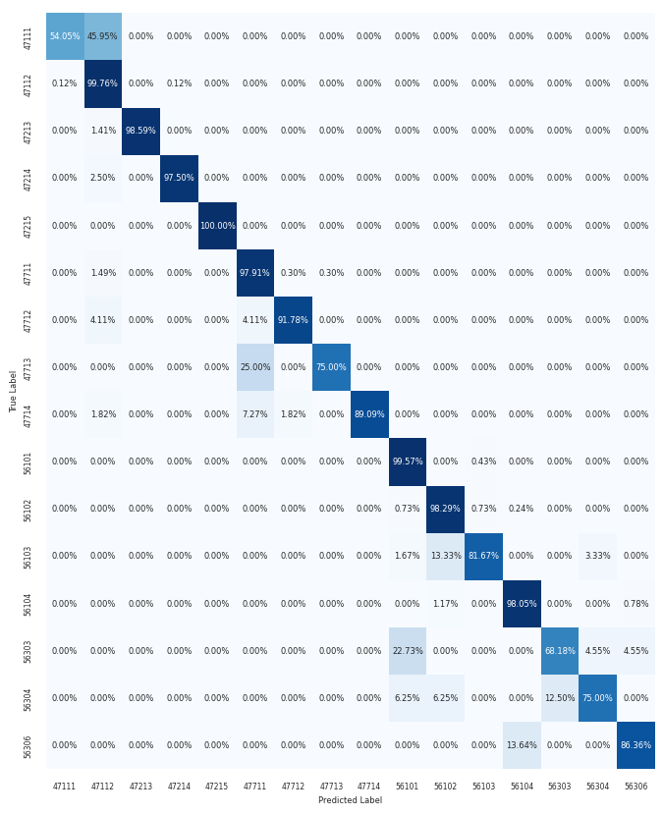
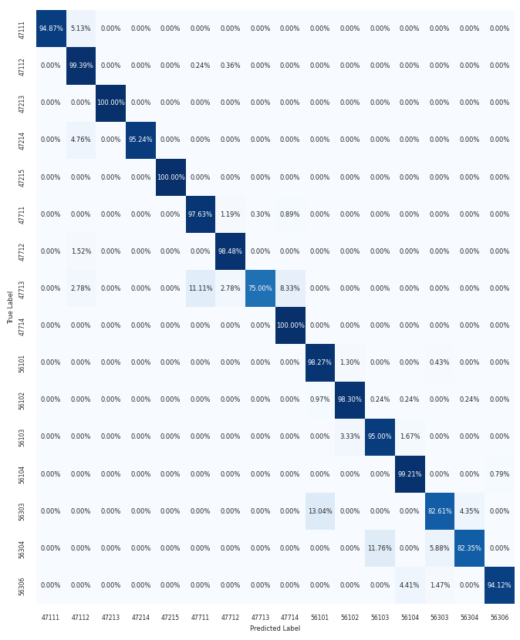
Results
Figure 6 Confusion matrix from scenario 2: (a) DRF, (b) IndoBERT
(a)
(b)

Slide 15
Conclusion
These results show that using machine learning models for industry classification based on textual descriptions of the establishment's main activities and products is feasible. The application of DRF and IndoBERT to classify 5-digit KBLI in sections G and I shows promising results. Two scenarios were formed, which included building a model without differentiating their sections and building a model for each section. For both scenarios, IndoBERT's performance exceeded DRF. IndoBERT has 0.96 accuracy in the first scenario, while DRF is 0.95. In the second scenario, the accuracy of IndoBERT is 0.98 while DRF is 0.96. In this research, forming a model for each section provides better results than forming one model for all sections.

Slide 16
THANK YOU

