Slide 1
Introducing Top-tier profiling of Multinational Enterprise Groups in the EuroGroups Register Wiesbaden group 2023 – Session 2 A. Depire (ESTAT) S. Rommelspacher (Destatis) (members of the task force for the future EGR)
Eurostat G1 / Destatis
2 October 2023

Slide 2
What is the EuroGroups Register (EGR) ?

Slide 3
Introduction
The European Statistical System allocated high priority to the better measuring of globalisation related activities
The EuroGroup Register (EGR) is part of the EU statistical infrastructure and has been built up to better capture globalisation effects as well as for improving the consistency of national data on MNE (MultiNational Enterprise) groups
European Business Statistics (EBS) regulation empowers the EGR as the authoritative source for production of the cross-border and globalisation related official statistics

Slide 4
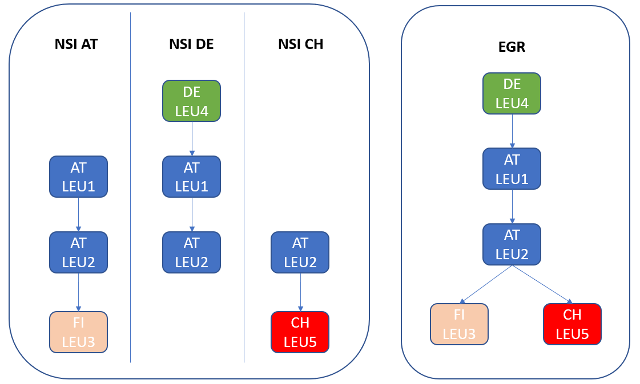
EGR MNE groups’ structures
EGR provides the complete view of all enterprises and legal units in the same MNE group, i.e., foreign affiliates enterprises of an MNE group gets the same UCI (Ultimate Controlling institutional Unit)
Data exchanges between the national BRs and the EGR are regulated by legal framework and are compliant with standards for data and metadata exchanges

Slide 5
Did you know? Figures from the EGR (2021)
The EGR final frame for reference 2021 was delivered in March 2023
155.983 Multinational Enterprise groups (MNE) operating in EU and EFTA countries
over 1.4 million legal units
533 400 enterprises in the EU and EFTA countries employing over 45 million people
443 700 enterprises outside the EU and EFTA
10% of MNE groups in EGR cover over 90% of employment: in EGR MNE groups are very polarized and few large ones dominate
75% MNE groups are controlled by an EU country (66%) or an EFTA country (9%), together covering 84 % of EGR employment
UK controls more than 11 700 MNE groups in EGR; US around 7 900, China around 2 700
Multinational enterprise groups and their structure - Experimental statistics - Eurostat

Slide 6
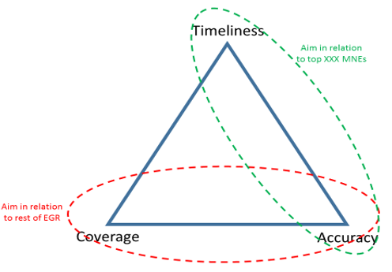
Strategy for the EGR quality
The strategy consists in implementing a so-called “two-tier” approach:
Focus on accuracy and timeliness for the TOP-TIER (the largest) MNEs, which are the most important for the EU economy, as agreed by the European Statistical System (ESS)
Invest in full automation for the ‘BULK-TIER’ while timeliness for those is not such a high priority.
Eurostat set up the Task Force for the future EGR with members from 13 EU NSIs to analyse and propose how to implement this strategy

Slide 7
How to select the Top-tier groups ?

Slide 8
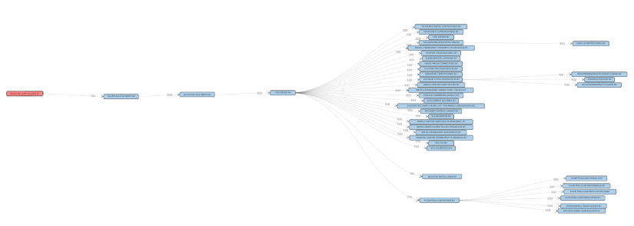
Complex and Statistical Impact (CSI) index
To identify the ‘Top tier’ MNE groups, the Task Force for the Future EGR agreed to work on a composite index involving
Size
Number of LEUs
Number of employees
Number of cross-border relations
Number of NACE codes
Complexity
Number of ownership layers
Number of employees in largest LEU
Implementation

Slide 9
First version of the CSI index – results and issues
Applying this initial CSI index based on rankings,
2020: 2,365 MNE groups (~ 2% of MNE groups) 2021: 2,903 MNE groups.
As this number was considered too high by the NSIs due to resource constraints, a further analysis and an updated version of the CSI index was necessary.
Nb
+22%
Year
2020
2021

Slide 10
New version: Quantile-based method
A first analysis showed that the groups with only 2 LEUs should be discarded.
A quantile-based method for each variable was adopted:
All variables divided into 10 classes except
The EU employment divided into 25 classes (due to its importance)
This approach, contrary to the ranking method, can handle the ties inside the same criterion.
Each group in the i^{th} class receives i points for each criterion.
➔ We call Top-tier groups the ones having 75 points.

Slide 11
New version of CSI index results
For 2021, 1669 groups selected (1% of the total MNE). They cover around 50% of the total employment in EU.
With this approach based on quantiles, the number of Top-tier groups should remain stable over years
The treatment of each MNE is assigned to the country where the Global Decision Center is located.
If it is outside EU+EFTA, a similar rank-rule on involved countries to find the « responsible » EU+EFTA country is used.

Slide 12
Implementing the Top-tier profiling process in EGR

Slide 13
European Profiling until 2022
Analysing the legal, economic, and operational structure of an enterprise group to get the best delineation of the statistical unit 'enterprise’
Collaborative task between GDC country, partner countries and Eurostat
In some cases including an interview with the group
Eurostat has developed an IT tool called IPT (Interactive Profiling Tool) to support the European Profiling activities.

Slide 14
Top-tier profiling
The process had to be reviewed and to be made as intelligent as possible and supported by efficient tools
Eurostat and the task force developed a new and leaner process and improved the existing tools for this purpose
Focus on the structures of the legal units and their relationships within the enterprise group
Enterprises can be optionally treated or automatically provided
Technical support possibilities to speed up the process could be adopted from the IT tool iProfAnT, which is used in Germany

Slide 15
Lean treatment process for Top-tier profiling
Automatable process step
Optional process step
Mandatory process step

Slide 16
Top-tier profiling with technical support

Slide 17
Values of the top-tier profiling
Lean process for treatment is developed
Technical support of the process will be improved
Data quality in EGR and NSBRs will be higher
Higher accuracy for enterprise groups with an high CSI-Value
EGR cycle with more continuous data
It will be possible to increase the exchange of updated information between NSBRs and EGR
Additional staff to be recruited and trained

Slide 18
current status and future goals

Slide 19
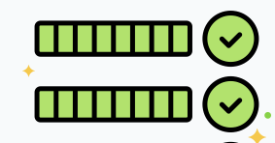
Status and objectives to achieve
The implementation of the two-tier process is already well advanced
The RY 2021 EGR data integrated for the first time the European profiling data.
The RY 2022 EGR data will propose at the beginning of T+12 high quality information on the Top tier MNE groups.
Objectives:
to further increase the accuracy of all Top-tier MNE groups
to further increase the timeliness and frequency: - from 2024 one more EGR data release at T+4 will be available.
to move towards an event-driven approach for updating of the MNE groups

Slide 20
Resources for EGR
https://webgate.ec.europa.eu/fpfis/wikis/x/tFBSD - IPT Wiki
IPT User Guide – Latest version is available online
ESTAT-IPT@ec.europa.eu.int – support requests and questions about using IPT

Slide 21
Keep in touch
Alexandre.Depire@ec.europa.eu
Simon.Rommelspacher@destatis.de
https://ec.europa.eu/eurostat/web/main/home

Slide 22
Thank you
© European Union 2020
Unless otherwise noted the reuse of this presentation is authorised under the CC BY 4.0 license. For any use or reproduction of elements that are not owned by the EU, permission may need to be sought directly from the respective right holders.

