Slide 1

Roadmap to Achieve 100% VNRBD in a Resource Restricted Setting - Sri Lankan Perspective Sri Lanka
Dr.Ananda Gunasekera
MBBS,M.Sc.(Med.Adm.) MCMA
COO - Asian Association of Transfusion Medicine
Fmr. Deputy Director General(Medical Services) & Director NBTS
Ministry of Health, Sri Lanka

Slide 2


Healthcare System in Sri Lanka
National Health Policy
One of the first developing nations in
world to provide;
- free Education &
- free Healthcare
Provides Promotive,Preventive,Curative & Rehabilitative healthcare free

Slide 3
As a result....
Infant Mortality Rate under 1yr (per 1000 live births) – 6.2
(India – 25.5, China -5.7,Japan – 1.7, USA 5.5 )
(Based on WB & UN data 2024)
Maternal Mortality Rate (per 100,000 live births) - 33
(Thailand – 48, India – 97, USA – 18.6, China 29, Japan 5 )
(Based on WB & UN data 2018 to 2023()
Life expectancy at birth – 77,73 years (overall)
((Sweden – 83.3 ,USA – 78.4, India – 70.4)
(Based on WB & UN data 2023)
Literacy rate - 92%
(India - 77%, Thailand - 94% ,China – 96.7 %)
(Based on WB & UN data 2023)

Slide 4
AATM Member Countries (26)
Very Diverse Health Systems Policies & Economies

Slide 5
Blood Transfusion service – Sri Lanka
Established in late 1950s
Directly under the Ministry of Health
Nationally Coordinated
Sole supplier of Blood and Blood Products to the;
- entire Government sector
- majority of Private sector

Slide 6
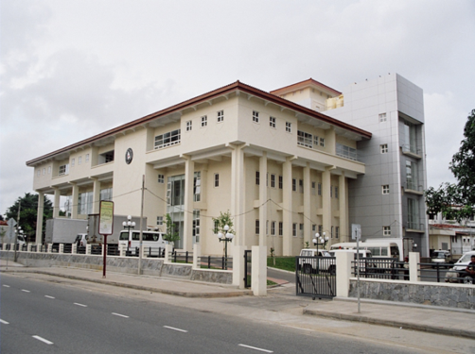
Administrative net work of NBTS - SL
Director/NBTS - Head of the Service
National Blood Centre (NBC) – Operational Head Quarters
88 hospital Based Blood Banks – Managed through 16 clusters
Total Man power – 1036
Transfusion Medicine
a recognized specialty by PGIM- SL
Board certified Consultants

Slide 7
Blood Donor Department
Seperate unit – Blood donor Department
under direct supervision of the Director
Responsible for ;
-Donor motivation
-Donor recruitment
-Blood collection
-Donor welfare & retention
-Research on development of new strategies

Slide 8
Progress Till 100% VNRBD

Slide 9
Vital Statistics of NBTS

Slide 10
Vital Statistics of NBTS ....cntd. Where we stand now
Paid Donations are not entertained.

Slide 11
Vital Statistics of NBTS ....cntd. Prevalence of TTI among units collected (2002 – 2010)

Slide 12
Vital Statistics of NBTS ....cntd. Blood Collection Pattern

Slide 13
Vital Statistics of NBTS ....cntd. First time and repeat donations
Repeat
First time

Slide 14

Traditional stratergies
1.Evidence Based Management System
Regular monitoring of monthly statistics of all blood banks

Slide 15
Traditional Stratergies ..... cntd.
2. Giving wider awareness to Blood Donation
3.Annual Celebrations of World Blood Donor Day

Slide 16
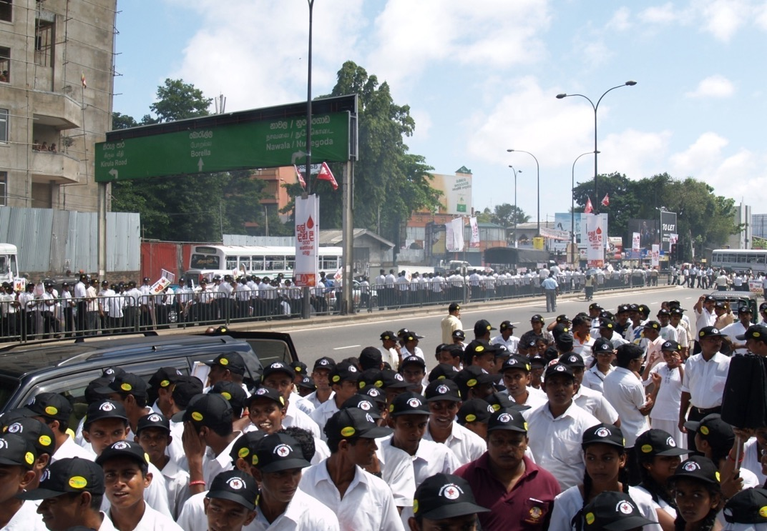
Walk for life - 2009

Slide 17
Traditional Stratergies .....cntd.
4.Providing easy access to Blood Donation facilities by;
Development of Hospital Based Blood Banks Island wide
Development of a Regional Cluster System
Opening up new blood banks in newly liberated areas in North & East of the country

Slide 18
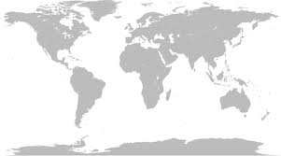
5. Haemovigilance
Country | No. of Haemovigilance Reports published upto 2020 | Reporting system Mandatory/Voluntary
UK(SHOT) | 24 ( Ref. SHOT report 2010) | Voluntary
New Zealand | 17 (Ref. National Haemovigilance programme Annual Report 2010) | Mandatory
Australia | 14 ( Ref. Australian Haemovigilance Report 2010) | Voluntary
Sri Lanka | 7 (Ref Haemovigilance report 2010 Sri Lanka) | Mandatory
Haemovigilance

Slide 19
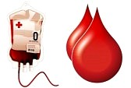
Haemovigilance
Donor Process Recipient
Haemovigilance
Vein Vein
Haemovigilance

Slide 20
Haemovigilance System -SL
The National Haemovigilance Centre of Sri Lanka was established in 2009 at the National Blood Centre
Mandatory reporting system
All adverse reactions (including near misses ) are expected to report
Done in a fact finding culture( not fault finding)
Consultant Transfusion Physician and
One medical officer attached to the unit
Haemovigilance

Slide 21
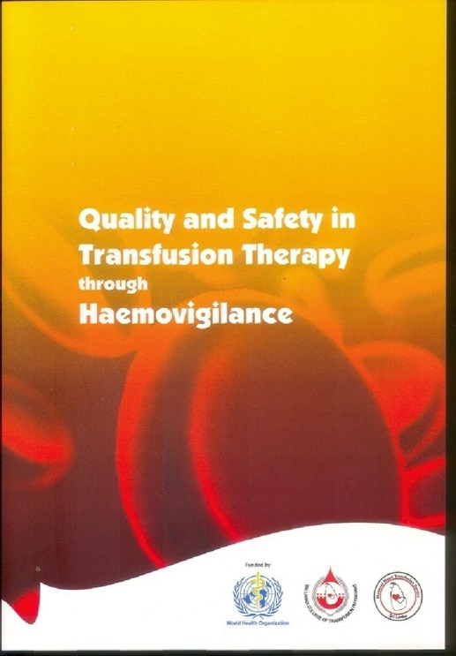
Guidelines for reporting
Haemovigilance
Guide lines for transfusion reaction reporting, investigation and management for blood banks and wards are included in this hand book

Slide 22
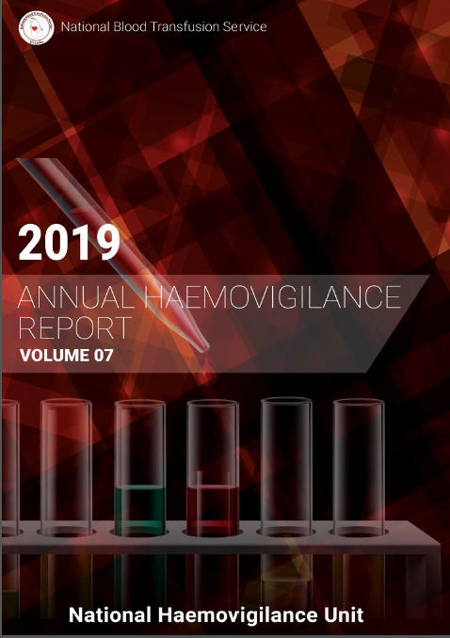

Slide 23
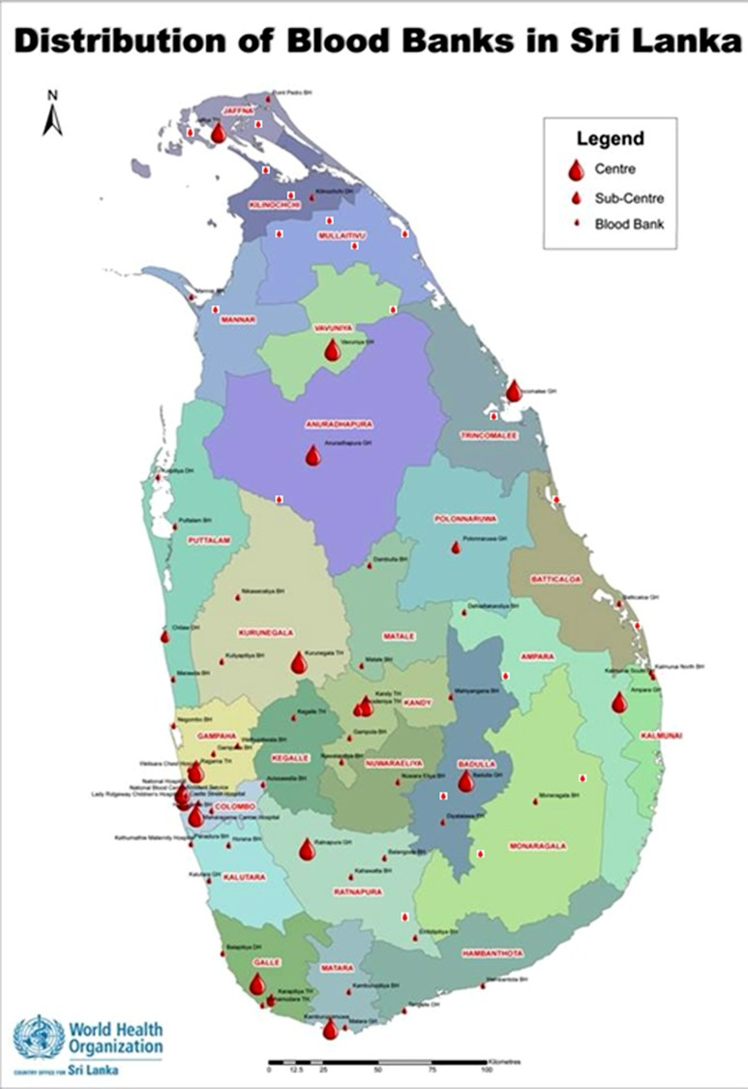

Slide 24
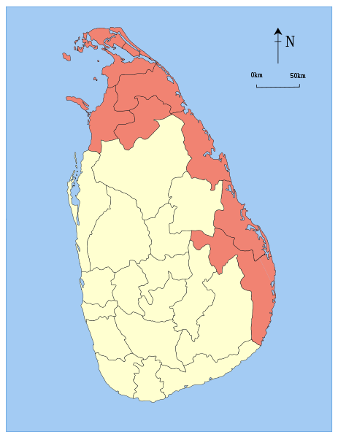
New Blood Banks established in North and East of the Country

Slide 25
Novel Strategies
1. Giving wider awareness to Blood Donation
through;
Identification of Population based target levels
Value added programmes in Mobile Drives
Social Marketing Concepts
Effective Use of Social Media

Slide 26
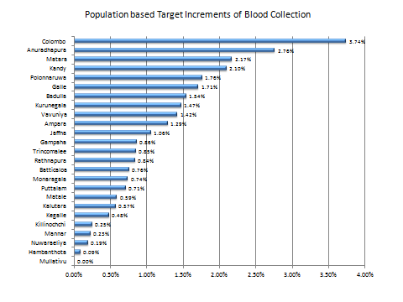
Population based target levels

Slide 27
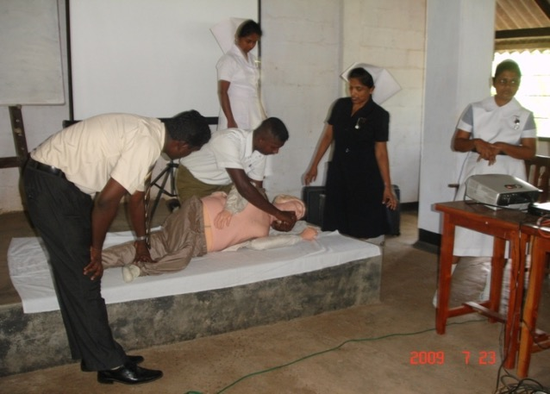
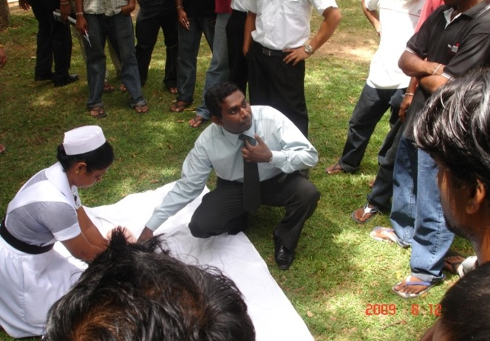
Giving Wider Awareness to blood donation through; Value Added programmes
Introduction of CPR Training to Mobile Drives

Slide 28
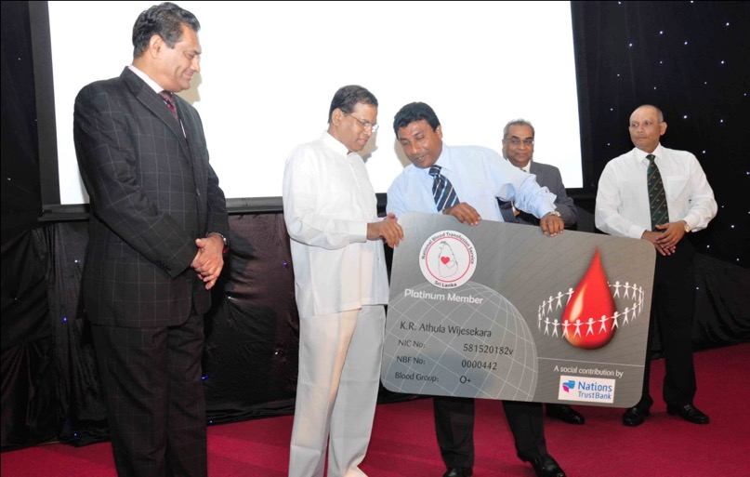
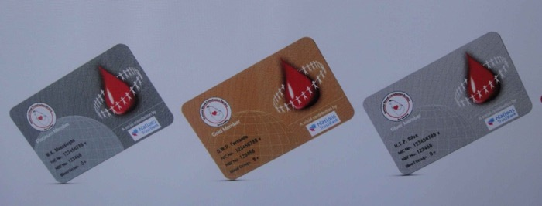
Giving Wider Awareness to Blood Donation Through; Social Marketing Concepts
Loyalty system to appreciate the milestones of blood donations by introducing Blood Donor Cards for the Donors & Organizers in :
Silver
Gold
Platinum

Slide 29
Novel Stratergies ......cntd.
2.Development of Mobile Calendar
Mobile Calendar
 | Ministries | Departments | Co operations
January
February | 04 | 04
March | 04 | 04 | 05
April | 02 | 02
May | 04 | 04
June | 04 | 04
July | 04 | 04
August | 04 | 04
September | 04 | 04
October | 04 | 04
November | 04 | 04
December | 04 | 04 | 06

Slide 30
Novel Strategies .....cntd.
3.Addressing Seasonal Variation in Blood Donation
Monthly Blood Collection – NBTS (Jan – Aug 2010 & 2011)

Slide 31
Novel Strategies ......cntd
5.Credibility Development of the Organization
Through targeting National Awards for Quality of Service;
ISO 15189 Accreditation for Laboratories
Provincial Productivity Award 2009 – Commendation
Taiki Akimoto 5S Award 2010 – Winner
National Health Excellence Awards 2009/2010 - Gold Award
National Green Awards 2010 – Silver Award
National Quality Award 2010 – Merit Award

Slide 32
We Achieved the Pinacle

Slide 33
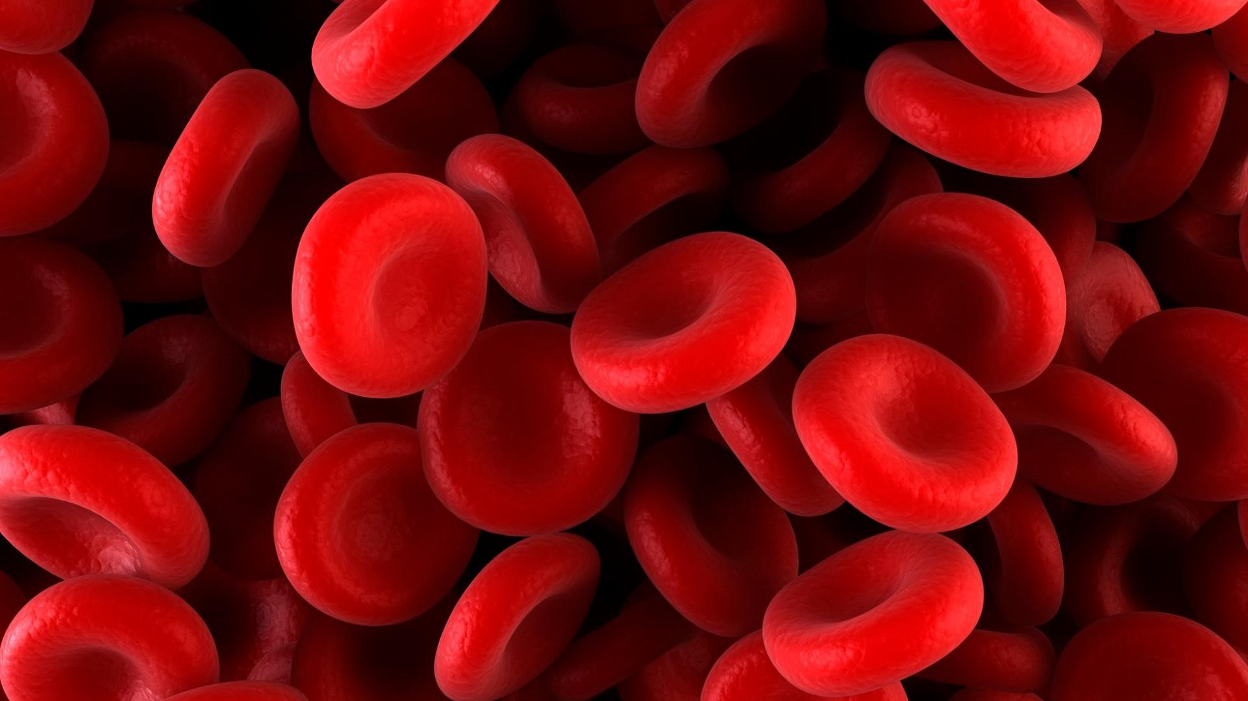
Year | Voluntary Collection | Replacement collection | Total collection | As a %
2004 | 106,106 | 86,813 | 192,919 | 55
2005 | 130,442 | 76,938 | 207,380 | 62.9
2006 | 185,064 | 61,688 | 246,752 | 75
2007 | 209,774 | 50,468 | 260,212 | 80.6
2008 | 282,446 | 37,645 | 319,891 | 88.3
2009 | 267,773 | 42,136 | 309,909 | 86.4
2010 | 268,128 | 34,755 | 302,883 | 88.5
2011 | 318,885 | 11,315 | 330,200 | 96.6
2012 | 349,423 | 2,182 | 351,605 | 99.4
2013 | 380,808 | 0 | 380,808 | 100
2014 | 380367 | 0 | 380367 | 100
2015 | 395500 | 0 | 395500 | 100
2016 | 414175 | 0 | 414175 | 100
2017 | 423668 | 0 | 423668 | 100
2018 | 450640 | 0 | 450640 | 100
2019 | 444515 | 0 | 444515 | 100
2020 | 397833 | 0 | 397833 | 100
2021 | 385054 | 0 | 385054 | 100
2022 | 424127 | 0 | 424127 | 100
2023 | 466061 | 0 | 466061 | 100

Slide 34
Escalation of 100% voluntary non remunerated Blood Donation Sri Lanka

Slide 35
Annual blood collection

Slide 36
Blood component processing
NBTS practices 100% blood processing.

Slide 37
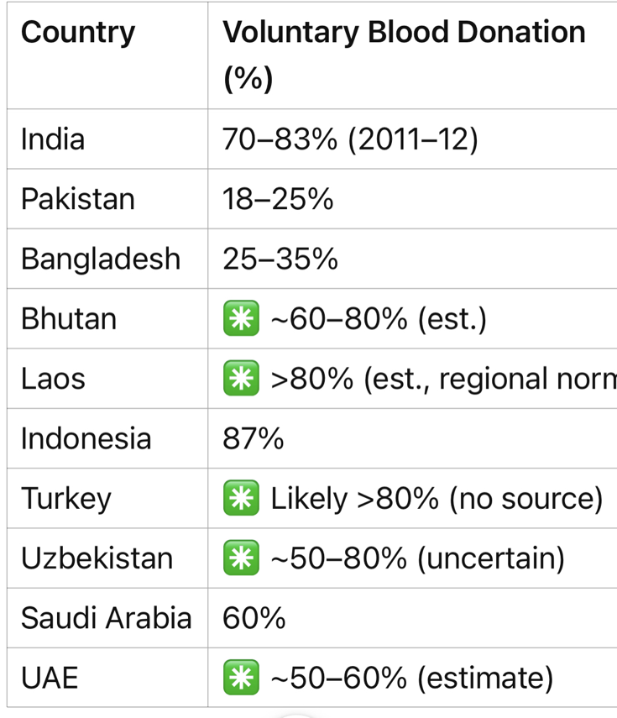
Few Examples from Member Countries Source: ChatGpt
Iran 100%

Slide 38
Let Us Discus…….
Is It only Financial Situation of a Country??
Is It only the Scientific Development of a country?
Is it only the Health Policy of the Country?
Is it only the Religion of a Country?
Is It only the Social & Cultural Situation of a Country?
OR
A COMBINATION OF ABOVE

Slide 39
Thank You

