Slide 1
Welcome to the 28th
meeting of the
Wiesbaden Group
on Business Registers
Marleen Verbruggen
Senior Director Economic and Business Statistics and National Accounts

Slide 2
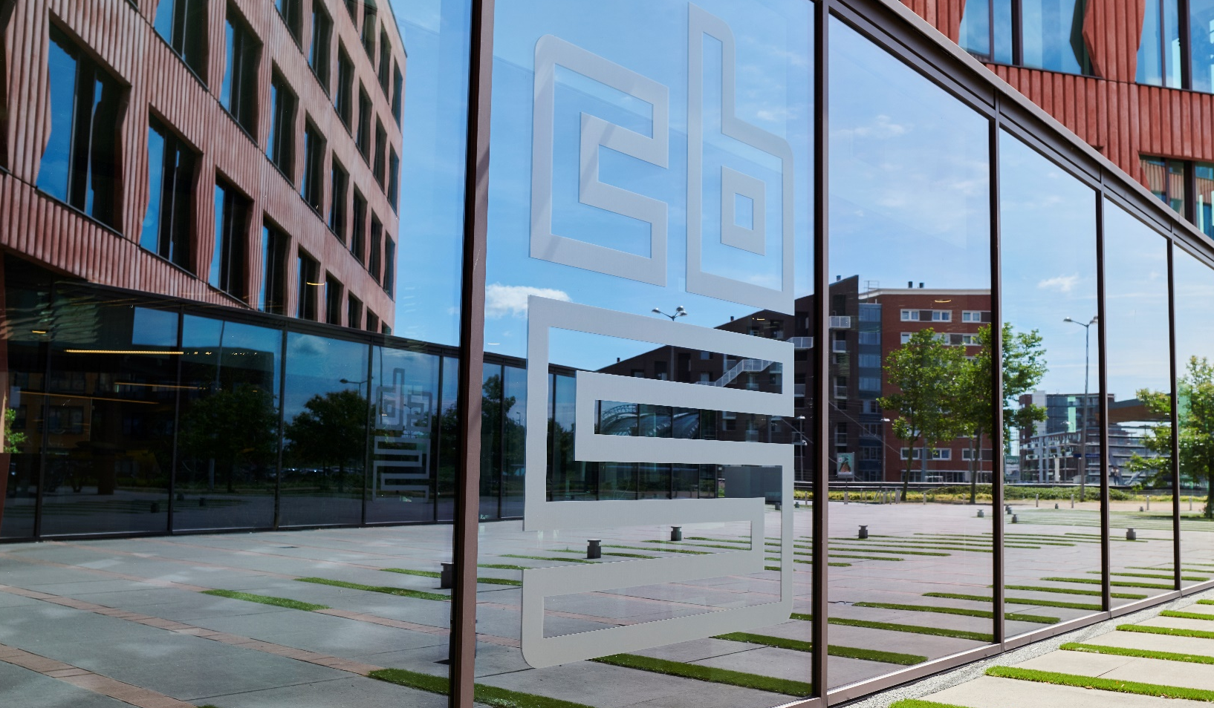
Let’s start with the facts
Notes:
Statistics Netherlands (CBS) stands for a society which is well-informed on the basis of actual facts. As the national statistical office, CBS offers insights into societal developments by providing reliable statistical information and data. These insights support the public debate, academic research, policy development and decision making processes. This has been our role since 1899.
And now for some actual facts...
At present, we have around 2,000 highly educated staff working at our offices in The Hague, Heerlen and on Bonaire, conducting around 600 research projects each year. In addition, we have a group of around 150 colleagues who visit people’s homes through wind and rain for our surveys every single day. CBS employs people from all backgrounds, from econometrics to mathematics and from sociology to public administration.

Slide 3
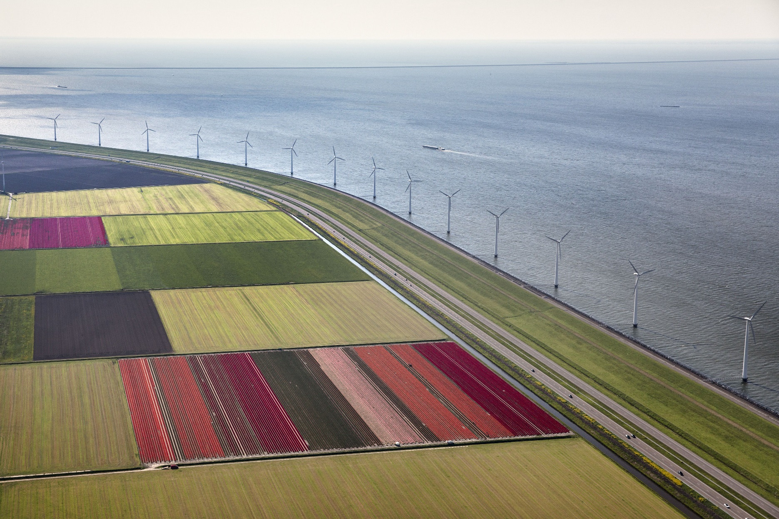
The Netherlands
3
Notes:
This is my home country. The Kingdom of the Netherlands, commonly known as the Netherlands. It is a sovereign state and constitutional monarchy undr King Willem Alexander. It has territory in western Europe, but also in the Caribbean. The Kingdom consists of four countries or parts: the Netherlands, Aruba, Curaçao, and Sint Maarten. Furthermore, there are three special municipalities (Bonaire, Saba, and Sint Eustatius) are located in the Caribbean. The Netherlands comprises roughly 98% of the Kingdom's land area and population.
The Netherlands is a small country. It is only 300 kilometers long and 200 kilometers wide. A quarter of the Netherlands is below sea level!
The Netherlands is very densely populated with 17 million inhabitants, which means an average of 413 persons per square kilometer.
The Dutch language is also used in South Africa. The Cape Dutch dialects of Southern Africa have evolved into Afrikaans which is spoken to some degree by at least 16 million people, mainly in South Africa and Namibia.

Slide 4
The Netherlands
Kingdom: 4 countries (+ A, C, St M)
Small country 300 km long, 200 km wide
Quarter of the land below sea level
17,83 million inhabitants
Densely populated: 523 persons / km²
Notes:
The Kingdom of the Netherlands, commonly known as the Netherlands. It is a sovereign state and constitutional monarchy under King Willem Alexander. It has territory in western Europe, but also in the Caribbean. The Kingdom consists of four countries or parts: the Netherlands, Aruba, Curaçao, and Sint Maarten. Furthermore, there are three special municipalities (Bonaire, Saba, and Sint Eustatius) are located in the Caribbean. The Netherlands comprises roughly 98% of the Kingdom's land area and population.
The Netherlands is a small country. It is only 300 kilometers long and 200 kilometers wide. A quarter of the Netherlands is below sea level!
The Netherlands is very densely populated with 17.83 million inhabitants, which means an average of 523 persons per square kilometer.

Slide 5
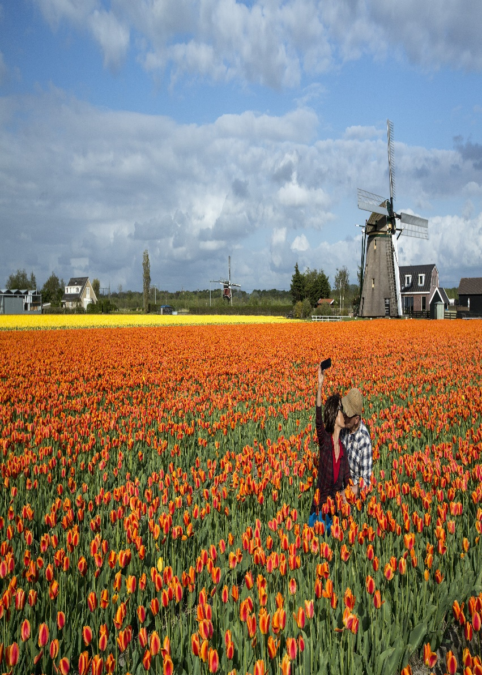
Dutch culture
5
Notes:
Tulips, windmills and wooden shoes. Holland is famous for it. But we don’t walk on wooden shoes every day… Keukenhof should be visited once in your lifetime.
New acquaintances should be greeted with a handshake. As for longer-term friends, a 3-point kiss - that’s cheek-to-cheek-to-cheek, is commonplace.
Breakfast typically consists of a slice of bread with various toppings like HAGELSLAG different cheeses, peanut butter, treacle, and chocolate spread.
Bikes (fietsen) are an inescapable part of Dutch culture. A typical bike comes with locks (at least 2), saddle bags for shopping, two bells to warn traffic, baby seats mounted at both ends and/or a bakfiets (sturdy wooden compartment for travel of pianos, dogs and children). Watch our for e-bikes!! They are much faster than you expect (old lady…).
We walk and drive right!
Scheduling-living by the diary. Don’t be surprised if a dinner with a Dutch friend is scheduled six weeks in advance. The Dutch live by schedules and are strict on adhering to them. Dutch people are never late for an appointment - so they'll expect you to take the same care with your timekeeping.
The Dutch directness in the communication with foreigners regularly causes misunderstandings.
They speak straightforward, in a friendly tone in rather short, clear, sober sentences lacking any form of politeness or courtesy. This naked style of conversation has its positive sides, as you can ask a Dutch person anything and know you’ll get the answer.
What they don't teach you in any integration class. When you walk into a shop, it's customary to greet the shop person with a simple 'hello' or 'good daySame goes when you walk into a waiting room full of people, say at the dentists or doctors office. And finally the same applies when you get into an elevator, and then to wish 'have a nice day' or' goodbye', when you or another exits the elevator.
The Netherlands has an egalitarian society. Status and respect are obtained through study and work and not through family ties or old age. Every person is equal and should be treated accordingly, which may be difficult for foreigners to understand.
Being very organised and time conscious, one may have to plan business appointments up to four weeks ahead, with bosses, clients and colleagues.
As for your private agenda, with some friends you may be expected to plan an evening at the cinema six weeks from today.
Dutch businessmen do not feel obligated to entertain foreign business visitors after business hours.
Consensus (the so-called Polder model)
The Dutch are famous in the Western world for the many hours a week they spend in meetings. Decision-making processes are complex.
Everyone involved needs to be heard. In the end a compromise will be reached in which everyone agrees.

Slide 6
Dutch culture
Tulips, windmills and wooden shoes
Breakfast: a slice of bread with various toppings like ‘hagelslag’, cheeses, peanut butter
Hello by kissing cheeks 3 times
But also
Dutch directness
Scheduling-living by the diary
Notes:
Tulips, windmills and wooden shoes. Holland is famous for it. But we don’t walk on wooden shoes every day… Keukenhof should be visited once in your lifetime.
New acquaintances should be greeted with a handshake. As for longer-term friends, a 3-point kiss - that’s cheek-to-cheek-to-cheek, is commonplace.
Breakfast typically consists of a slice of bread with various toppings like HAGELSLAG different cheeses, peanut butter, treacle, and chocolate spread.
Bikes (fietsen) are an inescapable part of Dutch culture. A typical bike comes with locks (at least 2), saddle bags for shopping, two bells to warn traffic, baby seats mounted at both ends and/or a bakfiets (sturdy wooden compartment for travel of pianos, dogs and children). Watch our for e-bikes!! They are much faster than you expect (old lady…).
We walk and drive right!
Scheduling-living by the diary. Don’t be surprised if a dinner with a Dutch friend is scheduled six weeks in advance. The Dutch live by schedules and are strict on adhering to them. Dutch people are never late for an appointment - so they'll expect you to take the same care with your timekeeping.
The Dutch directness in the communication with foreigners regularly causes misunderstandings.
They speak straightforward, in a friendly tone in rather short, clear, sober sentences lacking any form of politeness or courtesy. This naked style of conversation has its positive sides, as you can ask a Dutch person anything and know you’ll get the answer.
What they don't teach you in any integration class. When you walk into a shop, it's customary to greet the shop person with a simple 'hello' or 'good daySame goes when you walk into a waiting room full of people, say at the dentists or doctors office. And finally the same applies when you get into an elevator, and then to wish 'have a nice day' or' goodbye', when you or another exits the elevator.
The Netherlands has an egalitarian society. Status and respect are obtained through study and work and not through family ties or old age. Every person is equal and should be treated accordingly, which may be difficult for foreigners to understand.
Being very organised and time conscious, one may have to plan business appointments up to four weeks ahead, with bosses, clients and colleagues.
As for your private agenda, with some friends you may be expected to plan an evening at the cinema six weeks from today.
Dutch businessmen do not feel obligated to entertain foreign business visitors after business hours.
Consensus (the so-called Polder model)
The Dutch are famous in the Western world for the many hours a week they spend in meetings. Decision-making processes are complex.
Everyone involved needs to be heard. In the end a compromise will be reached in which everyone agrees.

Slide 7
Facts and figures CBS
Statistics Netherlands (CBS): established in 1899
Produces 95% of official Dutch statistics
> 3.500 tables with > 14 billion entries > 600 news releases
Only national statistical authority for EU statistics
Employees amount to around 2100 (1780 fte)
Three locations: The Hague, Heerlen & Bonaire

Slide 8
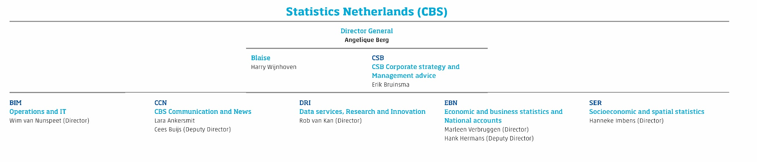
Organisation structure

Slide 9
Statistics Netherlands
is an autonomous administrative authority
(in Dutch: ZBO), with its own law, has a statutory
duty: statistics for practice, policy and science
is objective and independent
never publishes about individuals or companies: privacy protection is essential
Notes:
European statistics law alongside CBS law
CBS publishes everything
DG is not subordinate to minister
No information traceable to individuals or companies

Slide 10
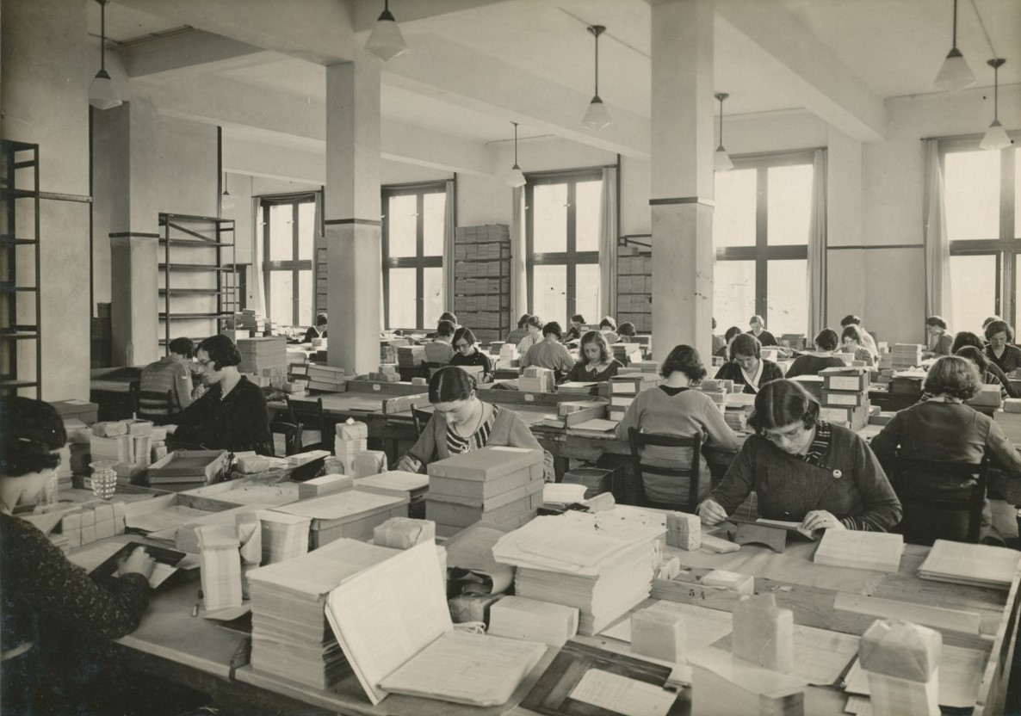
Statistics 100 years ago
Notes:
Veel papierwerk, vrachtwagens vol. Nog geen computers…

Slide 11
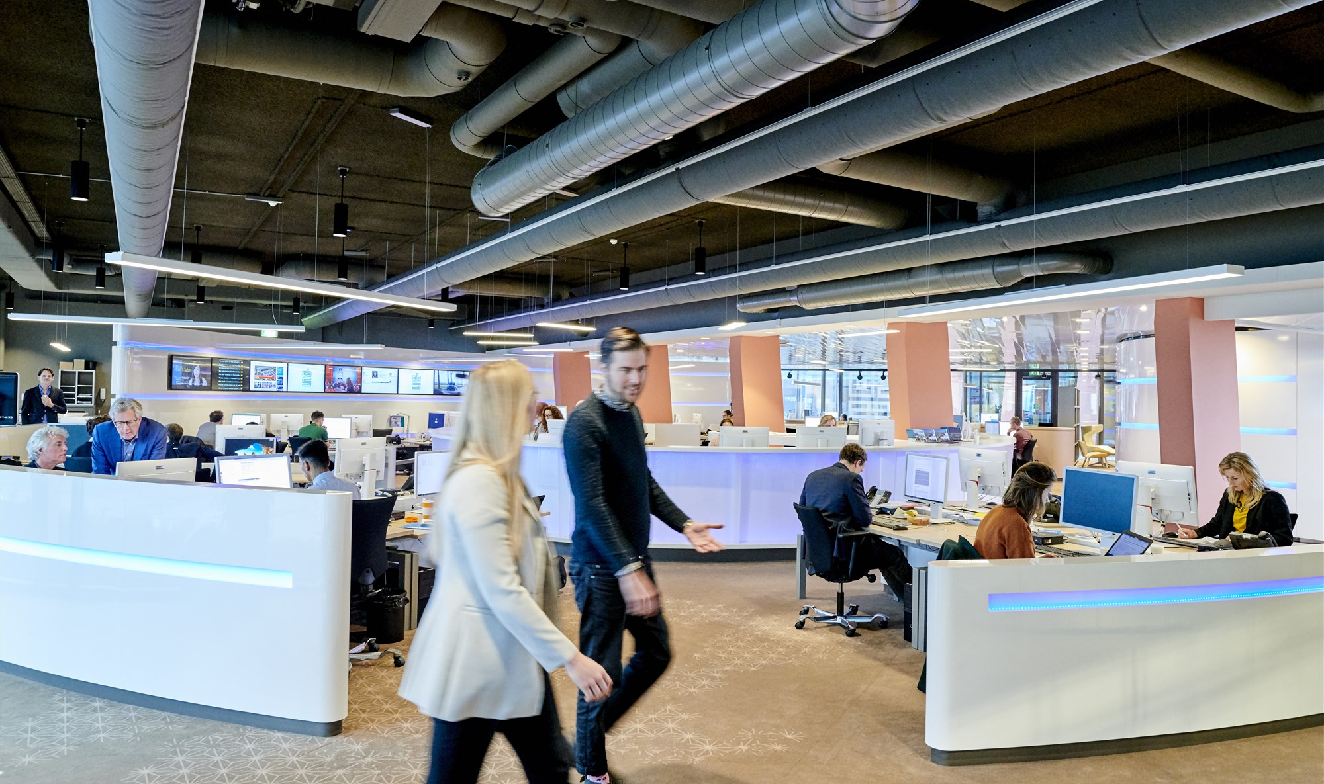
Statistics now
Notes:
Our state of the art newsroom was opened at the end of 2015. It has its own studio facilities. You will receive/have been on a tour.
New concept (combining the success of CNN and google), great success nationally (other government organisations), and internationally (other NSIs)

Slide 12
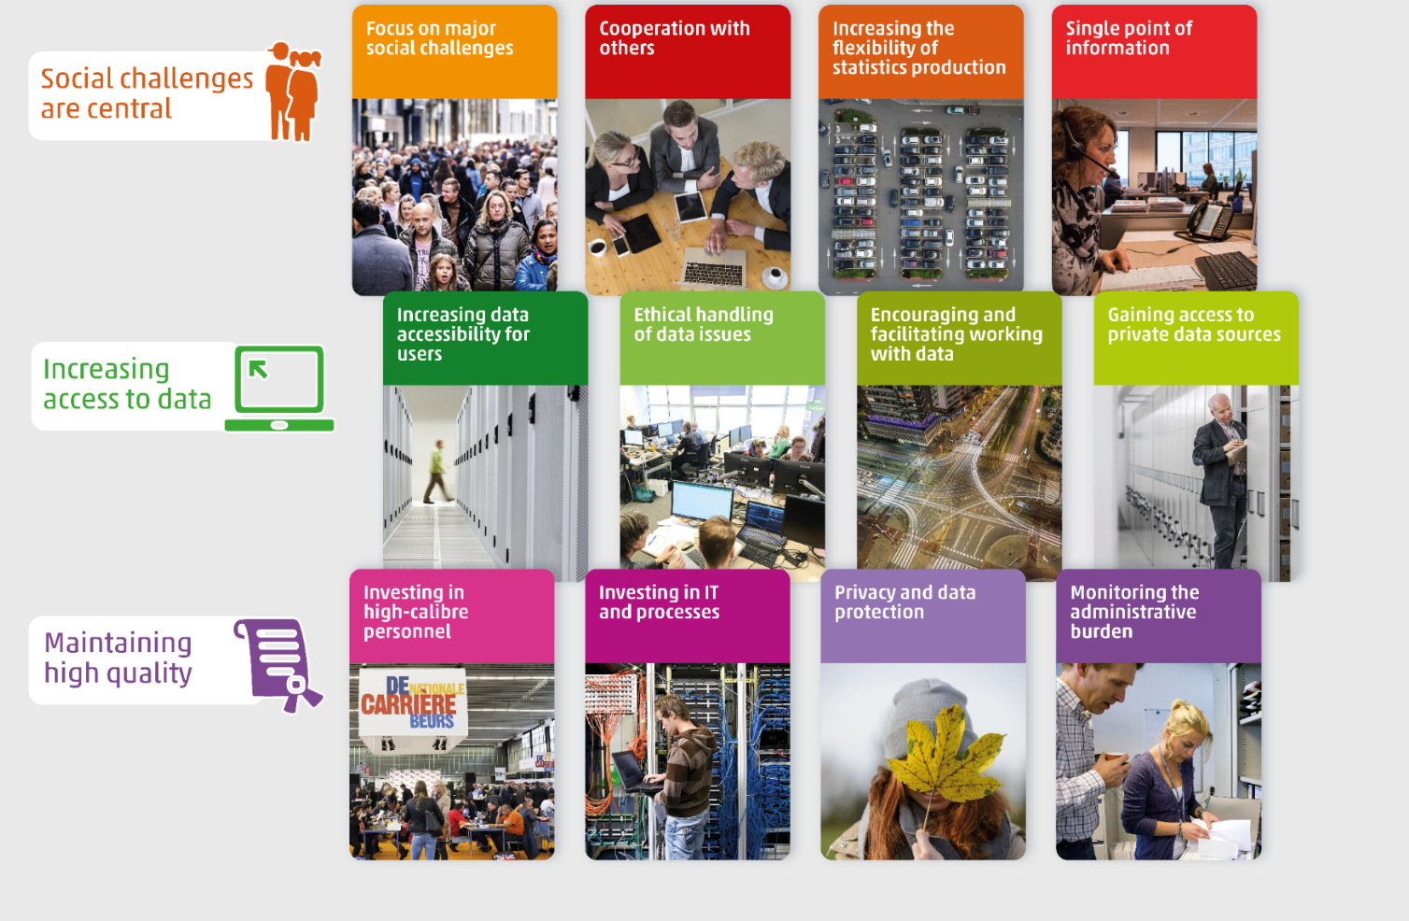
Multi-annual Programme 2024-2028

Slide 13
Thank you

