Slide 1
OECD-UNSD
Multinational Enterprise
Information Platform
Graham Pilgrim, Head of Real-time Data Analytics
28th meeting of the Wiesbaden Group on Business Registers
2-6 October 2023, The Hague, The Netherlands
Notes:
[10min slot for presentation]
Introduce self
Introduce the Multinational Enterprise Information Platform:
- Joint initiative of UNSD and OECD with commitment to continue for an annual release
- Aim is to understand MNEs in more detail than currently possible using novel data and approaches
- First release was made on 16th February 2023
Purpose of this presentation:
- Quick introduction to the platform
- Reflect on how global unique identifiers could help in improving and enhancing initiatives like ours

Slide 2
A co-operation between OECD and UNSD
Understanding the structure and behaviour of MNEs is fundamental to the production of consistent global statistics and understanding GVCs
Have combined to create the OECD-UNSD Multinational Enterprise Information Platform
Have made data publicly available, for NSOs, researchers and the general public alike as compiled from timely open-source information.
Notes:
State questions which can be answered using this data set
Mention uptake of this data

Slide 3
Framework
Smart data platform to bring together a range of sources from the traditional (eg. Annual Reports) to alternative (eg. Metadata from webpages).
Requires advanced data handling to match records, and new storage methods such as graph databases to query.
Our database is designed to cover all MNEs, but manual data capture and validation is required – so our initial release is limited to the largest 500 MNEs globally.

Slide 4
Data available
Currently for the largest 500 MNEs:
Global Register: 123K subsidiaries including location, ownership structure and identifiers (Business Registry, OpenCorporates, LEI, PermID) when available.
Digital Register: 113K websites with measures to determine their importance

Slide 5
Data sources and Construction

Slide 6
Data Sources
Data Source | Description
Annual Reporting | Annual reports give details of financials and reporting scope. Manually captured.
PermID | Database of companies made available by Thomson Reuters.
Legal Entity Identifier | Database of companies engaging in financial transactions along with relationships.
Security Certificates | Database of websites and the security certificate which exists on the site
Common Crawl | Database of websites: metadata, underlying links and importance of each site
Wikidata | Database of companies from Wikidata, including websites, relationships and daily page views
GDELT Project | Database of global news and events, fully searchable by time period and phrase
Open Street Map | Database of geographic locations (eg. Shops, Factories etc).
Crunchbase
Country Specific | Finland: WHOIS register UK: Persons of Significant Control, Gender Pay Gap, ICO, Modern Slavery US: Visa requests, Emails assigned to business registers

Slide 7
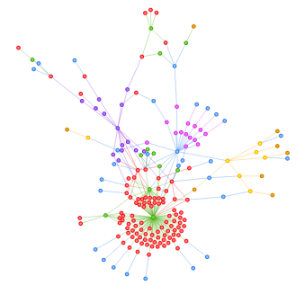
Construction
Graph database:
Points are identifiers for a company
Lines are connections
Profile for an MNE is generated via a search algorithm for connected points from the root.
Problems:
Find unique companies
Joint ventures

Slide 8
Challenges and Solution

Slide 9
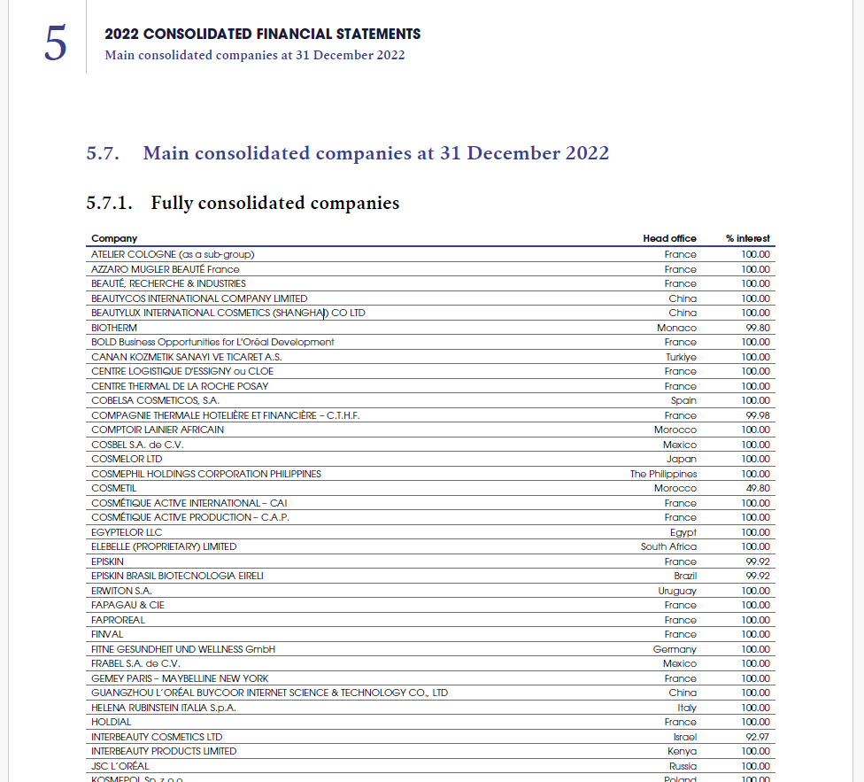
Challenges in PDF Data Extraction
Annual reports serve as the primary data sources for the identification of the subsidiaries of an MNE. Annual reports are often published in PDF format.
Challenges include:
Unstructured data
Inconsistent formatting
Variability in languages and font
Large volume of data

Slide 10
Solution – PDF Data Extraction
Use of Data Extraction Tools, including:
Optical Character Recognition (OCR) technology, which converts scanned documents, including PDFs, into machine-readable text.
Online platforms that provide PDF to Excel and PDF to CSV conversion services.
Desktop applications (e.g., Power BI and Able2Extract Professional) for converting PDFs into various formats, including Excel and CSV.
Collaborative initiatives:
Collaborative efforts among organizations to develop and share AI solutions for automated data extraction from annual reports.

Slide 11
Challenges in Timeliness of Data
Limited Real-time Capture:
Traditional data extraction methods, often reliant on periodic reports or batch processing, may not capture real-time events effectively.
Significant restructuring events, such as mergers, acquisitions, or sudden financial changes, can reshape the landscape of an organization.
Solution:
The use of alternative data sources allows for the near-to-real-time understanding of a firm.
Incorporating a “news tracking tool” to identify major restructuring events that can have significant impacts on MNE structure and behavior.

Slide 12
News monitor: identifying key events
Daily news articles for Adobe Inc.
Articles during period of interest suggest M&A activity:

Slide 13
Outputs and policy use

Slide 14
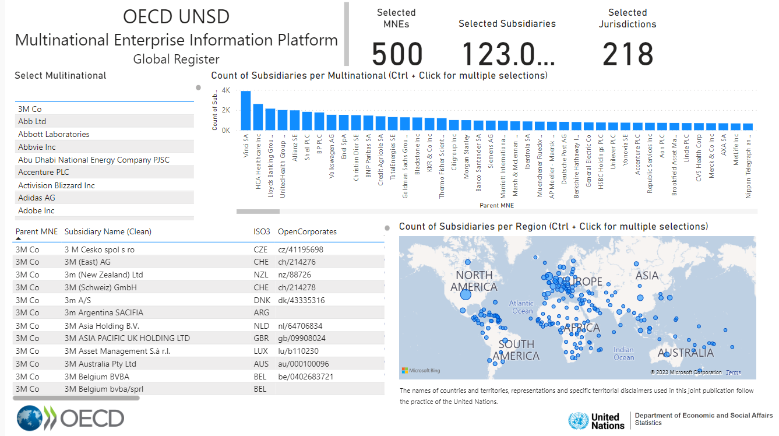
Dashboard
Select a company and explore the available information:

Slide 15
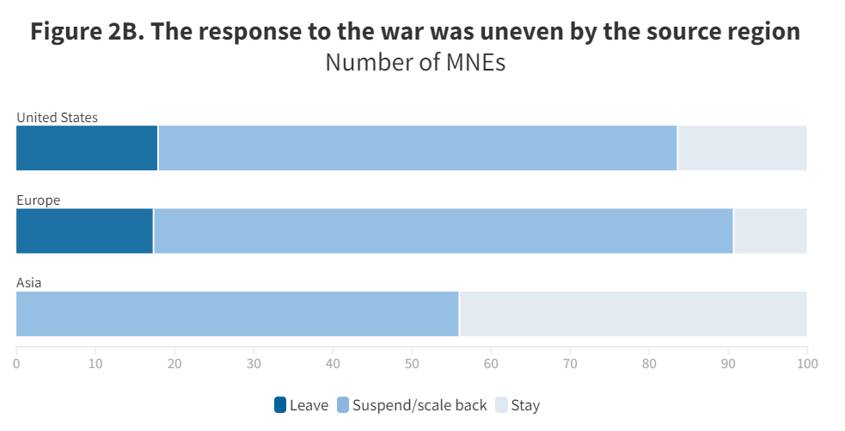
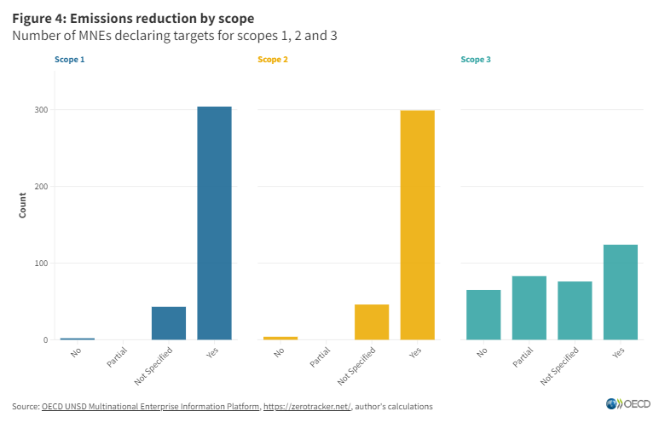
OECD study: Russia-Ukraine impacts and climate change commitments
Reaction to Russia-Ukraine conflict has determined by region and industry in many cases
Most MNEs have made targets for reduction of emissions in Scope 1 and 2, however Scope 3 targets are limited.

Slide 16
Uses for measuring resilience?
Given issues in country X, which large companies headquartered in my jurisdiction are likely to experience problems?
Identify major events for large companies headquartered in my jurisdiction
Identify companies operating primarily digitally within your jurisdiction (lower barriers to change)

Slide 17
Global Initiative on Unique Identifiers for Businesses
The Global Initiative on Unique Identifiers for Businesses aims to strengthen and availability of national identifiers in country to strengthen SBRs and the mapping to global identifiers such as LEI
This initiative was endorsed by the UNSC in March 2023
The availability of global identifiers would greatly facilitate the establishment and maintenance of MEIP

Slide 18
THANK YOU
Download the data and explore the dashboard: bit.ly/mne-platform

