Slide 1

Plasma donation for fractionation with or without a prior in-person interview in experienced donors: Assessing safety for donors
ECDHM September 2025
Wijk aan Zee | The Netherlands
Maria Starup Hauge Marianne Skak Raunkjær
Christina Lindgaard Stick
Bitten Aagaard

Slide 2
None has any conflicts of interest to declaire
Maria Starup Hauge Marianne Skak Raunkjær
Christina Lindgaard Stick
Bitten Aagaard

Slide 3
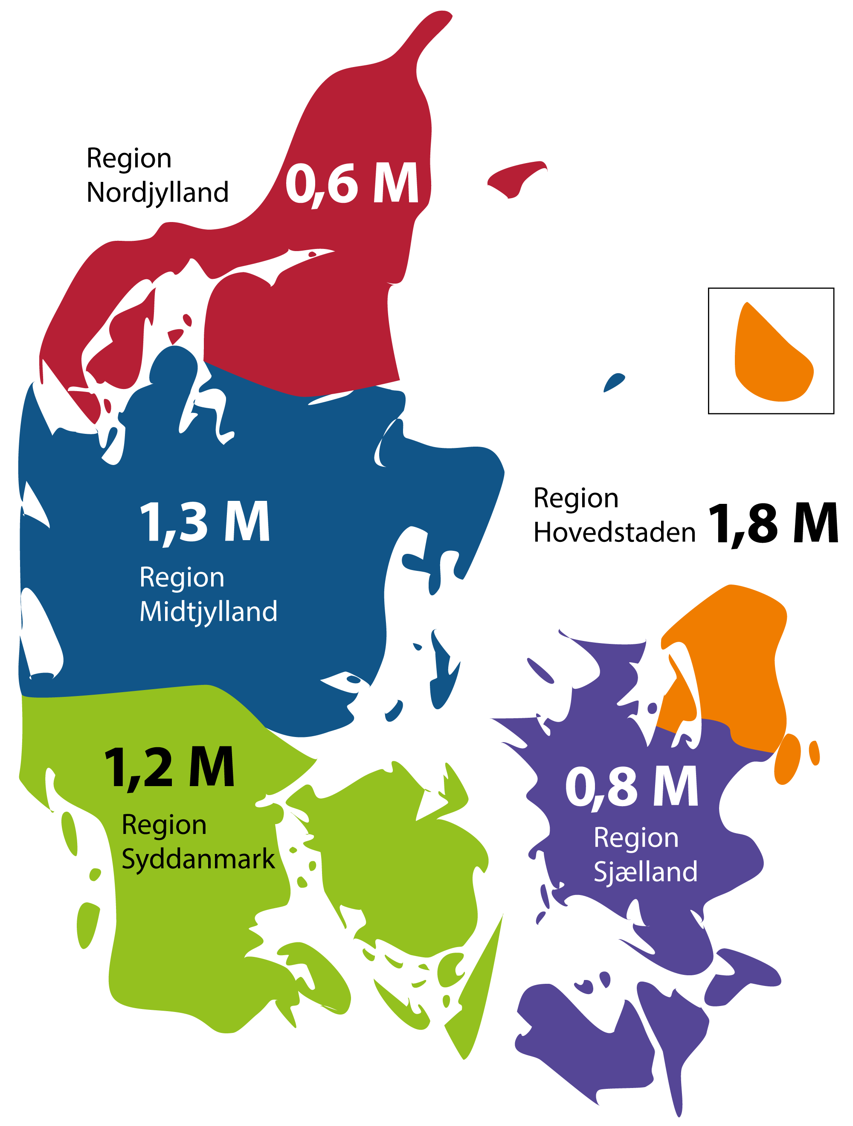
Blood bank establishments in Denmark
2021: Danish Regions decided to become self-sufficient with plasma for lifesaving medical products (albumin and immunoglobulin sc/iv)
2024: 50% self-sufficient
202?: 100% self-sufficient

Slide 4



Legislation and standards for Blood banks
National competent authority:
Board refering to The Ministry of the Interior and Health:
Laws, announcements and inspections/audits
DONORS ARE
VOLUNTEERS
AND
NON-RE- MUNERATED
Danish Association of Blood Donors
Make the laws/announcements operational in everyday life
Professionel society, specialists in immunology and transfusion medicine

Slide 5
Workflow for donations at collection sites
The donor fill out an electronic health donor (EHD) questionaire
Follwed up by an in-person interview with bloodbank staff - elaborating questions in generel and to questionaire.
All donorcriterias met ->
DONATION
Questions:
Does the time consuming (both donor and staff) in-person interview add extra safety to:
The donor/donation a) (severe) adverse reactions and events (S)ARE b) completed donations
The quality of the products?

Slide 6
Participants in the pilot study
Inclusion criteria:
Age < 65 years
A minimum of ten prior donations
Three uncomplicated donations within the last three months
A completed EHD questionnaire without remarks on the day of donation
The control group (n = 109) Followed standard procedures, including completion of the EHD questionnaire and an in-person interview with experienced staff before proceeded to donation.
The intervention group (n = 104) Donors completed the EHD questionnaire, and if no issues were identified, proceeded directly to donation without a prior in-person interview

Slide 7
Results
Written informed consent: The intervention group (n = 49/104=50%),
The control group (n = 50/109=51%)
Adverse events
Historical records compromising donation
Post-donation information
Completed donation
Adverse events,
Three adverse events were recorded:
two (4 %) in the intervention group (delayed bleeding at puncture site and infiltration) and
one (2 %) in the control group (delayed bleeding at puncture site).
.

Slide 8
Results
None historical records compromising donation No post-donation information Completed donation
Two uncompleted donations were recorded:
two (4 %) in the intervention group (failed venipuncture, a technical equipment issues)
Historical records compromising donation
Post-donation information
Completed donation
.

Slide 9
Results post-donation questionnaire
Donors received a questionnaire post-donation
Donor experience regarding +/- in-person interview prior to donation
(204 questionnaires 137 answers)
60 % the in-person interview has no impact on their confidence in relation to donation
38 % the in-person interview has an impact on confidence/monitoring of both donorsafety and the quality of the donated component
82 % the in-person interview has no impact om their movitation to donate
.

Slide 10
Perspectives
Is the group of regular plasmadonors homogeneous?
What criterias should define the groups?
Independent donor criterias and pre-donation procedures for plasmadonors?
Donor satisfaction?
Donor motivation?
Donor retention?

Slide 11
To follow up
Questionnaire to/interview with staff at collection site:
Experiences in general
Experiences in peticular regarding:
confidence for donor
the quality of the components
workflow
donor satisfaction
any other business?

Slide 12

Questions?
Please contact me by mail:
biaaj@rn.dk
Thank you for your attention☺

