Slide 1
PLASMARATHON A campaign to recruit plasma donors from sports clubs
Service du Sang de la Croix-Rouge de Belgique
Mrs Marie-Ange Moureaux ECDHM – 12 september 2025
Notes:
Good morning, I’m Marie-Ange Moureaux, I work as a marketing and communication coordinator at the Red Cross in the French-speaking region of Belgium.
I’m responsible for plasma campaigns and marketing tools. Today I’m here to talk about our recruitment campaign from 2024, called Plasmarathon.

Slide 2
« No conflict of interest to declare »
Notes:
Before starting, I’d like to inform you that I have no conflict of interest to declare.

Slide 3
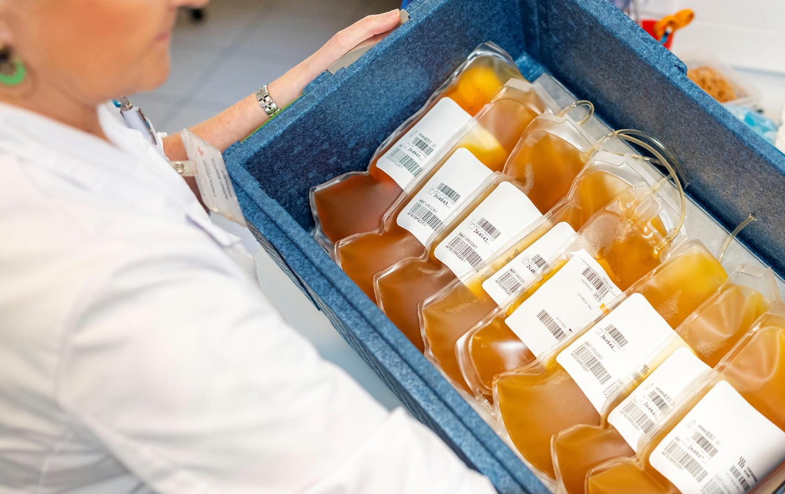

PLASMA
Context of the Plasma.
Why a campaign?
Notes:
To start, I’ll give you the context of our campaign.

Slide 4


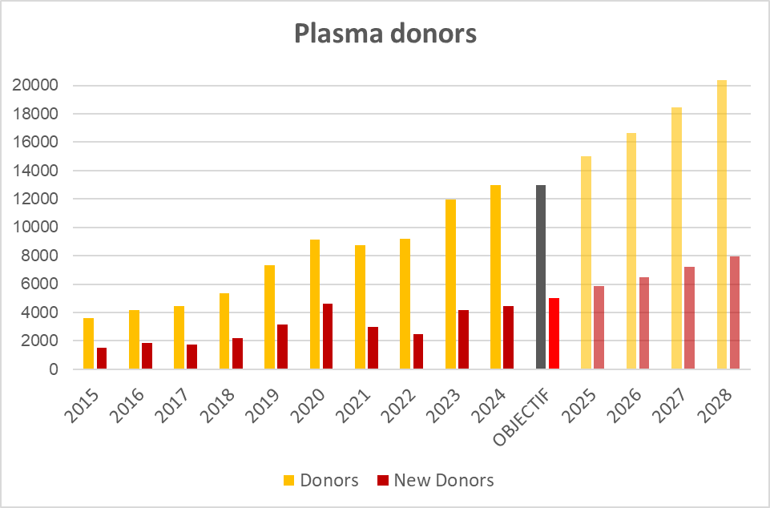
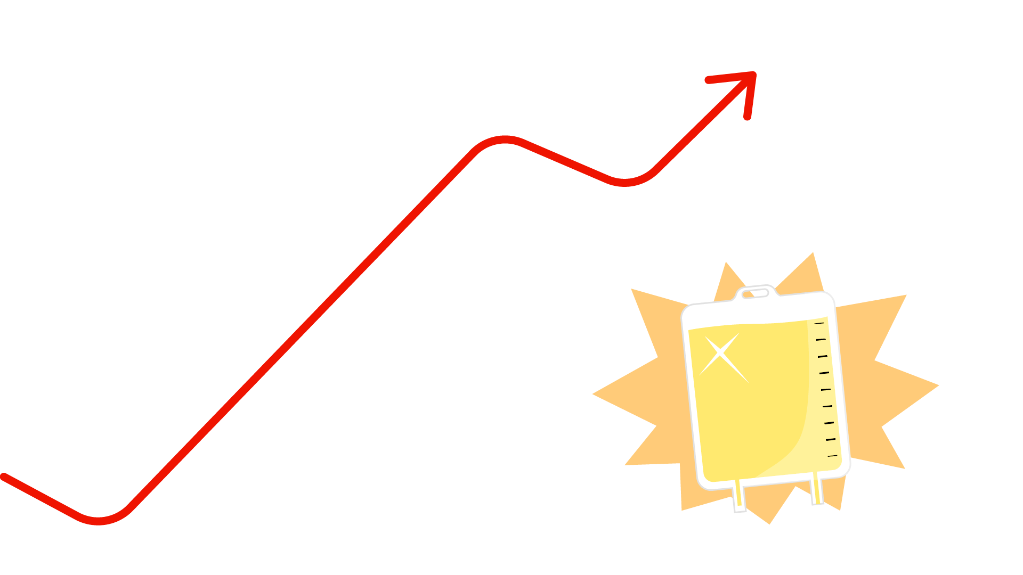
AIMS of the campaign PLASMA SFS
Plasma Challenges
Increasing european self sufficiency based on voluntary unpaid donors
Growing demand on Immunoglobulins
In 2024, we needed to have 13,000 donors and 45,000 donation.
Aims in 2024 13,000 donors
In 2018 5348 donors
Sustain growth and reach the target of 1,000 plasma donors in 2024 by a recruitment campaign (brand new donors and motivating known donors)
5000 PLASMA donors
Notes:
As all other European Countries, we have to increase plasma donations based on voluntary unpaid donors. This is to meet the growing demand on immunoglobulins.
To stick to the government plan, we needed to have 13000 plasma donors in 2024.
In 2018, we had 5348. Compare 2023, we needed to have 1000 plasma donors over than 2024. But the standard DM actions weren’t enough for 2024.
We had to launch an innovative campaign with two specific goals :
First, recruiting brand new donors (total number in 23 11,938 – Total in 24 12,958)
Second, encouraging the return of known donors

Slide 5

Plasmarathon
An Innovative campaign :
to strengthen team spirit
Notes:
Then We came up with PLASMARATHON, a campaign focussed on sport clubs and Team Spirit.

Slide 6
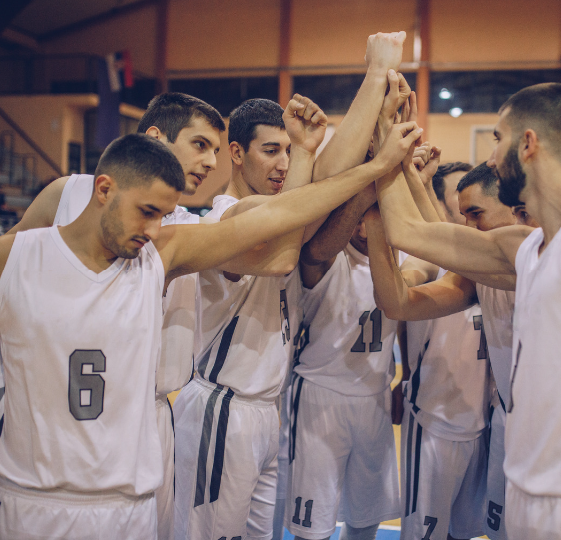
Inspirations - Context of the campaign
Sport clubs need to get equipment (a win-win for everyone). Sport Clubs members are usually healthy young donors.
2024 - Olympics games – EURO FOOTBALL
New scientific study confirmed the donating plasma has a very little impact on sports performances (*)
Plasma donation’s registration was developed on-line in 2024 and the new donors wera accepted to donate plasma in first intention
Spontaneous donation became possible
*Mortier A, Khoudary J, van Dooslaerde Ten Ryen S, Lannoy C, Benoit N, Antoine N, et al. Effets de la fréquence de la plasmaphérèse sur l'état de santé et l'exercice Performance chez les hommes : un essai contrôlé randomisé. Vox Sang.2024;119:134–43.PLASMAPHÉRÈSE, SANTÉ ET PERFORMANCE EXERCICE 143– Cette étude a été menée à l'UCLouvain, en Belgique, de mars 2022 à décembre 2022, et a été approuvée par le Comité d'éthique de l'UCLouvain (2020/04NOV/541)
Notes:
Why did we choose to make a campaign based on sports clubs ? - First : we know that sports clubs always need new equipment, but don’t, generally, have enough funds to afford it.
- Second : 2024, counted two big sporting events : Olympic Games and European football Cup. We wanted to take advantage of this audience.
Furthermore, in 2022, a study made by the Catholic University of Leuven (UCL§ Kul § Belgian Rode Kruis) confirmed that donating plasma has very little impact on sports performance.
Two other elements, specific to us, made it also easier to launch a recruitment campaign across the whole population and other usual channel :
- The possibility for new donors to start directly with a plasma donation. Previously, you had to start with a blood donation.
- A donor could register for a plasma donation directly on-line.
As a result, spontaneity became, possible.

Slide 7
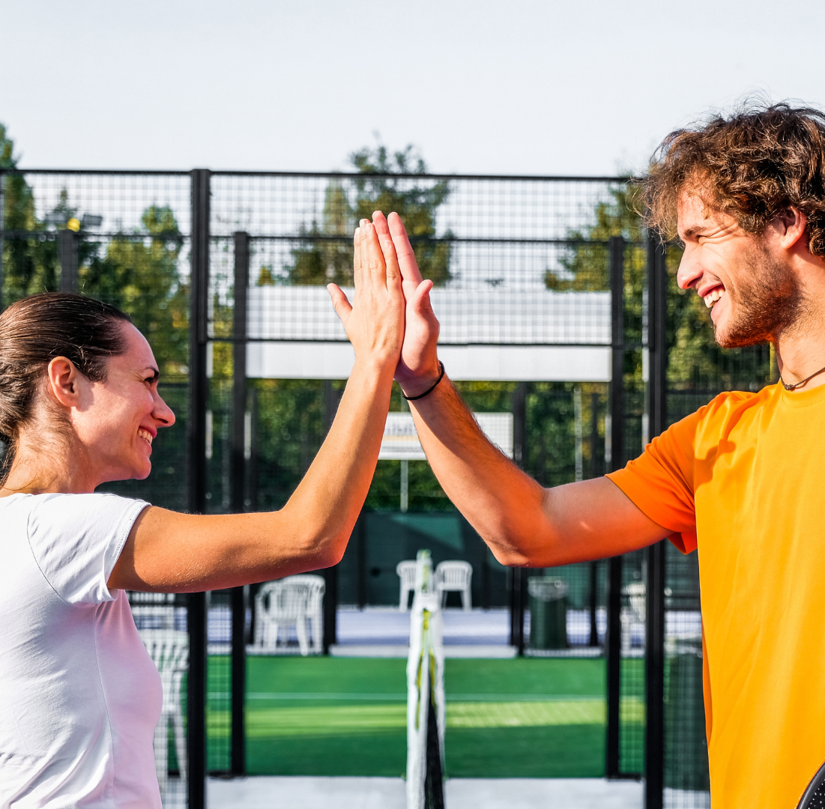
Process and planning
From July to November 2024
Notes:
The whole campaign (process included) ran from July to November 2024

Slide 8

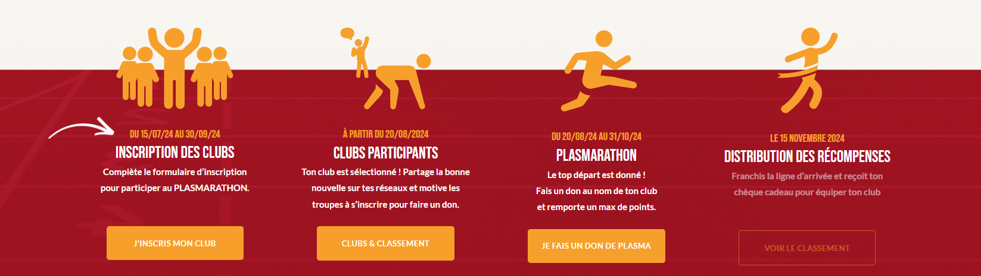

A WIN-WIN concept
The club mobilized people for doing a good deed. By taking part, the club earned 5 points for each plasma donation made in its name and win sports equipements.
5 steps
1
2
3
4
5
from 15th july
from 1 AUGUSTUS 2024 TO 30 SEPTEMBER :
20th august 2024
from 1 september TO 30 november:
1st December
Contact the clubs and sport organizations
PLASMARATHON Boosting actions during the campaign
MONITOR plasma donations during the campaign
Clubs registrations
Thank you action
Notes:
Plasmarathon is a win/win Concept.
The club then needs to mobilize people but for doing a good deed : plasma donation
For every plasma donation made in its name, the clubs earnt 5 points.
The first step starting from the 15th of july has invited clubs to take part in the campaign.
We made it so by :
Targeting the sports clubs in the neigbourhood of our donation centers
Contacting sports clubs and the sports organizations wich could be interested of the campaign.
The second step, from the 1st or August, was managing Clubs registrations
We checked to make sure that the clubs were legitimate and accepted our regulation. The donation period from 20thAugust to 30th of November.
During the donation period, we stayed in regular contact with the clubs and we monitored the donations.
We continuously encouraged them and had regular marketing action to boost the campaign.
At the end of the campaign, we thanked the clubs for their donations and converted all the points into a voucher. 1 pt = 1€.

Slide 9

Manage the plasma donation rewarding the club
Clubs became a campaign stakeholder
Visibility pack including unique club’s registration link for full traceability
Award of 50 incentive points
Campaign dedicated website for Booking appointments for the Operation Plasmarathon
https://www.plasmarathon.be/rdv/?club=megagym-ardenne
Notes:
After full registration, the club GOT a visibility pack with a direct link to book an appointment on the dedicated website..
We also created their personal promotional tools.
Clubs could also earn 50 extra points by sharing the campaign on their own channels.

Slide 10
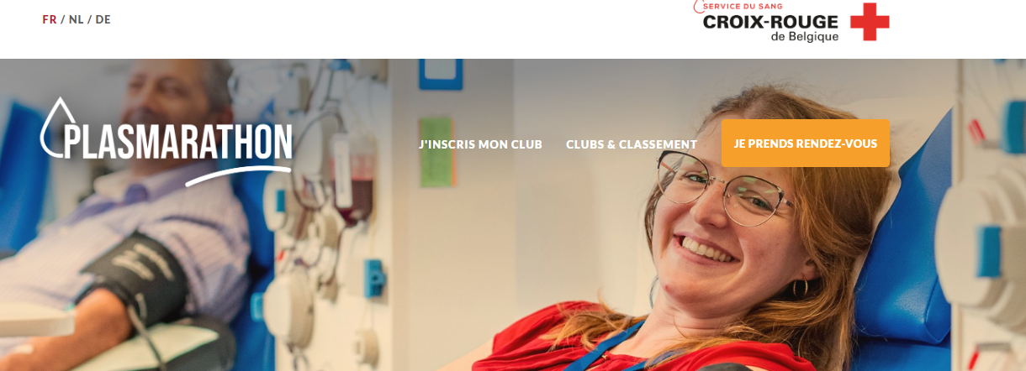
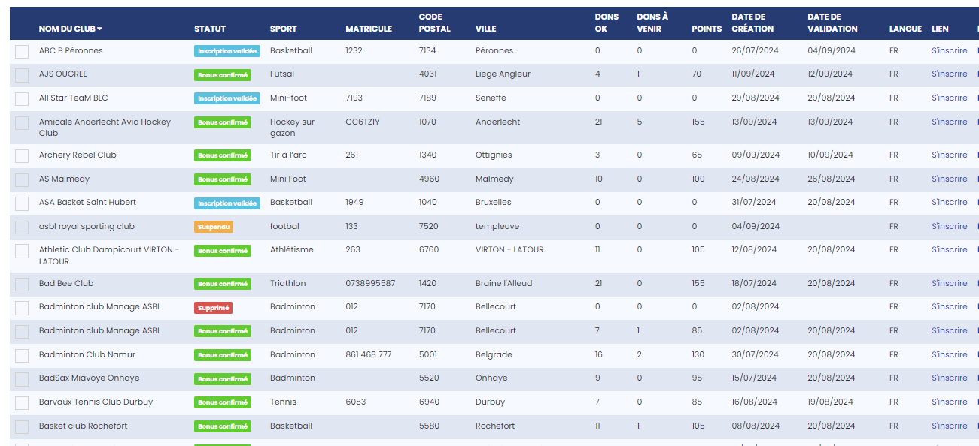
Registrations Clubs Dashboard
Each appointment could be identified
Club management in the appointment booking application.
Notes:
In our appointment tool, every donor could link his donation to the sport club of his choice.
We managed with the help of a dashboard to follow the involvement of the clubs and keep track of appointment, donation and points earned by each club
- how many appointments were planned,
- how many donations each club had made, and the points they earned, - which collection center had more success

Slide 11
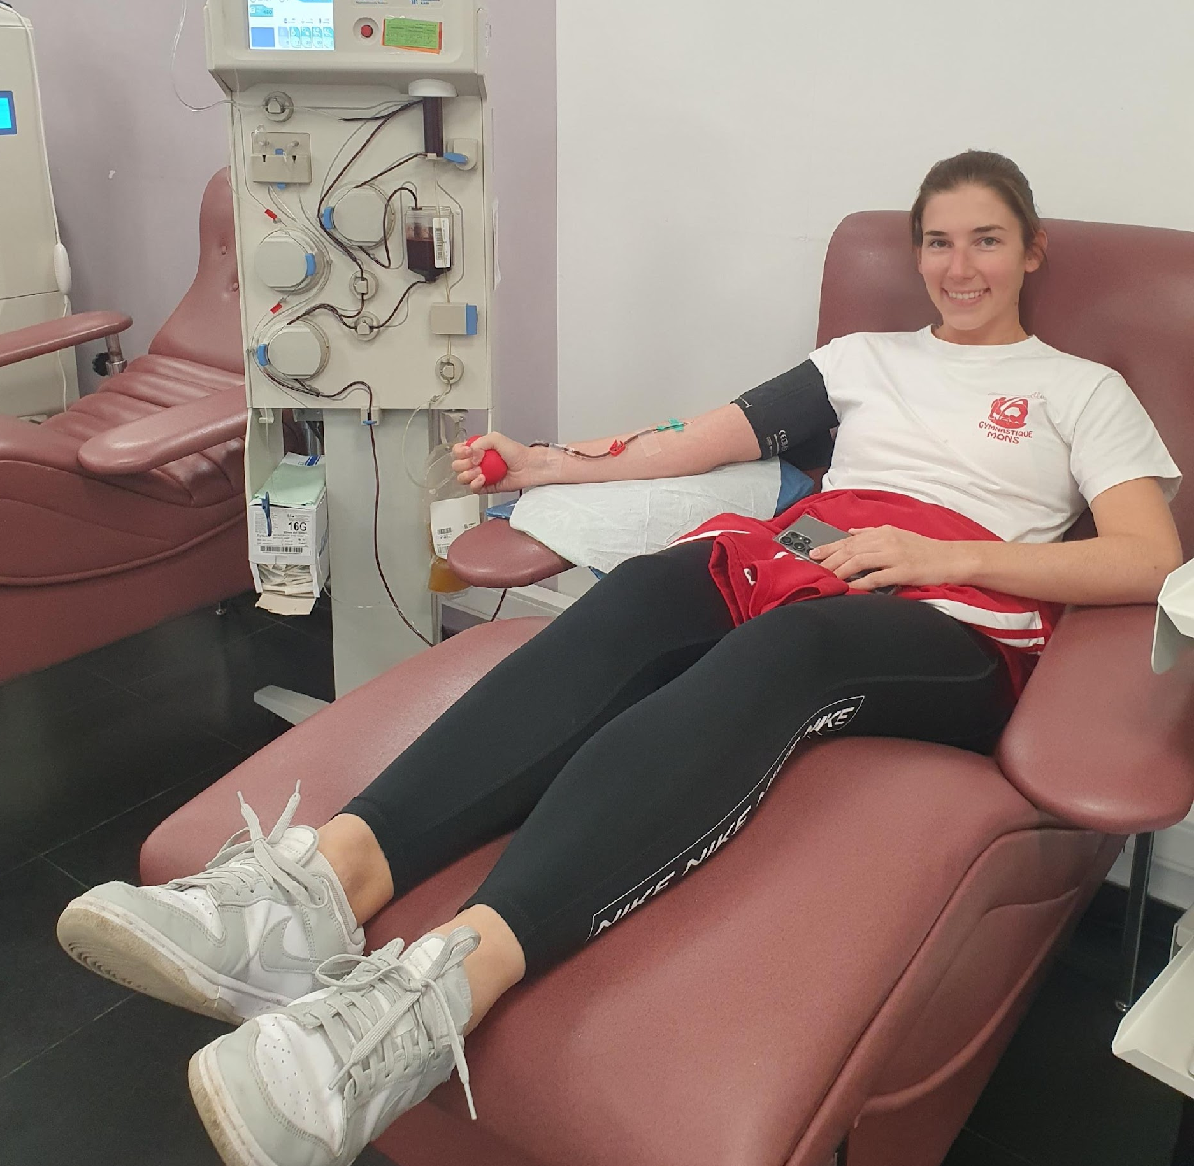
RESULTS
Donation period
From 20/8/24 to 30/11/24

Slide 12
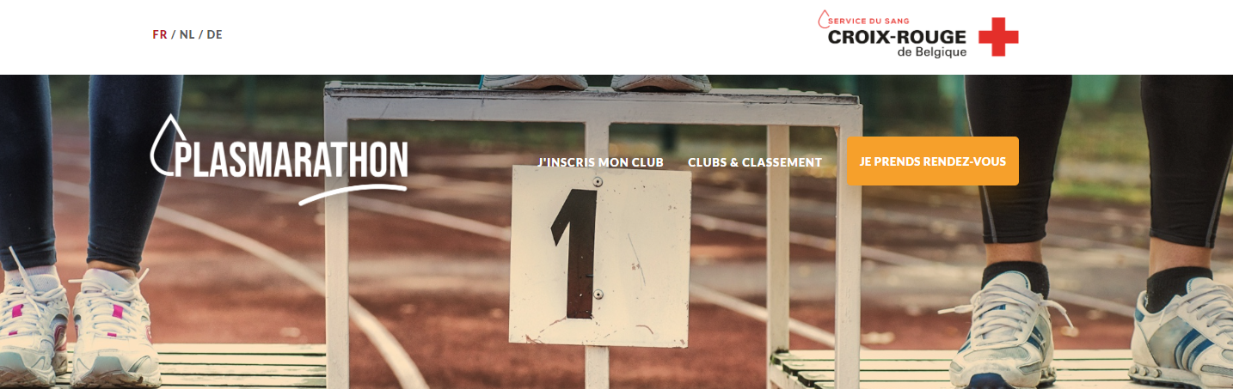
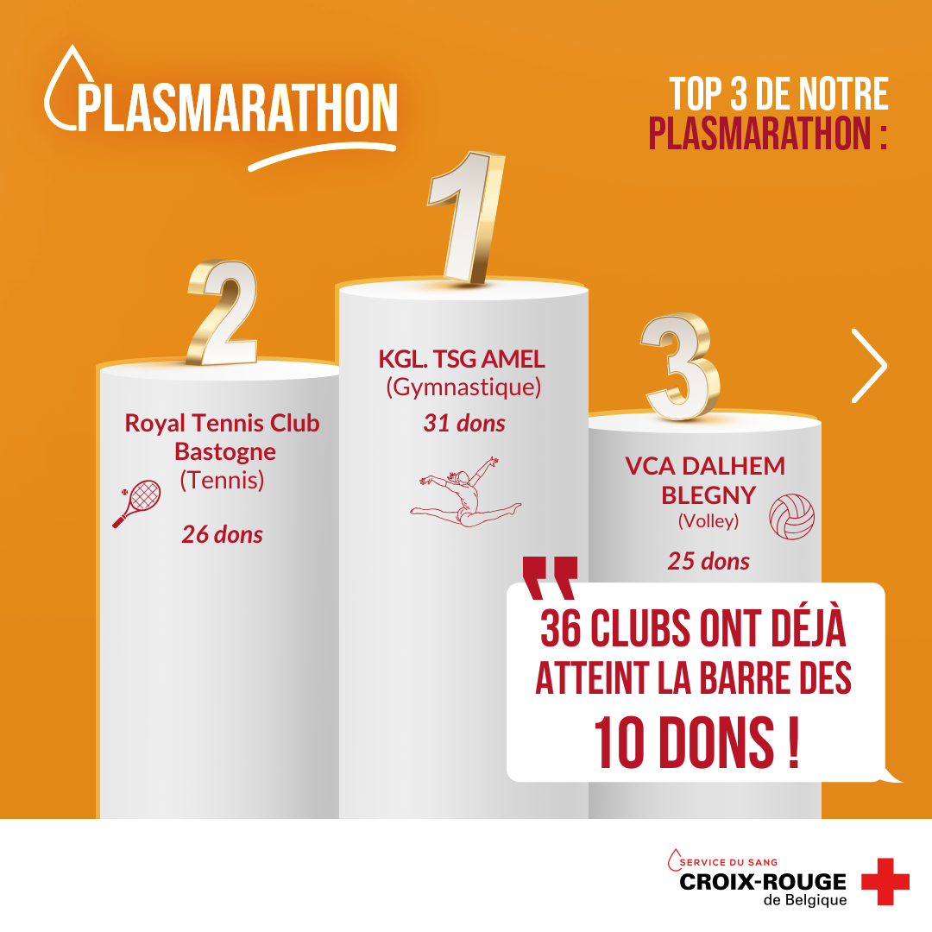
Results of participation
109 sport clubs from 25 differents disciplines
36 sport clubs reached more than 15 appointments, including 10 with more than 30 appointments
Notes:
Results of the campaign: In total, 109 sports clubs took part in the campaign, from 25 different disciplines. 36 clubs reached more than 15 appointments 10 of which had more than 30. one club reached 42 donations.

Slide 13
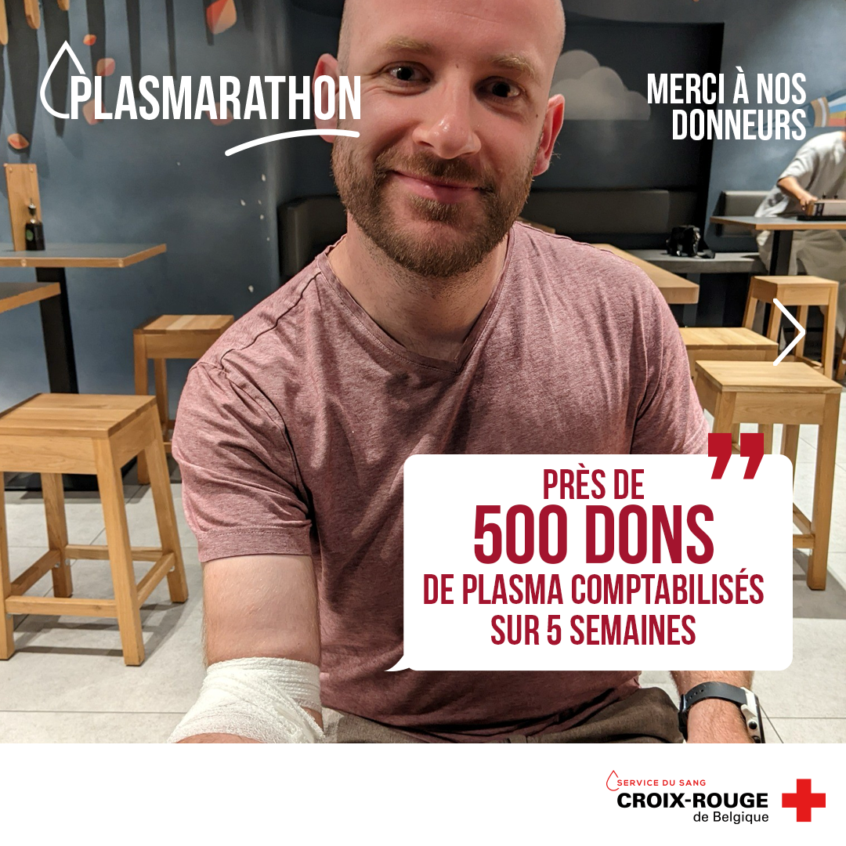
Results
Numbers of new donations and donors
Appointments | Donations
1 651 | 1358
 | DONORS | DONATION
Total Donors | 817 | 1358
Plasma donation | 757 | 1197
First time plasma donors | 117 | 191
Not allowed to donate | 61 | 0
The donor give on average of 2 times during the campaign
The new donor gave more than 1 time
Notes:
For the campaign, 1651 appointments were actually during the campaign made, which resulted in 1358 donations. October was the most active month. In Novembre, we had to reduce the promotion as got a recommandation from the Belgian Agency who did not agree with some points of the methodology. In total, we had 757 plasma donors related Plasmarathon. 117 of which, donated plasma for the first time and 76 were brand new donors
not
We remarked that the campaign had the biggest impact in more rural areas.
This may be because there is a greater feeling of “community” in those areas, compared to more urban areas or cities.
Des 817 donneurs qui ont donné pendant le plasmarathon, il y en a 377 qui sont revenu après pour donner en P pour 1519 dons au total. donc période 01/12/2024 au 10/9/2025 16h
46.14% des donneurs ont encore donné après la campagne
One in two is continuing to donate plasma

Slide 14
New donors 2024 - Recruitment impact
 | Nb New plasma donors |  | Nb Donations by New Plasma Donors
 | 2023 | 2024 | 2023 | 2024
AUGUST | 8 | 55 | 10 | 125
SEPTEMBER | 22 | 84 | 49 | 170
OCTOBER | 31 | 89 | 46 | 149
NOVEMBER | 16 | 42 | 22 | 70
Plasmarathon Period | 77 | 270 | 127 | 514
ANNUAL | 188 | 528 | 418 | 1188
Plasmarathon had a real impact on the recruitment in general
During the same period, the new donors in 2024 were more the 3 times higher than 2023. The number of donations by new donors was 4 times higher.
50% of new donors in 2024 were recruited during the 3 months of Plasmarathon
Notes:
Compared to 2023, we obtained a great result. During the same period (From august to novembre), between 23 and 24, numbers of new donors was more than 3 times higher than 23.
The donations made by these donors was 4 times higher.
50% of new donors in 2024 were recruited during Plasmarathon
Thanks to our encouragement, we also created return donors.

Slide 15

Conclusion
What are the key takeaways? Lessons to learn?

Slide 16
Conclusion
Really Great impact :
- Raising awareness and visibility
- Attracting new donors and already donor’s motivation.
Very close to our target of 1000 donors- Thanks to that, we reached the goal of the year.
The number of new donors doubled over a short period.
Noticed : Participant involvement depended on the region and confirmed the usual trend.
Notes:
Really great impact : raising awareness and visibility, attracting new donors, and existing donors’ motivation.
Although we didn’t reach our target of 1000 donors, we came very close.
The Plasmarathon campaign met its recruitment objective and had a positive impact on donations in 2024.

Slide 17
Lessons Learnt
A POINT TO REMEMBER: The Belgian Federal Agency for Medicines and Health Products was challenged overly challenging and too « lucrative » nature of this campaign.
This aspect should be reconsidered for the next edition.
The 1st Plasmarathon campaign was a Real Proof of Concept
Easy to participate
Replicable
Extendable over a couple of months
Duplicable with other stakeholders (youth clubs)
Inexpensive to run again

Slide 18
A recruiting campaign in 2024…
and 2025 ?
Many people continue to donate in 2025

Slide 19
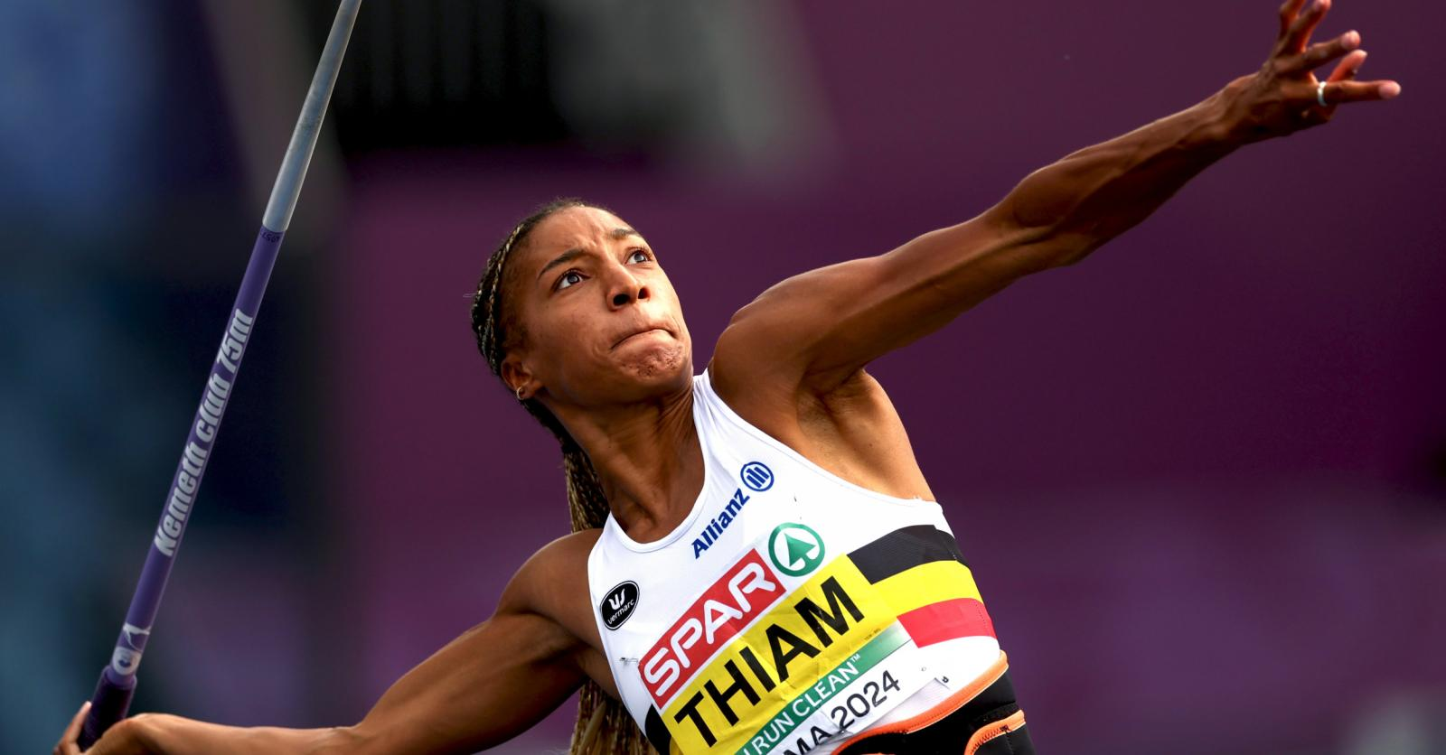
Thank you

