Slide 1
Implementing profiling in the Swedish Business Register
The 28th Meeting of the Wiesbaden Group on Business Registers
The Hague, 2-6 October 2023
Session 2: Profiling complex Statistical Units (Sus)
Johanna Jonsson, Advisor at the Large Cases Unit
Richard Nilsson, Advisor at the Business Register

Slide 2

Introduction
Profiling has been mentioned before
A few times
Focus this year is the implementation in the live register
Adapting routines to limited resources

Slide 3

Annual frame vs live register
Profiling first implemented in the annual frame
The 4th year of profiling

Slide 4

Annual frame vs live register
Implemented in the live register in 2022
35 complex ENTs became 53 000
Fictitious ENT-ids
Ancillary units

Slide 5

Updating frozen frame
31 december. Kind of.
Number of employees
Turnover
Automatic profiling and coding of ancillary units

Slide 6

Enterprise Groups
No admin source
Yearly financial statements
Commersial provider
Time lag
No date of closure

Slide 7

Integrating the EGR
The EGR as the main source
Commersial provider used for updates
More stability in the national groups

Slide 8

Automatic profiling
Currently in a temporary solution
Group = ENT for 95%
Continuity
Number of persons employed as proxy

Slide 9

Automatic profiling
Very small ENTs
What is the core?
Very large ENTs
Semi-automatic

Slide 10

Ancillary units
Comparing the part with the whole
Too large ENTs?
Also time lag in turnover

Slide 11
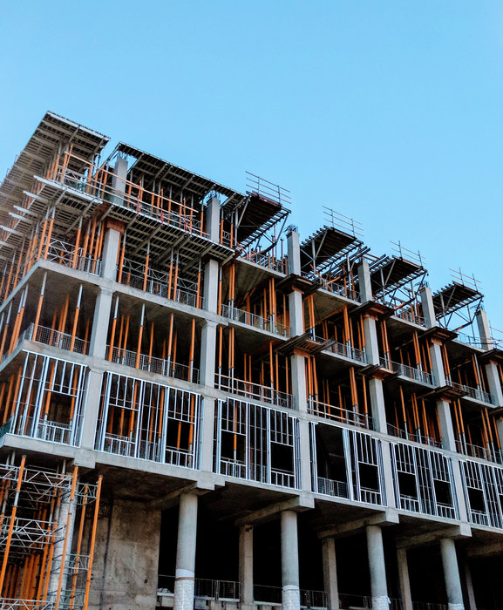
Only 3 automatic
Holding companies (64.20)
Business management (70)
Real estate (68.10)
The result of several projects
Only for automatic coding, not manual

Slide 12
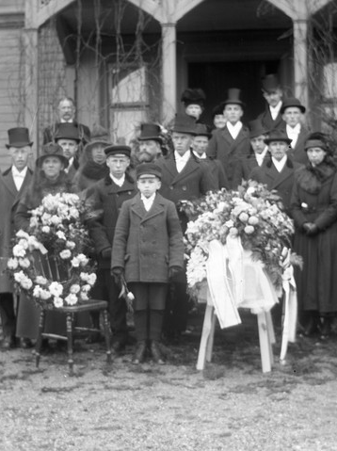
Time lag
Problem with missing NACE
Need to implement automatic coding of ancillary units in the live register using the current values of variables

Slide 13
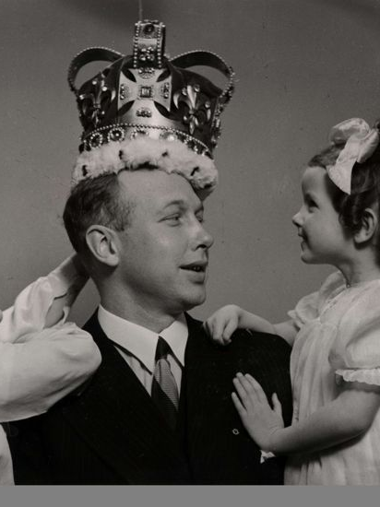
Head Offices
Statistics Sweden has changed the handling of large head offices compared to previous years
We considered them not as separated ENTS but as ancillary units to the rest of the group.
This view has changed in order to better harmonise with other European countries.

Slide 14

Profiling in the live register
Implemented in 2022
Several ancillary units were in fact not ancillary or even part of a group
Events after the profiling year

Slide 15
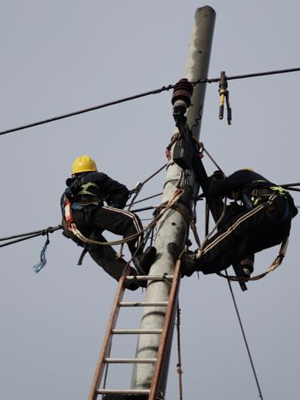
Profiling in the live register
Refined frame exposed to weekly updates
Large changes need to be handled as they happen

Slide 16

Register maintenance
Focus is LOU, LEU and KAU
Newly registered and de-registered units

Slide 17

Possibilities with PAYE
Monthly connection between LEU and individuals
Follow cluster of individuals
Continuity of KAU
New LEU in the right group and/or ENT

Slide 18

Conclusions
Profiling is an ongoing process
Keep learning as we keep profiling
Always limited by the available data
National legislation and our budget set hard boundaries

