Slide 1
Down Under Deciphered: Australia’s fresh take on business location
Simon Blades

Slide 2
ABS Business Register admin dataflow
Business
Individual
Tax File Number
Tax File Number
Australian Tax Office
Australian Business Number
Australian Business Register
Type of Activity Unit
Profiled
Enterprise Group
Type of Activity Unit
Economic Units Model
Australian Bureau of Statistics
Non-profiled
Type of Activity Unit

Slide 3
Challenges

Slide 4
Strategies
Relational Database
Triangulation
Location Polysemy

Slide 5
Relational Database
Standard identifiers
Data management
Scalability and innovation
Relational Database

Slide 6
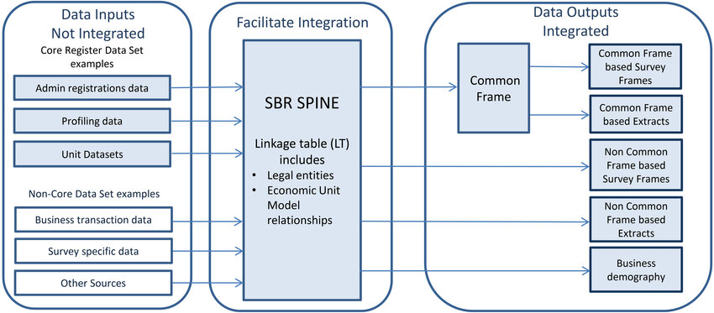
Relational Database
Relational Database

Slide 7
Triangulation
Utilise multiple sources to mitigate errors
Increases the complexity of the work
Requires new data skill-sets
Triangulation

Slide 8
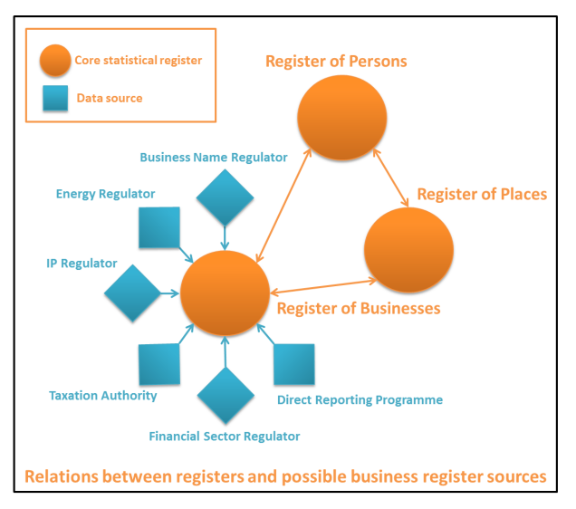
Triangulation
Triangulation

Slide 9
Location Polysemy
Beyond ‘brick and mortar’
Longitudinal business vs cross-sectional business
Employee clusters
Supply chain analysis
Location Polysemy

Slide 10
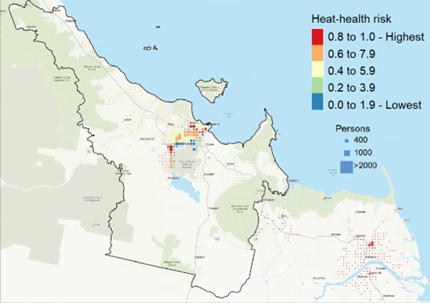
Location Polysemy
Location Polysemy

Slide 11
Conclusion
ABS is on the journey to build a transparent relational database that is scalable to enable multiple sources
to be triangulated and novel concepts to be trialled and implemented as parallel processes to traditional
Statistical Business Register production.

