Slide 1
European Business Registry Association
Marco Vianello, EBRA Board member

Slide 2
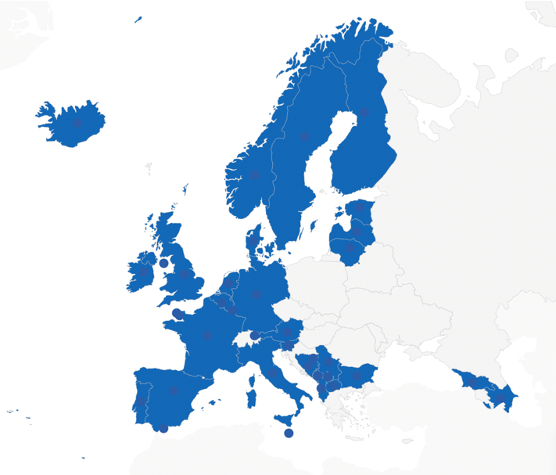
An Association of business registries from across
Europe (EU and non-EU)
42 Members representing 35 countries
Founded in 2019 (20+ year history)
7 Board Members (Core team support)

Slide 3
​ ​
Business Registries in Europe
First Council Directive 68/151/EEC of 9 March 1968 (replaced by Directive (EU) 2017/1132 of the European Parliament and of the Council) defines how to set up a company and the capital and disclosure requirements
National Business Register
Market Transparency
Economic planning
Public accountability

Slide 4
​
Challenges facing the Business Registers
EU legislation upgrading Digital Company Law (giving greater digital access to the registers)
Beneficial ownership - identifying the real beneficial owner and running the registers
The balance between transparency and protecting privacy (following ECJ on WM (C‑37/20) and Sovim SA (C‑601/20) v. Luxembourg Business Register)

Slide 5
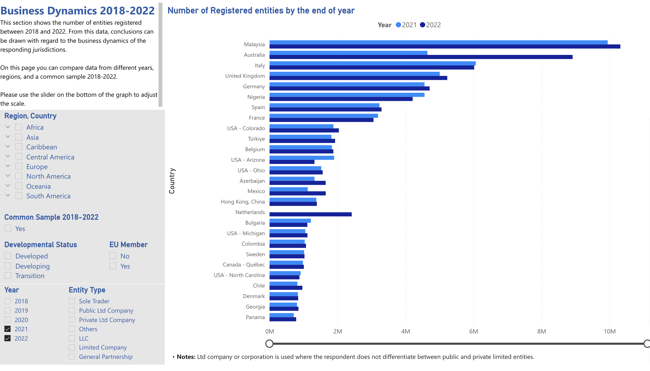
International Survey and Report
Results are published in a digital dashboard
Two surveys each year (digital)
Open to all Business Registers to complete
Run in collaboration with CRF, IACA and ASORLAC
Over 90 responses worldwide
Surveys look at Business Dynamics and relevant topics, e.g. Fees
Go to EBRA.be to see the dashboards and extract data

Slide 6
EBRA Annual Conference Tbilisi, Georgia 2024
12 and 13 June 2024

Slide 7
​
Follow EBRA:
For more information:
Marco Vianello: marco.vianello@infocamere.it
Follow EBRA:
European Business Registry Association
@EBRA_BusReg
www.ebra.be

