Slide 1
Statistical Business Registers and Geospatial Information
Julian Chow UNSD
28th Meeting of the Wiesbaden Group on Business Registers
2-6 October 2023
Acknowledgement:
Masahiko Yagi, Ilaria Di Matteo, Zhiyuan Qian, Pedro Farinas, Mark Iliffe (UNSD) and Hank Hermans (CBS) and Claudio Stenner (IBGE) for their input in developing the paper underpinning this presentation
* INEGI in sharing their experience in georeferencing SBR in this presentation

Slide 2
Location as a link between society, the economy and the environment

Slide 3
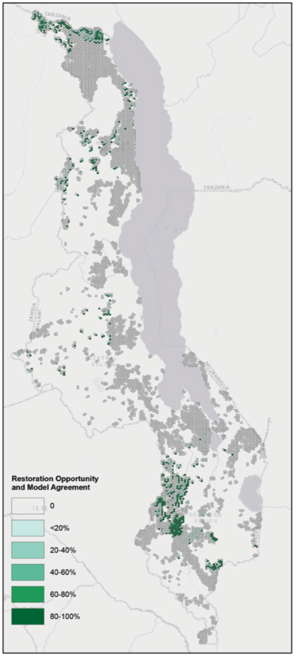
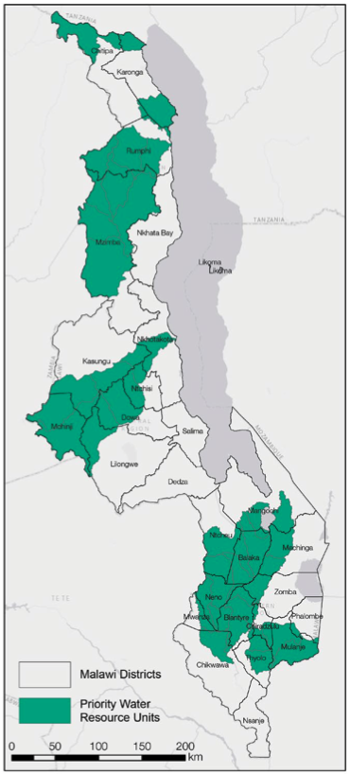
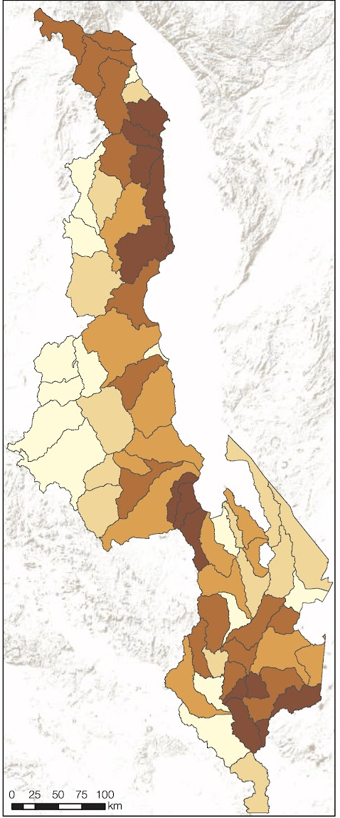
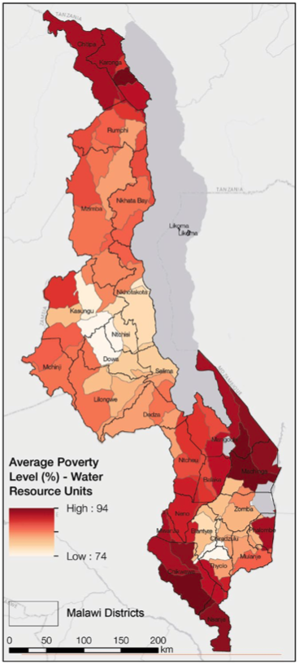
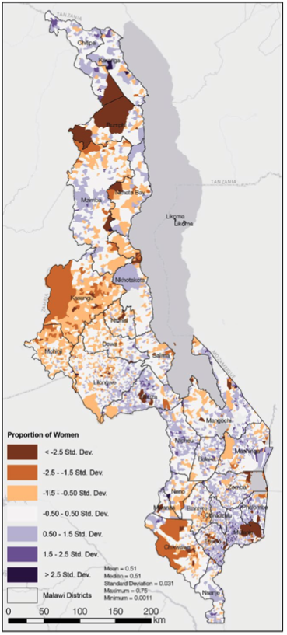
Spatial integration of ecosystem accounts with social indicators
Forest Landscape Restoration priority areas
Water Source Areas
Ecosystem Services Benefits
Poverty
Proportion of Women
Beatty et al., 2018. Landscapes, at your service: Applications of the Restoration Opportunities Optimization Tool (ROOT). IUCN.

Slide 4


Background
The United Nations Statistical Commission, at its 53rd session in March 2022
  Requested the Committee of Experts on Business and Trade Statistics (UNCEBTS) to develop guidelines to assist countries to integrate geospatial information into SBRs building on country experiences
The TT-SBR included in its work plan the preparation of a report on the “Integration of geospatial information in SBRs” to be submitted to the next UNSC in March 2024
The Global Statistical Geospatial Framework (GSGF), developed by the UN Expert
Group on the Integration of Statistical and Geospatial Information (EG-ISGI),
was endorsed in 2020 by the United Nations Committee of Experts on Global
Geospatial Information Management (UN-GGIM) and the UNSC
Close collaboration between the TT-SBR and EG-ISGI to ensure that the report is in full alignment with the GSGF
Notes:
More specifically, with the proliferation of mobile technology and its electronic hand-held devices,
and with an easier access to satellite imagery and use of geospatial technologies, as well as the
pervasive web-based and crowd-sourced tools, there is a shift from traditional paper-based census
data collection methods to new technology and digital-based approaches. This led geospatial
information methodologies and technologies to be adopted by National Statistical Organizations
(NSOs), including in many developing countries, and there is a recognition that the appropriate use
and application of these technologies is beneficial to the efficiency of the preparatory, enumeration,
processing and dissemination phases of the population and housing censuses, and ultimately to
their overall quality.
Today, virtually every NSO uses GIS to create digital maps, develop and maintain databases,
disseminate geostatistical products, and provide a wide range of services. Geospatial information is
also instrumental for other statistical activities, such as the creation of a geo-referenced national
dwelling frame to identify (physical address) and locate (geographic coordinates) all structures on
the ground. This helps set up a national register of buildings and dwellings, develop a business
frame for use in an economic census, improve the coverage in parcel units, and establish the
National Spatial Data Infrastructure (NSDI) with new spatial datasets and standards. In addition,
geospatial information supports the maintenance of frames that are required as a basis for the
statistical sampling frame for surveys and censuses.

Slide 5
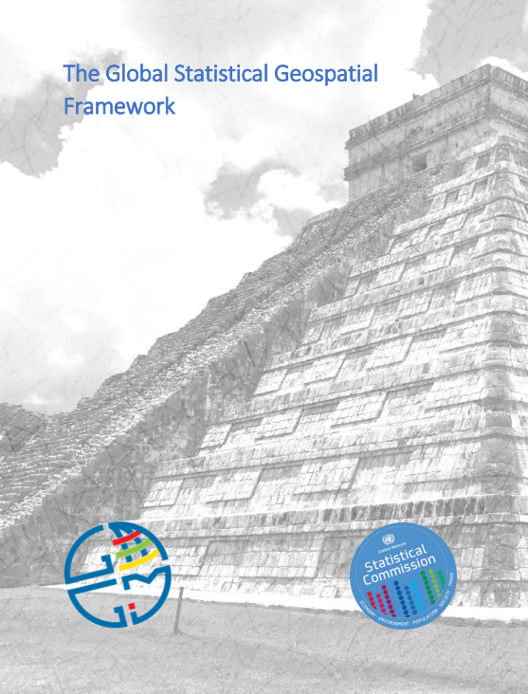
Global Statistical Geospatial Framework (GSGF)
The GSGF provides the framework to facilitate the integration of statistical and geospatial information, between NSOs and National Geospatial Information Agencies (NGIAs)
Developed by the UN Expert Group on the Integration of Statistical and Geospatial Information (EG-ISGI)
Endorsed by United Nations Committee of Experts on Global
Geospatial Information Management (UN-GGIM) in 2020 and
by the UNSC in 2021

Slide 6
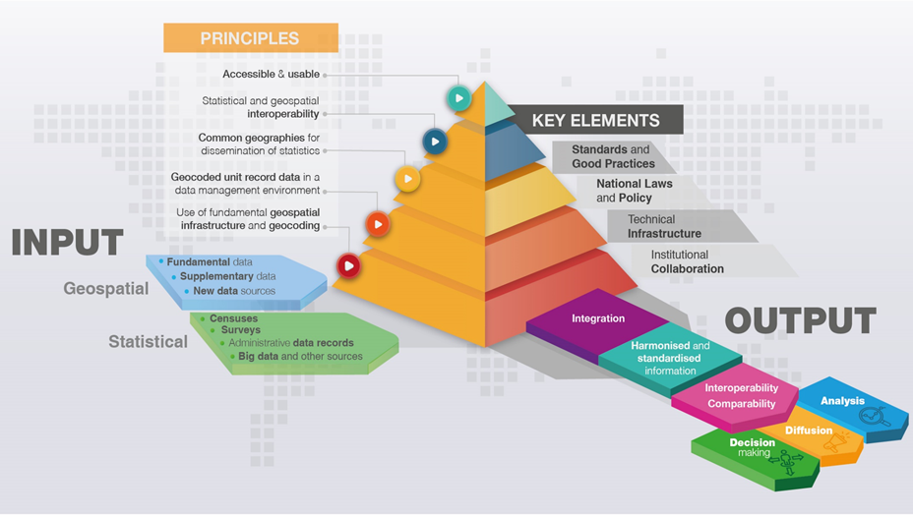
Global Statistical Geospatial Framework (GSGF)
The GSGF contains five Principles:
  Use of fundamental geospatial infrastructure and geocoding;
  Geocoded unit record data in a data management environment;
  Common geographies for the dissemination of statistics;
  Statistical and geospatial interoperability; and,
  Accessible and usable geospatially enabled statistics.

Slide 7
Global Statistical Geospatial Framework (GSGF)
Principle 1: Use of fundamental geospatial infrastructure and geocoding
Implementation of Principle 1 achieves the following objectives:
Address, property, building, and location information are accurate and consistent, meeting country-level agreed standards and good practices;
Geocoding results are as accurate and consistent as possible using common approaches or systems; and,
Any geocoding issues are consistently managed through application of standardized approaches.

Slide 8
Principle 2: Geocoded unit record data in a data management environment
Implementation of Principle 2 achieves the following objectives:
• All statistical microdata is geospatially enabled for flexible use in analysis, visualization, dissemination and statistical data integration processes;
• Aggregation of data for larger geographies is simplified through storage of a unique identifier or code for a small area geography or standard grid cell for each unit record;
• Adaptation to changes to existing geographies or to allow compilation of data for new geographies is enabled;
• Data can be effectively managed, including the protection of privacy and confidentiality;
• Clear data maintenance and custodianship roles are defined; and,
• Geocoded information and metadata are consistent, interpretable and systematically maintained.
Global Statistical Geospatial Framework (GSGF)

Slide 9
Principle 3: Common geographies for dissemination of statistics
Implementation of Principle 3 achieves the following objectives:
• Data from different sources can be integrated using a common geography;
• The visualization, analysis and interpretation of statistical and geographic information is simplified;
• Metadata supports data aggregation, integration and use;
• Identification and application of aggregation and disaggregation methods will enhance data quality and the assessment, consistency and increased use of data; and,
• The conversion of data between geographies is supported, through standard conversion mechanisms (e.g. through correspondences
Global Statistical Geospatial Framework (GSGF)

Slide 10
Principle 5: Accessible and usable
geospatially enabled statistics
Implementation of Principle 5 achieves the following objectives:
• Data custodians can release data, with data privacy and confidentiality protected;
• Data users can discover and access geospatially enabled statistics;
• Data users can undertake analysis and visualisation;
• Web services and linked data methods enable machine-tomachine access, as well as dynamic linkage of information; and,
• Data users can know the status of modifications / changes in the data provided by data custodians through data integrity checks.
Principle 4: Statistical and geospatial
Interoperability
Implementation of Principle 4 achieves the following objectives:
• Greater efficiency and simplification in the creation, discovery, integration and use of geospatially enabled statistics and geospatial data;
• Ensures service-based or machine-readable access mechanisms (e.g. through APIs) are implemented to provide greater efficiency of access and use, and to allow adaptation
and evolution of uses through time; and,
• Increases the potential application of a larger range of data and technologies.

Slide 11
Establishment characteristics – Geographical location code
Purpose
The geographical location code complements the address and postal codes and can be used to derive classifications relating to the geographical location of units at the most detailed level, also other national classifications such as administrative regions, travel-to-work areas, health regions, and education regions.
Definition
Countries can decide which code is most useful for their own purpose.
Proxies
The geographical location code can refer to a classification at the most detailed level used in the country. It can refer to geocoding according to latitude and longitude points.
Sources
Administrative sources.
Source: United Nations Guidelines on Statistical Business Registers, final draft prior to official editing (2020)

Slide 12
Example from Mexico: Geographical coordinates in the SBR
Identification (Name and company name)
Localization (Address and geographical coordinates)
Contact (Telephone numbers, web page, e-mail address and social networks)
Economic (Strata of employees and economic activity code NAICS)
Control Identifier (Enterprise Statistical Code – CLEE)

Slide 13
The use of technology for updating SBR and putting geographic coordinates
The field operations are crucial for updating the SBR. So, INEGI is using GPS in the Mobile electronic equipment of people gathering data under the Computer Assisted Personal Interviewing (CAPI)
Likewise, through the Computer Assisted Web Interviewing (CAWI), INEGI identifies changes in the businesses informed by the respondents of Economic Surveys, and afterwards these changes are verified directly by INEGI. In the case of new establishments (births) the geographic coordinates are assigned
In addition, linking the SBR with the registers provided by Government Agencies INEGI also assign the geographic coordinates

Slide 14
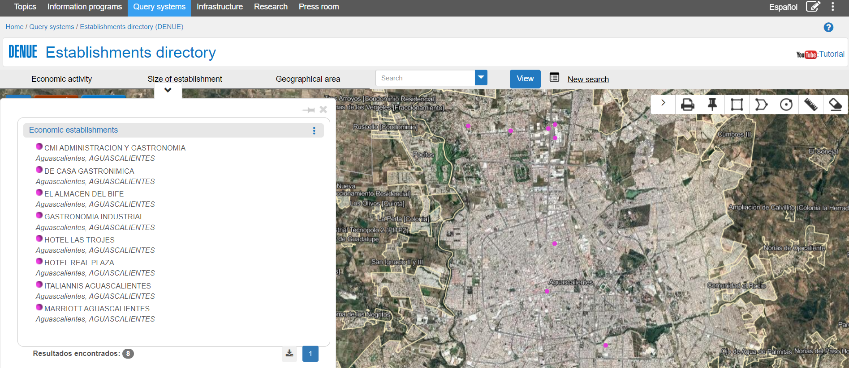
DENUE offers statistical information referred to a geographic area, which increases the variety of products, the interrelation of data and their analysis when visualizing them on digital cartography
In Mexico, INEGI has developed some exercises institutionally and others in coordination with some public and private institutions
DENUE is available in: https://www.inegi.org.mx/app/mapa/denue/default.aspx

Slide 15
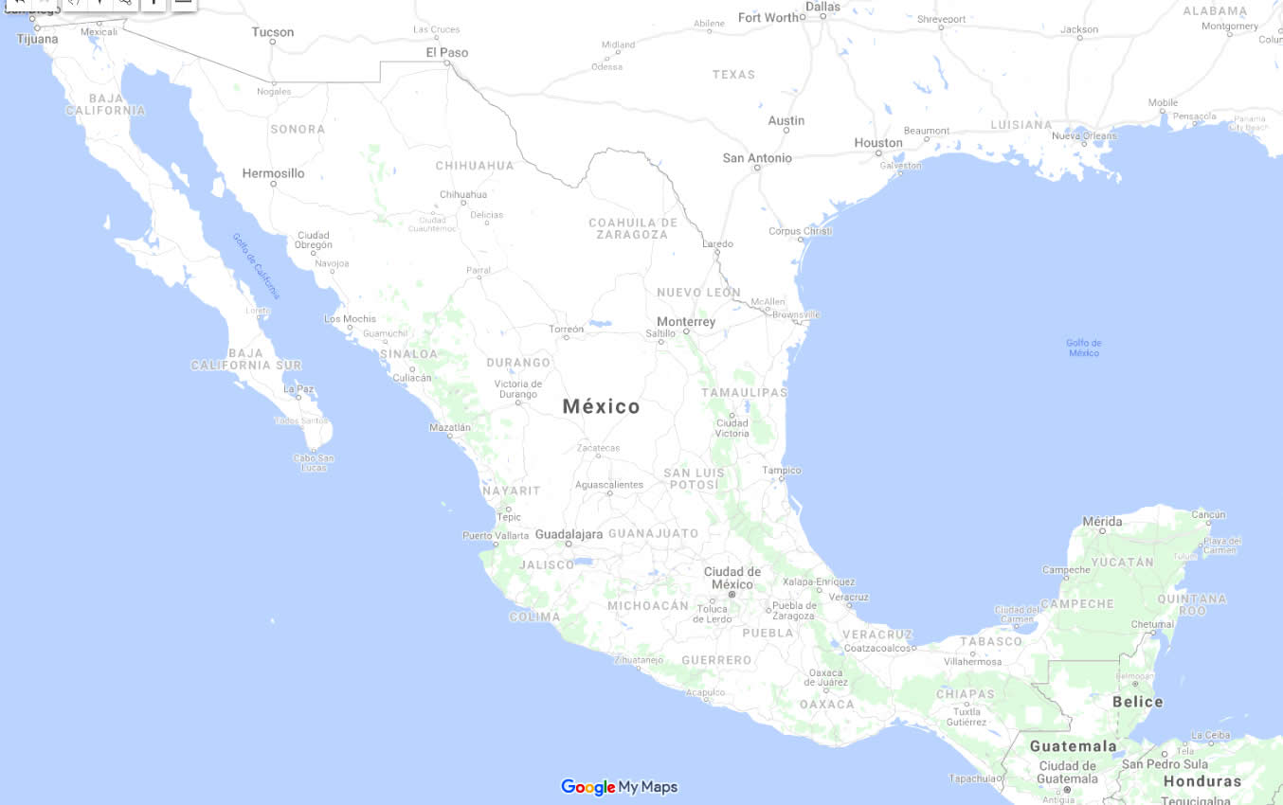
Evolution of an enterprise of convenience stores
2008 2013 2018

Slide 16
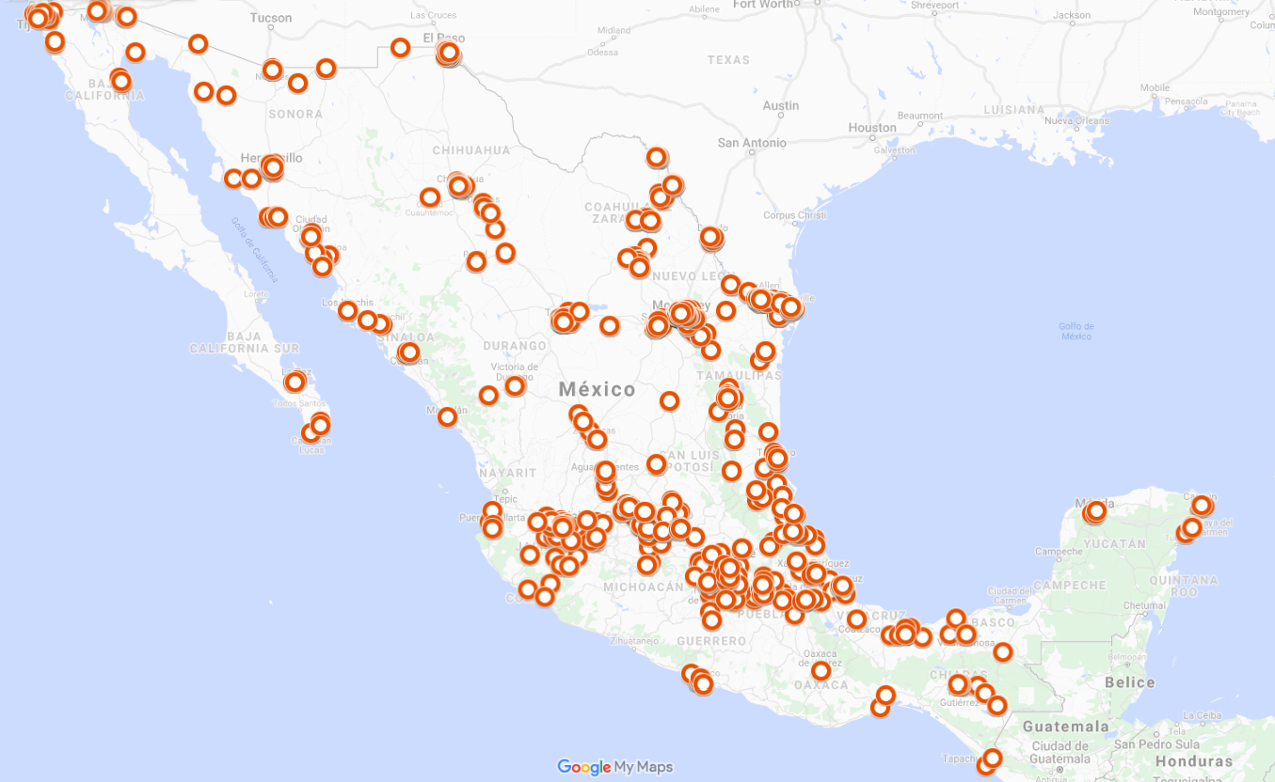
Evolution of an enterprise of convenience stores
2008 2013 2018
5,596 Establishments
TOP 2008
1. Nuevo León
2. Tamaulipas
3. Baja California
4. Mexico City

Slide 17
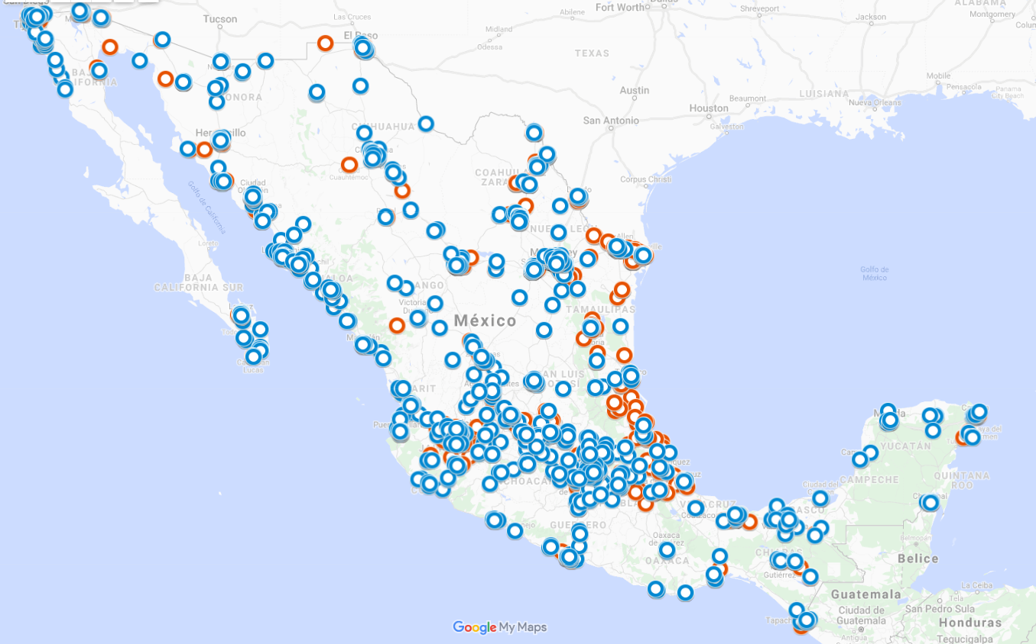
Evolution of an enterprise of convenience stores
2008 2013 2018
9, 648 Establishments
TOP 2013
1. Mexico City
2. Nuevo León
3. México
4. Jalisco

Slide 18
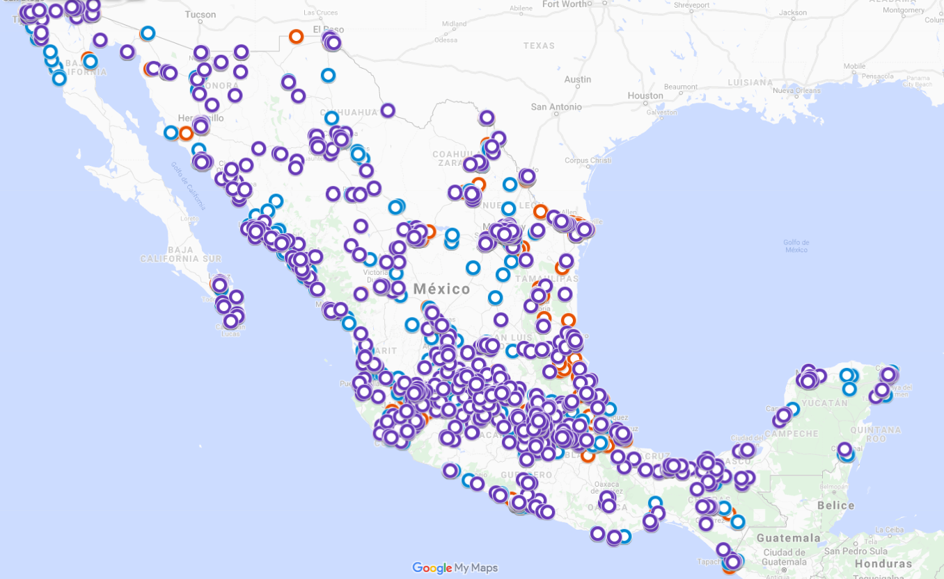
Evolution of an enterprise of convenience stores
2008 2013 2018
15, 241 Establishments
TOP 2018
1. Mexico City
2. Nuevo León
3. México
4. Jalisco

Slide 19
Report on the integration of geospatial information in SBRS
The main objective of the report is to provide guidelines
It mainly covers the following sections:
  What is geospatial information and benefits of integrating it in the SBR
  What it means integrating spatial information in the SBR
  How is geospatial information maintained
  How to integrate geospatial information in the SBR
  Country examples of the benefits of the integration

Slide 20
Thank you!

