Slide 1
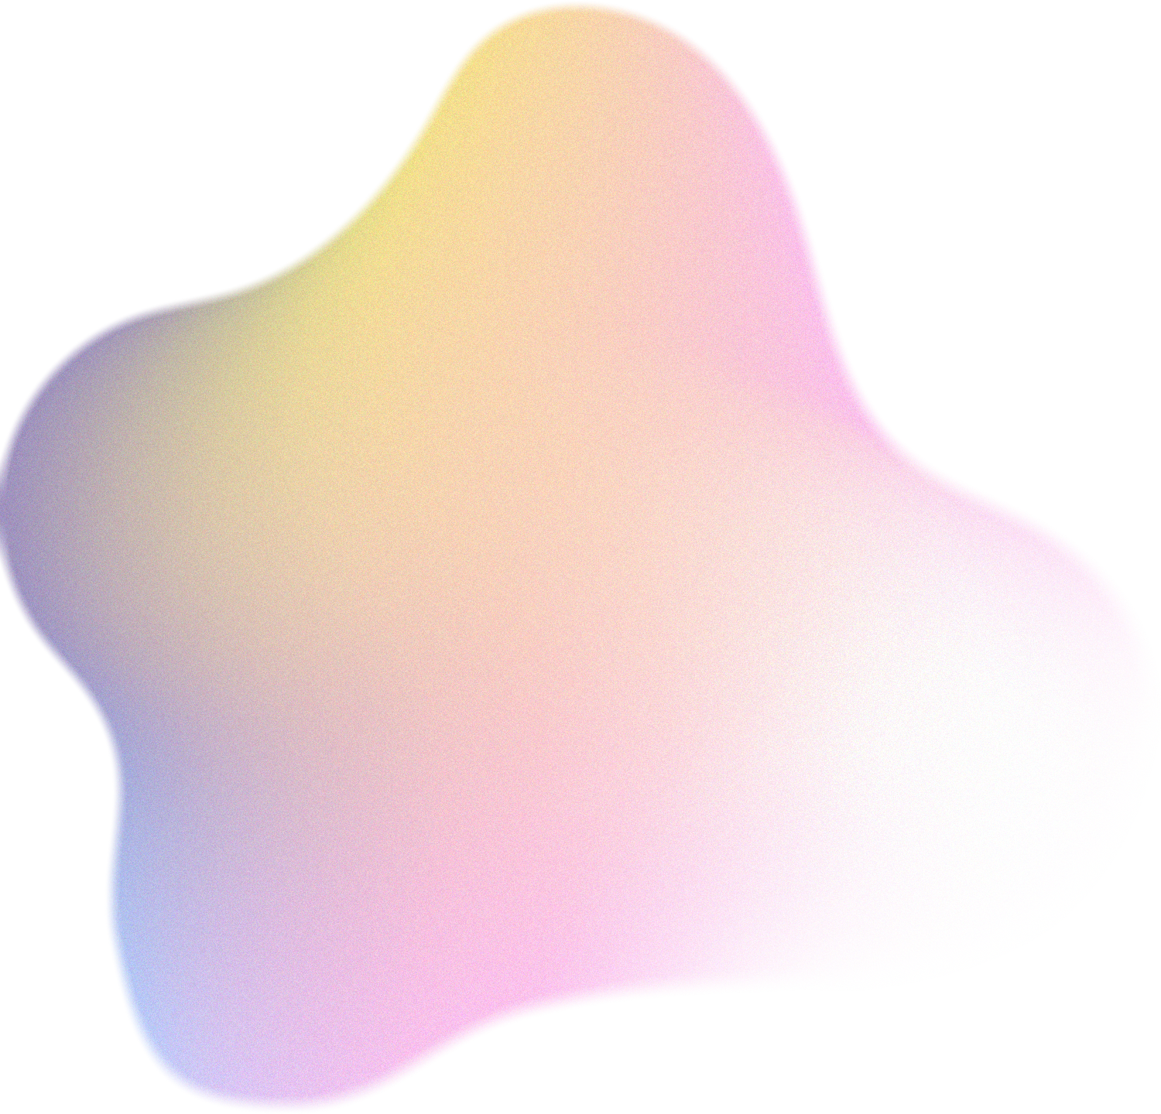




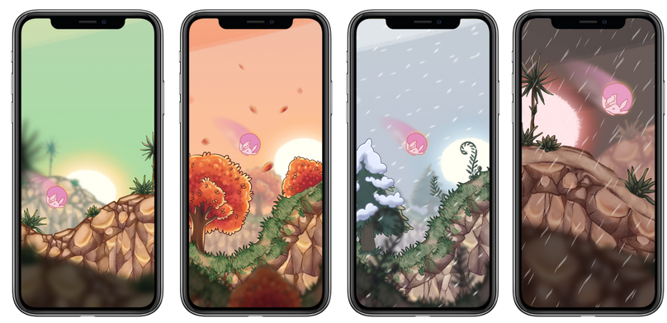
ECDHM 2025
Predicting Vasovagal Reactions During Blood Donation Using Video-Based Physiological Signal Extraction and Machine Learning
Judita Rudokaite, L. L. Sharon Ong, Itir Onal Ertugrul, Mart P. Janssen & Elisabeth M. J. Huis in ‘t Veld

Slide 2


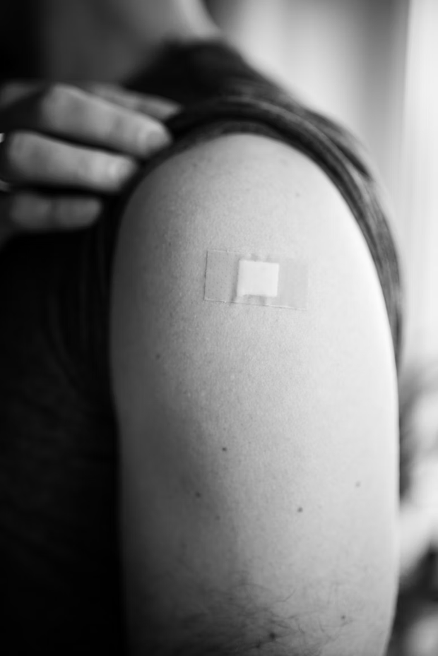
Prevalence & Public Health Impact of Needle Fear & VVR
ECDHM 2025
Vasovagal reactions (VVR):
10–20% of first-time blood donors experience VVRs
2–5% of repeat donors still affected
Needle fear prevalence:
Affects ~20–30% of adults
Up to 50% of children
Public health impact:
20–30% of donors who faint do not return to donate again
33% of people with needle fear avoid vaccinations
52% avoid blood draws and 49% avoid blood donations
In the U.S., 16% of adults skip flu shots due to needle anxiety
In the UK, 10% of COVID-19 vaccine hesitancy linked to needle fear
Overall, 22% avoid medical treatments involving needles

Slide 3


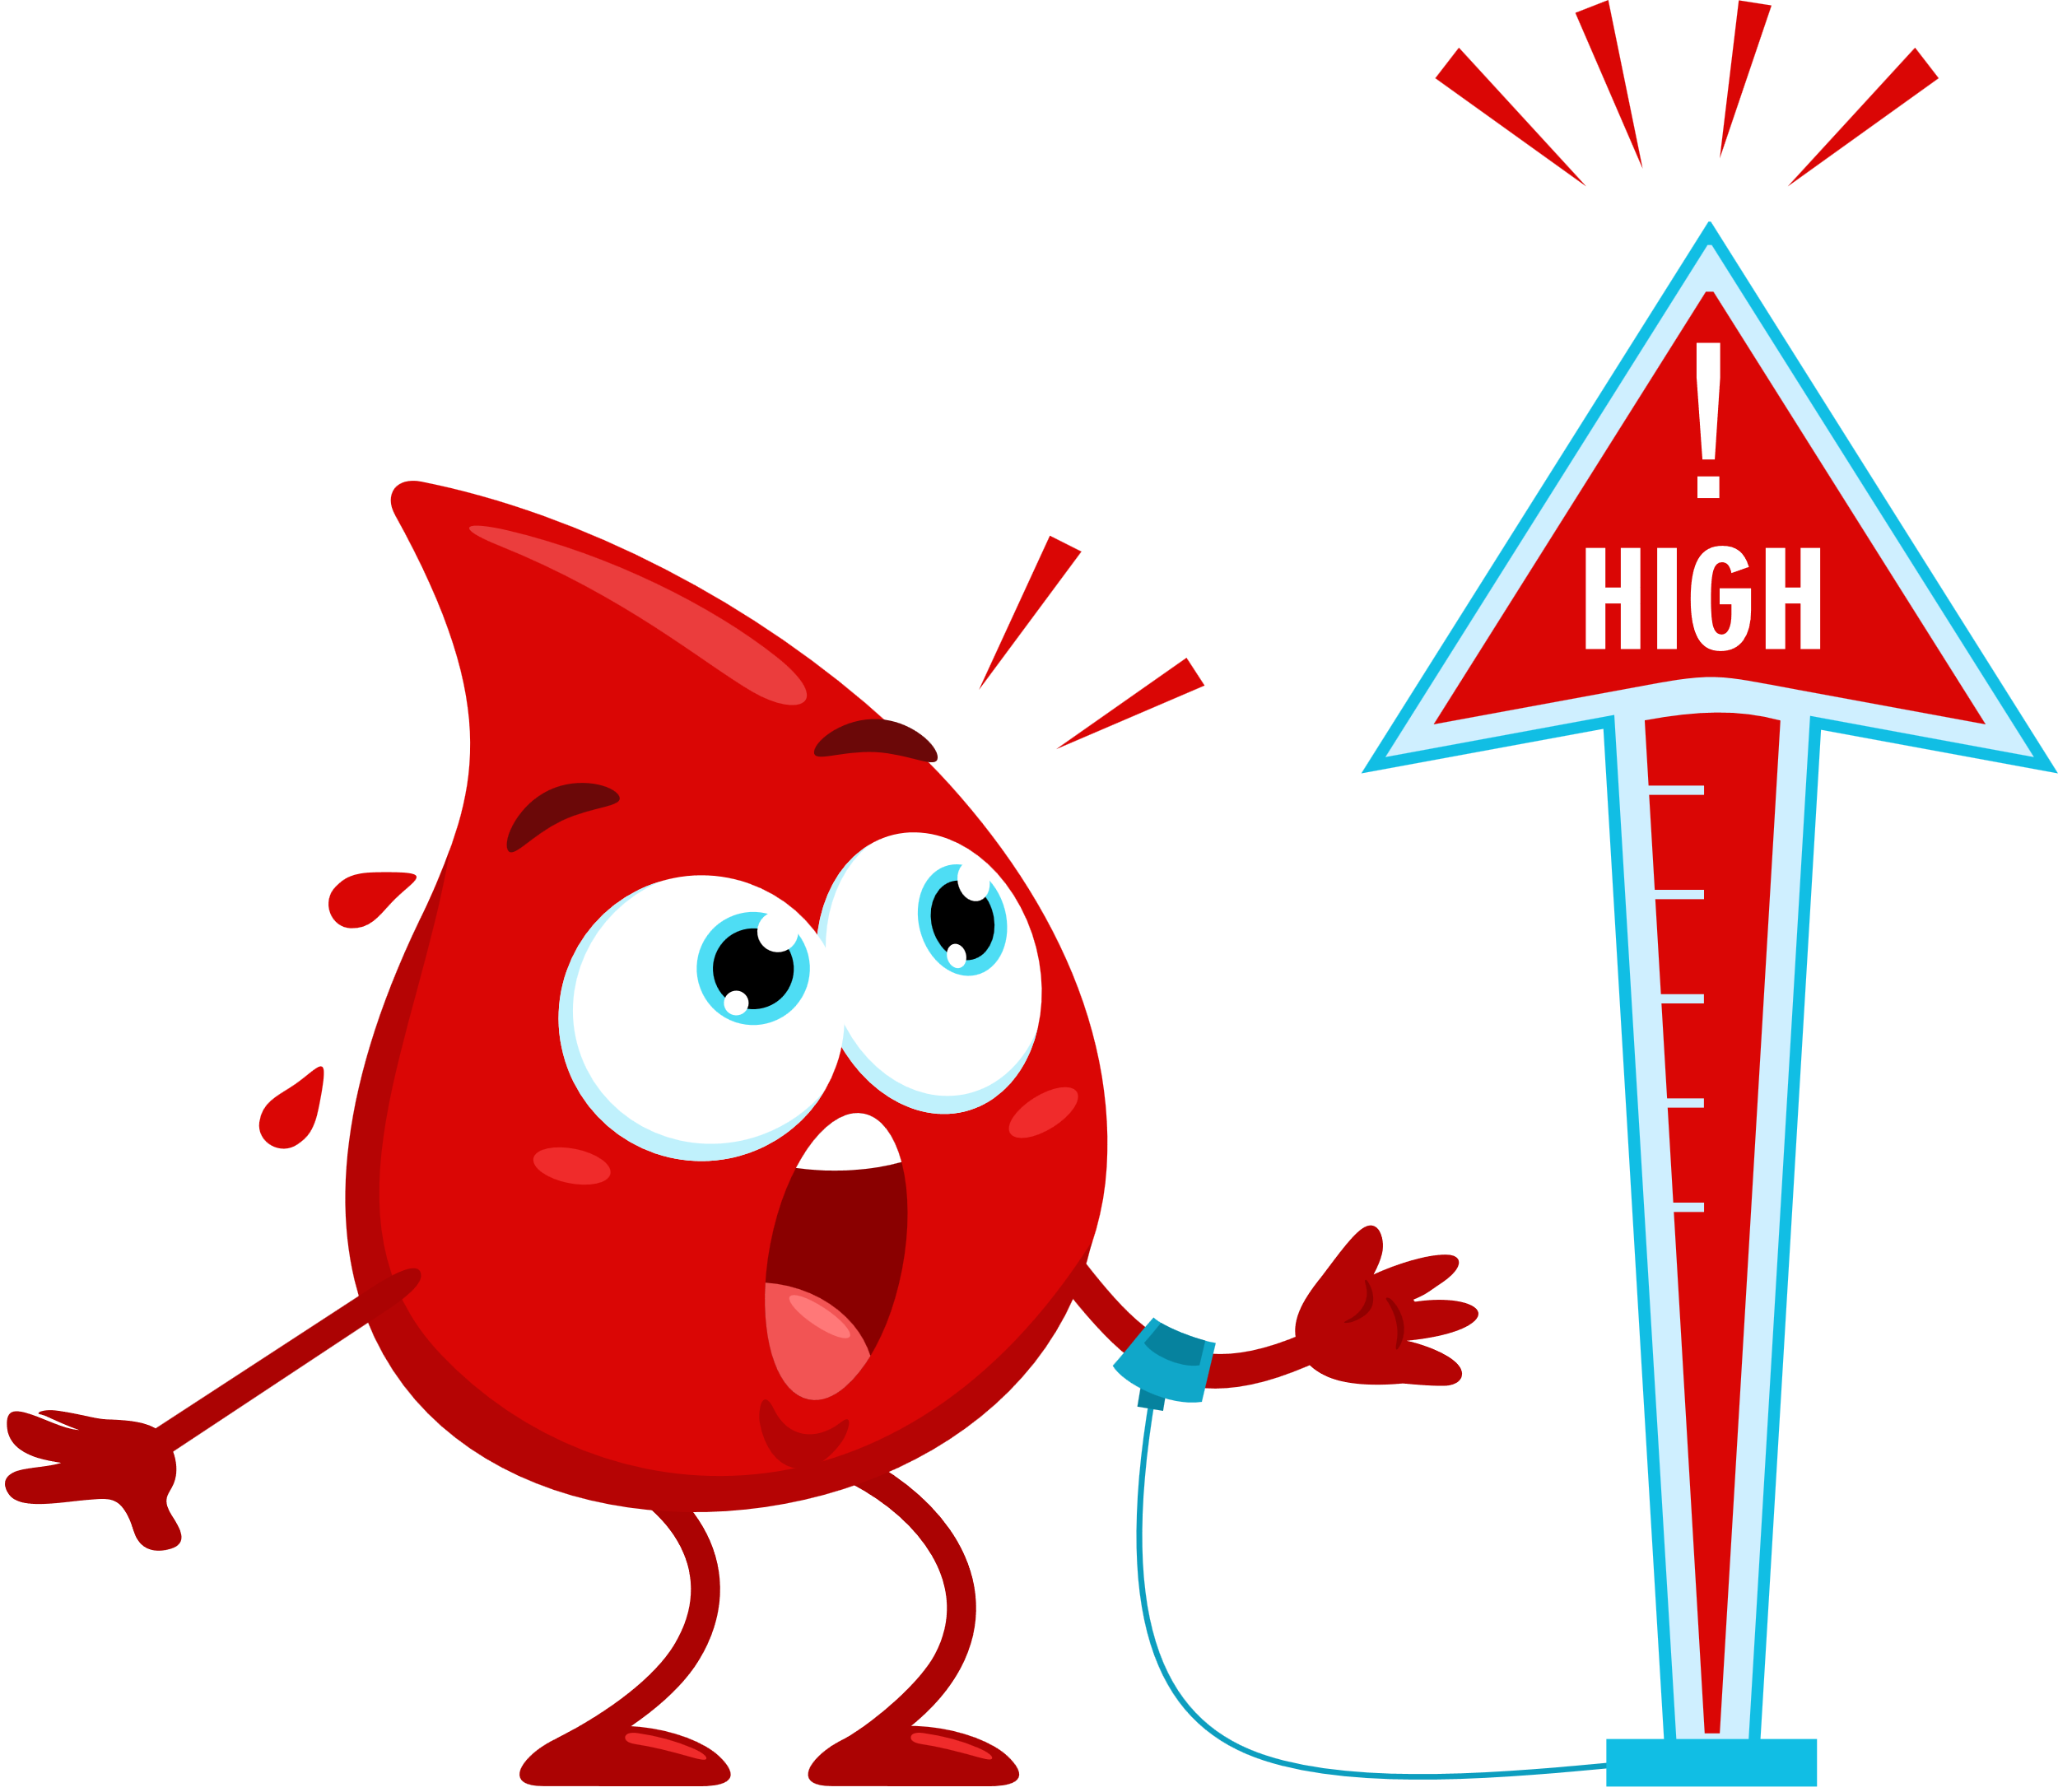
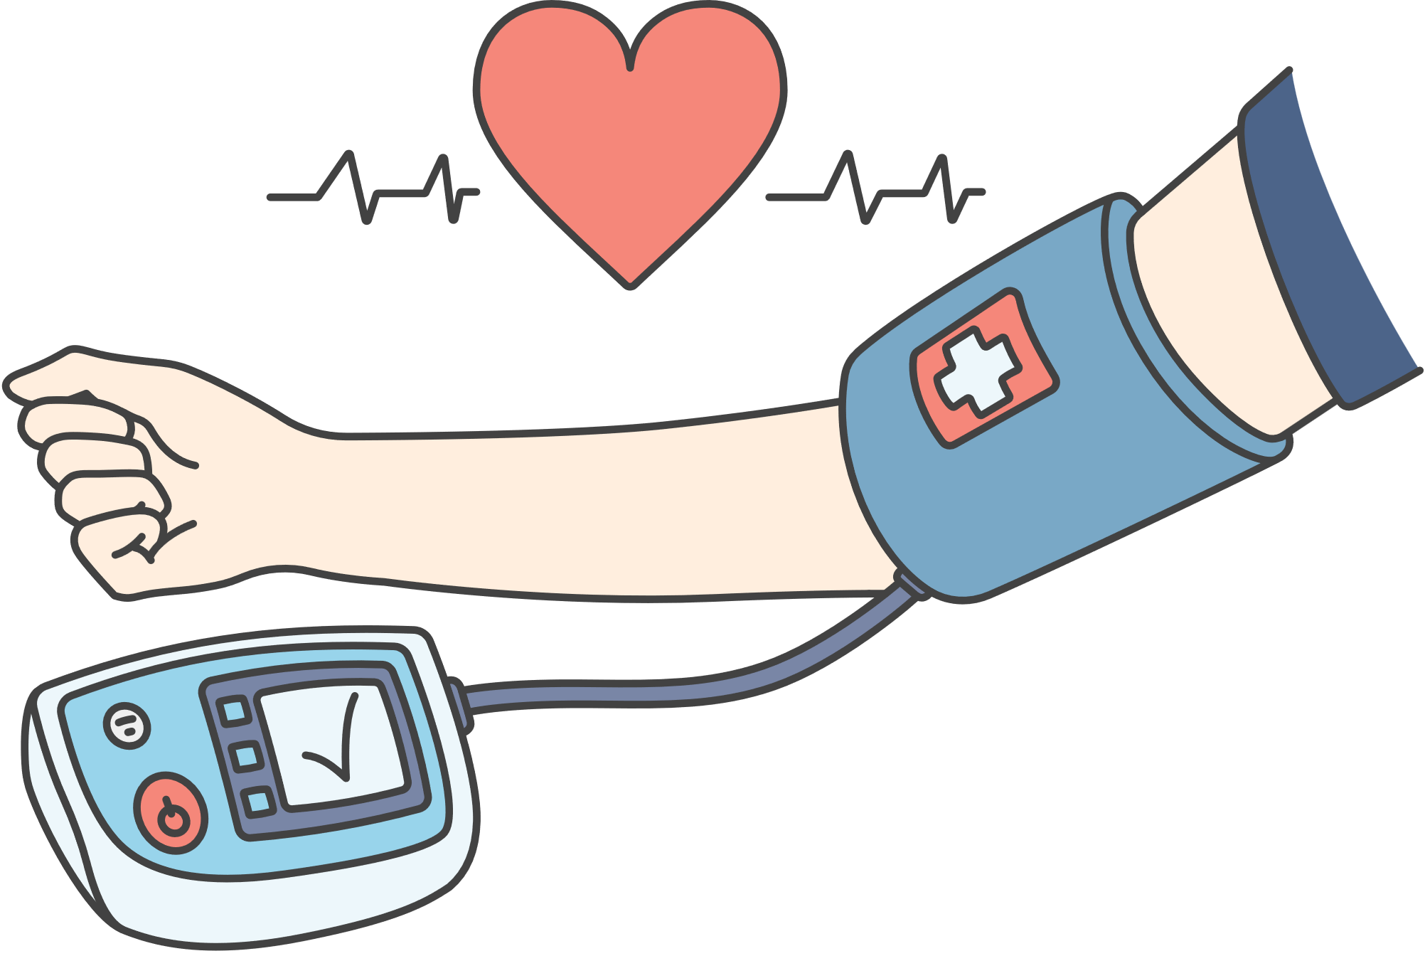

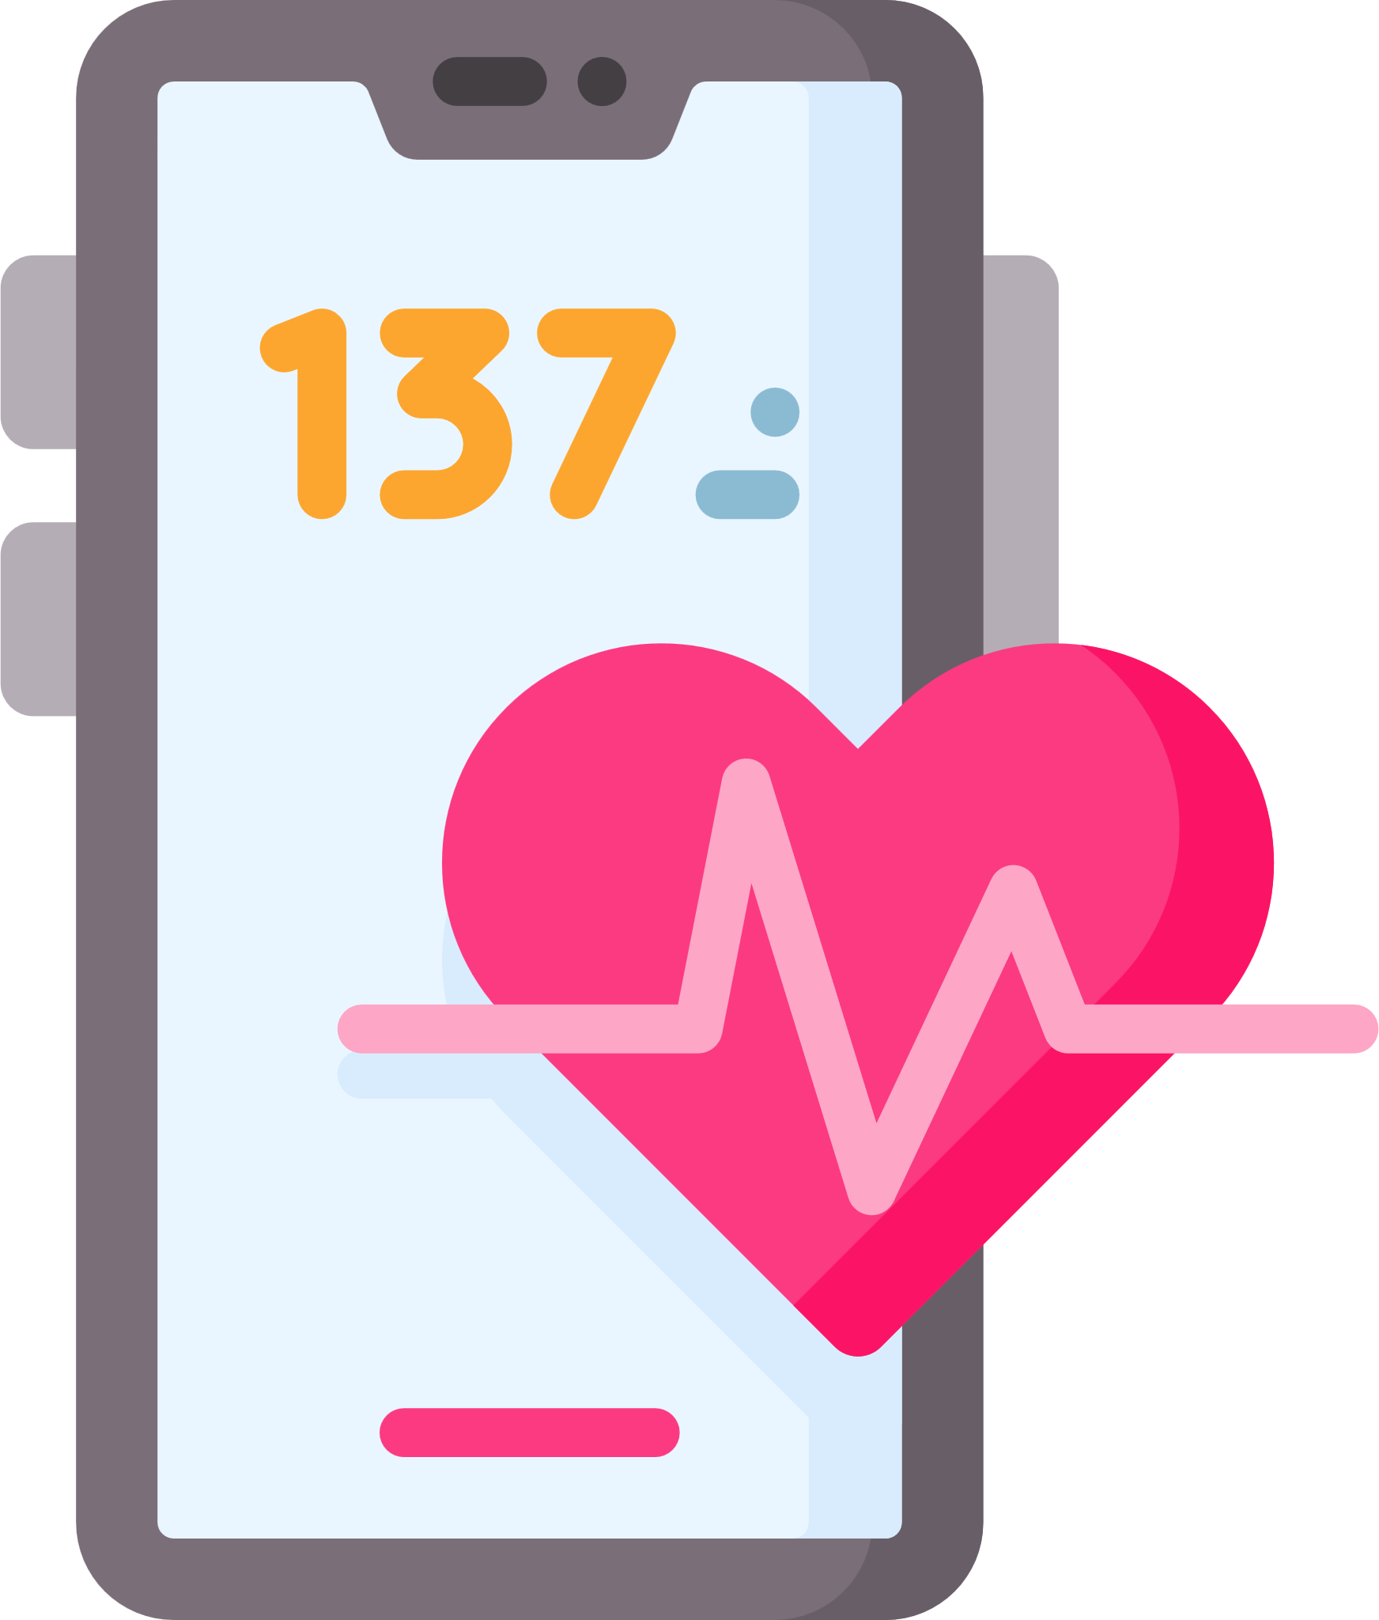
Rationale: Why Focus on Physiology?
Traditional Methods (Tilt table testing, HRV belts/electrodes)
Stress trigger
Autonomic Nervous System Dysregulation
Physiological Markers
VVRs
Our approach (non-contact, video-based monitoring + ML to detect early risk patterns)

Slide 4
Study aims
1
Develop video-based pipeline to extract HR & breathing pattern from facial videos
2
Predict VVR risk using extracted features and ML techniques
3
Validate our findings with external independent dataset

Slide 5
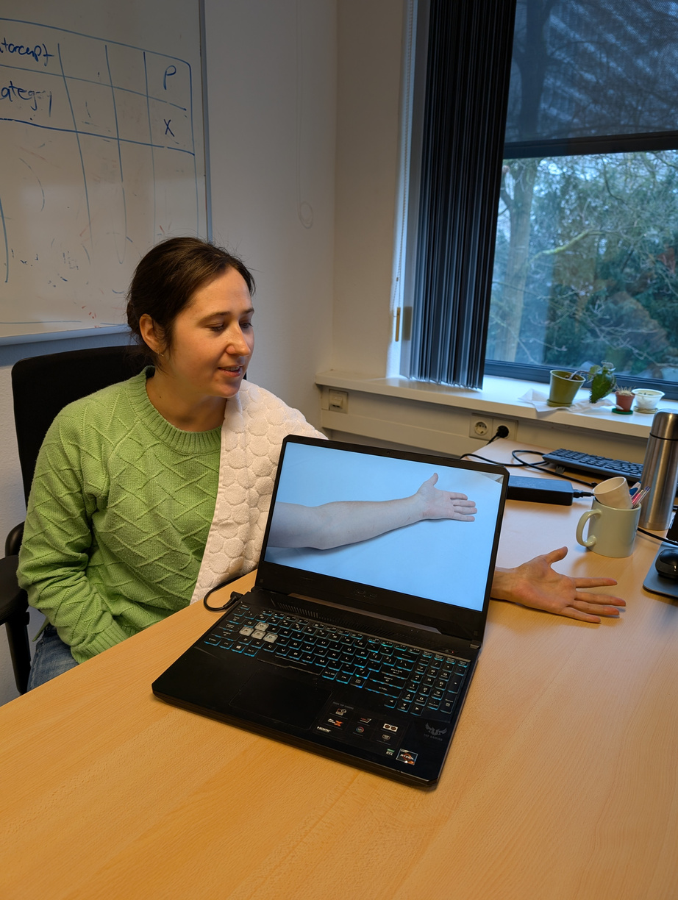
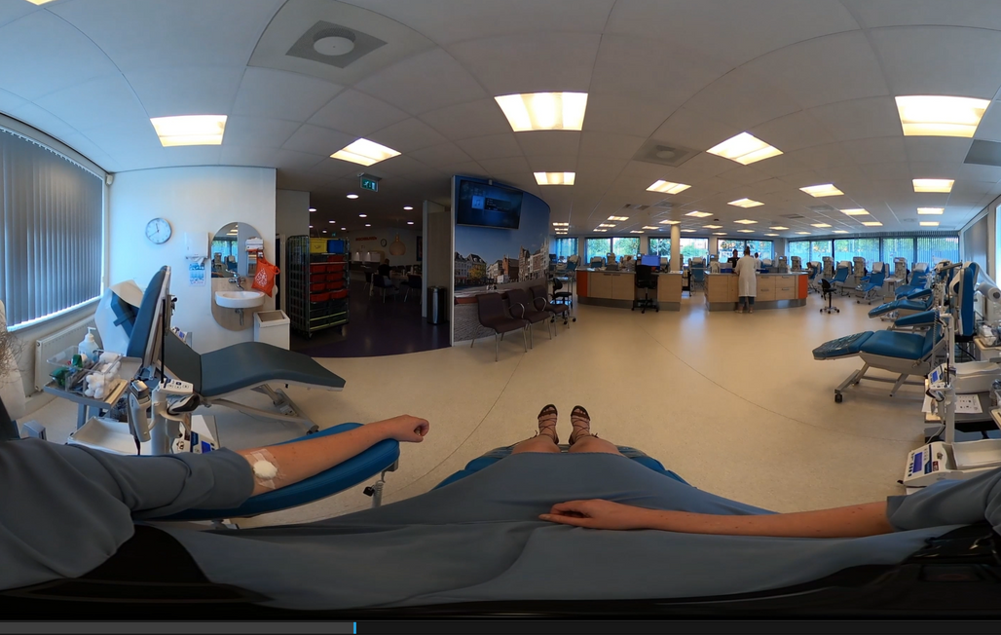

Participants & study design
ECDHM 2025
Training data - Blood Donors
Validation data - Students (Independent Test Set)
305 donors from 4 locations (Sanquin, NL):
(1) 86 experienced VVR
(2) 64 control donors (no VVR)
(3) 155 first-time donors
7 stages recorded (before, during, after donation)
VVR scores: self-reported, ranging from 8–40
Videos:
Total: 1,943
45s clips,
225 frames
5 FPS
123 students from Tilburg University (lab setting)
Based on Rubber Arm Illusion paradigm → simulated blood donation (participants watched standardized 5-min virtual blood draw video)
VVR scores: self-reported
after donation
Videos: 123 total
(225 frames, 5 FPS)

Slide 6

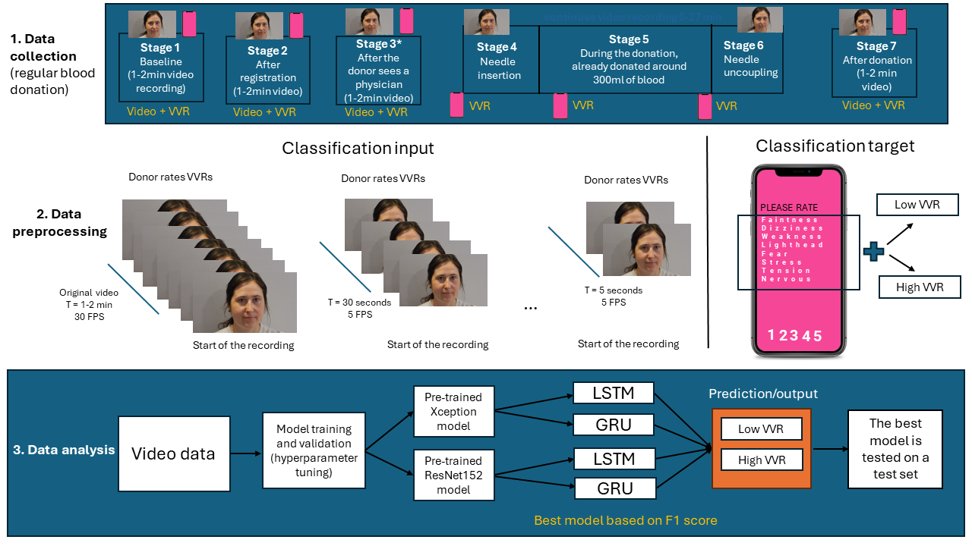
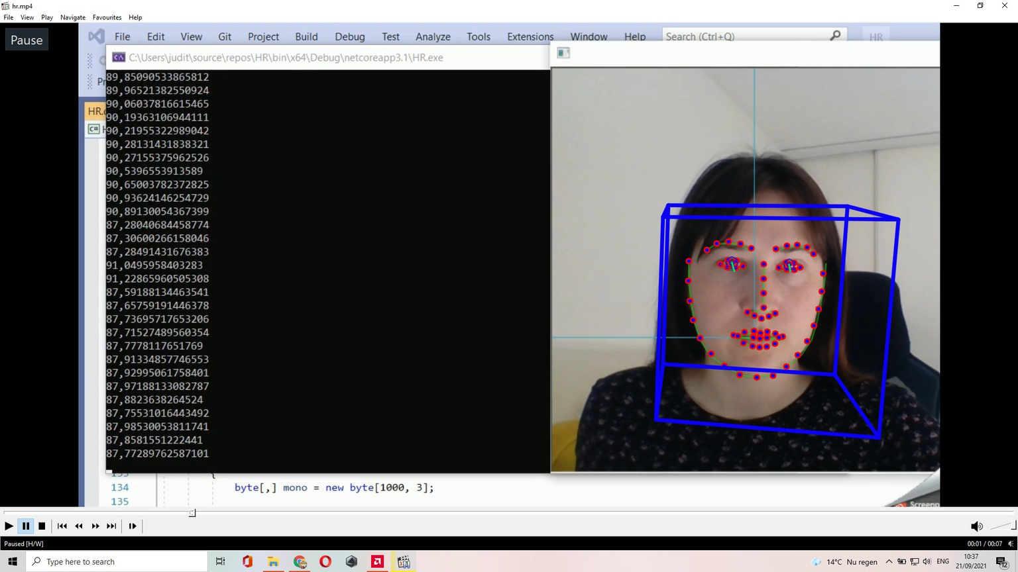
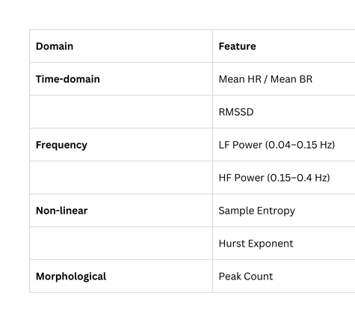
Methodology
17 HR features + 17 BR features = 34 total features per video segment.

Slide 7
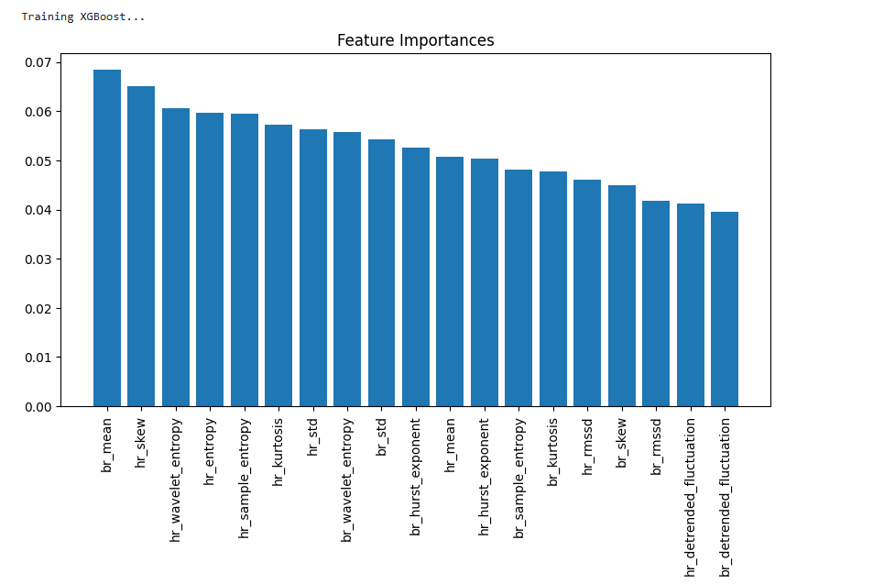
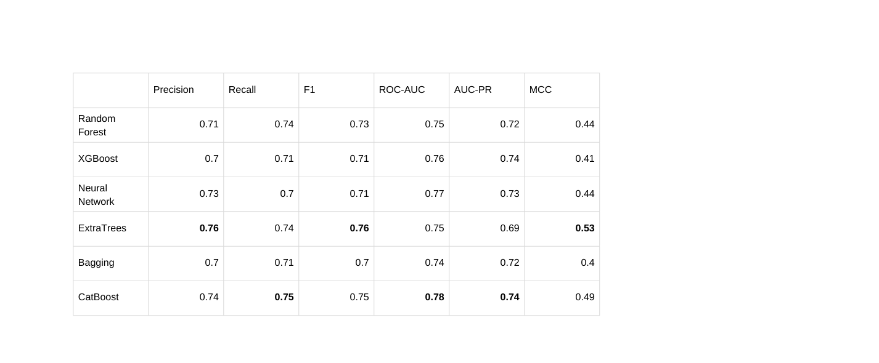
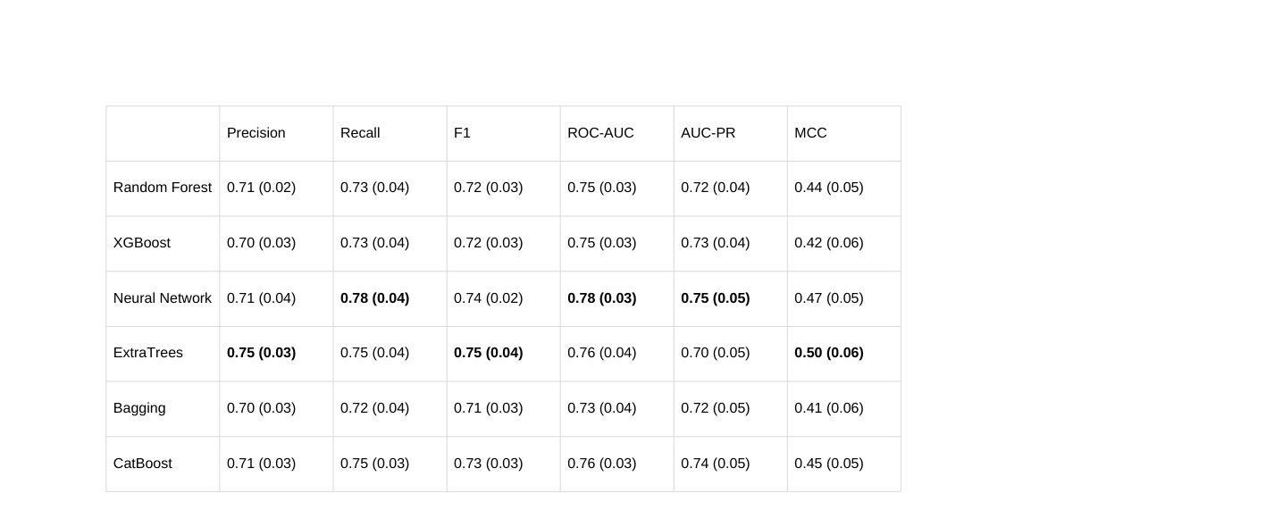
Results
Training data - Blood Donors (N = 1943)
Average cross-validation with standard deviation
Independent Test Set (N = 123)

Slide 8

Discussion
Video-based heart rate & breathing features can predict VVR risk.
Ensemble models (ExtraTrees, CatBoost) showed best generalization.
Non-invasive, camera-only monitoring is feasible for donor safety.
Limitations
Class imbalance (low number of high-VVR cases).
Only RGB video used (no thermal/other modalities).
Results may not generalize beyond Dutch donors/students.
Indirect HR/BR estimation introduces noise.
Future Directions
Improve models with transformers & multimodal data.
Test in real-time clinical settings.
Personalize using donor baselines & VVR profiles.
Increase explainability
Extend to other populations

Slide 9
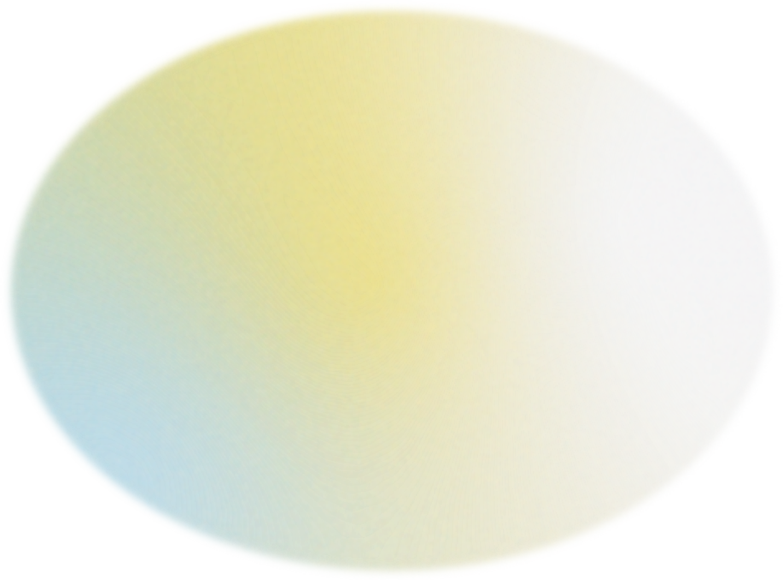
ECDHM 2025
Thank you!
Want to know more?
j.rudokaite@tilburguniversity.edu
www.ainar.io

