Slide 1
PCE2022 SUFFERING AND FLOURISHING: POSITIVE EMOTIONS AND THEIR ROLES IN TRANSFORMING EMOTIONAL PAIN AND FACILITATING THERAPEUTIC CHANGE
SEMIPLENARY
Shigeru Iwakabe
Ritsumeikan University, Osaka, Japan

Slide 2
My Work
Psychotherapy researcher - Emotional change process- Transforming core painful emotions
A humanistic integrative psychotherapist
Emotion-focused therapy outcome research in Japan
Accelerated Experiential Dynamic Psychotherapy in English speaking countries
Training, supervision, and professional development
Social and cultural issues in psychotherapy

Slide 3
Positive Emotions

Slide 4
Positive Emotions
Joy
Relief
Calmness
Contentment
A result of good therapeutic work or Driver of change? (Stalikas & Fitzpatrick, 2008)

Slide 5
Interest/curiosity
Interest arises in contexts appraised as safe and as offering novelty, change, and a sense of possibility (Izard, 1977)
the momentary thought-action tendency of interest is to attend or orient (e.g., Frijda, 1986)
Energize exploratory behaviors and engagement

Slide 6
Trust
Comfort
Ease
Attachment
Essential to building therapeutic relationship

Slide 7
Contentment
prompts individuals to savor their current life circumstances and recent successes, experience "oneness" with the world around them, and integrate recent events and achievements into their overall self-concept and world view (de Rivera et al., 1989; Izard, 1977).
not simple passivity, but rather a mindful broadening of a person's self-views and world views.
creates the urge to savor and integrate recent events and experiences creating a new sense of self and a new world view.

Slide 8
Awe
a feeling of reverential respect mixed with fear or wonder.
Occurs when we encounter something extraordinary
Alter the way we think of the world(Keltner & Haidt, 2003).
Allow us to take in large amount of information to promote cognitive accommodation (e.g., Shiota et al., 2007).

Slide 9
Love
love experiences are made up of many positive emotions, including interest, joy and contentment.
To the extent that love triggers the more specific positive emotions of interest, contentment, and joy, it also broadens the momentary thought-action repertoire as people explore, savor, and play with the people they love.
love helps to build and strengthen social bonds and attachment.

Slide 10
Broaden-and-Build Theory (Fredrickson, 2000)
Enhanced wellbeing
Adjustment
Health
Building Resources
Strength
Social skills
Knowledges
Relationship
openness
New thoughts
Actions
Relationships
Positive Emotion
Sharing, connecting
joy

Slide 11
Emotional change processes in psychotherapy

Slide 12
Emotion change process in psychotherapy
Activation of a problematic emotional state
Activation of adaptive emotional state(s)
The creation of a permanent connection between previously unintegrated maladaptive emotional memory networks and adaptive emotional networks.
Transformative Emotional Sequence (Welling, 2012)
Commonality in AEDP, EFT, EMDR, Coherence theory

Slide 13
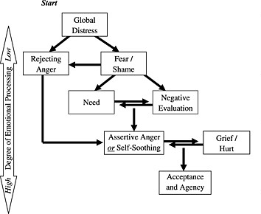
Emotional Processing Model by Pasucal-Leone & Greenberg (2007)
What about positive emotions?

Slide 14
Client Dialectical Emotional change process in psychotherapy
Emotional Distress
Deeply rooted emotional Conflicts
Adaptive emotional response
Positive emotional state/affirmation of self
Trust, comfort empathy
Relief
hope
Fear of abandonment-> connection
Strength
Energy
Resilience
Motivation
generated
Confidence
A sense of achievement
Pride/joy

Slide 15
Research Findings

Slide 16
Can the experience of positive emotions alone make meaningful sessions? (Nakamura et al., 2022)
High Pos
Low Neg
Flourishing
Highest depth
High Pos
High Neg
Striving
SEQ DEPTH
Average Pos Em
Average Neg Em

Slide 17
Characteristics of hi positive and low negative sessions with depth
Come from early, middle, late sessions
Sharing of positive emotions such as accomplishment for their collaboration
Gratitude and relational positive emotions explicitly shared and savored
Corrective emotional experiences scores were high

Slide 18
Japanese clients’ subjective Experience in EFT (Iwakabe et al., 2022) Therapeutic Relationship
Safety and consistent emotional environment
Experiential Guiding
Affirmation, Validation, and Valuing
Therapist Positive Characteristics
Increased presence and responsiveness at critical moments
Challenges and difficulties

Slide 19
Change Process
Expressing emotions
Identifying core emotional issues
Gaining and enhancing awareness
Emotional Broadening and Transformation
Challenges and Difficulties

Slide 20
Expressing emotions
“In the chair work, the therapist encouraged me to express my love to my grandparents. I would never imagine doing something like that in a real life. But when I did, something was lifted in myself, something that was very heavy in my heart.”

Slide 21
Emotional broadening and transformation
Something inside me changed. I do not carry that heavy feeling in myself that had been there for many years. I do physically feel differently.

Slide 22
Accelerated Experiential Dynamic Psychotherapy (AEDP: Fosha, 2000, 2020)
Help their patients process both the negative emotions and positive emotions
Meta-processing – processing an experience of change (what was it like for you to have done this work with me?) – consolidating and extending the work that has been just accomplished.

Slide 23
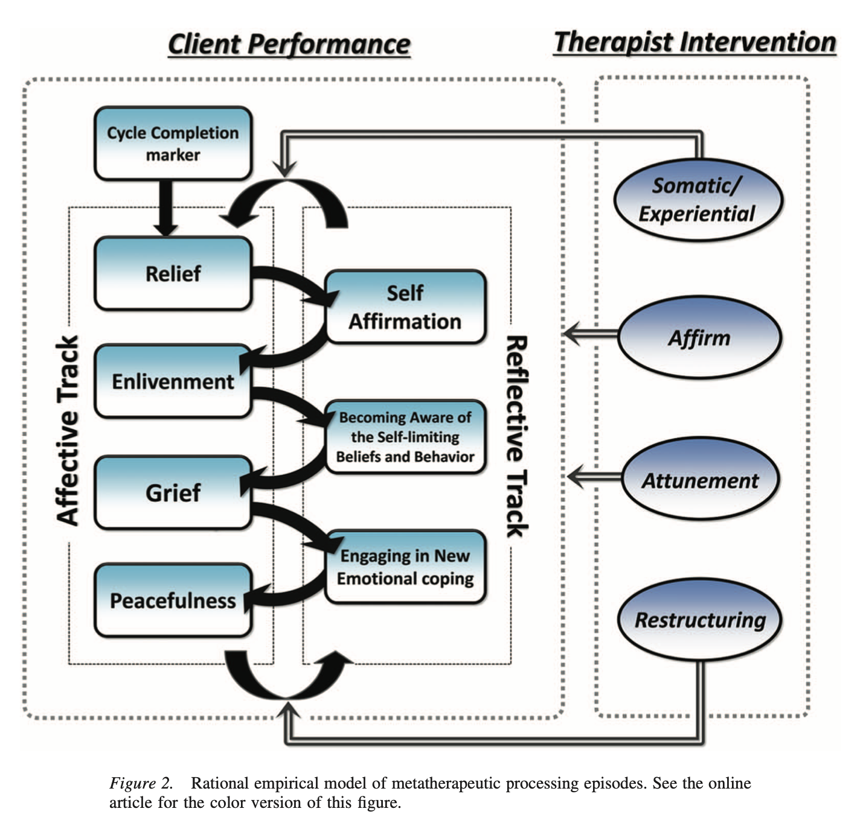
What happens when the therapist works with the experience of change? (after working through the experience of core affect or primary adaptive emotion)
Iwakabe, S., & Conceicao, N. (2016). Metatherapeutic processing as a change-based therapeutic immediacy task: Building an initial process model using a task-analytic research strategy. Journal of Psychotherapy Integration, 26(3), 230–247. https://doi.org/10.1037/int0000016

Slide 24
Other Findings
Participants who reported a greater propensity to experience positive emotions at pre-treatment displayed the largest reduction in anxiety symptoms as well as fewer symptoms following treatment. Positive emotions remained a robust predictor of change in symptoms when controlling for baseline depression severity (Taylor et al., 2017).
Increase in the working alliance is associated with increase in positive emotions(Bartholomew, 2021)

Slide 25
Therapeutic work with positive emotions

Slide 26
Spiral of positive emotions (Fredrickson, 1998, 2013)
Undoing self-limiting cognition and behaviors
Expanding the cognitive and behavioral repertoires
Flexibility and openness
Increase in energy
More positive emotions
Not about reaching a completion, but flourishing in motion

Slide 27
Savoring

Slide 30
Savoring
Attend to, appreciate, and enhance the positive experiences (Bryant & Veroff, 2006: Savoring: A New Model of Positive Experience).
The attempt to fully feel, enjoy, and extend our positive experiences.
Savoring vs. coping
Involves
Mindfulness
Capitalizing the present
Playfulness

Slide 31
The use of positive emotions in experiential psychotherapies
Experiential therapy by Al Mahrer (1990) enacting the past scene that evoked a strong emotion by becoming the person you want to be.
Self-soothing in EFT Talking to child self or self in distress by enacting a compassionate other or self (Greenberg, 2021)
Metaprocessing in AEDP “What was it like to have done this work (with me)?
Portrayal in AEDP imagery enactment of scenes that were emotionally significant
Focusing (Gendlin, 1978)

Slide 32
Clinical Example
Client (1/2)
late 30s. Part time work
Recently separated from wife and 1 year old daughter
Depressed anxious and isolated
His father forced him to study from an early age to advance to a good university, did not allow him usual boys activities from watching TVs, reading comics, or doing sports.
He grew up feeling inferior to others and felt ashamed for not knowing anything that other kids were talking about.

Slide 33
Clinical Example
Client (2/2)
Failed entrance exams and ended up in a “less than mediocre” college.
Chose a job with less-than-optimal work conditions consequently feeling used, dissatisfied and constantly looking for another job.
Moved to a small city to start his marriage
Overly controlling and constantly worried about finances.

Slide 34
Case formulation
Emotional conflicts: Core shame, Inferiority, resentment
Stuck in cycles of negative emotions
Needs: to feel accepted, competent, capable, and strong
Defensive/secondary emotions/ resentment, anxiety, resignation

Slide 35
In this session (8th sessions)
Th helped the client slow down and loosen his guardedness
Cl allowed himself to feel grief over his lost childhood when he wasn’t even allowed to enjoy what everyone else enjoyed like reading comics or watching TV shows that all other kids loved
Th suggests two imagery work in which he plays with the child self

Slide 36
The first vignette (starting from 33min-45): Taking out for comics shopping
Th invited the client to talk to himself as a young boy feeling alienated, inferior, and alone in a group of kids.
Th then invite the client to imagine the scene in which he (as an adult) would take himself (as a young boy) to buy comics he always loved.

Slide 38
I want to buy him what he wants
Love/kindness/sympathy
Reflecting/Amazed/surprised
excitement
Intensified
Playful/exuberant
A sense of resolution/completion
Process of Client Emotional Experience
joy
Moved/grief
liberated/free

Slide 39
Roles of Positive Emotions
Antidote to aloneness, hopelessness, helplessness,
“I don’t have to be alone anymore”
“I feel liberated.”
Grief = “Mourning the self (Fosha, 2009)” the transformational affect of emotional pain, involves painful but liberating grief and compassion for one's suffering, and one's losses

Slide 40
The second vignette (46 min to 56)
Th suggests that the client and the young self go to play basketball together.
Cl recalls himself who was excited, energetic, voracious, and tireless.
Cl feels awe toward this young boy: “he is unstoppable”

Slide 42
Affirmation of self: Shame to Awe
The client feels awe to this young boy, moved to tears
Shame alienation, isolation, fear to insatiable, full of energy, Joy
Affirmation of the self
The client and Th together witnesses his internal strength and capacity to learn

Slide 43
Vignette 1 to Vignette 2
Vignette 1 | Vignette2
Undoing Aloneness | Energized
Understanding pain | Voracious/insatiable
Liberated from the confinement | Full of joy
Compassion | Action/Play/Awe
A more complete processing of positive emotions and expansion

Slide 44
Therapist Interventions in facilitating client positive emotional experience
Suggesting an experiential work
Activating and evoking emotional experience
Guiding his attention to his somatic experience of feeling
Helping the patient stay with it
Witnessing & Appreciating
Sharing the experience
Helping him make meaning about of his experience

Slide 45
Discussion (1/2)
Positive emotions occur from the early session of EFT and affect-focused therapy: trust, hope, interest are needed from the beginning.
Emotional processing is a dialectical process
The most meaningful sessions are those with both high negative and positive emotions

Slide 46
Discussion (2/2)
Not any positive emotions but positive emotions as arising from fulfilling unmet needs
Positive emotions should be explored, experienced, and processed as rigorously as negative emotions

Slide 47
Thank you.
Acknowledgements
Niels Bagge, Laco Timulak, PCE Organizing Committee
The client, The members of Psychotherapy Research Team at Ochanomizu University, Tokyo, Japan, Kaori Nakamura, Marina Yabuk-DiCorcia, IsEFT, AEDP Research Team.

