Slide 1
FinDonor study in retrospect a decade of improving iron balance of blood donors
ECDHM 2025
Johanna Castrén
Mikko Arvas

Slide 2
No conflicts of interest

Slide 3
Background facts
Finnish Red Cross Blood Service
National blood service
Ca 175 000 WB donations / year
Minimum Hb for donation
125 g/L (F) and 135 g/L (M)
Risk based iron supplementation policy (in Finland since 40 years)
Current policy since 2021: Dietary supplement (Ferrous(bi)glycine + Folic Acid)
20 x 50 mg for all F of 26 - 50 years
40 x 50 mg for all F of 18 - 25 years (this was doubled based on FinDonor study results)
20 x 50 mg for any F or M returning to donate in less than 4 months
Instructions:
Take a pill every other or every day
Take all the pills
Risk based donation intervals
Minimum donation intervals:
91 days for F with a recommendation of
2-3 times a year for age 26+
Once a year for age 18-25
61 days for M with recommendation of 3-4 times a year

Slide 4
10 years history of donor health study activities in FIN

Slide 5
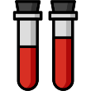



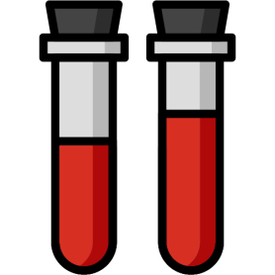
FinDonor 10000 (2580 blood donors)
First FD
event
FD
event
non-FD
donation
FD
event
FD
event
Lobier 2019 Vox Sanquinis
05.2015
12.2017
Health and lifestyle
questionnaire II
Health and lifestyle
questionnaire I
Blood count
Ferritin
sTfR
CRP
Pirkko Mattila
Pia Niittymäki
Antti Larjo

Slide 6
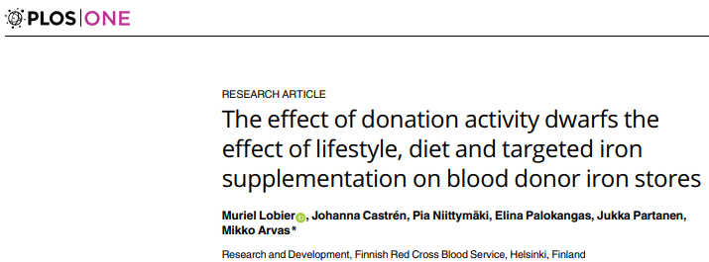

Muriel Lobier
2019
1. The importance of donation activity on iron stores

Slide 7
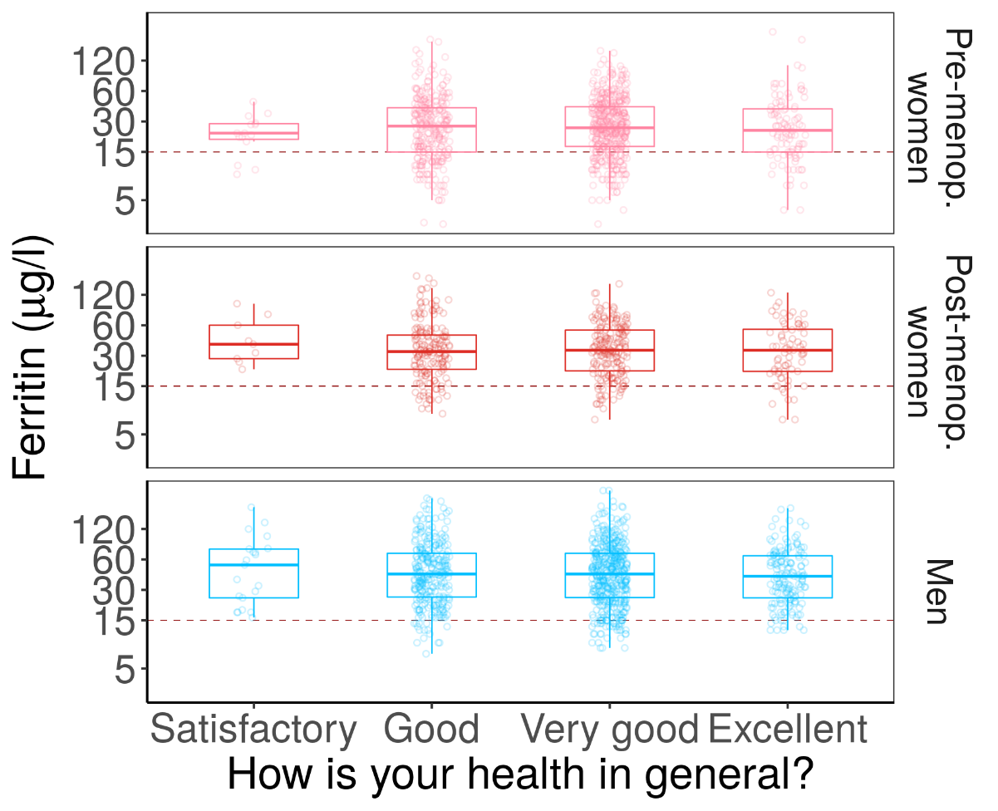
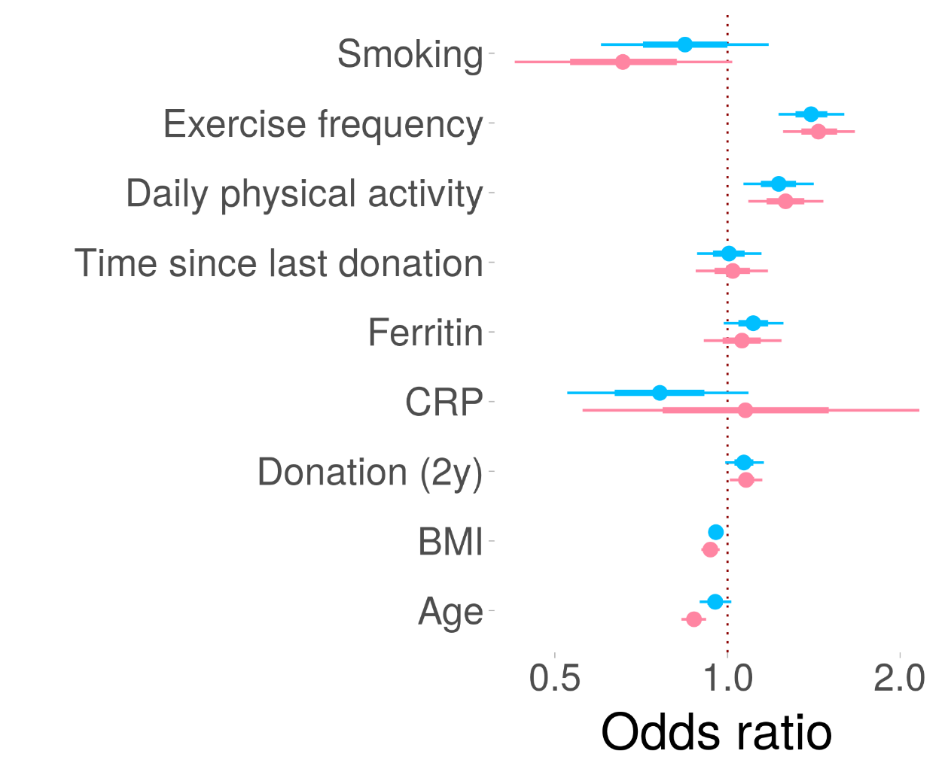
2. No association with ferritin and self estimated health
Muriel Lobier

Slide 8
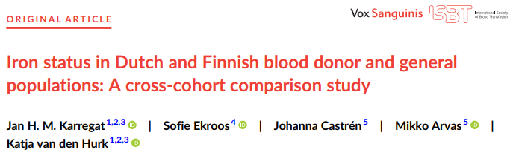

Slide 9
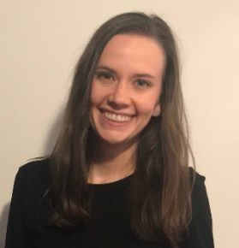
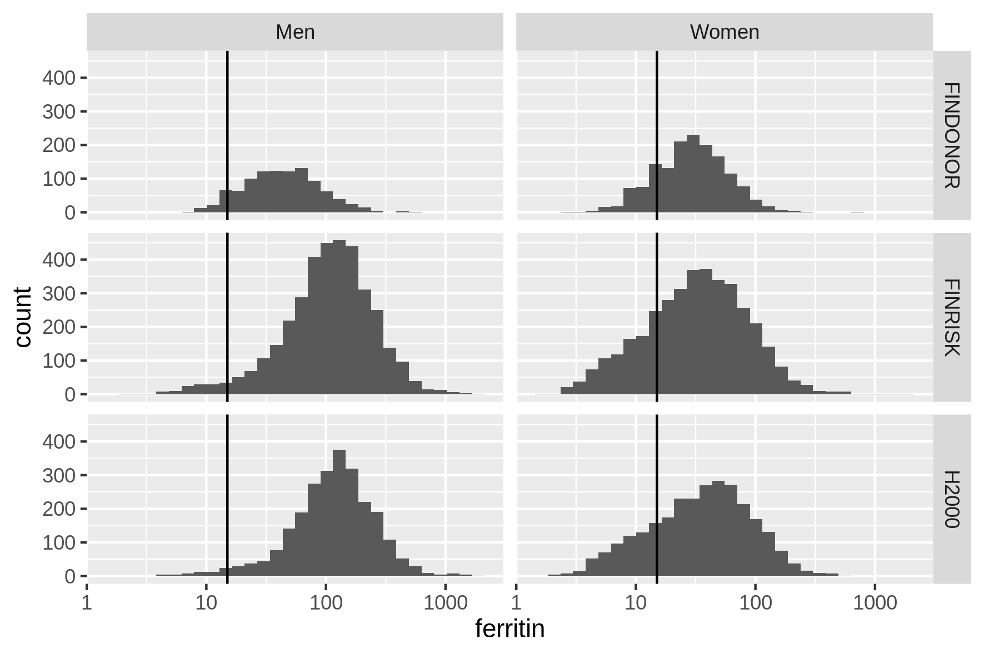
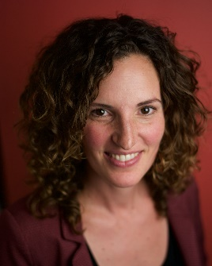

Ferritin levels - blood donors vs. general population?
Overall Finnish regular blood donors have lower median ferritin levels than general population.
https://github.com/FRCBS/iron_measurement_comparisons
Karregat & al 2024
Sofie Ekroos
Katja van den Hurk
Jan Karregat

Slide 10
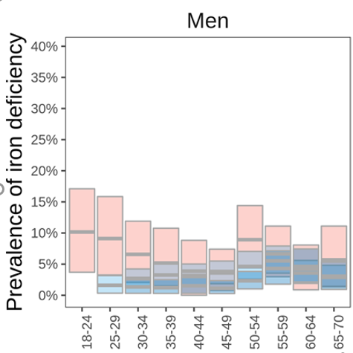
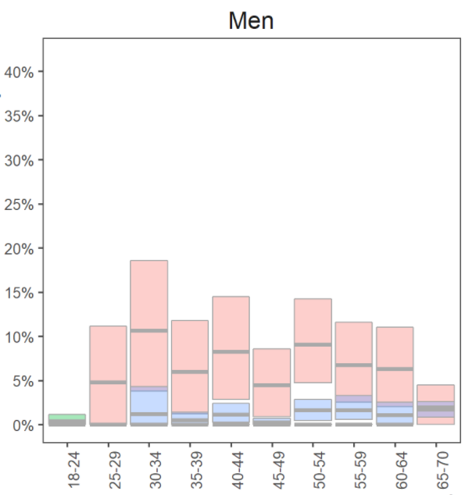
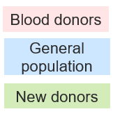


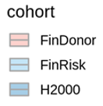

Proportion of ID individuals - blood donors vs general population? (WHO definition 15 μg/L)
Finnish male <30 and Dutch male >30 donors more iron deficient than general population…
Notes:
Suomi: ID prevalenssi luovuttajilla ja normaaliväestöllä menee päällekkäin, paitsi nuorissa miehisä. Miksi? Ei kuukautisia tai muuta selitystä
Hollanti: normaaliväestön ID prevalenssi kauttaaltaan pienempi verrattuna luovuttajiin, tämä ei näy left tailsissä (huom ei ole <30v)

Slide 11
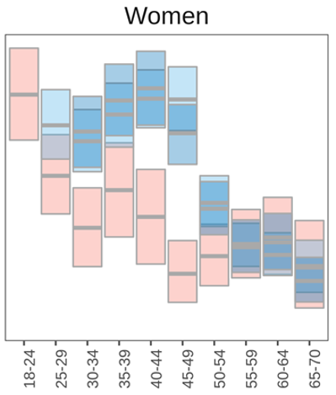
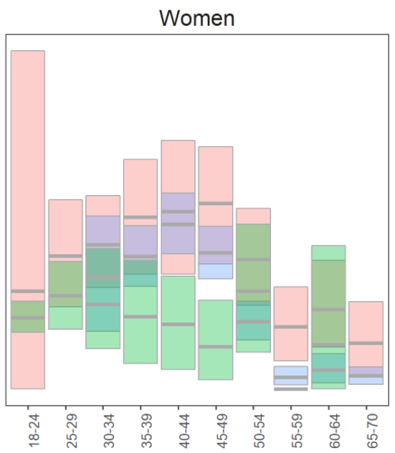

How do iron stores of blood donors compare to the general population?
…although median ferritin is lower in premenopausal Finnish female blood donors than in the general population, iron deficiency is more prevalent in the general population compared to donors!
Notes:
Suomi: verenluovuttajien ID prevalenssi paljon pienempi premenopausaalisissa naisissa
Hollanti: nuoret liian pieni ryhmä, muuten molemmat seuraavat toisiaan paitsi uudet luovuttajat. Verenluovuttajissa joko enemmän tai yhtä paljon raudpuutetta verrattuna normaaliväestöön. Menopaussi erottuu, mutta ei niin selkeästi. Vanhemmissa selkeämpi ero (uusia luov liian vähän 60-vuotiaissa)

Slide 12
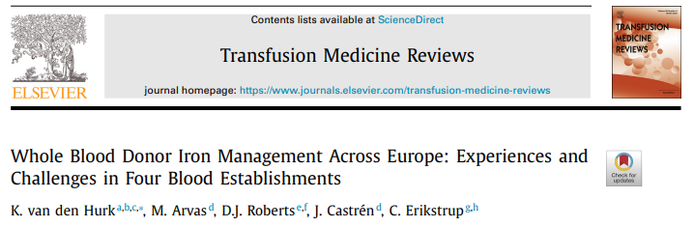

Slide 13
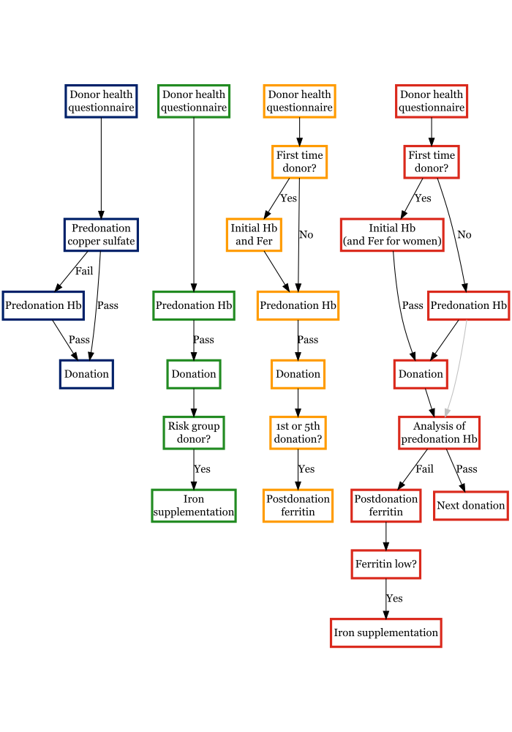
Policy & Hb deferral comparision of four European countries
England
Finland
Netherlands
Denmark
Data collected 2021:
National Health Service - Blood and Transplant (NHSBT, England)
Finnish Red Cross Blood Service (FRBCS, Finland)
Sanquin (the Netherlands)
Central Denmark Region (Denmark)

Slide 14
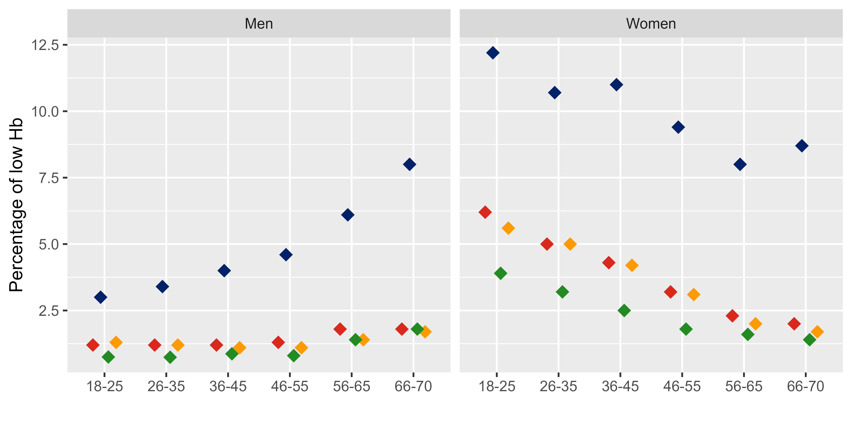
Hb – deferral rates of Finnish blood donors compare well to other European countries
Hb – deferral rates of repeat blood donors in Finland (♦) and 3 other comparable European countries in year 2021
Age in years
Age in years
https://github.com/FRCBS/IronManagementPolicyComparison
Hurk & al 2024

Slide 15
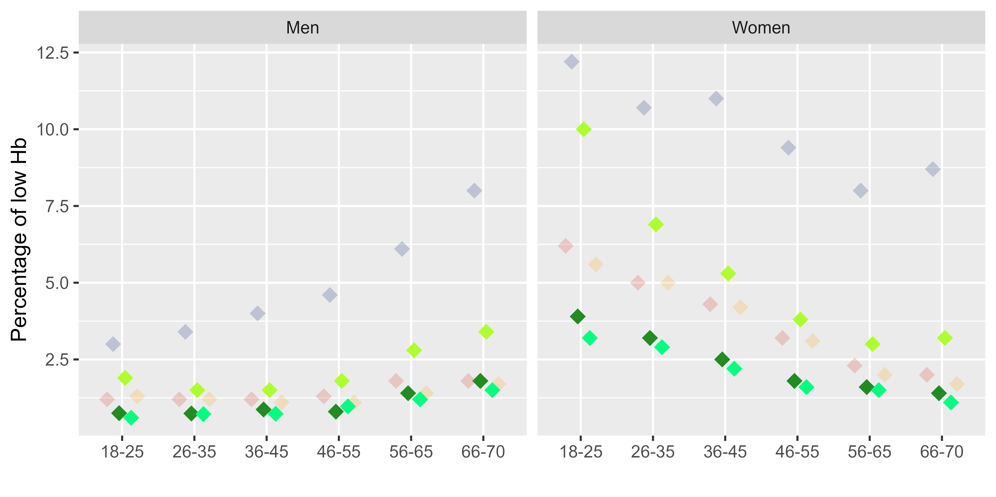
Hb – deferral rates of Finnish blood donors -> Impact of FinDonor study
2015
Unpublished work!
Unpublished work!
2021
2023
Age in years
Age in years

Slide 16
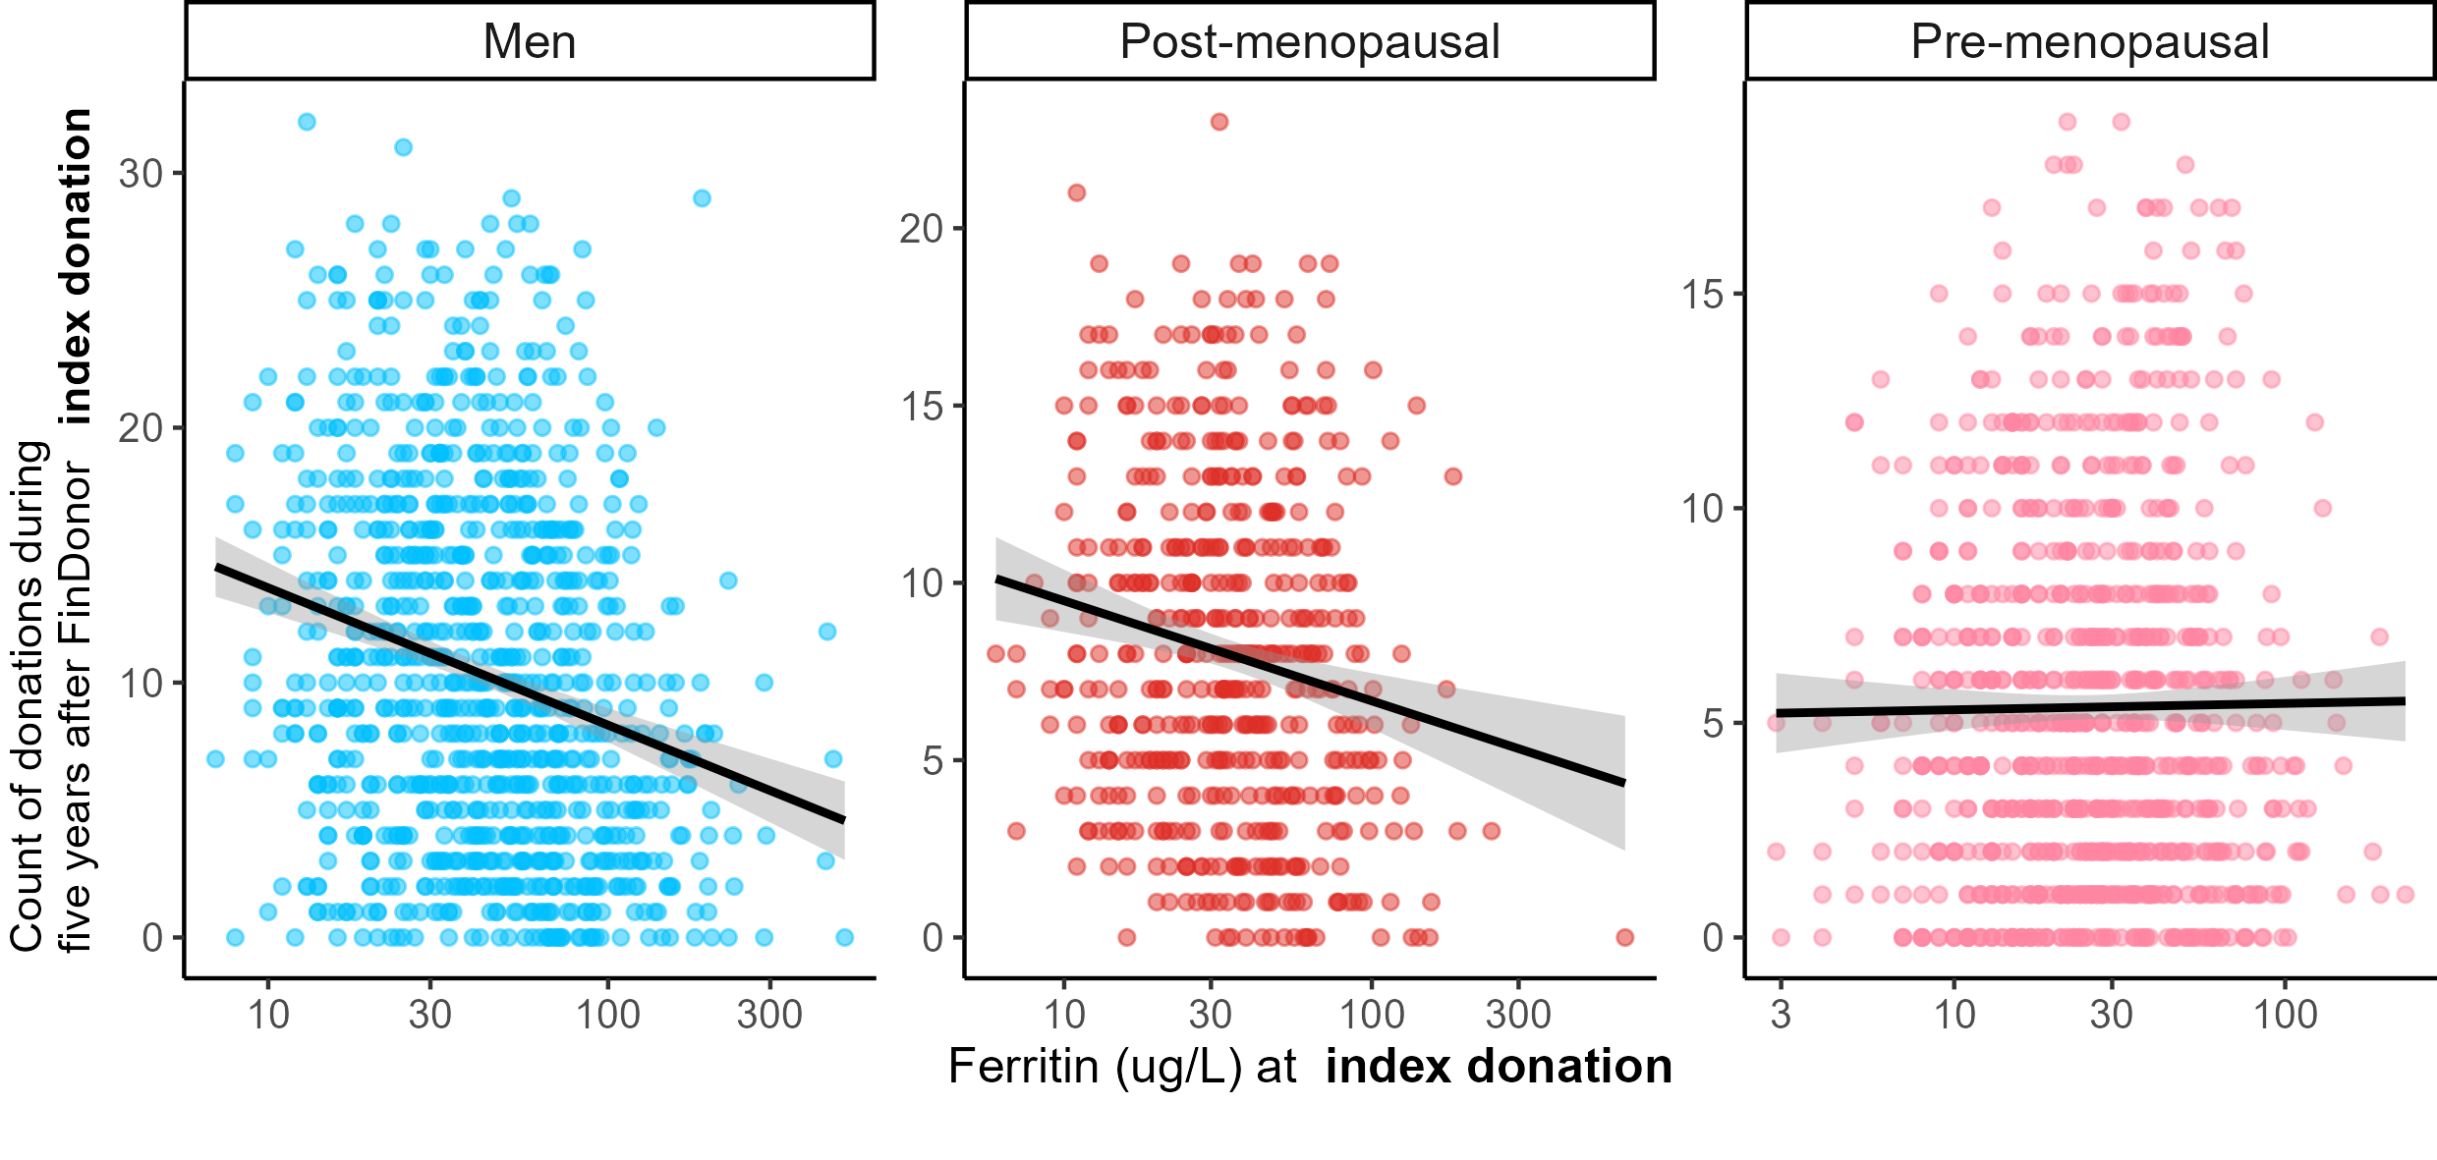
Ferritin is very hard to interpret in a healthy person
Unpublished work!
Unpublished work!
Notes:
In FinDonor enrollment data we found no association between self-estimated health and ferritin levels. To explore if ferritin at enrollment donation of FinDonor affected subsequent donation behavior we counted whole blood donations in the following five years. Median annual count of donations was 0.8 for premenopausal, 1.6 for post-menopausal and 1.8 for men, including the 4 % of donors with no donations after enrollment. We found a negative correlation between enrollment ferritin and count of following blood donations among men ( -0.3 - -0.2 95 % CI) and postmenopausal women (-0.3 - -0.1 95 % CI) and no correlation among pre-menopausal women. Meaning that the lower a person’s ferritin in enrollment was, the more they donated afterwards. Donation activity is the most important factor explaining ferritin variation in FinDonor enrollment data, which explains this seemingly paradoxical result.

Slide 17
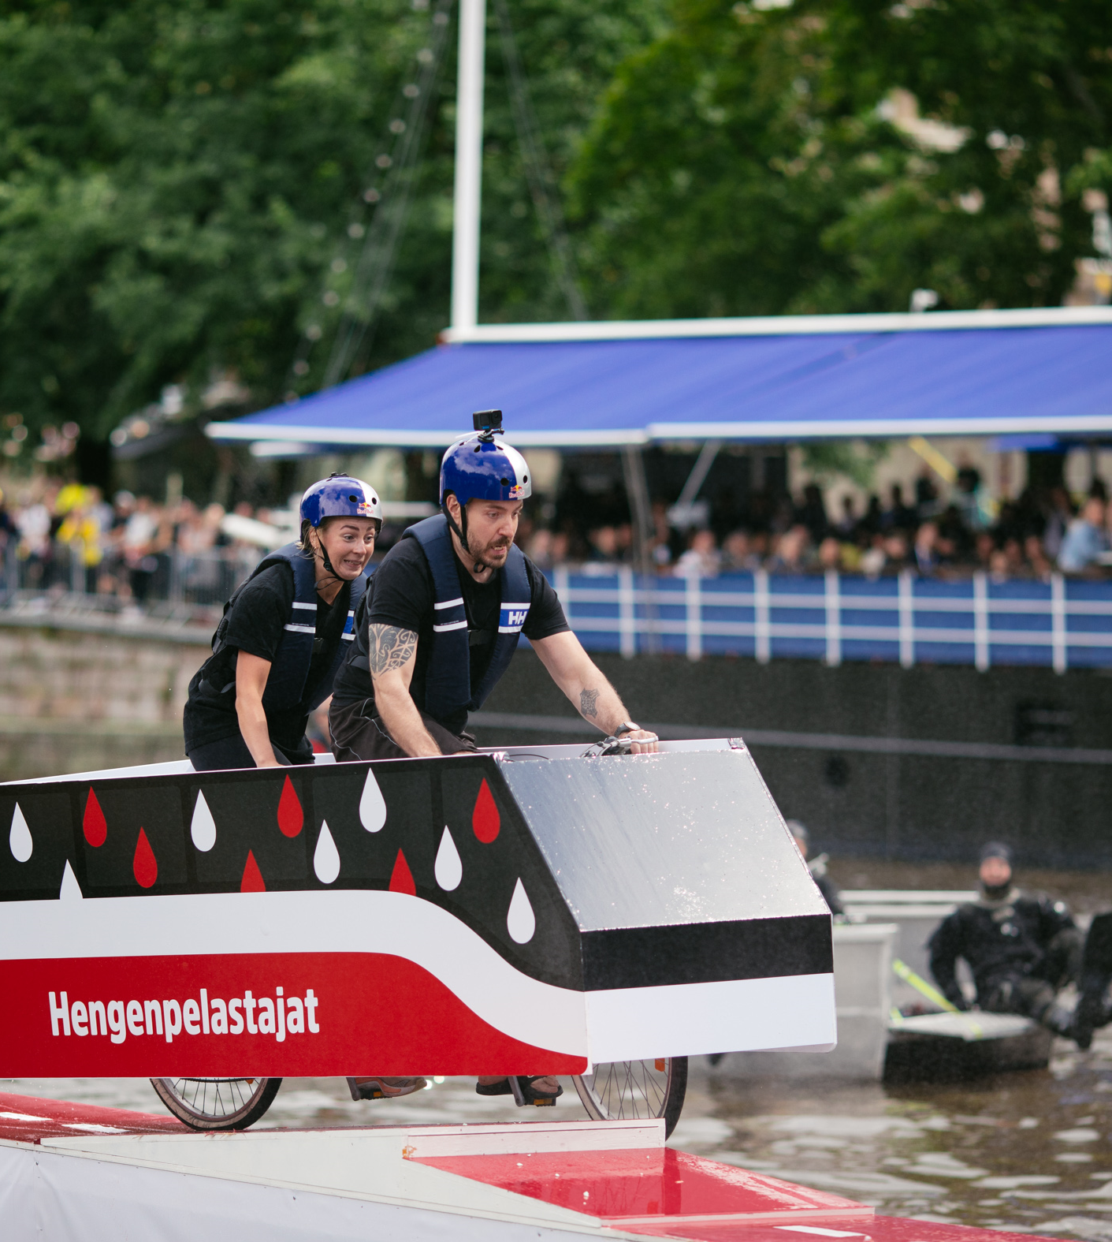
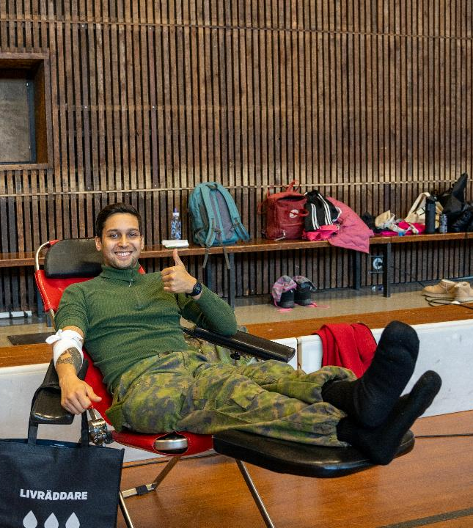
Summary
In FinDonor study of active blood donors (2015 – 2017) we found that:
There is no association between self-estimated health and ferritin, as has been shown previously in literature
20 % of premenopausal women had ferritin <15 μg/L
33 % of women age 18-25 had ferritin <15 μg/L
► We started to recommended that women of age 18-25 donate only once a year
► For women age 18-25 we moved from 20 x 50 mg to 40 x 50 mg iron supplementation
When comparing FinDonor population to general population:
General population has the same or higher prevalence of iron deficiency
Hb deferral rate in Finland is by international standards very low
Can be assumed that our practises protect iron stores of Finnish blood donors well

Slide 18
Thank you mikko.arvas@bloodservice.fi johanna.castren@bloodservice.fi

