Slide 1

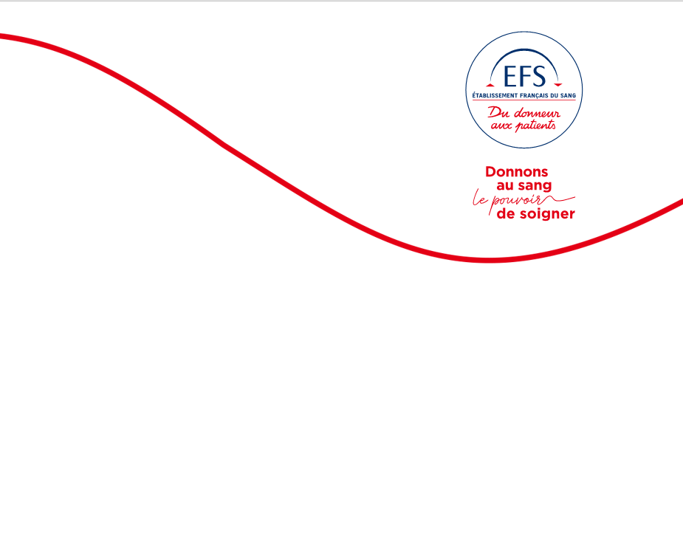


Impact of ferritin-guided donation interval policies in the Netherlands and France
L. MALARD, A. MEULENBELD, E. POUCHOL, M. JANSSEN, S. LAPERCHE, J.B. THIBERT, K. VAN DEN HURK

Slide 2
No conflict of interest to declare

Slide 3

In memory of Mart

Slide 4
Context
The Netherlands and France have introduced a ferritin-guided donation interval policy to reduce iron deficiency (ID)
How do ferritin levels, low Hb, deferral rates and donor return rates compare in both settings?
Compare Hb levels of whole population, not only those subject to ferritin measurements
Compare the extended donation intervals (France has much shorter intervals than the NL, are these too short, or are the Dutch ones too long?)

Slide 5
Method (1/2): Implemented strategies
In NL, ferritin measured at the first donation and every 5th donation
In France, ferritin measured for every donor belonging to one of four pre-defined at-risk groups based on gender, age, donation interval, previous Hb and MCH
Donors with ID (ferritin <15 ng/mL) deferred for 12 months in NL and 6 months in France
Donors with low ferritin (15-30 ng/mL) deferred for 6 months only in NL

Slide 6
Method (2/2)
Two datasets for baseline characteristics:
Measurement week 0 of the FIND’EM study in NL (1)
Data from the FERRIDON study in France (2)
To study the impact of the implementation:
Inclusion of all whole blood donations in a set period after implementation
Assessment of ID detected rates, low ferritin and low Hb rates, post-deferral return rates and ferritin levels

Slide 7
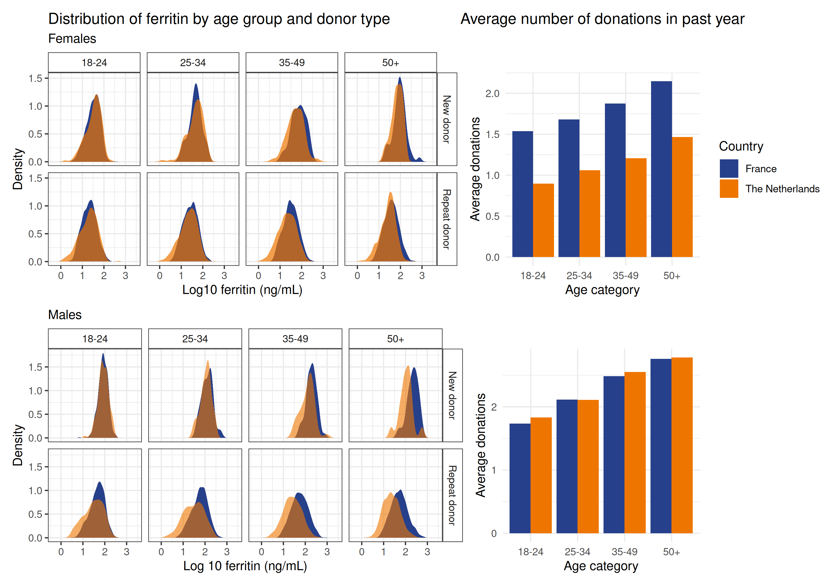
Results (1/6) Before the policy implementation:
Ferritin distribution
Ferritin distribution similar in NL and in France with repeat donors having lower ferritin values especially for females and more pronounced with older age

Slide 8
Results (2/6) Before the policy implementation: Deferral rates
Prevalence of ID similar for women in NL and France (24.2% vs 20.5%)
Higher prevalence among Dutch males than French males (25.0% vs 7.0%)
Higher prevalence of anemia in France than in NL for women (12.2% vs 6.5%) and for men (4.4% vs 3.1%)
 | The Netherlands (FIND’EM - measurement week 0) |  | France (FERRIDON)
 | Female | Male | Female | Male
Number of measurements | 4,520 | 4,660 | 4,678 | 5,031
Hb deferral (%) | 146 (6.5) | 293 (3.1) | 183 (3.9) | 44 (0.9)
Low Hb (European thresholds)*(%) | 146 (6.5) | 293 (3.1) | 572 (12.2) | 221 (4.4)
ID (ferritin < 15) (%) | 1,092 (24.2) | 1,167 (25.0) | 961 (20.5) | 354 (7.0)
Low ferritin (ferritin 15-30) (%) | 967 (21.4) | 990 (21.2) | 1,280 (27.4) | 832 (16.5)
*In France, the limit for Hb deferral is 12.0 and 13.0 g/dL for females and males, respectively, while the European limit for low Hb is 12.5 and 13.5 g/dL for females and males, respectively. In the Netherlands, the European thresholds for Hb deferral are used.

Slide 9
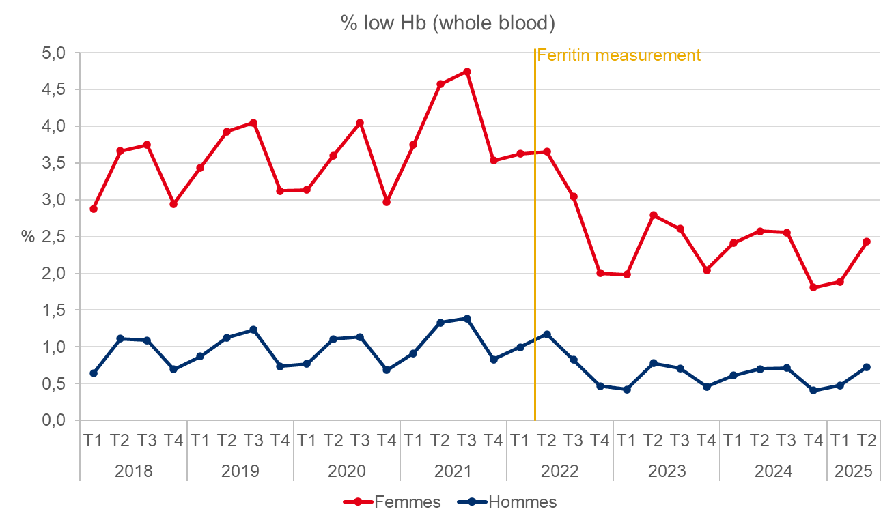
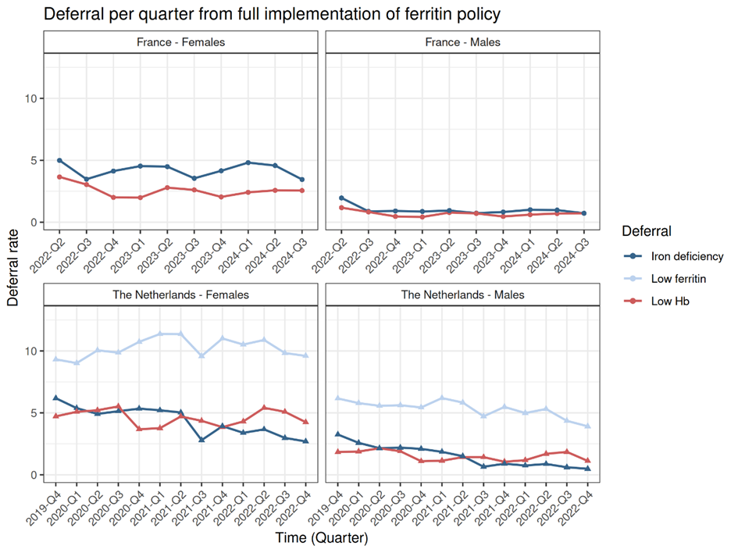
Results (3/6) After the policy implementation: Deferral
Slight decrease in the prevalence of low Hb deferral especially among men in both countries
(n.s)
(n.s)
(n.s)
(n.s)
(n.s)
(n.s)
(n.s)
p(<0.001)
(n.s)
p(<0.001)

Slide 10
Results (3/6) After the policy implementation: Deferral
Slight decrease in the prevalence of low Hb deferral especially among men in both countries
Decrease over time of the prevalence of ID deferrals in NL for both sexes as well as the low ferritin deferrals among men
Fluctuations over time of the prevalence of ID and low Hb but no downward trend in France
(n.s)
(n.s)
(n.s)
(n.s)
(n.s)
(n.s)
(n.s)
p(<0.001)
(n.s)
p(<0.001)

Slide 11
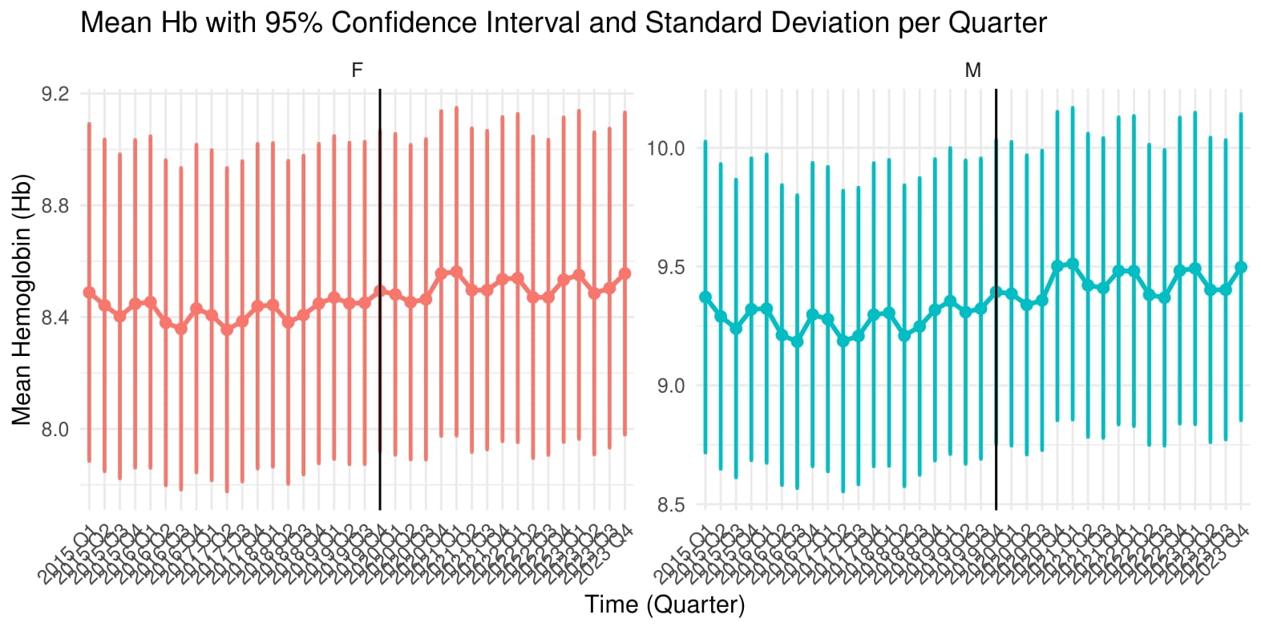
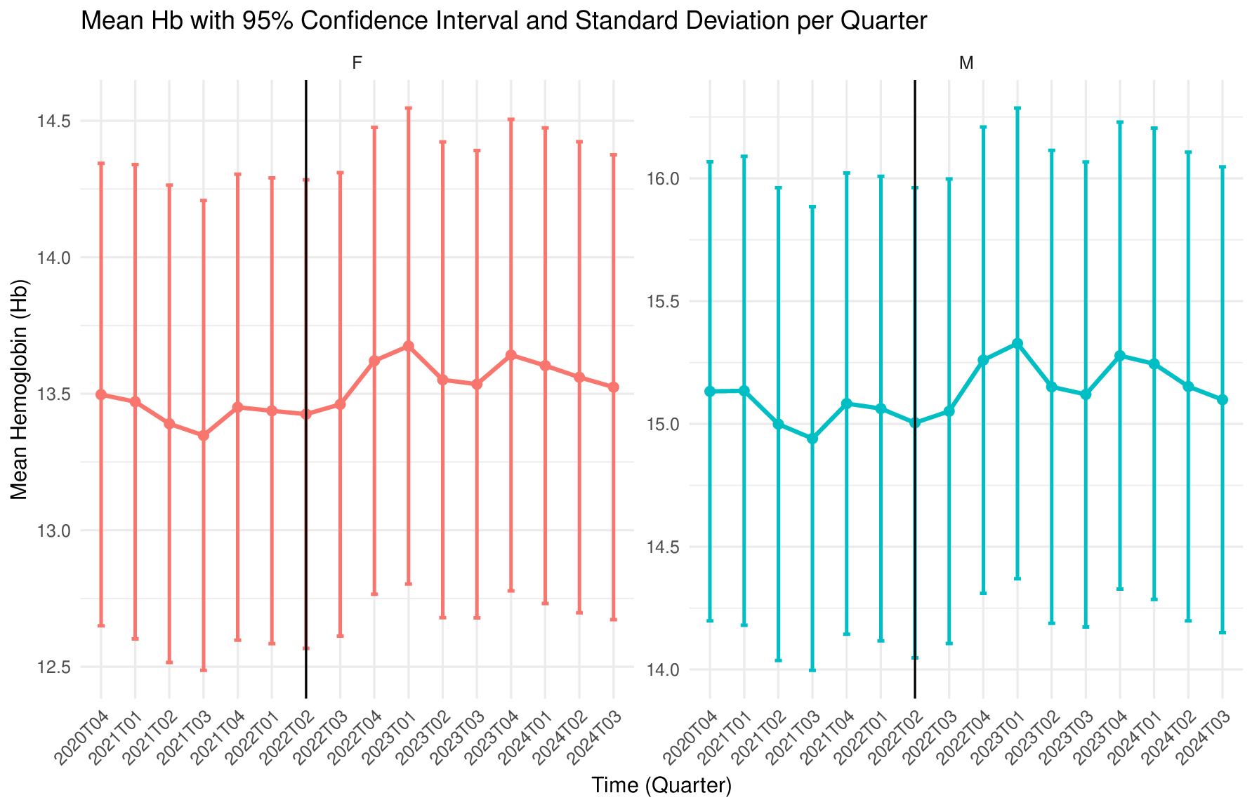
Results (4 /6) After the policy implementation:
Hb levels over time
Sanquin
Population: all donations before & after implementation of the policies
EFS

Slide 12
Results (5 /6) After the policy implementation: Deferral
 | The Netherlands |  | France
 | Female | Male | Female | Male
Dates | From 01-11-2019 to 01-01-2023 |  | From 01-04-2022 to 30-09-2024
Number of donations | 863,834 | 745,365 | 2,697,376 | 2,843,836
Number of ferritin measurements (%) | 317,102 (36.7) | 224,058 (30.1) | 688,991 (25.5) | 379,771 (13.4)
Hb deferrals (%) | 44,070 (5.1) | 12,585 (1.7) | 69,302 (2.6) | 19,419 (0.7)
Low Hb (European thresholds)* (%) | 44,070 (5.1) | 12,585 (1.7) | 256,009 (9.5) | 90,313 (3.2)
ID deferrals (ferritin < 15) (%)⁺ | 41,555 (4.8) | 11,642 (1.6) | 113,832 (4.2) | 27,977 (1.0)
Low ferritin deferrals (ferritin 15-30) (%)⁺ | 98,122 (11.3) | 43,620 (5.9) | NA | NA
Median ferritin at deferral [IQR]
ID deferral | 11.0 [8.0 – 13.0] | 11 [9 – 13] | 11.7 [9.7 – 13.4] | 12.9 [11.3 – 14.0]
Low ferritin deferral | 22 [18 – 26] | 23 [19 – 26] | NA | NA
Median Hb at deferral [IQR] | 12.0 [11.7 – 12.1] | 12.9 [12.6 – 13.1] | 11.7 [11.5 – 11.9] | 12.7 [12.5 – 12.9]
*In France, the limit for Hb deferral is 12.0 and 13.0 g/dL for females and males, respectively, while the European limit for low Hb is 12.5 and 13.5 g/dL for females and males, respectively. In the Netherlands, the European thresholds for Hb deferral are used. ⁺Proportions are based on total number of donations.
Despite differences in prevention strategies, similar proportions of detected ID: 4.8% in NL and 4.2% in France among women and 1.6% in NL and 1% in France among men
Deferral rates for low ferritin (the Netherlands only), ID, and low Hb in whole blood donors after implementation of ferritin-guided donation interval policies

Slide 13
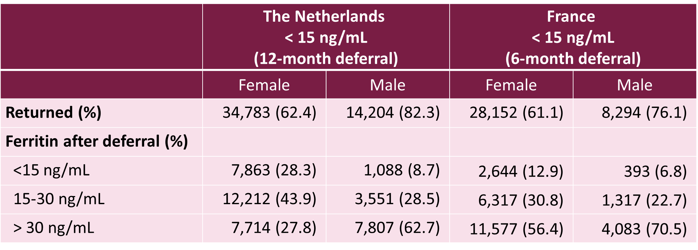
Results (6/6) After the policy implementation:
Donor return
Although the duration of the deferral was twice as long in NL:
Similar proportion of donors returning to donation
Higher percentage of donors with ID at return donation in NL than in France, especially for women
Similarly, higher proportion of donors returning for donation with ferritin ≥ 30 ng/mL in France than in NL

Slide 14
Discussion
Although different policies were implemented in NL and in France:
Similar proportions of ID and mean Hb level improvements in donors detected
Return rates after deferral were also comparable for donors deferred for ID
Unexpected higher rate of ID among donors deferred for 12 months compared with donors deferred for 6 months requires further investigations (“GP” effect in France? + pre-donation Hb in France before ferritin tests)
Risk-group-based strategy in France does not allow to identify donors with ID outside these groups, unlike the Dutch strategy
Comparison of ferritin levels between the two countries needs to be cautiously interpreted (lack of standardization)
Both approaches led to a reduction in iron deficiency prevalence and low Hb deferrals, confirming that a ferritin-guided policy is effective, even in different operational contexts.

Slide 15
Thank you
CONTACT
Jean-Baptiste THIBERT
jean-baptiste.thibert@efs.sante.fr
  + 33 (0)6 80 88 35 73

