Slide 1
Sri Lanka Statistical Business Register (SLSBR)
Over view
Current status
Challenges
Way forward…

Slide 2
Current status of the SBR :
SLSBR was established in 2015
Developed based on the data obtained at the listing stage of the Economic Census 2013
SLSIC is used to identify the economic activity (constructed based on ISIC Rev. 4)
All entities except micro businesses (employment <4) are included--158,000 records
Micro sector accounts for almost 90% of total businesses
Main purpose:
Sampling frames for annual surveys & other ad-hoc surveys
Production of other statistics is not currently done

Slide 3
Current status :
Not officially launched
Hosted in the DCS Server
Not linked to administrative sources & data from the administrative sources are uploaded or entered into the system
Unique identification number is available only for the businesses registered at the Department of Registrar of Companies (DRoC)
No unique ID number available for companies registered at provisional offices as different formats are followed.

Slide 4
Current status :
Variables included
Identification & contact variables
Name of the establishment/owner
Postal address
Telephone number
Stratification variables
Main economic activity (SLSIC code)
Number of persons engaged
Geographical location
(District, Divisional Secretariat division)
Other
legal status(if available)

Slide 5
Updating mechanism :
Business registration system in the country
All incorporated entities are registered at the Department of Registrar of companies (DRoC)
Unique identification number available (shared with the tax authority)
Reports to DRoC annually
Not mandatory to declare the business activity upon registration
Sole ownership and partnership businesses are registered at the divisional Secretariats – 332
Each district has it’s own system of registrations
Unique ID not available
All provisional business registers are not digitized yet.

Slide 6
Updating mechanism (continued…)
Feedback from Annual, quarterly and Monthly surveys of DCS
Administrative Data Sources
Data sources used
Department of Registrar of companies (DRoC)
Local government authority License Register MC/UC/Rural councils
Tourism Development Authority
Web Scraping
Business associations (Ex: Apparel manufacturers association, Association of IT services providers,……)
Potential data sources
Department of Inland Revenue (Tax Register)
Central Bank EPF Division (Social Security Register)
Ministry of Industrial Development
Board of Investment
………….?

Slide 7
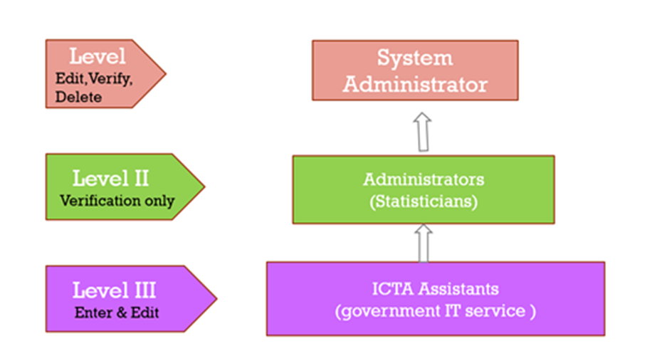
Operational structure :
Developed by the ICT division of the DCS
Designed at three levels ( based on the functional duties of the officers, control they have over the SBR and Level of access to data)
Matching program facilitates matching of units without unique IDs at a specified accuracy level prior to verification.

Slide 8
Challenges :
Issues in accessing administrative data & data sharing
Acts of various Departments and Authorities
Department of Inland Revenue
Inland Revenue Act
Introduction of a unique system to issue business ID numbers
Confidentiality of Data & risk of data sharing
Digitizing registries at provisional registration offices

Slide 9
Thank You!

