Slide 1
Generating Self-Compassion in Emotion-Focused Therapy
Laco Timulak

Slide 2
Several contexts in which Self-Compassion is generated in EFT
Symptom Level
  When C is overwhelmed (soothing global distress)
  When in symptom level process (self-interruption, self-worrying, self-compulsing) C sees the impact/cost of the protective process
Core Pain Transformation Level
  In self-critic dialogues
  In unfinished business dialogue

Slide 3
Symptom Level – Generating Self-Compassion

Slide 4
Soothing Global Distress through use of an Imaginary Dialogue
Marker: C overwhelmed, dysregulated, high arousal low differentiation

Slide 5
C asked to nominate a person that has, or has had in the past, a soothing presence that they could draw on when in need of calming and soothing
Cs often nominate persons who are no longer alive, e.g., a cherished parent or grandparent

Slide 6
when you feel all this upset here, now, who comes to mind who would have a calming presence, or who would be good to have around when you are so upset?

Slide 7
After C nominates a person T invites the client to move to the other chair and enact that person,
to look at themselves in the other chair and express what that other person would do or say if she or he saw them so upset:

Slide 8
come here… be your grandmother, what would she say if she saw you so upset, what would she say now? What does she feel towards you? Convey her presence.

Slide 9
As C enacts that caring person, T asks them to pay attention inwardly to how it is to convey that caring presence.

Slide 10
T then asks C to move back to the self’s chair and notice how it is to receive that calming presence.
T may say:
  So she is saying that everything will be alright, that she is here with you, that she feels very loving and caring towards you. How is it to get it? How is it to hear it? How is it to be a recipient of it?

Slide 11
As C expresses the impact, T encourages C to express what it feels like to the caring other
  e.g., the client says: I feel soothed; the therapist says: you feel so soothed, so tell her ‘it is so soothing to receive this from you’).
Attending to, acknowledging and expressing the sense of being soothed and calmed allows C to bathe in the feeling thus consolidating the experience.

Slide 12
An example
Les Greenberg in his work with ‘Marcy’ in video Emotion-Focused Therapy over Time (American Psychological Association, 2007),
where he invites the client to enact the presence of her father who had a calming effect on her when he was still alive.

Slide 13
Self-Compassion in symptom level process (self-interruption, self-worrying, self-compulsing)

Slide 14
Dealing with Varied Symptoms (examples)
Only if the symptoms central to the process and cannot be bypassed or are entrenched that they live life on their own
Working with interruption in the chairs (self-interruption, behavioural interruption)
Worry dialogues (GAD and SAD symptoms)
Worry dialogues + phobic object (PD, PTSD, and SF symptoms)
Worry dialogues + phobic object + compulsion (OCD)
Rumination dialogues (MDD symptoms)

Slide 15
Experiencer chair Worrier chair
Worrier dialogue
1. Marker – worrying, exhaustion
2. Enactment of worrying – experiential quality
3. Accessing and differentiating anxiety and tiredness
4. Articulating and expressing need for freedom, for less limited time
5. Probing for compassion – seeing the pain and unmet need (highlighting function of worry
If no compassion coming – go with the increased worry (unable to control)
If compassion is coming – savor it experientially and express it
6a. Building protective anger, set boundary to the worry
6b. Letting compassion in – savoring it

Slide 16
Worrier dialogue
Experiencer chair
Worrier chair
1. Marker – Something bad is going to happen to my children
2. Worry yourself– Something bad is going to happen
3. What happen inside when you get this? – exhaustion, anxiety, pain of loosing them
4. What do you need when you are exposed to such a worry? Break
5. What do you feel towards the exhausted part of self?
More worrying (Then what drives this worrying?)
Caring, compassionate feeling
6a. What do you do in the face of this worrying? Stand up to it
6b. Can you let that caring feelings in? How does it feel? Relieving

Slide 17
Reflection & home assignment – worry dialogue
Parts enacted in the Experiencer Chair
Parts enacted in the
Worrier Chair
How do I worry myself?
What drives my worries?
What impact the worrying has?
What do I need in the face of the worry?
What do I feel towards the impacted part of me?
How can I face the worry?

Slide 18
Experiencer chair Interrupter chair
Self-Interrupter dialogue
1. Marker – obstruction
2. Enactment of interruption (highlighting its function)
3. Accessing and differentiating the impact of interruption - tension
4. Articulating and expressing need for emotional experience and expression
5. Probing for compassion – seeing the impact/cost of the interruption (highlighting the protective function of interruption)
If no compassion coming – go with the increased interruption/tensing/suppression
If compassion is coming – facilitating resolve to let go of protection
6a. Building protective anger, setting boundary to the interrupter – expression 6b. Letting compassion in – savouring it experientially – going ahead with expr.

Slide 20
Symptom level task difficulties often center on client inability to let go of the process (e.g., self-worry) that brings the emotional toll/cost (e.g., anxiety).
Validating the function of this process, whilst simultaneously bringing to the fore the experienced emotional toll (cost), constitutes a dialectical process central to this type of work.
Softening on behalf of the part of the self that causes symptoms (e.g., Worrier, Obsessor) typically only comes about as a consequence of experiencing the cost of this treatment

Slide 21
softening is frequently brought about not only by witnessing the suffering wrought on the self, but also by the expression of boundary setting protective anger from the experiencing self
Well-developed awareness of these processes provides a holding that can help the client reconcile these types of dialectical-emotional processes (protection vs. cost – self-worrying vs. the anxiety it brings).

Slide 22
Core Pain Transformation Level
  In self-critic dialogues
  In unfinished business dialogue

Slide 23
Triggers - other
Behavioural avoidance
GLOBAL DISTRESS –
Secondary emotions
Problematic self-treatment
Anxiety /apprehension
Emotional avoidance
CORE EMOTIONAL PAIN
Loneliness Shame Fear/Terror
UNMET NEEDS
To be loved (connected
To be accepted
To be safe
COMPASSION
PROTECTIVE ANGER
Grieving, letting go
Relief
Agency, empowerment

Slide 24
Two chair critic dialogue
Experiencer chair
Critic chair
1. Marker – self-contempt, negative self-treatment present
2. Enactment of criticism – harsh, poignant, main message, experiential quality
3. Accessing and differentiating core pain – loneliness, shame, primary fear
4. Articulating and expressing unmet need
5. Probing for compassion – seeing the pain and unmet need
A) (If no compassion coming – highlighting rejection (message and mistreatment in it, function of it)
B) If compassion is coming – savor it experientially and expressing it
6a) Building protective anger, setting boundary
6b) Letting compassion in – savoring it

Slide 25
Two chair critic dialogue
Experiencer chair
Critic chair
1. Marker – You are a bad mother
2. Enactment – You are a bad mother
3. What happens inside? - I feel flawed.
4. What do you need when you are criticized like this? – A break
5. Probing for compassion – Can you see her pain?
If no – criticize her further and what drives this criticism
If yes, express it – I care
6a. What’s your response if she keeps doing this? – I’ll fight you
6b. How does it feel to be cared about? - Brings relief

Slide 26
Reflection & home assignment – two chair critic dialogue
Parts enacted in the Experiencer Chair
Parts enacted in the
Critic Chair
How do I criticize (attack) myself?
What drives my criticism?
How do I feel when I am being criticized (treated badly)?
What do I need in the face of the criticism?
What do I feel towards the hurt, shamed, put down, vulnerable part of me?
How can I face the critic?

Slide 27
Empty chair dialogue
Experiencer chair
Other chair
1. Marker – unfinished business, hurt
2. Expressing pain, unfinished hurt and anger
2. Enactment of negative other – harsh, hurtful other, getting core message from them
3. Accessing and differentiating core pain – loneliness, shame, primary fear, perhaps protective anger if comes
4. Articulating and expressing unmet need
5. Probing for compassion – seeing the pain and unmet need
A) If no compassion coming – highlighting rejection (message and mistreatment in it, function of it)
B) If compassion is coming – savor it experientially and expressing it
6a) Building protective anger, setting boundary
6b) Letting compassion in – savoring it

Slide 28
Empty chair dialogue
Experiencer chair
Other chair
1. Marker – She never loved me and always disapproved
2. You never loved me and always disapproved
2. Enactment of harsh other – I do not love you, I disapprove
3. Core pain – I feel sad, unloved, ashamed and unlovable
4. Unmet need – I so much need(ed) you to love me
5. Probing for compassion –
A) I am unable to love you (because I am unhappy and depressed myself)
B) If compassion is coming – I do love you
6a) Protective anger – I do deserve to be loved, I am worthy
6b) savoring it – I love you too, I always missed you.

Slide 29
Reflection & home assignment – empty chair dialogue
Parts enacted in the Experiencer Chair
Parts enacted in the
Other Chair
What was hurtful in the other’s behaviour?
What was the implied message?
How do I feel when I am being treated like this?
What do I need(ed) when I am treated like this?
What do I feel towards the hurt, shamed, put down, vulnerable part of me?
How can I protect myself when I am treated in a way that hurts?

Slide 30
it is in these tasks that we hope C will not only access core painful feelings and the unmet needs associated with them, but will also transform those core painful feelings through generating self-compassion and healthy boundary setting protective anger.

Slide 31
It is also often in the context of these tasks that the therapist through his or her relational presence and communication, most powerfully offers compassionate responses towards C’s pain and affirmative validation of C’s needs.

Slide 32
it will be the freshness of the felt and expressed pain that later in the dialogue has the potential to elicit compassion (see stage 5B)

Slide 33
In the Self-Critic Dialogue
Probing for Compassion Stage.
Once C accesses and expresses the core painful feelings linked to the criticism and articulates what he or she needs from the Critic,
T asks C to move back to the Critic chair, where he or she invites C, as Critic, to see what their response is to the pain and need as expressed by the vulnerable self

Slide 34
Therapist: So, if you could come back here [pointing to the Critic chair]. So, she is saying [pointing to the Experiencer chair]. I am aching, I feel so, so worthless. And she is so distressed. She is saying I need you to be gentler with me. What is your response to that? Can you see her pain? What do you feel towards her, here-and-now, as she is expressing this to you?

Slide 35
If there is no softening in the Critic and thus no expression of compassion towards the self in the Experiencer chair at this stage, T acknowledges this and asks C to express where they are in terms of self-treatment (e.g., So you are saying I do not see your pain. So tell her: I don’t see your pain, I feel cold towards you; stage 5A).
This further escalation in the Critic will be used in stage 6A (below) as a challenge for the Experiencer to stand up to the Critic and set a boundary to him/her.

Slide 36
T is also enquiring after the function of the criticism/escalation
often when C expresses a rigidly harsh and invalidating position, highlighting the function of that harshness points to implicitly self-protective (and thus inherently compassionate) aspects of the self-treatment.

Slide 37
Where the Critic softens and expresses compassion (e.g., I see your pain and I care about you, I will try to be gentler with you),
T asks C to move back to the Experiencer chair and see how it is to receive this compassion: Come back here [the Experiencer chair]. How is it to hear it: I care about you? How does it feel inside? Can you let it in?

Slide 38
C may not want to trust that the compassion is genuine for fear that in their naivety, they would only get even more hurt the next time (e.g., I don’t trust you, you will come and attack me again).

Slide 39
block to letting in compassion, it is important that is explored, named, and expressed by C
T validates it and asks C still to try how it is to receive such compassion

Slide 40
Therapist: Come back here [to the Experiencer chair]. How is it to hear it: ‘I care about you?’ How does it feel inside? Can you let it in?
Client: I don’t know whether I can trust her… that she wouldn’t attack me again.
Therapist: OK, so it is ‘I cannot trust you’. Can you tell her that?
Client: I cannot trust you. You will come and attack me again.

Slide 41
Therapist: Ok so it is like: ‘I cannot trust’… But how is it when she says this… here-and-now. How does it feel to hear it here?
Client: It feels nice.
Therapist: Ok, so tell her, ‘it feels nice, but I have to be cautious with you’.
Client: It feels nice.

Slide 42
Self-compassion is most fully felt when both its offering (stage 5B) and reception (6B) are experienced and expressed.

Slide 43
Self-Compassion in the context of UFB

Slide 44
Once C has accessed the freshly felt pain and expressed both this pain and the need implicit in the pain to the other, T asks C to move back to the Other chair.

Slide 45
C is asked to enact the other, not as C normally sees them (stage 2B), but rather as the other sitting here now, seeing and hearing the pain and need expressed in the Self chair.

Slide 46
The prototypical instruction in stage 5 is something along the following lines:
T: Come back here [pointing at the Other chair]. Be your dad [the other with whom is the UFB]. What do you feel towards that little boy, missing you so much and wanting you to be there for him [C in the Self chair]? What do you feel towards him, right now? What is your response to him?

Slide 47
The response of the other can come in either one of two forms (again stages 5A and 5B) or in a mixture of these two forms (a mixture of 5A and 5B).
If the enacted other is non-responsive to the pain and unmet needs (stage 5A), T goes with this rejection and asks C to express this non-responsiveness from the Other chair: So tell him, ‘I don’t see your pain, I do not know what you are talking about’.
This is coupled with an inquiry about what it is that blocks a compassionate response or what the function of the non-responsiveness is: What makes it so difficult to see his pain?

Slide 48
the non-responsiveness of the other is used in stage 6A to build protective anger towards the other and thereby validate unmet needs from within (consolidated by affirmation from the therapist).

Slide 49
If C in the position of the Other softens towards the pain and unmet needs expressed in the Self chair (stage 5B), T encourages the client to express this compassionate and caring response:

Slide 50
Example:
C[as the father in the Other chair]: I did not know you missed me.
T: And what do you feel towards him [pointing at the Self chair], toward your son here-and-now?
C: I love him.
T: Could you tell him? I love you.
C: I love you.
T: And what do you feel as you are saying it?
C: I feel a lot of love, but I am also sad that I did not know, that I was not there for you.

Slide 51
Again, It is important here that C not only expresses or offers compassion to the vulnerable self but also savors the experience of offering it.

Slide 52
the expression of compassion can often also bring sadness.
It is as if the expression of compassion invites more vulnerability, but also sadness and grief for the pain that had to be endured

Slide 53
Clients may struggle with accessing and expressing compassion for several reasons.
For instance, if T does not adequately facilitate C’s accessing and expression of core pain (stage 3), then there is no pain to witness and thus nothing to elicit the client’s compassion.
Some Cs may have very few positive experiences of the other in reality.

Slide 54
C collapses into hopelessness that the other isn’t there or because avoidance tendencies make it hard for C to truly witness the self’s pain

Slide 55
in many cases of assault or abuse, it would be inappropriate to even expose C’s vulnerability to the Other let alone seek a compassionate response.

Slide 56
the caring response can come through the enactment of another caring person in the C’s life

Slide 57
T may ask C: Was there anybody who could see your pain? Was there ever anybody who had those qualities… anybody you assume could understand what you feel?
As C nominates the person, T asks C to enact that person in the Other chair: e.g., So come here, be that teacher as he sees this boy feeling so sad, missing his dad, what is his response to the boy?

Slide 58
Where C struggles to nominate a person from their life, they may be prompted to nominate
  an idealized person (e.g., an ideal parent; the therapist may suggest this collaboratively) or
  a non-human subject (e.g., a loved pet; God).

Slide 59
A common variant of the responsive other in the Self-Soothing part of this dialogue is a compassionate response from the adult self in the Other chair to the younger vulnerable self in the Self chair.

Slide 60
So come here, be yourself as you are now, an adult. Can you see that boy? What do you feel towards him, right here right now? Can you see his pain? What would you say to him?

Slide 61
If C encounters a block,
  critic (e.g., I am not deserving),
  a sense of hopelessness (e.g., that it would be too easy to be responsive to their younger self from their adult’s position and that this somehow would invalidate the suffering) or some other form.
T acknowledges, does not give up, and

Slide 62
may, in a creative effort to acknowledge it but by-pass the block,
asks C to imagine, not themselves as a little boy, but simply another boy, similarly aged.

Slide 63
can you look at that boy from your neighborhood, that so much wants his dad to be there for him. What do you feel towards him as you see him here?).

Slide 64
Some other suggestions:
Pertaining to stage 3 (revelation of core pain)
At times, T may also ask C to nominate the responsive other just to reveal the pain to them because the hurtful other may not be seen as safe to reveal the pain to. (from the self chair)
At times, the responsive other may serve as somebody who sees the pain and that voices what they see in the hurt self (this may be a safe caring way of approaching pain)

Slide 65
Consolidating Changes
Homework (awareness and consolidation)
Low-intensity EFT interventions (online)

Slide 66


Slide 67


Slide 68
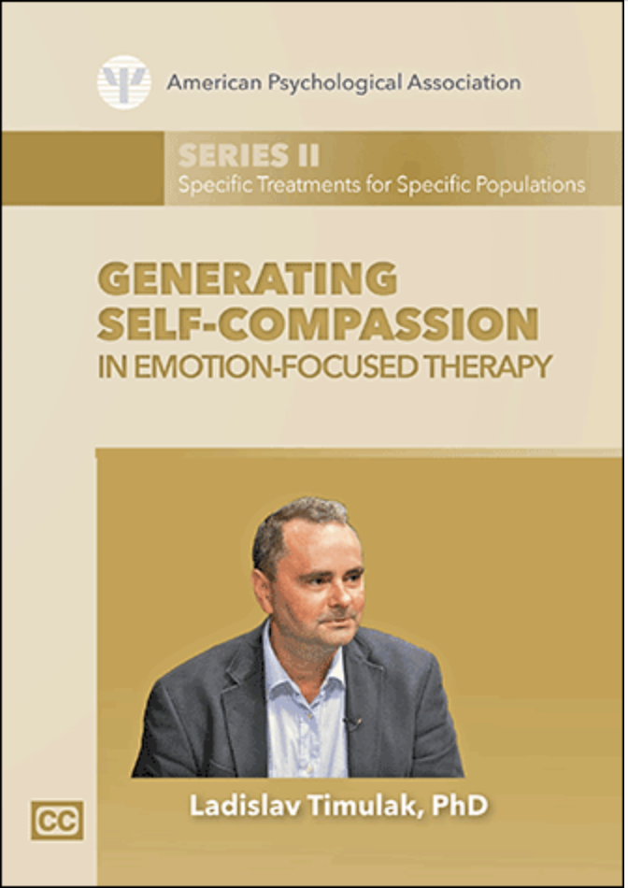

Slide 69
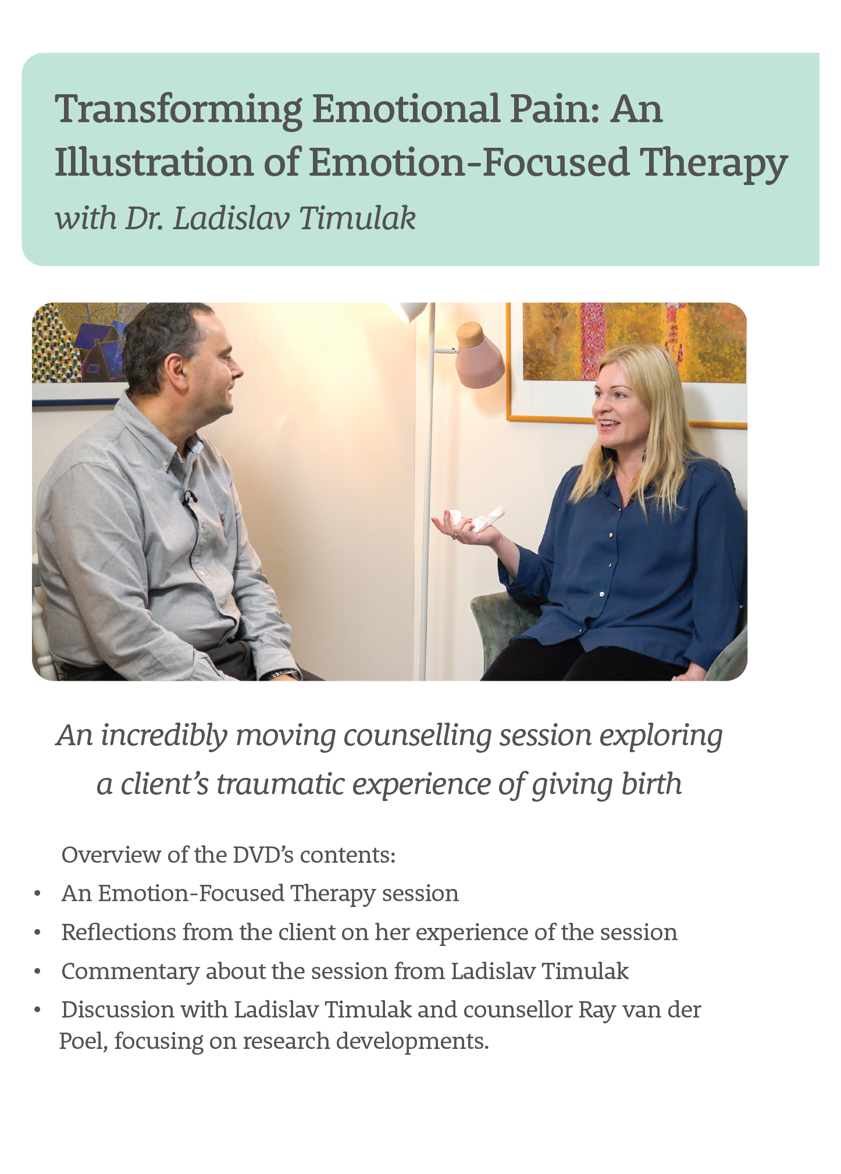

Available to purchase from the cpcab online shop now:
EFT Training Videos
EFT Training DVD’s
www.cpcab.co.uk/shop/

Slide 70
Masterclass 4 en 5 november 2022
Masterclass Transdiagnostic EFT
Het nieuwe boek ‘Transdiagnostic Emotion-Focused Therapy’ van Laco Timulak heeft EFTiN gestimuleerd Laco Timulak uit te nodigen voor een masterclass.
We hebben hem bereid gevonden om in november 2022 naar Nederland te komen voor een intensieve tweedaagse masterclass.
Voor meer info en inschrijven:
https://www.eftin.nl/masterclasses/masterclass-transdiagnostic-emotion-focused-therapy/

