Slide 1
Happy Birthday 696/93
Session 2
Profiling complex Statistical Units (SUs)
28th Meeting of the Wiesbaden Group on Business Registers The Hague, 2 – 6 October 2023
Roland Sturm, Germany

Slide 2
A birthday oration
For the full text: see my paper

Slide 3
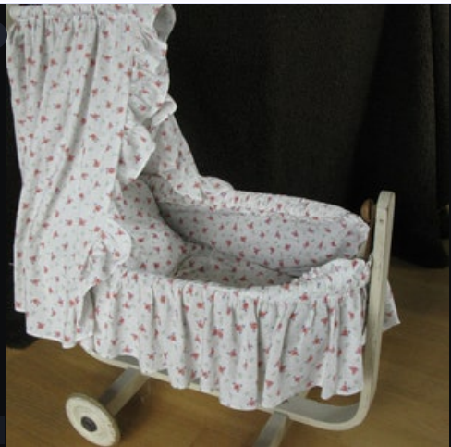
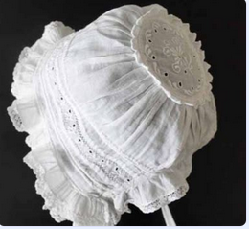
30 years ago – a child was born…
§§ 696/93

Slide 4
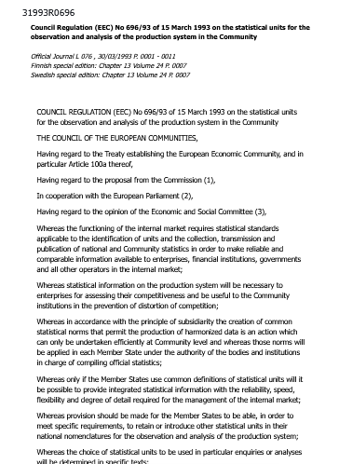
…with a charming name…
R2D2 C-3PO 696/93

Slide 5
You give guidance
tradesman
shop
group of companies
company
tax group
establishment
branch
legal unit
local unit
segment
enterprise
business
enterprise group
firm
holding
division
taxpayer

Slide 6
You give guidance
Distinction between non-statistical and statistical units
Intention of their use: purpose of statistics
Explanation Conceptual and practical aspects

Slide 7
You have good company by „Operational Rules 2015“
Task Force „Statistical Units“ 2014/2015
→ Notice of Intention
→ Operational Rules for Implementation

Slide 8
…and still a lot of work to do…
For example: splitting of legal units
to get appropriate enterprises

Slide 9
Splitting in case of Top-Down Profiling
EG
RE
RE
RE
RE
RE
RE
RE
RE
RE
RE
RE
RE
RE
RE
RE
RE
RE
ENT 1
ENT 2
ENT 3

Slide 10
„Do without splitting“ - a common convention
??
EG
ENT 4
RE
RE
RE
RE
RE
RE
RE
RE
RE
RE
RE
RE
RE
RE
RE
RE
RE
ENT 1
ENT 2
ENT 3

Slide 11
Lean Profiling → Fat Enterprises →?!
?!
EG
RE
RE
RE
RE
RE
RE
RE
RE
RE
RE
RE
RE
RE
RE
RE
RE
RE
ENT

Slide 12
A word on compromising
a sin or a necessity?
“We can’t just trust the register people – they are too conceptually pure!” (Eurostat)
Become a martyr?? “You’ll never make a saint of me” (Rolling Stones)
We all have to compromise when resources are short, even in the business register
(R.S.)
Where compromising should end: Calling our units by their proper names
– otherwise we will end in total confusion

Slide 13
Business Register is the harbour of units
Business register has heterogeneous users
who have very heterogeneous needs
and therefor needs a clear picture of the different units for statistics
Regulation 696/93 and her Operational Rules should be our guidance
Happy Birthday 696/93!

Slide 15
Contact
Statistisches Bundesamt 65180 Wiesbaden
Germany
Roland Sturm roland.sturm@destatis.de Phone +49 611 75-2580
www.destatis.de
www.destatis.de/kontakt

