Slide 1


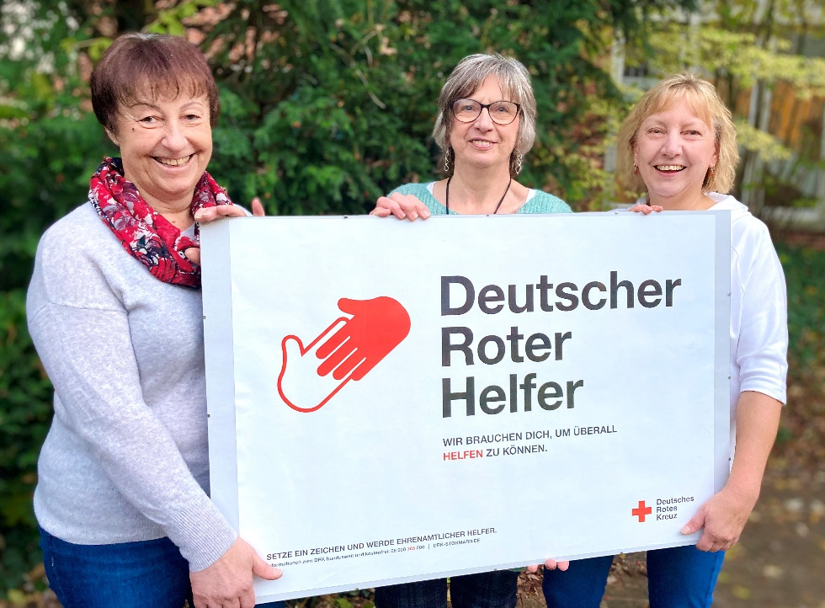
Sustainable Volunteer Management in Blood Donation Services
Research Group Engagement 2030
11th September 2025 13.30 -15.00

Slide 2
Disclosure
No conflict of interested to declare

Slide 3
Welcome to our Special Session: Sustainable Volunteer Management in Blood Donation Services
Blood Donations Services in many countries rely on the support of volunteers
Continuous and growing need for more individuals to voluntarily support NPOs (Schubert et al., 2023) – specifically in blood donation services
Objective:
Raise awareness of the importance of volunteers in blood donation
Advance empirical research on the intersection between volunteer management and blood donation services – addressing missing data
Outline best practices in volunteer management

Slide 4
Guiding Questions for Discussion: Sustainable Volunteer Management
How do you manage your volunteers? What are your biggest challenges?
What main aspects define a sustainable volunteer management?
(How) do you collect data on blood donation volunteers?
Do you have any recommendations regarding data collection?

Slide 5



Sustainable Volunteer Management in Blood Donation Services
Missing Data: Volunteering in Blood Donation Services Dr. Lena Kristin Kunz Dr. Sigrun Leipnitz German Red Cross Blood Donation Service North-East and Baden-Württemberg Hesse
Exploring Volunteer Management in Blood Donation: Current Research Gaps and Future Directions Prof. Dr. Silke Boenigk Sarah Fenske Alexander Rödl University of Hamburg
Volunteer Management in Blood Donation Services: Learning from Sanquin Annemieke de Fijter Sanquin
Notes:
Alternativer Titel
Missing Data: Volunteering in blood donation services

Slide 6
Missing Data: Volunteering in Blood Donation Services
1
Dr. Lena Kristin Kunz Dr. Sigrun Leipnitz
German Red Cross Blood Donation Service North-East and Baden-Württemberg Hessen

Slide 7
Volunteering in Germany
28.8 million (39.7%, age 14+) volunteers (FWS 2019, Simonson et al., 2022)
General increase of volunteers across the last 20 years
Increasing gender balance in volunteering
Shift in engagement areas from education towards civil protection & disaster control (ZiviZ, 2025)
Shifts in engagement behavior: rise in episodic volunteering, engagement patterns are changing, with a noticeable increase in short-term or event-based (episodic) volunteering (Cnaan et al., 2022)
FWS 2024 expected to be published in October 2025
No specific information on blood donations volunteers
Notes:
Andere Übersicht aus dem FWS zur besseren Beschreibung von volunteers

Slide 8
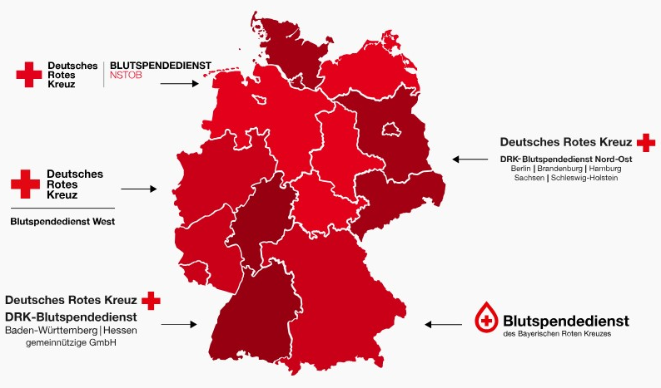
Overview German Red Cross Blood Donation Services
Nonprofit Organizations (gGmbH)
Over 2.8 million annual donations
40.000 blood donation appointments annually
The organization of these appointments is coordinated through a collaboration between full-time staff, volunteers, and voluntary helpers.

Slide 9
Current Challenges in Volunteer Engagement in Blood Donation
Limited awareness of volunteering beyond donating blood (e.g., different engagement opportunities)
Lack of available data on engaged volunteers in blood donation
Volunteers are formally engaged in regional GRC associations not at the Blood Donation Services
No access to identify who volunteers in blood donation services are
Notes:
There is an ongoing and growing need for individuals to support the organization and execution of blood donation appointments on a voluntary basis.
Many individuals are unaware that they can contribute to blood donation services in ways other than donating blood—such as through organizational support, outreach, logistics, or community coordination.

Slide 10
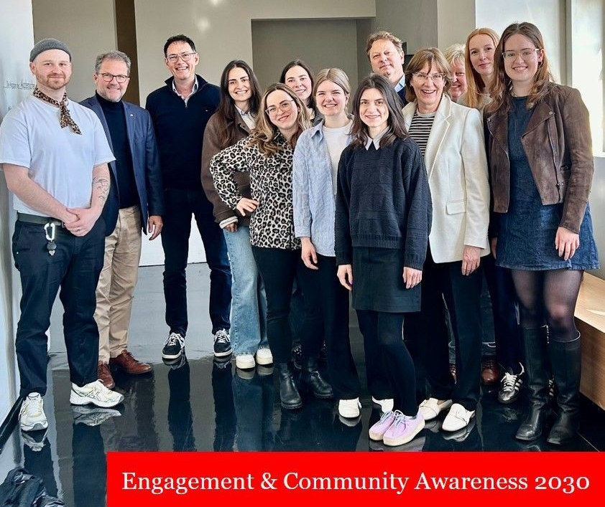
Social Impact Research Lab
Collaboration GRC Blood Donation Services North/East, Baden-Württemberg Hesse & University Hamburg
Research Groups
Community Awareness
Engagement 2030
Aim: We aim to develop evidence-based strategies for donor recruitment and retention, while integrating perspectives of volunteers and other key stakeholders to strengthen the entire blood-supply ecosystem.

Slide 11
Engagement 2030 Research Group
Volunteer Management
Preferences of Blood Donation Volunteers
Flexibilization in Blood Donation Engagement
Background: Volunteer management in blood donation service received little academic attention until now.
Background: In a competitive NPO landscape, it is vital to offer an appealing volunteering design to attract indispensable blood donation volunteers
Background: Societal trends, such as episodic volunteering, require an adjustment of engagement conditions
Aim: Identification of current best practices & challenges in regard to managing blood donation volunteers in the GRC
Aim: Presenting a comprehensive theoretical framework of volunteer preferences
Aim: Identification of relevant dimensions of flexibilization and fostering volunteer retention.

Slide 12

Pilot Study: Volunteer Management at the GRC Dr. Lena Kristin Kunz
1.1
Notes:
Volunteers are essential in the blood donation process
In a competivive NPO landscape, it is essential for BD organizations to recruit volunteers

Slide 13
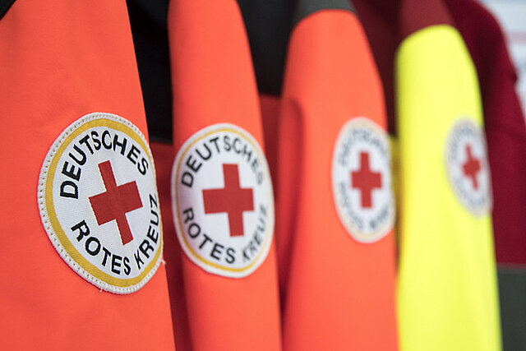
GRC Structures (Approx. 43.400 employees and 400.000 active volunteers)
Pilot Study: Volunteer Management at the GRC
Federal Association
> 1000
State Association
19
Local Branches
> 2000
District Association
> 400
Response Units
DRK e.V

Slide 14
Pilot Study: Volunteer Management at the GRC
Addressing missing data in volunteer management in blood donation
High demand for volunteers requires a sustainable volunteer management
Management & Support, Recruitment and Retention (Heeneman et al., 2012)
Qualitative Approach:
Semi-structured interviews (N = 11)
Volunteer coordinators and volunteers from different GRC entities with multiple involvements
GRC Structure | GRC employed | Volunteer Experience
State Association | 5
District Association |  | 4
Local Branch |  | 4
Blood Donation Services | 3
Response Units |  | 4

Slide 15
Results: Strategic Volunteer Management
Is there a formal or standardized approach to manage volunteers at the GRC?
Different perceptions depending on the level of the GRC entity
State Associations refer to recommendations of the Federal Association
Local Branches agree that there in no formal process
“(…) I wouldn’t really speak of a classic strategy here. Instead, there are many different approaches, and each local branch, each volunteer, has to consider which approach fits them. (Volunteer Coordinator, Local Branch)
Different roles of GRC levels
Federal Association provides strategic support (e.g., Online Volunteer Platform, recommendation paper)
State Associations support District Associations (e.g., organize network events, general visibility, training & education)
District Associations provide support to Local Branches (e.g., retention strategies in form of distinctions, networks)
Blood Donation Services (mostly) refer interested volunteers to Local Branches

Slide 16
Results: Recruitment of Volunteer
Best Practices: Recruitment
Personal contact is key
“It is very important to us that people can truly experience who we are.“ (Volunteer Coordinator, Local Branch)
Strategic PR and personal contact for specific volunteering demands
Clear and open communication about the variety of engagement fields
Highlighting the perks of volunteering in blood donation (mostly no weekly commitment, no intensive training)
“(…) you can’t really say there’s one single approach that will bring in lots of volunteers. It has to be a mix of everything. And what’s actually much more important is the ongoing support of the volunteers.” (Volunteer Coordinator, Local Branch)

Slide 17
Results: Retention and Engagement
Best Practices: Retention
Match between volunteer and engagement field
Structured volunteer recognition (e.g., awards, distinctions)
Personal contact, sense of community, positive feedback culture, and fun
“volunteers also want to have fun – they want to experience something in their GRC (local branch)…” (Volunteer, Local branch)
Retention of new volunteers is difficult when cohesive volunteer groups don’t allow new volunteers to join
Varying motives of volunteers need to be considered

Slide 18
Discussion
Different levels of the GRC focus on specific areas, while State Associations facilitate campaigns and general support, local branches focus on ‘on-the-job’ experience and personal contacts – support in day to day tasks - no standardized strategic approach
Each local branch has their own strategies, while general strategies are often seen as not fitting
Sustainable volunteer management seems more successful when staff structures support volunteer structures
Implications
Recruitment of volunteers needs to be complemented by effective retention mechanisms to sustainably manage volunteers.
Stronger integration of Blood Donation Services in GRC structures
More research on volunteer management and volunteers in blood donation is needed
to identify what strategies work in which circumstances
to identify individual differences in blood donation volunteers

Slide 19
Exploring Volunteer Management in Blood Donation
2
Prof. Dr. Silke Boenigk
Sarah Fenske
Alexander Rödl
University of Hamburg
Notes:
Silke & Sarah & Alex

Slide 20
Conceptualizing and Measuring Preferences of Blood Donation Volunteers Sarah Fenske, Silke Boenigk
2.1
Notes:
Volunteers are essential in the blood donation process
In a competivive NPO landscape, it is essential for BD organizations to recruit volunteers

Slide 21
Theory: Blood Donation Volunteer Preferences
Work (attribute) preferences are “the extent to which people desire a variety of specific qualities and outcomes from their paid work” (Konrad et al., 2000, p. 593)
Comprehensive insights in the paid work context
Range of studies since the 1970s: Work Preference Inventory (Amabile et al., 1994), Work Preference Indicator (Gilbert et al., 2008), Minnesota Importance Questionnaire (Rounds et al., 1981), …
Fragmented insights in the volunteering context
Time-commitment (Miner et al., 2025), episodic volunteering (Almog-Bar et al., 2022; Cnaan & Handy, 2005), digital platforms (van Teunenbroeck et al., 2025)

Slide 22
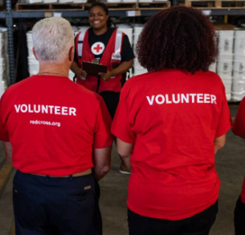
Method: Surveying Blood Donation Volunteers
Data Collection
Survey, GRC BDS volunteers
Collect quantitative data on GRC BDS volunteers
Measure volunteer preference framework
Data Analysis
Group difference analysis
Cluster Analysis/Conjoint Analysis/ …
https://www.redcross.org/local/dc-va-md-de/about-us/news-and-events/news/resolve-to-volunteer-in-2023.html

Slide 23
WIP: Blood Donation Volunteer Preferences
Dimension | Item
Task | Type, variety, autonomy, audience, responsibility
Time | Extent, frequency, length, spontaneity, schedule autonomy, time of day, day of week, occasions
Location | Type, location autonomy, variety
Social | Insider interaction, outsider interaction, acquintance, self-selection, variety
Environmental | Leadership, culture, feedback
Incentives | Monetary, other
Digitalization | Attitude, activities, internal communication, training
Other | Training, workload, influence, …
“[T]he extent to which people desire a variety of specific qualities and outcomes from their paid work” (Konrad et al., 2000, p. 593)

Slide 24
Flexibilization of Voluntary Work in Blood Donation Services Alexander Rödl, Silke Boenigk
2.2

Slide 25
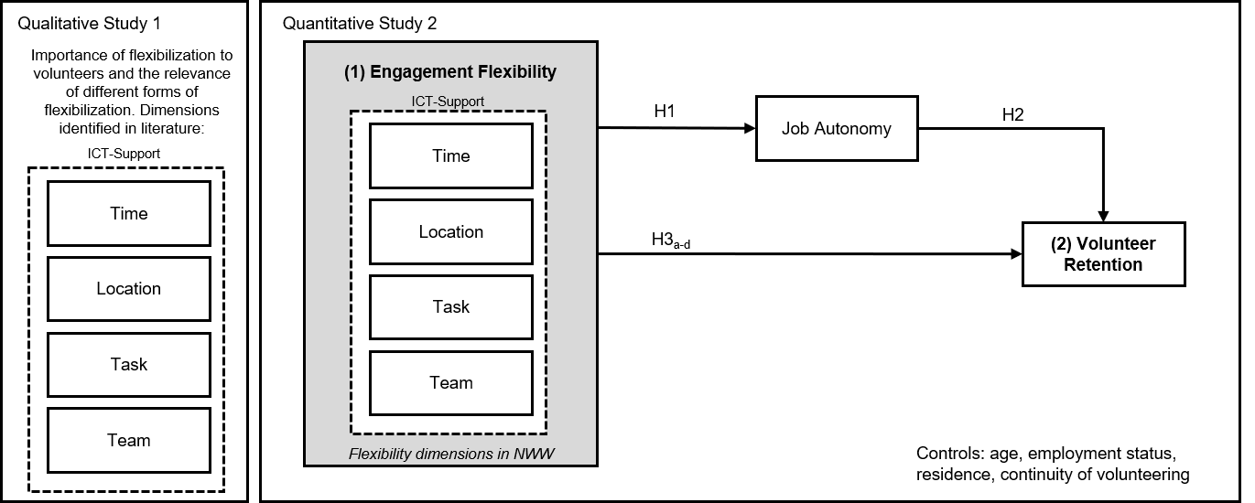
Conceptual Framework
Notes:
Time: Choice of appointment
Location: Choice of location
Task: choice of tasks
Team: choice of teams
ICT: using digital platforms

Slide 26
Mixed Methods Approach
Qualitative Research
Interviews with volunteers and volunteer coordinators
Qualitative content analysis
Quantitative Research
Survey for volunteers
Regression analysis
Exploratory Sequential Design

Slide 27
Preliminary results of the interviews
Preliminary findings show that voluntary work at GRC Blood Donation Service is seen as flexible
Volunteers appreciate this flexibility
Quotes from interviews:
“First of all, it is close to me and secondly, there are many young people of every nationality where I can maintain my language skills, so that is also a benefit for me” – VOL1
“I then send out the schedule by email, but not everyone has an email address, so sometimes I just print it out and send it by postal mail. But that's exactly what happens. Very little actually happens digitally.” – COR1
“This win-win situation and the flexibility come to mind here, […]. I can choose. That's flexibility for me.” – VOL1

Slide 28
Discussion: Sustainable Volunteer Management
How do you manage your volunteers? What are your biggest challenges?
What main aspects define a sustainable volunteer management?
(How) do you collect data on blood donation volunteers?
Do you have any recommendations regarding data collection?

Slide 29

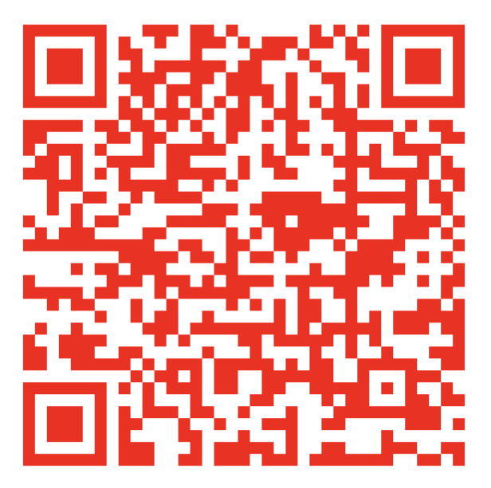
Thank you for your attention and participation!
Contact information on our Social Impact Research Lab landingpage

Slide 30
References
Almog-Bar, M., Ashkenazi-Anor, M., Hersberger-Langloh, S. E., Compion, S., & Butcher, J. (2022). Age Is But a Number? An Exploration of Age Differences in Episodic Volunteering. Voluntas, 33(3), 483–496.
Amabile, T. M., Hill, K. G., Hennessey, B. A., & Tighe, E. M. (1994). The Work Preference Inventory: Assessing Intrinsic and Extrinsic Motivational Orientations. Journal of Personality and Social Psychology, 66(5), 950–967.
Cnaan, R., & Handy, F. (2005). Towards Understanding Episodic Volunteering. Vrijwillige Inzet Onderzocht, 2(1), 29–35.
Gilbert, G. R., Sohi, R. S., & McEachern, A. G. (2008). Measuring Work Preferences. A Multidimensional Tool to Enhance Career Self-Management. Career Development International, 13(1), 56–78.
Konrad, A. M., Ritche, J. E., Lieb, P., & Corrigall, E. (2000). Sex differences and Similarities in Job Attibute Preferences: A Meta-Analysis. Psychological Bulletin, 126(4), 593–641.

Slide 31
References
Miner, G., Nayak, R., Butterfield, C., Schwarting, D., & Macarthur, S. (2025). Engaging Generation Z: Exploring Volunteering Preferences and Influential Factors for 4-H Programming. The Journal of Extension, 63(2), 1–10.
Rounds, J. B., Henly, G. A., Dawis, R. V., Hofquist, L. H., & Weiss, D. J. (1981). Manual for the Minnesota Importance Questionnaire. A Measure of Vocational Needs and Values. University of Minnesota.
van Teunenbroeck, C., Wymer, W., & Čačija, L. (2025). Fostering, Promoting and Encouraging Philanthropy: Mechanisms to Attract Younger Generations of Donors and Volunteers. Journal of Philanthropy, 30(2), 1–14.

