Slide 1
Initiation of Statistical Business Register in Nepal: Status, Challenges and Prospects in Reaching Maturity Model
Mahesh Chand Pradhan
Director
Economic Census Section
National Statistics Office
NEPAL
maheshcpradhan@gmail.com
Presentation for 28th meeting of the Wiesbaden Group on Business Registers

Slide 2
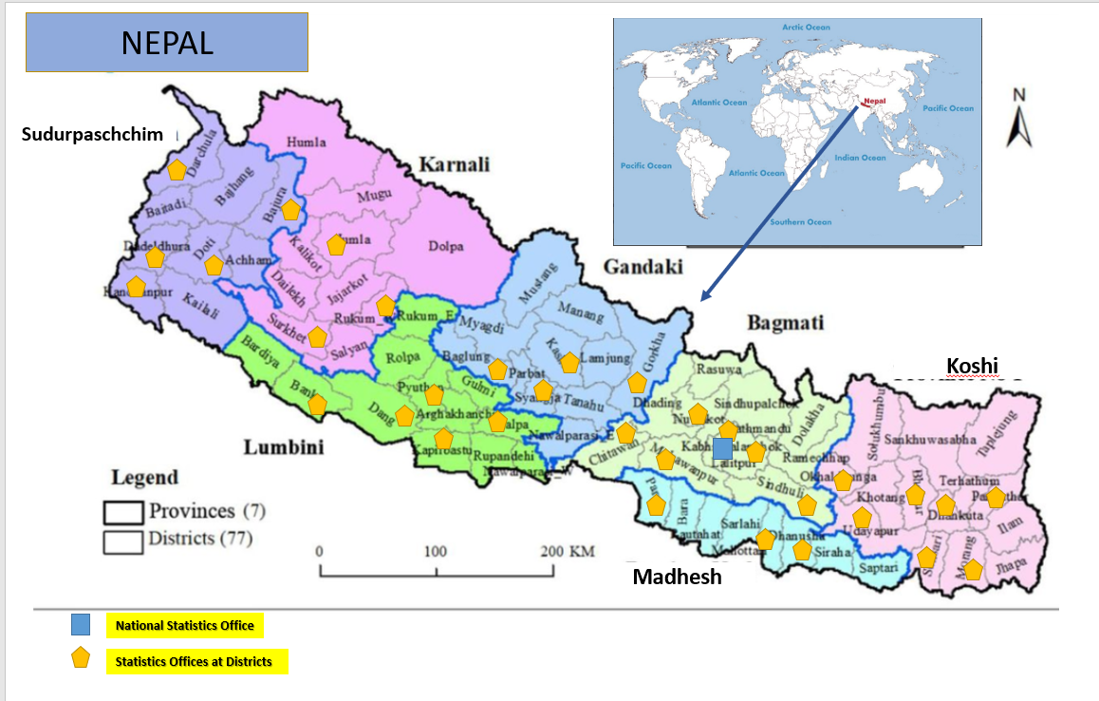

Slide 3
Contents
Introduction
Initiation of Statistical Business Register in Nepal
Rationale of Statistical Business Register in Nepal
Context of Economic Census of Nepal
Present Status of SBR in Nepal
Context of Legal Provisions for Registration of Business Entities
Examining the NSBR in SBR maturity model.
Challenges of SBR in Nepal
Prospects for Building Statistical Business Register in Nepal

Slide 4
Social Statistics Division
National Accounts Statistics Division
Economic Statistics Division
Government of Nepal
Office of Prime Ministers and Council of Ministers
National Statistics Office
Planning and Human Resources Division
Economic Census Section
Major functions
Establish statistical business register,
Conduct economic census and Economic Surveys
Study Informal Sectors
Statistics Offices at 33 Districts

Slide 5
Initiation of Statistical Business Register in Nepal
Past:
Non-existence of formal statistical business register in Nepal for a long time
Responsibility of the NSO increased to meet the growing demand for economic statistics.
First Effort:
The then Central Bureau of Statistics (CBS) initiated the effort of statistical business directory survey in 1997/1998
Discontinued the effort due to absence of designated institutional unit and other infrastructures.
Now:
Realization of a regular update database system of formal economic units (establishments or enterprises) in the form of Nepal Statistical Business Register (NSBR)
Institutional set up:
Organizational restructure of CBS established Economic Census Section in the end of 2013
Actions:
NSBR :
Efforts continued
Economic Census :
Implemented in 2018 for the first time in Nepal

Slide 6
Initiation of Statistical Business Register in Nepal
Efforts of Initiating SBR
Start from Fiscal Year 2014/15:
Initiated Trial Survey on NSBR in three districts (Dolakha, Palpa and Dang)
Trial Survey extended to 14 districts in subsequent years till before the year of Economic Census 2018.
Objectives of undertaking provisional SBR survey
to study the status of various economic units operated in the country and
develop a methodology to permanently establish SBR
Survey Process :
List collection from the authorized local registration office and
Collecting detail information of each establishment or business firms
Knowledge :
Not all registered units could be found at the address and operated or functional.
Status:
Continued program of Statistical Business Register in its annual fiscal year program via its statistics offices at districts.

Slide 7
Rationale of Statistical Business Register in Nepal
Non-existence of integrated data sources on establishments/ enterprises to produce a national sampling frame, and to produce various economic statistics for a long time.
The Economic Census 2018 has resolved to some extent, fulfilling the basic data on the characteristics of establishments at the same point in time but it may not be entire economic data sources.
Needs of the integrated data sources of establishments/ enterprises for institutionalizing the sustainable data sources
Seeking possibility of cost-effective way of producing basic economic statistics in long run
Need regular data for supporting National Accounts
The only way to achieve this goal was to establish the Nepal Statistical Business Register System.

Slide 8
Overall objective of NSBR :
Develop a standardized list of the economic units (establishments) formally registered in the authorized agencies in the reference fiscal year which contains standardized descriptions of the establishments required to be used as statistical purpose
Scope and coverage
ISIC Revision 4
Entire country covering the establishments or enterprises registered
Output of NSBR
To generate a live register as well as frozen register of different ISIC sectors and institutional sector in future.
Expected to provide
complete list of enterprises or establishments operated in formal economy.
Frame data for different economic surveys as well as for economic census.
Some basic economic statistics like number enterprises or establishments and employment status and further expected to make business demographic analysis in future.

Slide 9
Context of Economic Census of Nepal
CBS conducted national economic census in 2018 for the first time covering mostly all economic activities categorized in ISIC of the same period of time.
Major Purpose :
To comprehend the economic structure comprised with diverse ISIC sectors of economic activities and provide comprehensive statistical information for users.
Basic objectives
providing basic economic statistics up to local governments;
support national accounting system;
support to create statistical business register and develop sample frames; and
provide statistics of associated sectors to the business community, researchers and other statistics users for planning the prosperity of their business.
Scope: ISIC Revision Sectors except Sections A (Not Registered), O, T & U

Slide 10
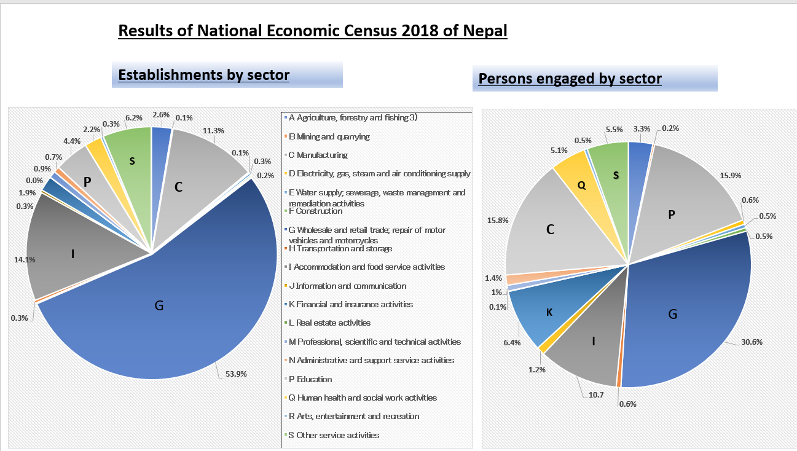
Data Collection Modality:
Paper and Pencil Interview (PAPI) : 89.84 %
Computer Assisted Personal Interview (CAPI): 9.52 % and
Computer Assisted Web Interview (CAWI) or online census : 0.64 %
Results:
Total Establishments: 923,356
Total Persons Engaged : 32,28,457 persons
(Total Number of Establishments)
923,356
(Registered)
462,605
(50.1%)
(Not Registered)
460,422
(49.9%)
Not Reported 329
(0.04%)

Slide 11
Present Status of NSBR
Modality of data collection:
33 Statistics Offices at districts collect data for NSBR in standard format
Training for staff on procedure to data collection and data entry for SBR from authoritative offices at districts.
Administrative Data Source :
Local level offices and other district registration offices.
The information is collected for business units on
newly registered,
renewed,
migrated, and
business closed.
Collection of data means:
Transcribing from the physical book records or
copy digital data.
Future Perspectives
Integrate or achieve data on business units at the central administrative bodies like data of company registrar into the Nepal Statistical Business Register.
Develop policy arrangements with concerned central level administrative agencies who maintain database of business units for administrative purpose

Slide 12
Contents of NSBR
A standard data collection form has been developed with key details which are as following:
Date of data collection, Name of District and district code, Fiscal Year for data collected, Name of Authorized Office from where data collected, Registration Status (New, Renewal, Migrated, Closed)
Name of Establishment/enterprise
Registration number in concerned office
Nature of establishment (production base, Energy related, Agriculture and Forestry related, Mining and quarrying, Tourism, Service, Others (to be specified)
Legal Status of Registered Establishment (Private, Partnership, Private Limited Company, Public Limited Company, Others)
Address where Establishment located (District, Local Level, Ward, Name of Settlement)
Telephone or Mobile Number of establishments
Name of main proprietor of the establishment
Number of persons engaged in the establishment
Total Capital (sum of current and fixed capital)
Main economic activity
Nepal Standard Industrial Classification Code (based on ISIC to be filled in statistics office)

Slide 13
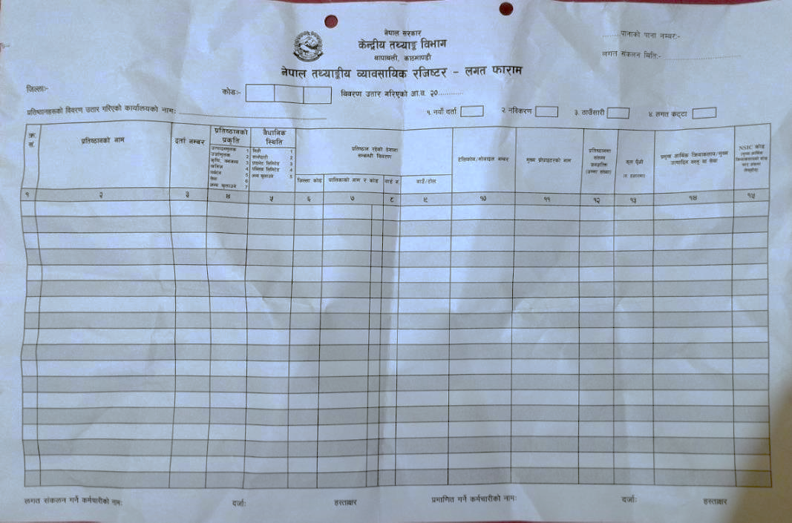

Slide 14
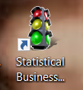
Data Entry Application and Synchronization
An application base on CSPro 7.7.1 software has been developed to make consistent management of data collected either in paper form or digital data form in different formats.
Name of the application: Nepal Statistical Business Register -NSBR application.
Use of Application:
For data entry,
Import digital data,
Data management and
Data synchronization or data upload to administrator in NSO.
Features:
Data dictionary
Supports in managing the newly entered data as well as stored previous data as well.
Concerning Statistics Offices have been distributed and trained about this NSBR application.
An interface has been in Nepali language.

Slide 15
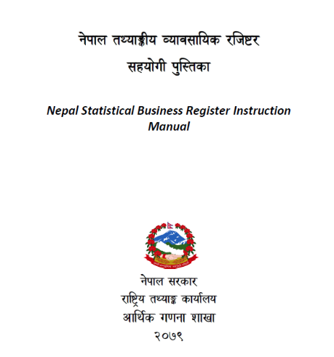
NSBR Manual in Nepali Language
A NSBR manual in Nepali language
For imparting knowledge on concept, definition on SBR, Data collection and compilation methods and data entry in the application.
The manual is composed of four sections namely:
General concept of Statistical Business Register,
SBR in Nepal,
Data Contents of NSBR,
NSBR Data Entry Application.

Slide 16
Context of Legal Provisions for Registration of Business Entities
Context of practice of business registrations has impact in NSBR
Some major laws that provision the registration of businesses
Company Act 2007
Industrial Enterprise Act 2019
Local Government Act 2017
Institution Registration Act 1977
Private Firm Registration Act 1957,
Cooperative Act 2017,
Partnership Act 1963,
Income Tax Act 2001
…
Under different provisions of laws, business entities of different ISIC sectors needs to register as per prevailing laws for different purpose.
Multidoor system of registration with different purposes with different format of records

Slide 17
Status of NSBR in the Maturity Model Framework
SN | Dimensions/ | Levels/ Stages |  |  |  | Remarks
 |  | Preliminary | Early | Mature | Advanced
1 | Legal and Institutional Arrangement |  | Statistical Act 1958 did not mention explicitly access to administrative data sources however Statistical regulations 1984 was indicative in regards to establish permanent database. | Statistical Act 2022. This act has mentioned for the access of administrative data sources that need to be integrated to form a part of National Statistical System. |  | Statistical Regulations and Directives under the process of development
2 | Data sources |  | Currently Economic Census 2018, SBR data collected from administrative sources of registrations government agencies at district and local levels. However unique identifier is yet to be developed for data linkage with different data sources. |  |  | In future, there is a vision to integrate data from other administrative sources like Data from Company Registrar, Department of Industry, Inland revenue Department and other admin sources after statistical regulations be formulated. This applies similarly to other surveys as well.
3 | Maintenance and update | Data on new, renewal, migrated and closed business entities have been continuously collected. But duplication and update mechanism are at infancy stage. |  |  |  | The data are not verified with data of same entity collected earlier from same source or others. Update means collecting predesigned information of newly registered or renewed or migrated or closed business entities only

Slide 18
SN | Dimensions/ | Levels/ Stages |  |  |  | Remarks
 |  | Preliminary | Early | Mature | Advanced
4 | Coverage |  | The data from economic census covers about 18 ISIC sectors both registered as well as unregistered business entities. It covers all geographic coverage. SBR data collection covers the business entities according to prevailing laws. |  |  | ISIC Section A (unregistered), Section O, Section T and U are not covered from economic census 2018. While the data sources from administrative sources only covers entities of formal economy.
5 | Use of SBR |  | The database of Economic Census has been utilized for some major surveys internally by NSO. Due to non-existence of comprehensive data distribution policy, individual data has not been shared with agencies out of NSO. The data collected from SBR are only compiled in the database only and is not ready for use. |  |  | Statistical regulation and directives will address data distribution policy which may address the access of microdata or designated users. SBR data use plan is yet to be developed.
6 | IT Environment |  | IT environment exists at NSO as well as at statistics offices. Data entry and synchronization software for SBR has been developed in recent years and implemented in respective statistics offices. The data is received at central administrator. The data is stored in csv format and also can be stored in other formats as well. |  |  | The application further needs to be progressed with the aspect of data maintenance, update and dissemination of SBR further. Strong IT infrastructure is needed to be established.
7 | Interoperability | SBR data is at preliminary stage to communicate and exchange standardized data. Such system has not been developed due to capacity constraint. |  |  |  | Such system will exist if there is integration of information system outside NSO in future.

Slide 19
Challenges of Developing SBR in Nepal
Developing Clear Directives for SBR data integration in Prevailing Legislation
Multi-Door Business Registration and Duplication Issue
Access constraints due to confidentiality issues
Diverse format of information records
Implementing Common Identifier
Filtering Duplication Issue
Maintenance and Update of SBR
IT infrastructure development

Slide 20
Prospects for Building SBR in Nepal
Possibility of high prospects or opportunities for the development of statistical business register in Nepal in future.
Some of the prospects for the development of SBR in Nepal.
Establishment of Economic Census Section
National Economic Census in 2018,
Continuation of efforts to build SBR
Existence of sub-ordinate statistics offices
Allocation of annual budget resources,
CSPro based application
Capacity development for staff of NSO on SBR and
Development of instruction manual
High scope of development of sustainable SBR in Nepal due to recent promulgation of Statistical Act 2022, and NSO as nodal statistical body for coordinating the affiliated agencies in the statistical system
Development of national data profile (NDP- www.nationaldata.gov.np/) with possibility of expansion of data integration for SBR with local governments in future
Possibility of data integration or access with Management Information Systems in digital environment of offices like Inland Revenue Department, Office of Company Registrar in future

Slide 21
Conclusion
Prevailing new legislation will be supportive in making SBR as integrated infrastructure for compilation, update and maintenance of SBR in coming days.
Needs Distinct SBR policy
International Guidelines and references are helpful in developing NSBR.
A long-term vision is the automation of IT based SBR where the information from administrative records will flow automatically in the SBR mechanism.
Nepal's Statistical Business Register has the potential to evolve through various stages of maturity like establishing basic foundation, integration and consolidation, data validation and quality assurance, data utilization and continuous improvement in future.
THANK YOU

