Slide 1
Profiling in Germany – A practical insight from Niedersachsen (Lower Saxony)
28th Meeting of the Wiesbaden group on business registers
The Hague, 2. October 2023
Franziska Große| Dez. 34

Slide 2
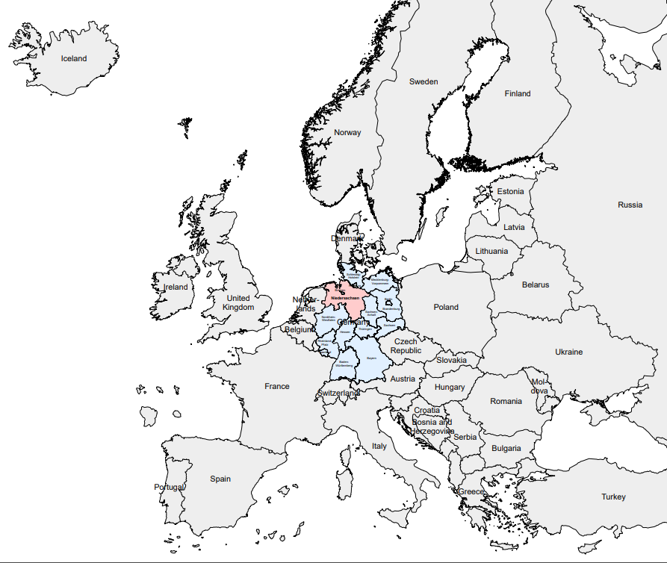
Where is Niedersachsen
(Lower Saxony)?
Key figures (next slide)

Slide 3
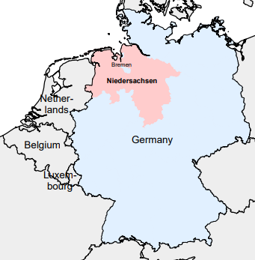
Notes:
BIP und Bevölkerung der 27 EU-Staaten und Niedersachsen in aufsteigender Reihenfolge (ascending order); direkte Nachbarn von Niedersachsen sowie Gastgeber Niederlande und Deutschland als weitere Eckdaten; und NI‘s bekanntester Konzern

Slide 4


Responsibilites for manual profiling in Germany
Methodology,
coordination
Practical Profiling and all other statistical offices of the „Länder“
Notes:
Let‘s keep it simple

Slide 5
Profiling in Niedersachsen
Oktober 2016: workshop with CBS
2017: Start of profiling with 3 profilers
2018: start with intensive profiling
2021: profiling for Bremen with 1 profiler
Through the years: further developing our methodolgy
annually >300 manual profilings, 2-3 new intensive profilings
How do we do profiling?

Slide 6

Data on Enterprise Groups
No administrative data on enterprise groups and group structure available
Purchase of data from a commercial provider according to our needs (e.g. statistical concept of control)
Data processed in our statistical business register (SBR) -> first picture of the enterprise groups (24’000)
Niedersachsen (2021): 310’000 legal units; 14 percent are part of Enterprise Groups
  78 percent turnover
  61 percent employees

Slide 7
Preparation
Algorithm suggests enterprise groups for manual profiling (2022: 230)
Profiler chooses an enterprise group for profiling
  Check of group structure:
    Commercial data might be wrong
    German decision center (national headquarter) in Niedersachsen?
    Profiler identifies the correct group structure with the help of
      Main ressource: annual report (IFRS, HGB)
  Manual profiling of previous year available?
    Yes: still valid? Update with (minor) changes or without changes?
    No: (first) desktop profiling
Notes:
Commercial data can be wrong: e.g.: LEU not part of EG; wrong head of EG
Other ressources: website, trade registers, databases, other commercial data, press, media reports
Not all EG have a German headquarter; decison: highest control in Germany

Slide 8
Preparation
Profiling
Identification of enterprises according to the rules of autonomy as written in the „Methodology of Profiling“ (ESSnet):
  An enterprise has accounts at its disposal
  The operations of an enterprise are managed in an integrated manner
  The enterprise is market-oriented
Assigning LEUs to enterprises
  Desktop Profiling

Slide 9
Preparation
Profiling
Results
Profiler was succesful to identify the enterprises with desktop profiling:
  Profiling report
  Prepare data to import directly into the SBR
Profiler didn‘t get a full or clear picture of the enterprises with desktop profiling:
Waiting for more information or Intensive Profiling?

Slide 10
Preparation
Profiling
Results
Intensive?
Very time-consuming, thus makes sense only for:
    Enterprise groups with a high significance for the economy of Niedersachsen
    Enterprise groups with high complexity
    Enterprise groups with lack of information (e.g. Foundations)
Since 2018 Niedersachsen had 7 (first) intensive profiling visits; afterwards: annual repeats

Slide 11
Preparation
Profiling
Results
Intensive?
Key findings – what we get:
Very helpful to understand the group in total; task: find the right person to answer our questions
Understand both sides (EG and statistical)
To get information about:
  structure, legal units (NACE-Codes)
  legal units without reports
Is information helpful for our statistical concepts?
Good cooperation?
Established further contacts; later helpful for LCU

Slide 12
Preparation
Profiling
Results
Intensive?
Key findings – what we don’t get:
Information about internal financial reporting
In some cases: no (consolidated) data (turnover, employees) for enterprises: internal reporting is different from statistical understanding
  Data in SBR is a sum of the related LEU
  SBS applies consolidation by algorithms

Slide 13

Preparation
Profiling
Results
Intensive?
Data
In the end:
Import of data directly into the SBR; available for all users (SBS, LCU, EGR,…)
  Data on group structure, enterprises, legal units (e.g. NACE-Code)
Profiler makes (optional) remarks how to deal with the profiling case in the future
Specific problems will be reported in our national working groups and probably lead to the adaption of our methodology
Acquire new data sources? ESRS=European Sustainability Reporting Standards

Slide 14
Preparation
Profiling
Results
Intensive?
Data
In the end:

Slide 15
Contact
Franziska Große
Tel.: (0049) -511-9898-3320
E-Mail: franziska.grosse@statistik.niedersachsen.de
Mail: LSN, Göttinger Chaussee 76, 30453 Hannover

Slide 16
References I
Bödeker, Daniel: „Profiling als fester Bestandteil der Wirtschaftsstatistik im LSN - Rückblick und Status Quo“ in Statistische Monatshefte Niedersachsen, 10/2021, S. 566ff. (https://www.statistik.niedersachsen.de/download/176052 )
Holtsch, Anna: „Konzernbesuche im Auftrag der amtlichen Statistik – Reisen in die Strukturlandschaft“ in Statistische Monatshefte Niedersachsen, 6/2020, S. 254ff. (https://www.statistik.niedersachsen.de/download/156595 )
Holtsch, Anna: „Der Wirtschaftsstruktur auf der Spur“ in Statistische Monatshefte Niedersachsen, 5/2020, S. 189ff. (https://www.statistik.niedersachsen.de/download/155763 )

Slide 17
References II
Simon Rommelspacher, “iProfAnt – Integrated Profiling Analysis Tool”, presentation during the 27th Meeting of the Wiesbaden Group on Business Registers, 2021.
ESSNet Profiling of large and complex Multinational Enterprise Groups, “Methodology of Profiling, Report of the Work package B of the ESSnet on profiling large and Complex MNEs: Conceptual framework, methodology, rules and standards.”, Version 3.0 (Version date 24-01-2014).
Eurostat database; tables: NAMA_10R_2GDP and DEMO_R_D2JAN.

