Slide 1

VOLUNTARY NON-REMUNERATED DONATIONS IN GEORGIA
EXPERIENCE, CHALLENGES, OPPORTUNITIES
Ketevan Shermadini, MD
National Center for Disease Control and Public Health. Tbilisi, Georgia
ECDHM 2025
11 september 2025, Wijk aan Zee, The Netherlands

Slide 2


Country information:
Caucasus region
69,700 square kilometers
Population in 2025 – 3 704 500 persons excluding occupied territories
Capital city -Tbilisi
Upper middle income country - based on the gross national income (GNI) of $ 8500 (2024)
RUSSIA
GEORGIA
BLACK SEA
AZERBAIJAN
TURKEY
ARMENIA

Slide 3
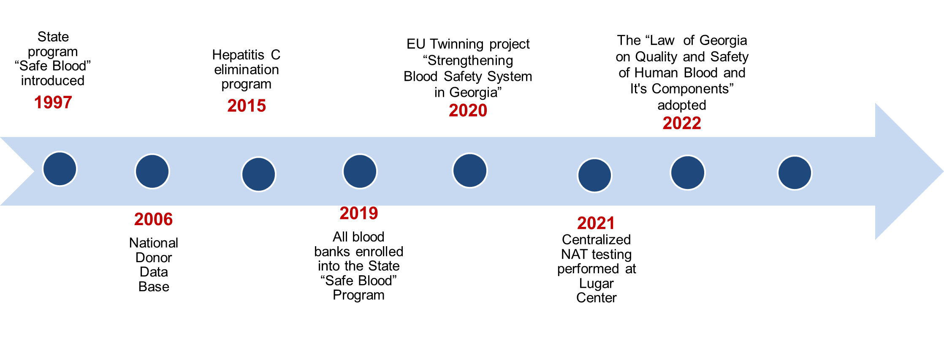
Background:
Blood Safety System development in Georgia
2025-2026
Implementation of the new legislation

Slide 4


Background:
Association Agreement signed in 2014 with European Union to harmonize national legislation with EU acquis
The National Hepatitis C elimination program promoting widescale reforms in health systems launched in 2015
The EU twinning project in 2020-2022 “Strengthening blood safety system in Georgia” contributed to significant changes, among them development and adoption of the new law.
NATIONAL CENTER FOR DISEASE CONTROL AND PUBLIC HEALTH

Slide 5
Background:
The “Law of Georgia on Quality and Safety of Human Blood and It’s Components”
Adopted by the parliament of Georgia on December 15, 2022
In line with the obligation of Georgia under the Association Agreement signed in 2014 with EU to harmonize its national legislation with EU acquis
Developed in active partnership of the EU Twinning project “Strengthening blood safety system in Georgia”
Full transition to VNRBD by April 1, 2026
Non-profit
Voluntary non-remunerated
Unified quality and safety standards
Centralized
In line with EU directives

Slide 6
National State Safe Blood Program
Background:
Centralized 100% coverage of NAT testing for HIV, HBV, and HCV at the Lugar Center since 2021
Serology testing for anti-HIV, anti-HCV, HBsAg and Syphilis for all donations performed at blood establishments
National External Quality Assessment (EQA) Program for blood banks was launched by the Lugar Center in 2021
Administration of a National Donor Database, that has been operating in the country since 2006
Mandatory requirement for blood establishments to notify donors reactive on TTI markers, and make referral to free treatment and care services for HIV, HCV, and HBV
Promotion of Voluntary non-remunerated blood donations (VNRBDs)

Slide 7
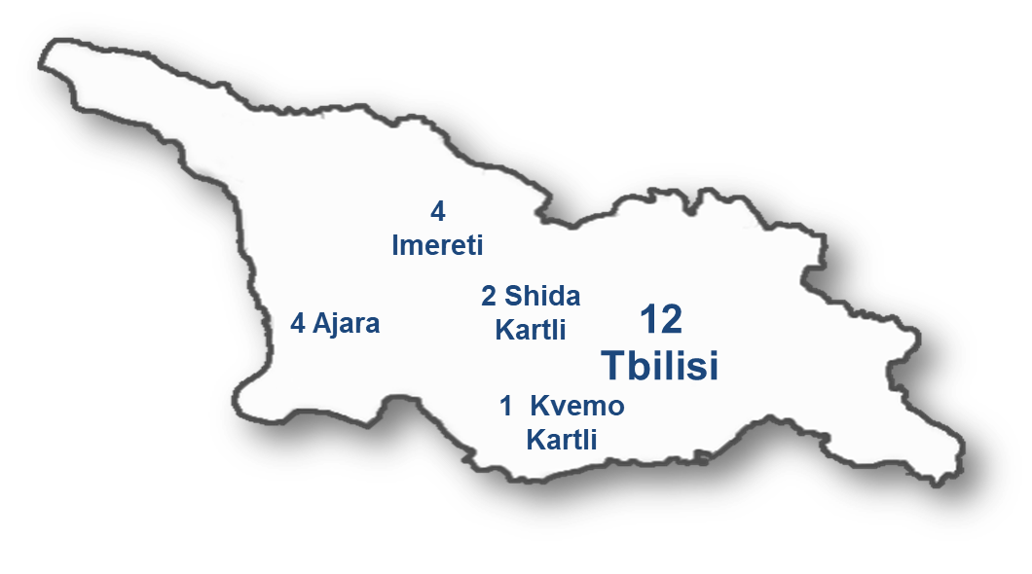
Current situation
22 blood establishments (BEs) and 1 plasma collection center (No fractionation plant in Georgia)
12 BEs are located in capital Tbilisi, 11 - in regions
53% of blood is collected in Tbilisi
11 BEs are hospital based, 12 are independent organizations
The most blood is collected on site at BE facilities. Approximately only 3% are mobile collections.
Only 4 large BEs have mobile collections and 2 to 3 fixed collection sites.
Number of donations at blood establishments vary from 500 to 14,000 per year
The most collections are whole blood, only up to 5% are apheresis
Currently 15 (65%) BEs out of 23 have non-profit status
Perecent of VNRBDs at different BEs varies from 0 to 100%
Regional distribution of BEs

Slide 8


Blood donations in 2024
Donation rate: 24 per 1000 population
94 671 donations of 66 166 donors
42.4% were first time donors
57.6% had ≥2 donations
74 % male
26 % female
The median age was 34 years (interquartile range: 26‒43)
NATIONAL CENTER FOR DISEASE CONTROL AND PUBLIC HEALTH

Slide 9
Donors and Donations by Remuneration Status in 2024
There were 94 671 donations from 66 166 donors in 2024
NATIONAL CENTER FOR DISEASE CONTROL AND PUBLIC HEALTH

Slide 10
Blood Donations by Remuneration Status in 2015-2024
NATIONAL CENTER FOR DISEASE CONTROL AND PUBLIC HEALTH

Slide 11
Transfusion Transmitted infections by mode of donation and remuneration status in 2018-2023
548,530 donations from 221,492 blood donors in 25 blood banks.
Paid donors had an average of 2.5 donations per year, compared to 1.0 donation per year for replacement, and 1.1 donation per year for VNRBDs.
During 2018–2023, the proportions of paid donors decreased (38.8–22.1 %); the proportions of replacement (19.1–26.0 %) and VNRBDs (38.7–48.3 %) increased.
Among first-time donors, prevalence decreased during 2018–2023 for anti-HCV (2.0–0.9 %) but were stable for HBsAg (range: 1.9 %-2.1 %) and anti-HIV (range: 0.1 %-0.2 %).
Among repeat donors, prevalence of anti-HCV decreased (from 0.3 % to 0.2 %) while rates were stable for anti-HIV (0.04 %-0.1 %), and HBsAg (0.1 % in all years).
The findings reiterate the importance of transitioning to exclusive voluntary non-remunerated donor pool. They also underscore the importance of donor retention to advance blood transfusion safety.
Prevalence of transfusion transmitted infections by mode of donation and
remuneration status among blood donors in Georgia, 2018–2023
Ketevan Shermadini, EvanM. Bloch , Shaun Shadaker et all. Transfusion and Apheresis Science. Volume 64, Issue 3, June 2025, 104110
NATIONAL CENTER FOR DISEASE CONTROL AND PUBLIC HEALTH

Slide 12


Ongoing Projects: Advance VNRBD recruitment
Within the framework of the state programs of Safe blood and Health Promotion, the informational-educational and recruitment campaigns are underway:
Promotion of the VNRBD through media advocacy, social media campaign through “I am a Donor” Facebook page
Events dedicated to World Blood Donor Day (donation campaigns) were carried out including the regions.
Educational meetings, development of materials, including languages other than Georgian (Armenian and Azerbaijan), placement of advertising banners in public transport and digital media. Organized blood drives in universities, different organizations and communities.
These interventions are in line with the communication strategy developed within the EU Twinning project, which is aimed at transitioning to the VNRBD system and supporting the country in the transition period
The educational material on donor health care and donor management were translated within the framework of the EU Twinning project and uploaded to the training portal of the NCDC https://learn.ncdc.ge,
KAP-survey conducted to identify barriers for VNRBD in Georgia in 2023 (Health Federation of Georgia)
The most common reason for refraining from donation was lack of adequate information and motivation about the need to donate. In the remaining cases, the reason was current state of health or fear of the procedure.
NATIONAL CENTER FOR DISEASE CONTROL AND PUBLIC HEALTH

Slide 13
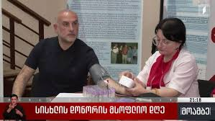
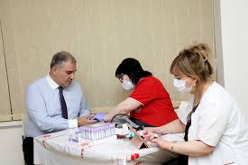
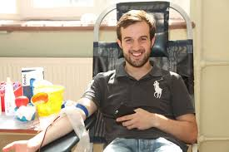
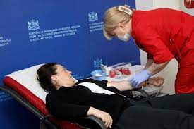
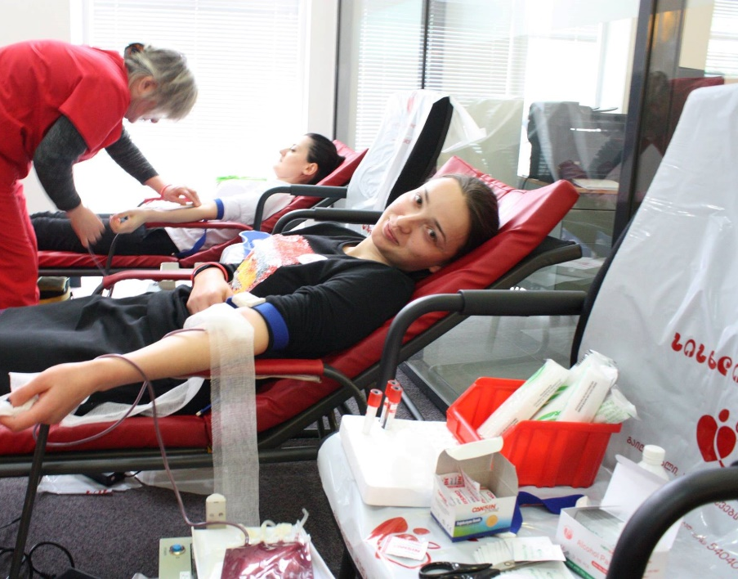
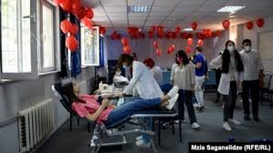

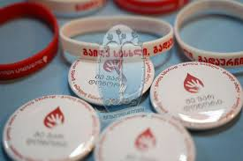
Ongoing Projects: VNRBD campaigns

Slide 14
The Law of Georgia on quality and safety of human blood and its components - VNRBD
The State is obliged to promote blood donation in accordance with the principles of voluntariness, non-remuneration and anonymity in order to achieve high standards of safety of blood and its components. Article 6(7)
It is prohibited give monetary compensation and/or benefits equivalent to monetary compensation (Article 6) …to a blood donor from April 1, 2026 (Article 41)
Donor has right to have:
The honorary donor title
Gifts that do not violate voluntariness of the donation
Free time from work during the donation period
Free health services in case of SAR and SAE during donation (article 7)
By-law on the mechanisms for the motivation and encouragement of VNRBDs is being developed
NATIONAL CENTER FOR DISEASE CONTROL AND PUBLIC HEALTH

Slide 15
Challenges and Future Plans
Reorganization and centralization of blood safety system
Establishment of the Central Blood Establishment (centralization of donor recruitment services)
Implementation of unified quality and safety standards in line with EU legislation
The implementation of the new Legislation will ensure institutionalization and sustainability of all legal, structural and functional changes
Transition to 100% Voluntary non-remunerated blood donations and maintain adequate blood supply
Implementation of the communication strategy to support Georgia in the transition period (including raise awareness among general population)
Implementation of the new mechanisms for donor motivation and encouragement in order to recruit and retain first time donors as regular VNRBDs
Notes:
Government of Georgia started activities for the centralization of the system, preparatory work has begun on the establishment of the National Blood Center (central blood establishment) and a centralized laboratory
According the new law there should be no more than three blood establishments operating in the country, taking into account the geographical access, one of which, the Central Blood Establishment, shall be established by the Government of Georgia on behalf of the state.
Planned strengthening of the existing awareness-raising campaigns based on the “communication strategy” for the recruitment and retention of voluntary non-remunerated blood donors

Slide 16
Acknowledgements:
Ekaterine Adamia W. Martin Smid
Vladimer Getia,
Maya Alkhazashvili,
Sofio Dolbadze,
Lela Kvachantiradze
NATIONAL CENTER FOR DISEASE CONTROL AND PUBLIC HEALTH

Slide 17
Contact info:
Ketevan Shermadini, MD
Coordinator, "Safe Blood" State program.
National Center for Disease Control and Public Health
Address: Kakheti Highway #99. 0198 Tbilisi, Georgia
Tel: +995 599274878
NATIONAL CENTER FOR DISEASE CONTROL AND PUBLIC HEALTH

Slide 18

Thank you!

