Slide 1
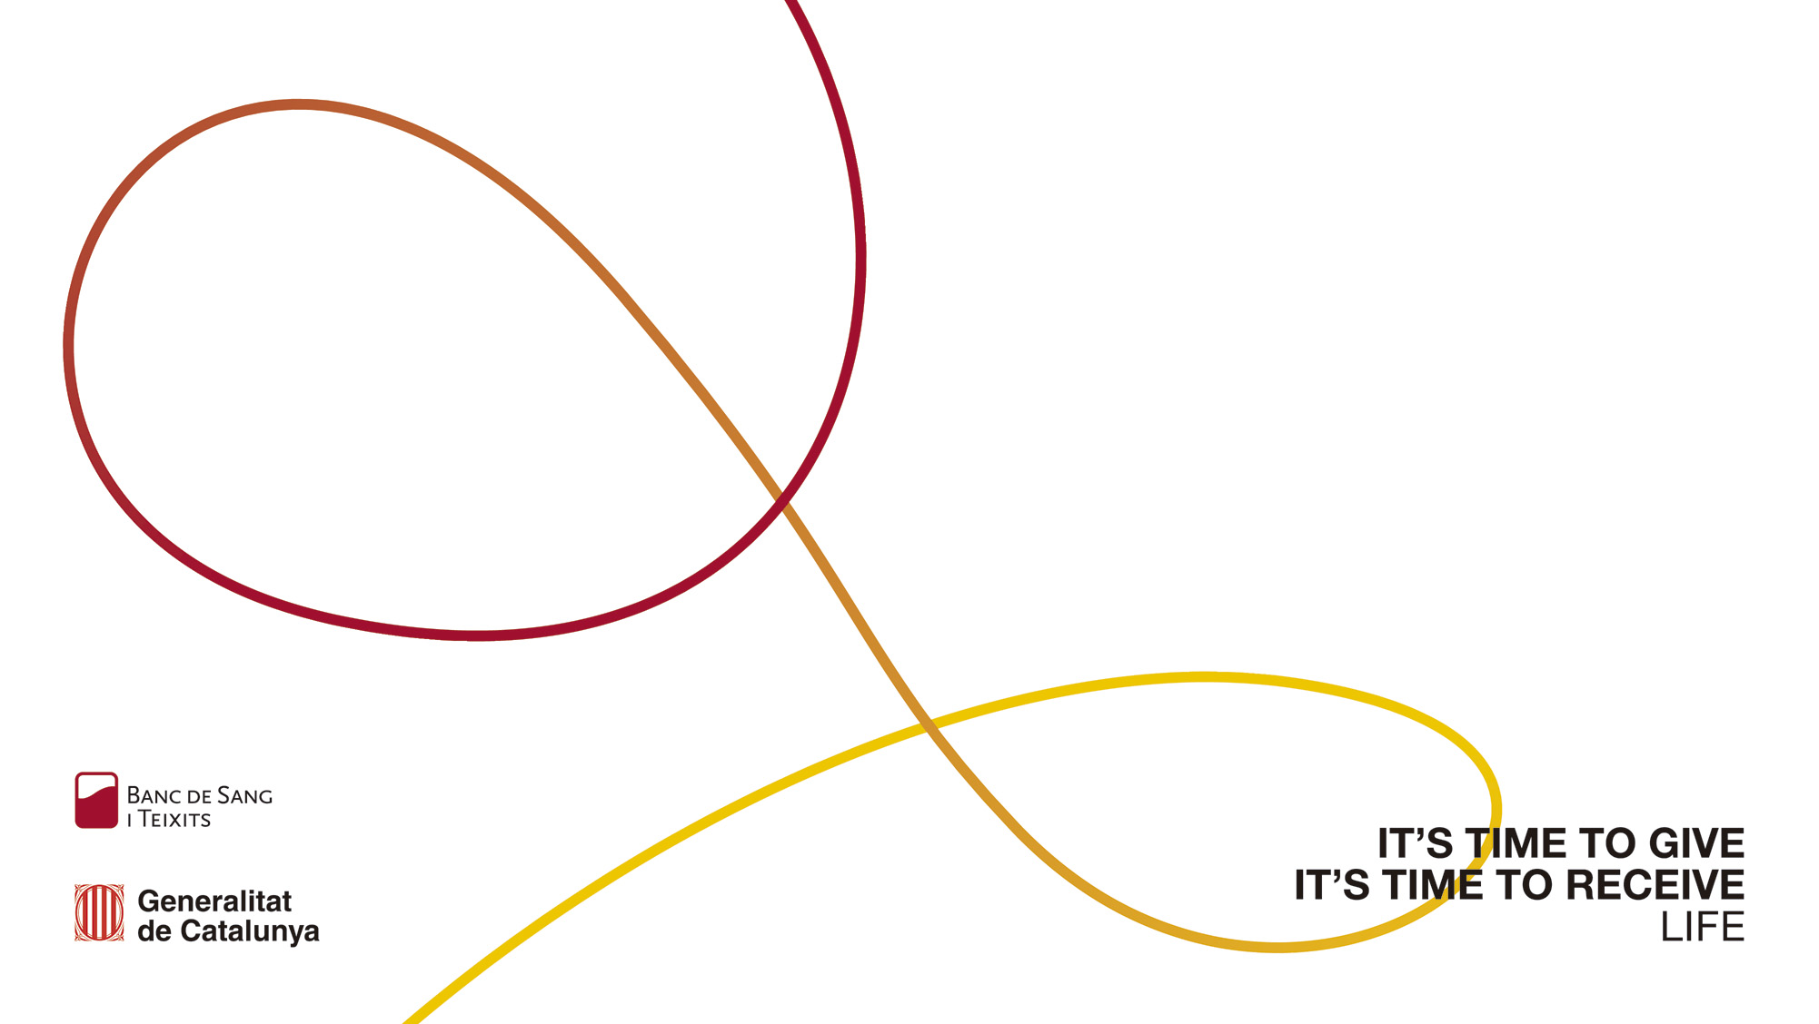
From Pixels to Purpose: Agumented Reality as a game-changer for blood donation in Catalonia

Slide 2
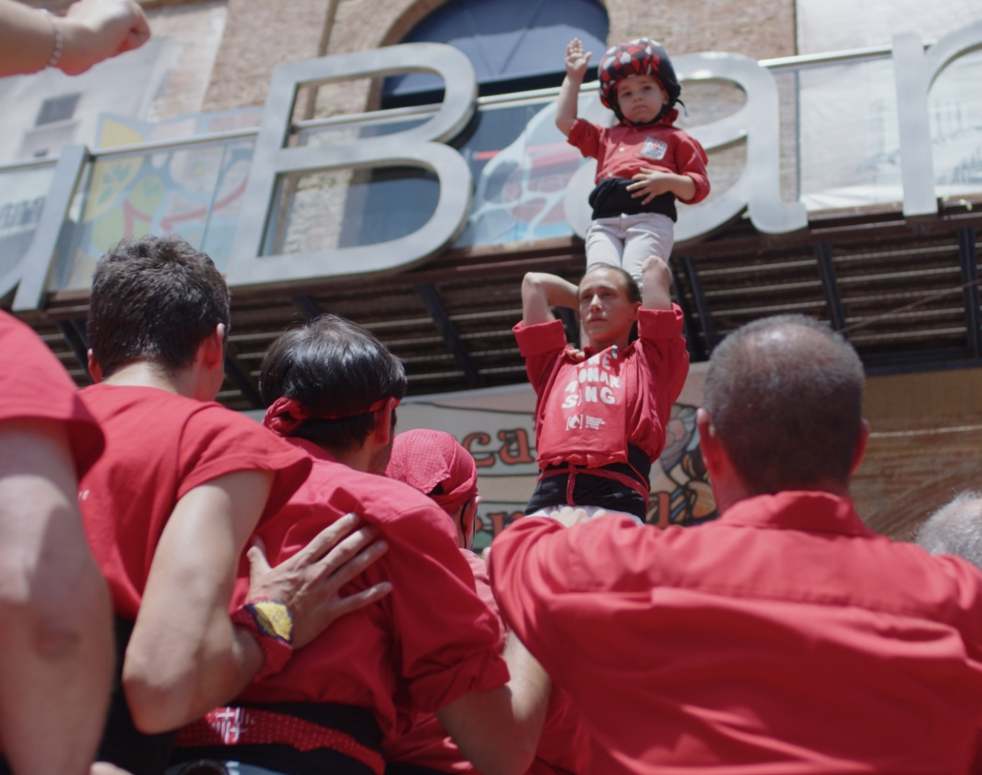


The challenge
Our Aproach
Implementation
Results & Impact
Conclusions

Slide 3

Banc de Sang i Teixits public organization
8 million people
5,3 million
18-70 years old
Notes:
This is Catalania and the red spot represent the 13 hospital blood Banks run by the BST which are also the main hospitals in Catalania,
So the actual catalan blood network has 13 hospital blood Banks which allows us to be near the patients, and 1 processing center which allows us to develop in the field of a transfusion center.

Slide 5
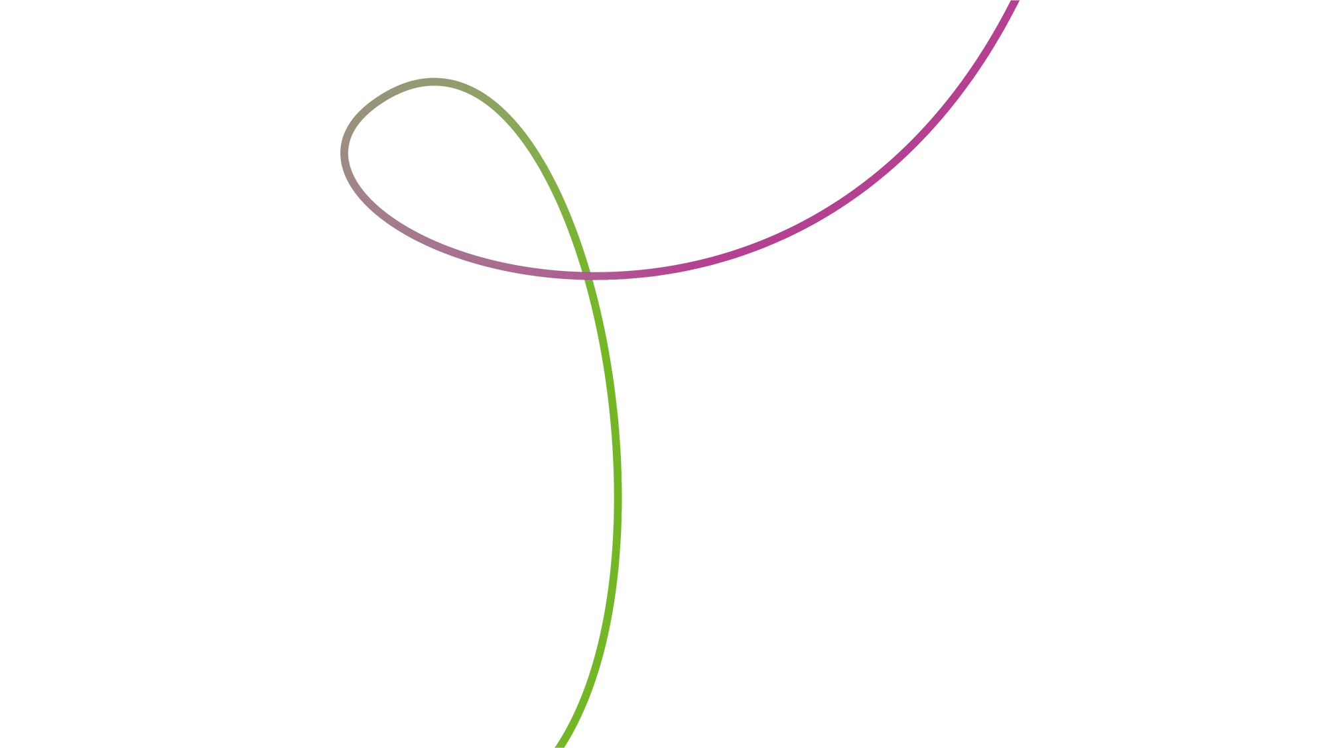
1
The Challenge

Slide 6
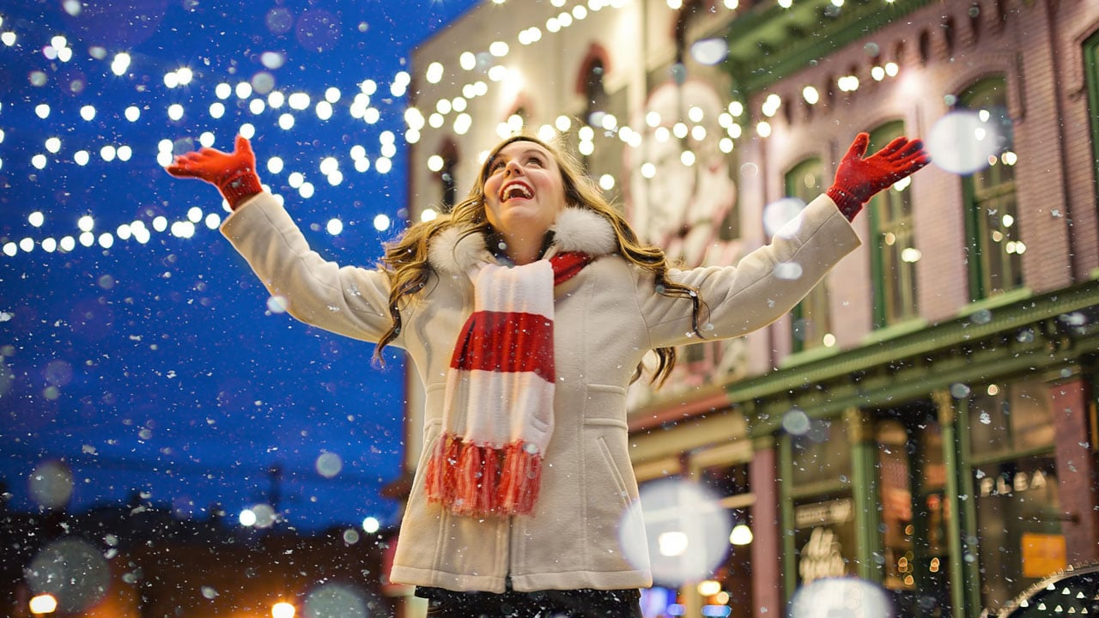
Notes:
The Challenge: January's Critical Donation Decline

Slide 7


Slide 8

2
Our aproach

Slide 9



Many organizations where you can collaborate
Hyper-informed society
the need to create bonds
For companies reaching their audience is a challenge
Innovation
to encourage participation

Slide 10
ATTRACTIVE
INNOVATIVE
COMMUNITY
COHESIVE
RESPONSABILITY

Slide 11
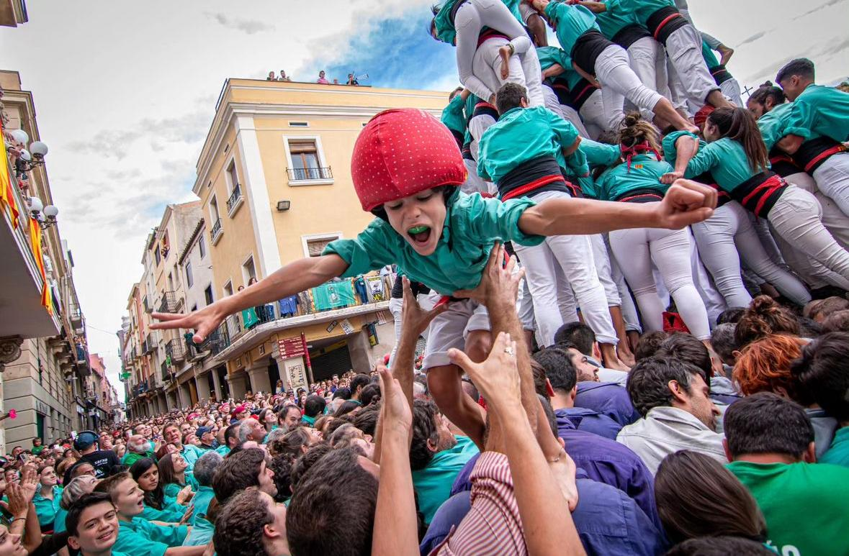
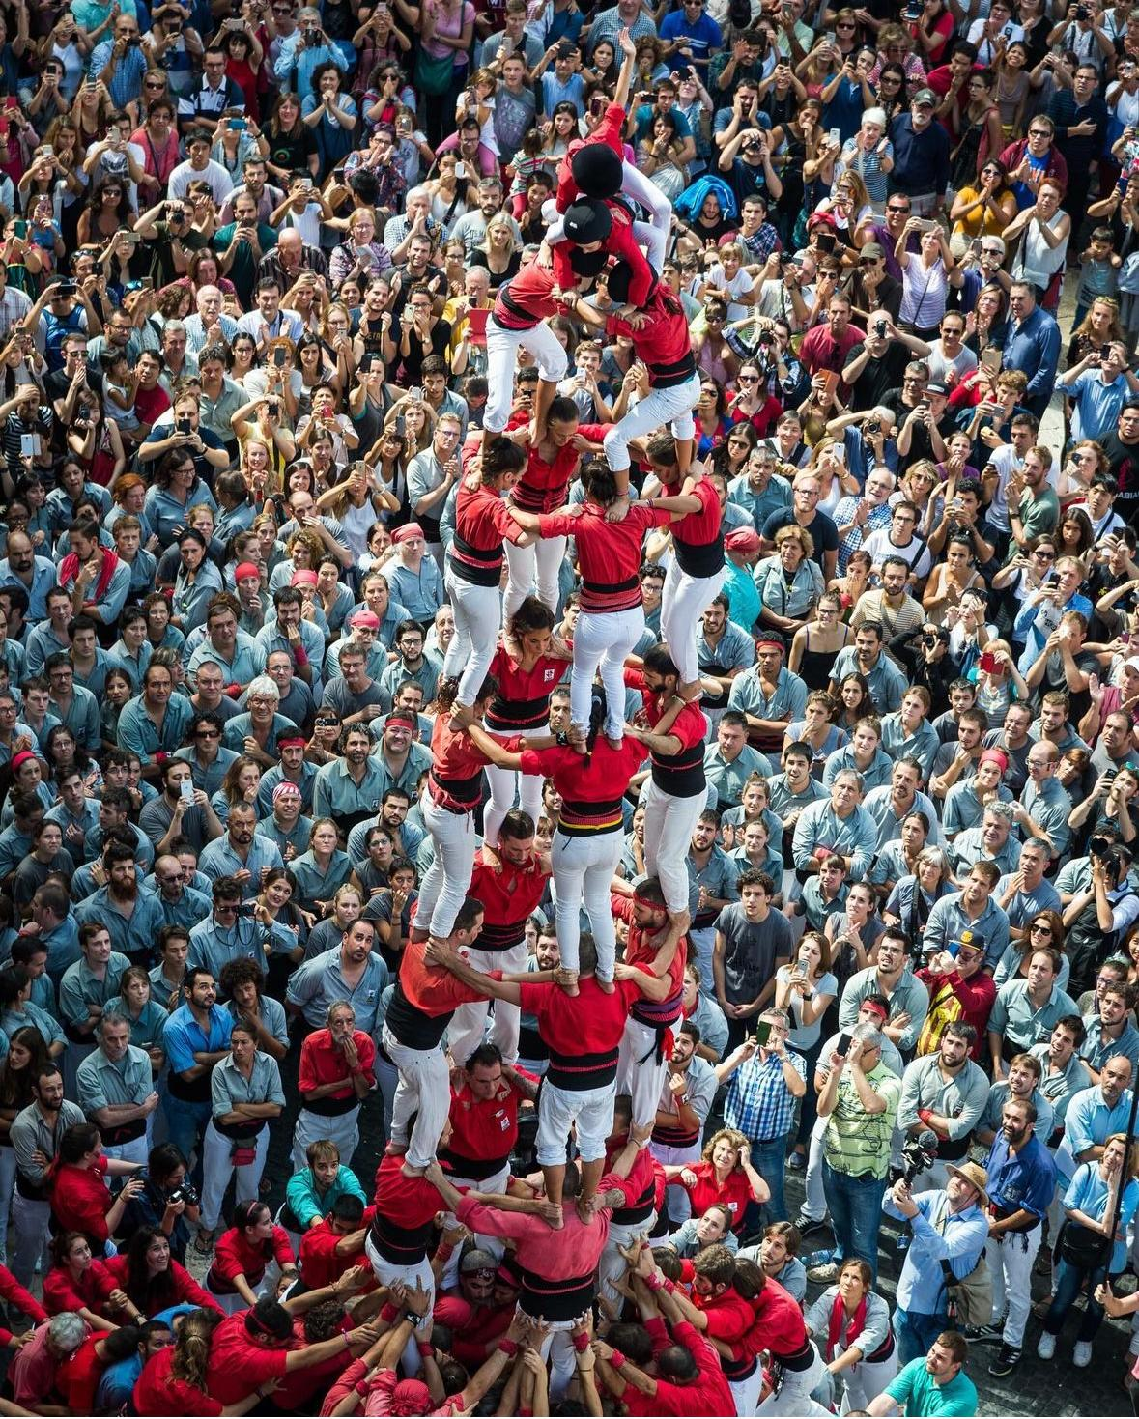
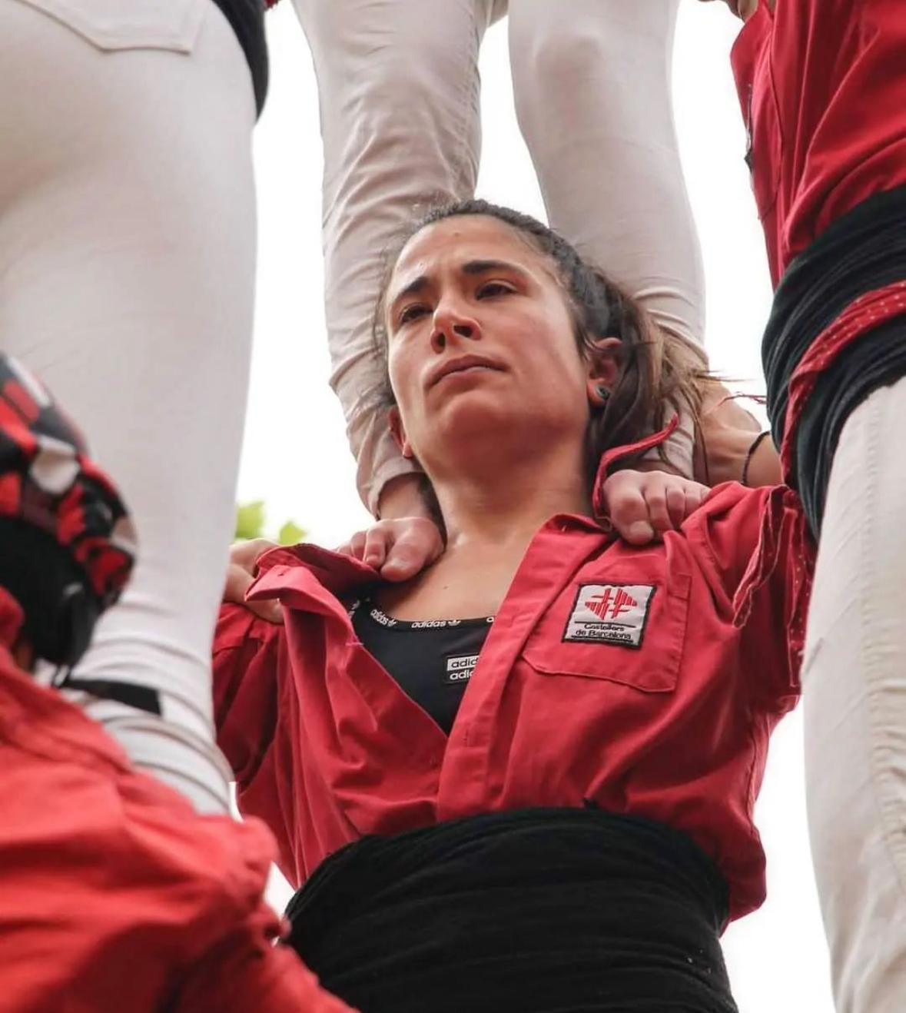
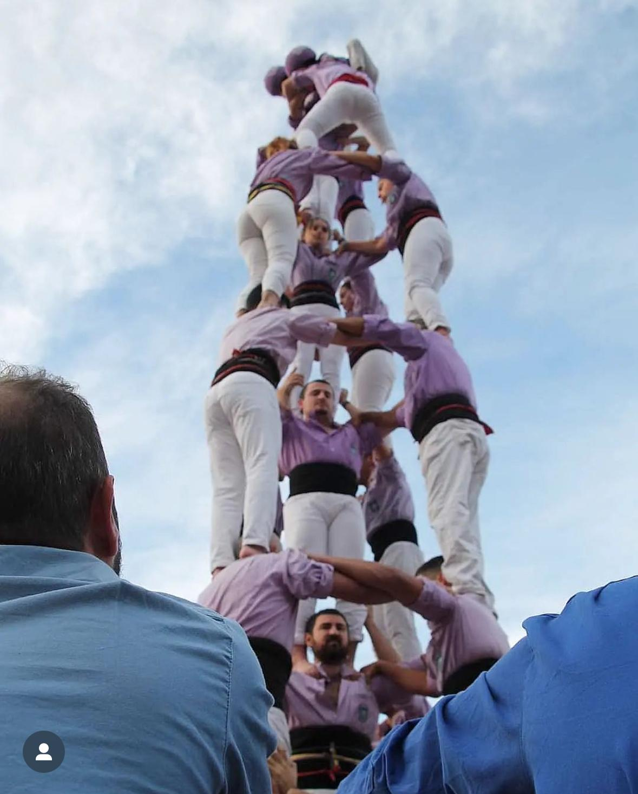
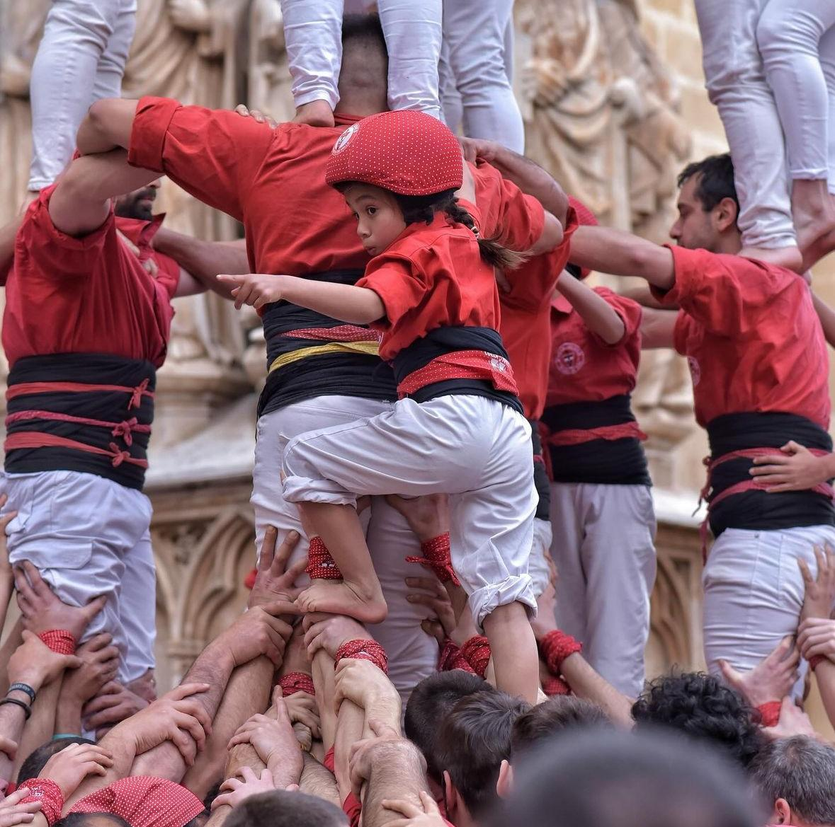
@castellersdevilafranca
@castellersdebarcelona
@fleurfieldscastelldefels
@jovesvalls
@fleurfieldscastellers
Notes:
The Power of Cultural Symbolism
Human Towers: "Castells"
The campaign strategically incorporated the human tower or "castell" - one of Catalonia's most powerful cultural symbols - as its central metaphor. These towers, built by teams of people standing on each other's shoulders, perfectly embody the campaign's core message:
Collective strength through individual contributions
Community achievement requiring participation from all
Cultural pride and shared identity
Visible demonstration of what can be accomplished together
By leveraging this deeply meaningful cultural symbol, the campaign tapped into existing emotional connections and community values, making the message more resonant and personally relevant to the Catalan audience.

Slide 12
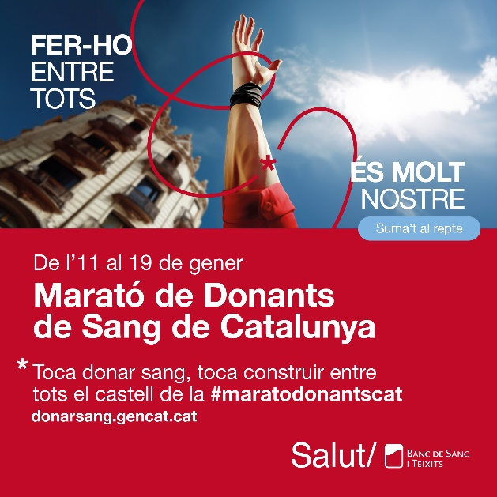
“Together we make a difference”
Notes:
At the heart of the initiative was a powerful unifying concept expressed through the slogan "Together, We Make a Difference." This central theme emphasized the collective impact of individual actions and positioned blood donation as a community achievement rather than a solitary act.
The campaign's core innovation was an interactive augmented reality installation that visually constructed a human tower with each blood donation. This dynamic digital representation grew in real-time, allowing donors to see how their contribution literally built upon others to create something magnificent and meaningful.
This approach transformed the abstract concept of blood donation into a visible, evolving demonstration of community power, making the impact of each donation immediately tangible and emotionally rewarding.

Slide 13
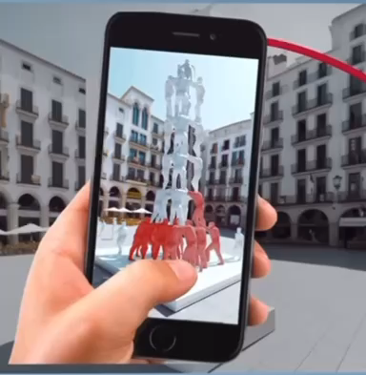
128.000
FROM JAN-JUNE
DONATIONS

Slide 14
3
Implementation

Slide 15
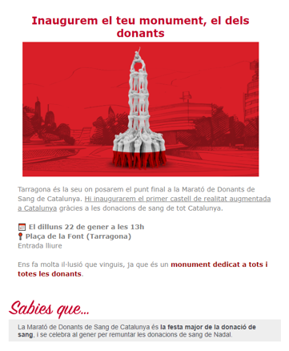
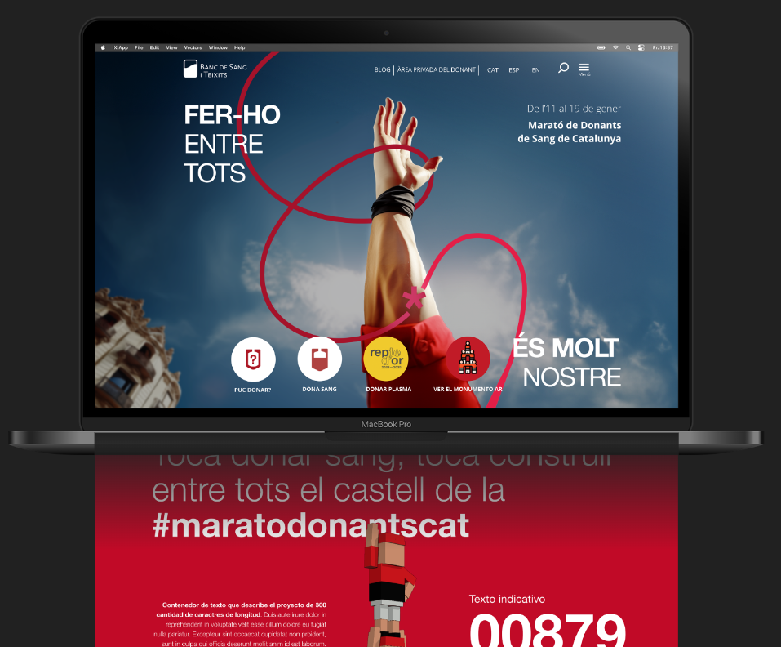
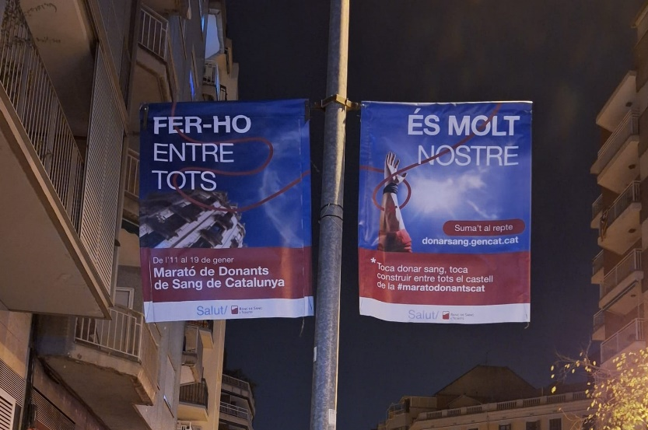



Multichannel Communication Strategy
Website Integration
Street Marketing
Direct Outreach
Incorporated into blood donation appointment website to centralize engagement
AR-enabled totems placed in key public areas across Catalonia
Newsletters targeting registered donors to encourage participation

Slide 16
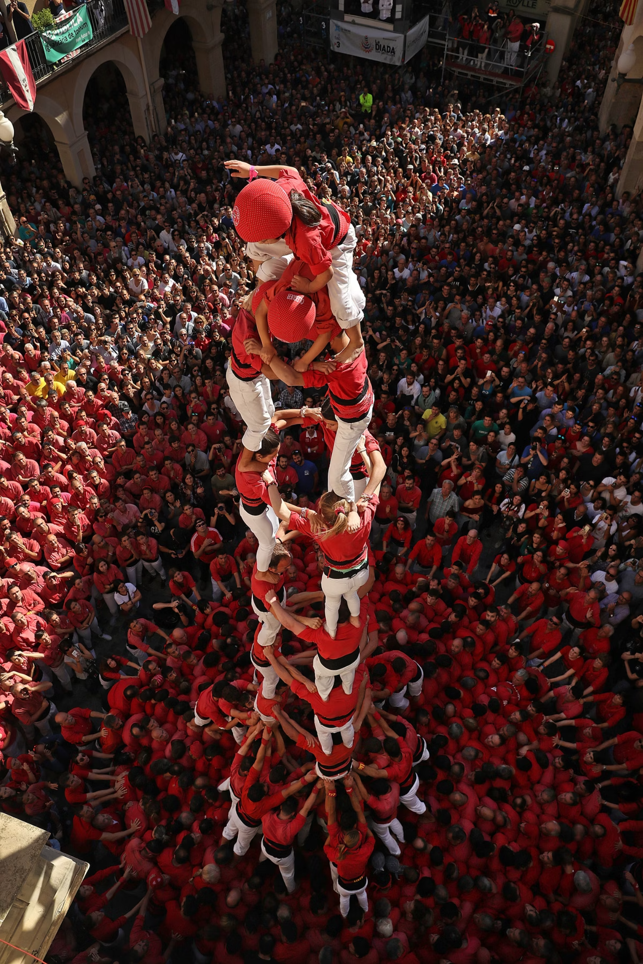



Extended Reach Strategies
Social & paid Media
Media Partnerships
Alliances

Slide 17
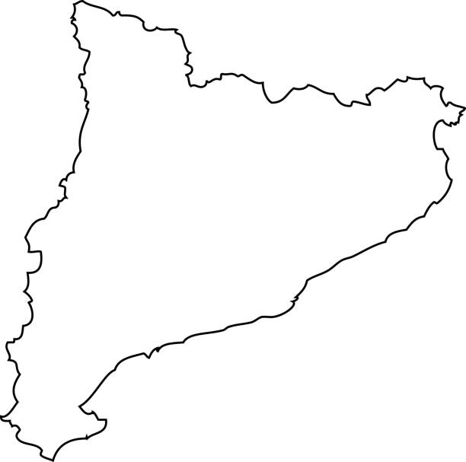
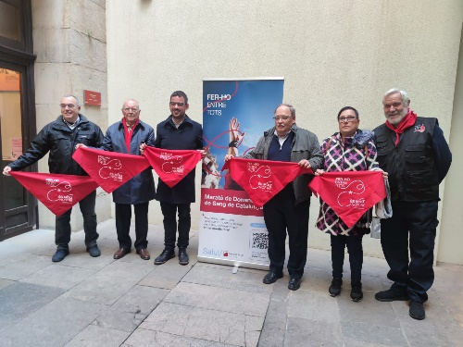
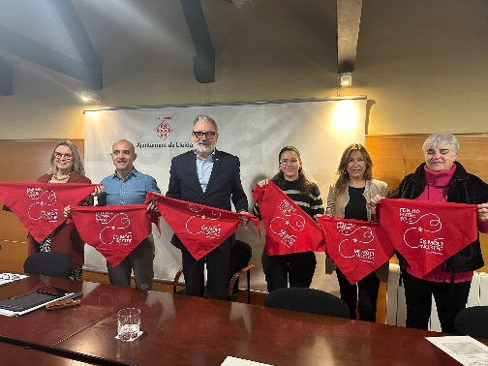
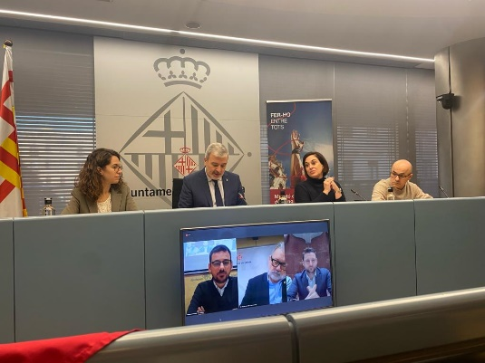
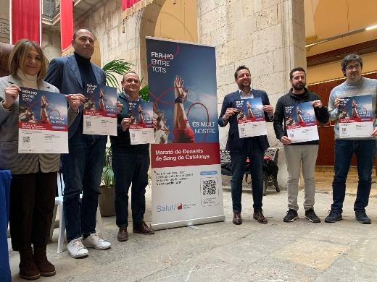
GGR
GIRONA
LLEIDA
BARCELONA
TARRAGONA

Slide 18
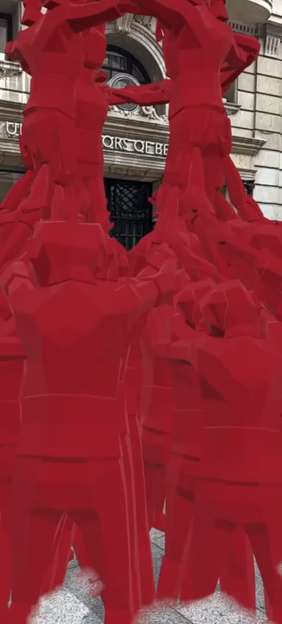
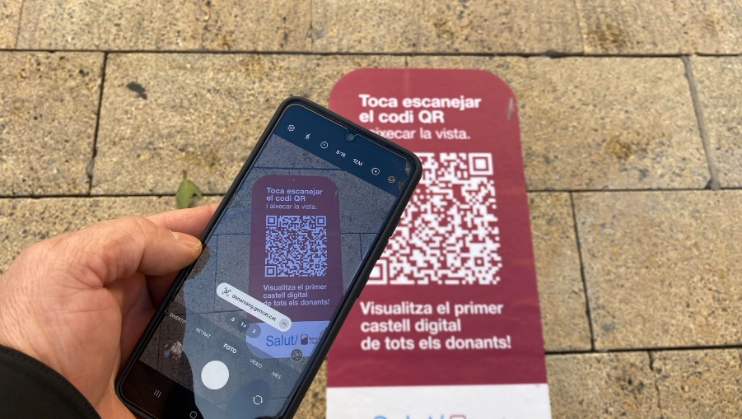

Slide 19
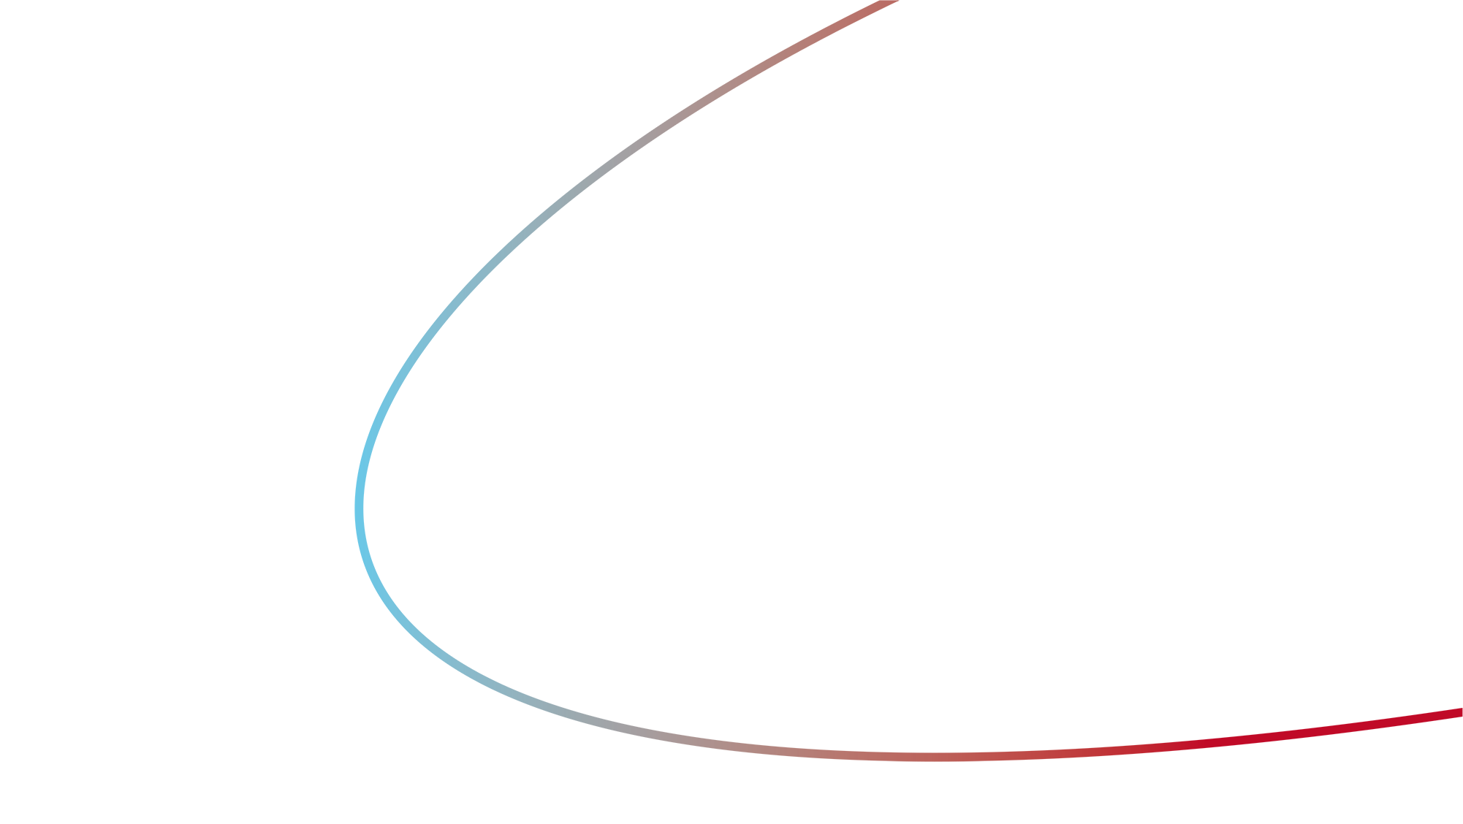
4
Results & Impact

Slide 20
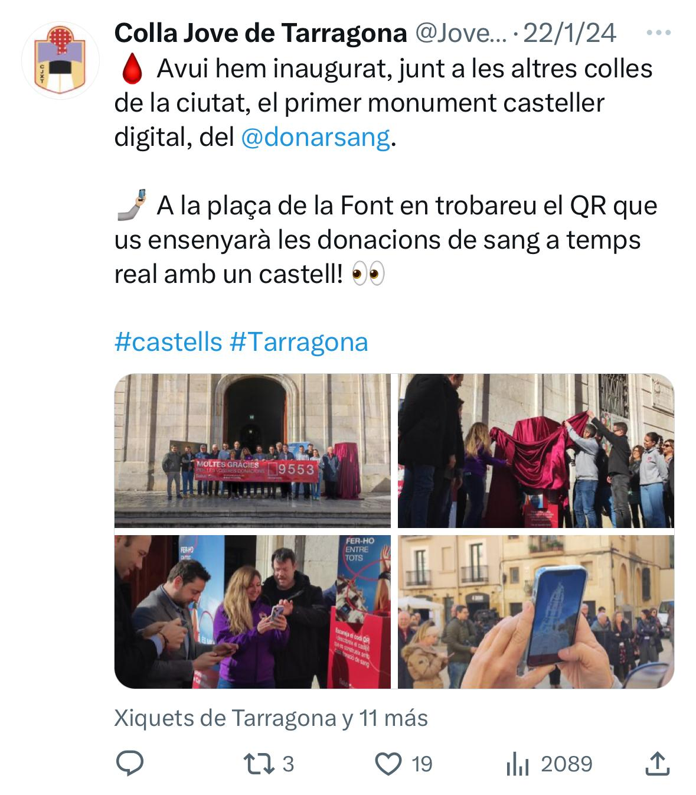
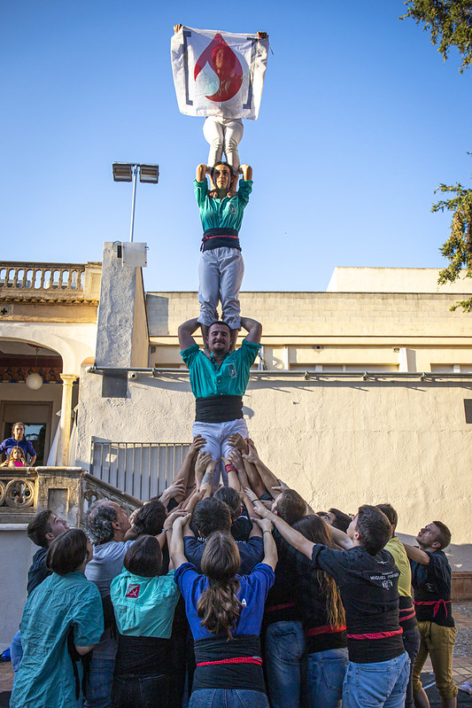
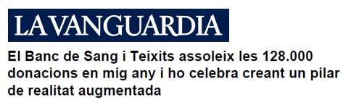
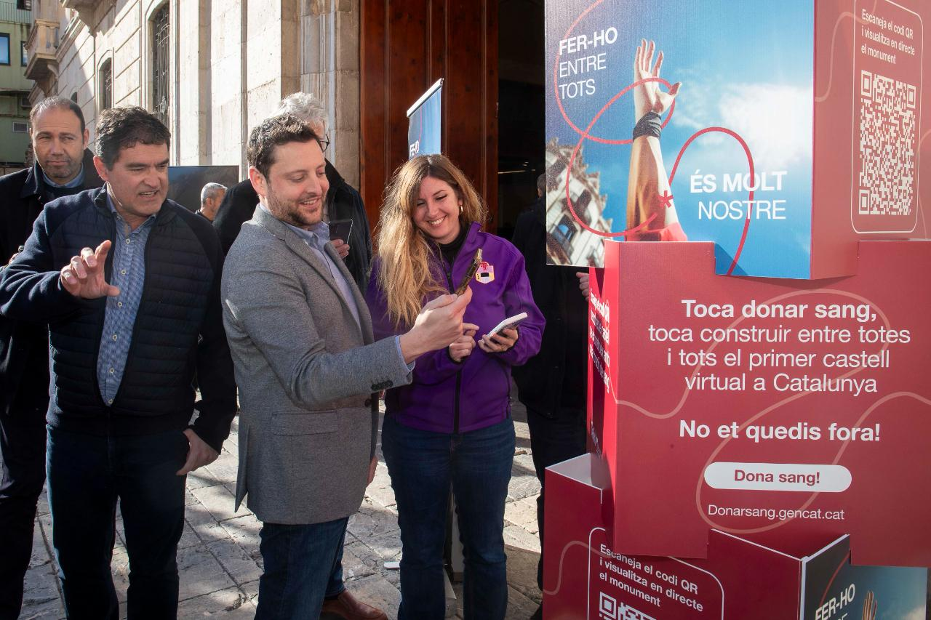
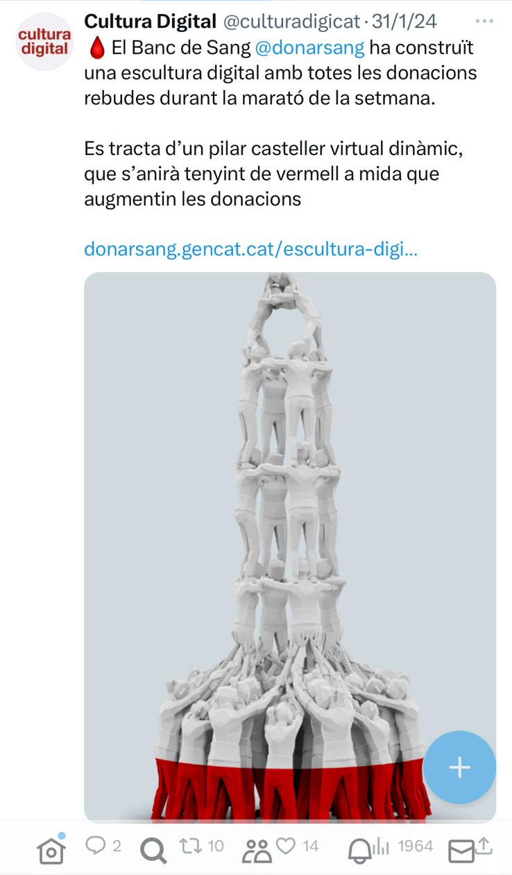
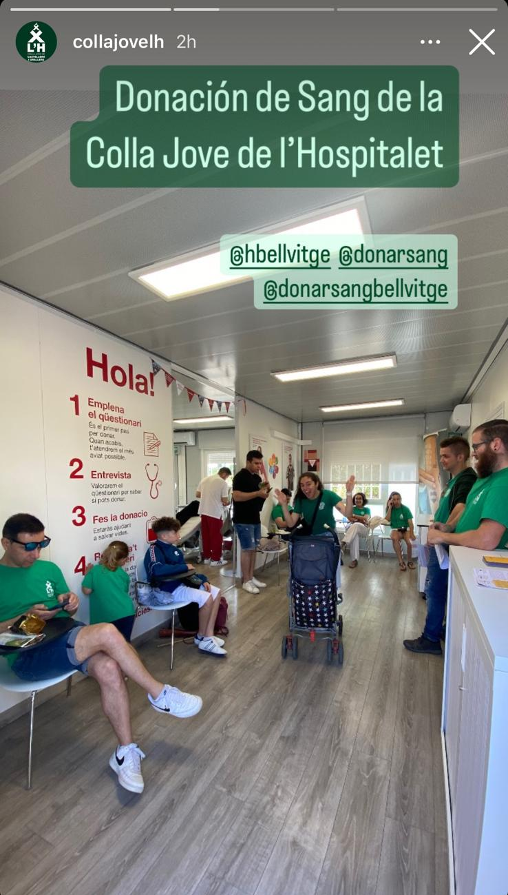
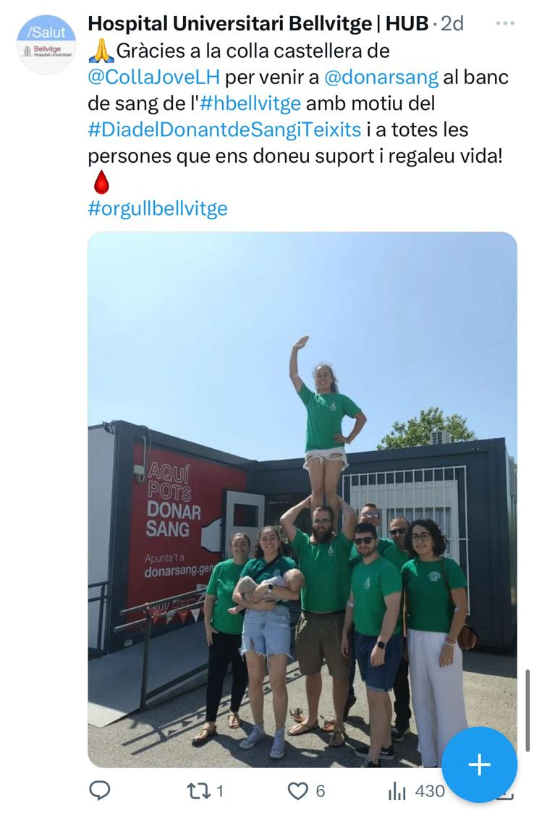
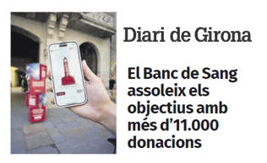
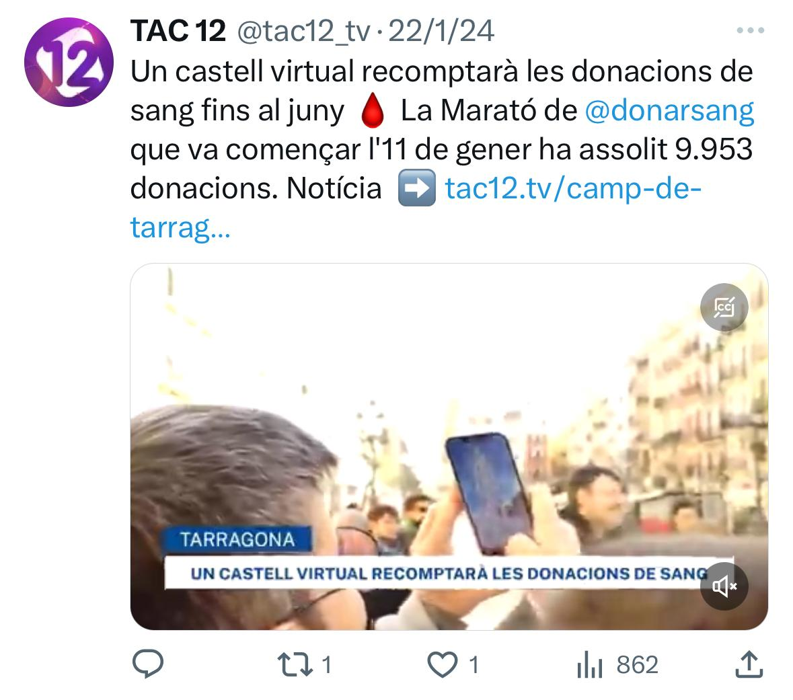
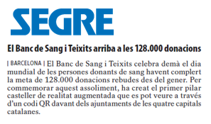
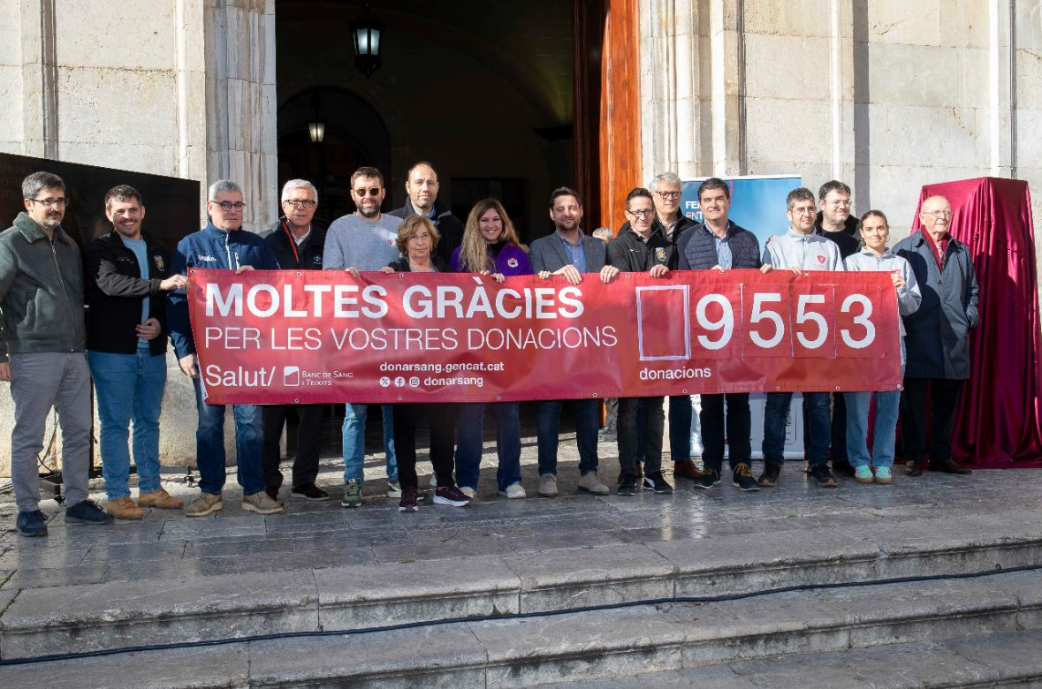
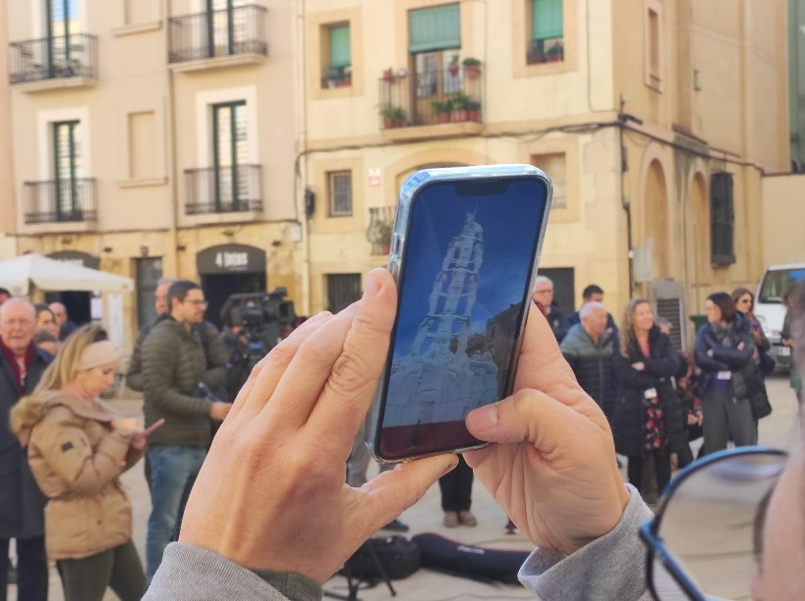


Slide 21
5
Conclusions

Slide 22




Impact
Cultural Relevance
Integration of heritage created a unique and memorable experience
Digital Innovation
Demonstrated potential of technology in building donor commitment
Community Building
Fostered deeper connections that extend beyond the campaign period
Engagement
Created foundation for ongoing participation in donation efforts

Slide 23
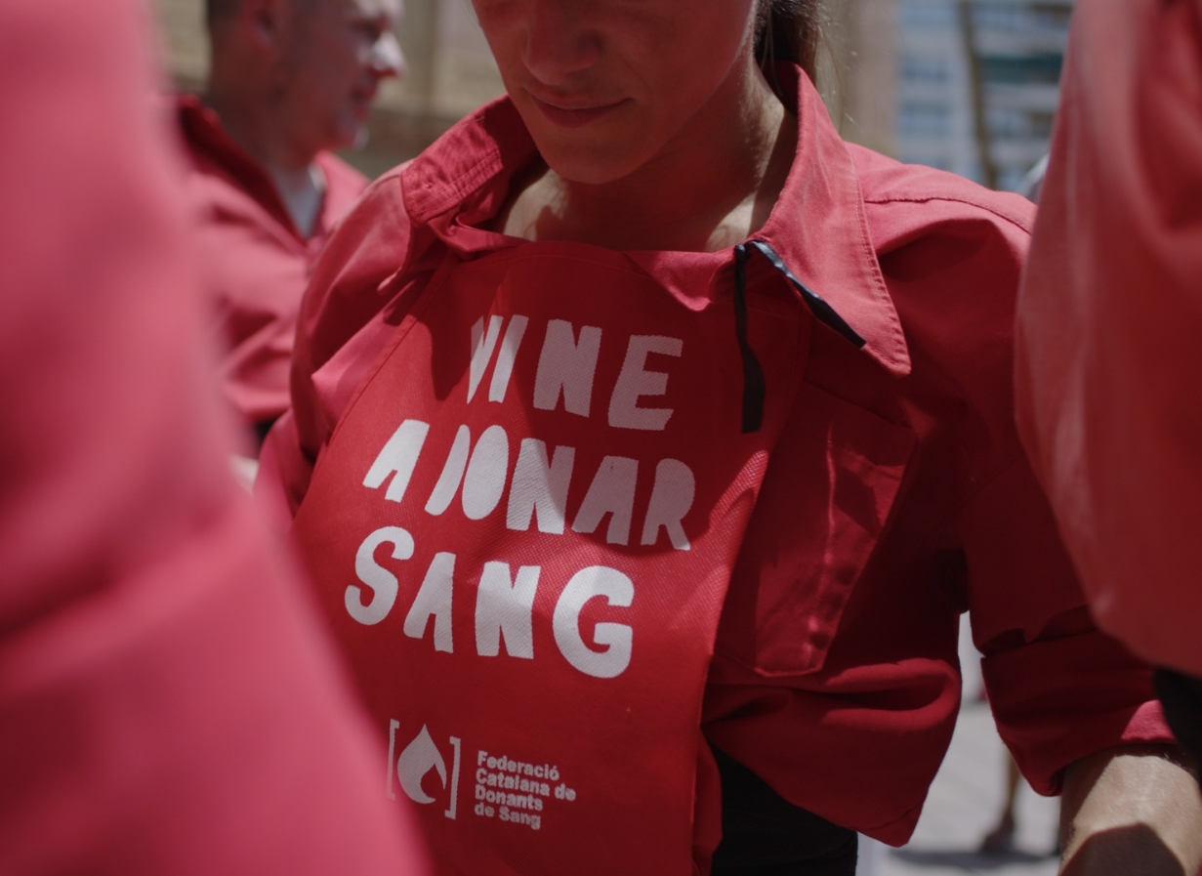
The power of augmented reality allows us to generate omnichannel conversation around blood donation
Visualizing the collective impact of the sum of individual actions fosters a culture of collaboration

Slide 24
