Slide 1

Expected outcomes of stratified post-donation testing in whole blood donation in England:
A discrete event simulation modelling study
Dr Lois Kim, Dr Hongchao Qi

Slide 2
Conflicts of interest
There are no conflicts of interest to declare.

Slide 3


What is post-donation testing (PDT)?
Hb from off-site post-donation test
Predicted Hb recovery
Stratified return pathway (time/test)
  No on-session Hb test for (most) donors
  No on-session Hb deferral for (most) donors
  More efficient use of staff/venue time
  Reduced costs?
Increased donations made under threshold?

Slide 4





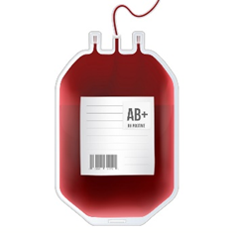
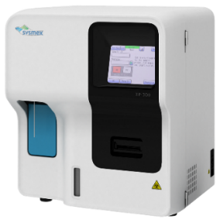
Microsimulation model
Build simulation model based on data from real-world studies of donors
18 months
N = 10,000 hypothetical donors
Change policy and re-run
e.g. return time, testing policy
Record outcomes & costs

Slide 5
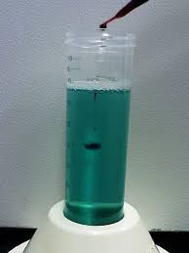



Current (women)
Eligible to return
Low Hb (115-124)
12 week deferral
On-site Hb test
Medium/high Hb (125+)
16 week recall
#ISBTBarcelona

Slide 6

PDT (women)
Eligible to return
High Hb (135+)
16 week recall
Medium Hb (125-134)
16 week recall
Low Hb (<125)
16 week recall
Off-site Hb test
#ISBTBarcelona

Slide 7
PDT (women)
Eligible to return
High Hb (135+)
16 week recall
Medium Hb (125-134)
16 week recall
Low Hb (<125)
26 week recall
Off-site Hb test
#ISBTBarcelona

Slide 8
PDT (women)
Eligible to return
Low Hb (<125)
12 week deferral
On-site Hb test
(subset only)
Medium/high Hb (125+)
16 week recall
High Hb (135+)
16 week recall
Medium Hb (125-134)
16 week recall
Low Hb (<125)
26 week recall
Off-site Hb test
#ISBTBarcelona

Slide 9
A few policy variations…
 |  | On-site tests? | Delayed return if donate + low PDT Hb?
 | Current (observed) | All | -
PDT | Strategy A | No | Yes
 | Strategy B | Low Hb at previous PDT | Yes
 | Strategy C | Low or medium Hb at previous PDT | Yes
 | Strategy D | Low or medium Hb at previous PDT | No

Slide 10
Simulated results scaled per 1000 donors (18m)
125g/dl (women),
135g/dl (men)
 |  | On-site tests | Donations | Under-threshold donations | Deferrals
M | Current (observed) | 2820 | 2670 | 2.3% | 5.5%
 | PDT: strategy C | 700 | 2660 | 3.0% | 3.3%
F | Current (observed) | 2050 | 1870 | 4.5% | 8.9%
 | PDT: strategy C | 780 | 1850 | 5.3% | 6.0%
Note: Observed in STRIDES based on CuSO4 + cHC. Simulated based on CuSO4 + cHC.

Slide 11
Simulated results scaled per 1000 donors (18m)
 |  | On-site tests | Donations | Under-threshold donations | Deferrals
M | Current (observed) | 2820 | 2670 | 2.3% | 5.5%
 | PDT: strategy A | 0 | 2700 | 6.5% | 0%
 | PDT: strategy B | 120 | 2700 | 5.1% | 1.0%
 | PDT: strategy C | 700 | 2660 | 3.0% | 3.3%
 | PDT: strategy D | 730 | 2700 | 3.3% | 3.7%
F | Current (observed) | 2050 | 1870 | 4.5% | 8.9%
 | PDT: strategy A | 0 | 1930 | 11.8% | 0%
 | PDT: strategy B | 170 | 1900 | 8.8% | 2.2%
 | PDT: strategy C | 780 | 1850 | 5.3% | 6.0%
 | PDT: strategy D | 800 | 1880 | 5.5% | 6.3%

Slide 12

Utility of different policies
$$U=N_{TD}−T_{UD}×N_{UD}−T_{LD}×N_{LD}$$
i.e.
Total donations collected
under-threshold donations x T_{UD}
Deferrals x T_{LD}
Deferrals
Large T_{UD} = strong preference to avoid under-threshold donations
Large T_{LD} = strong preference to avoid deferrals
Total donations
Under-threshold donations

Slide 13
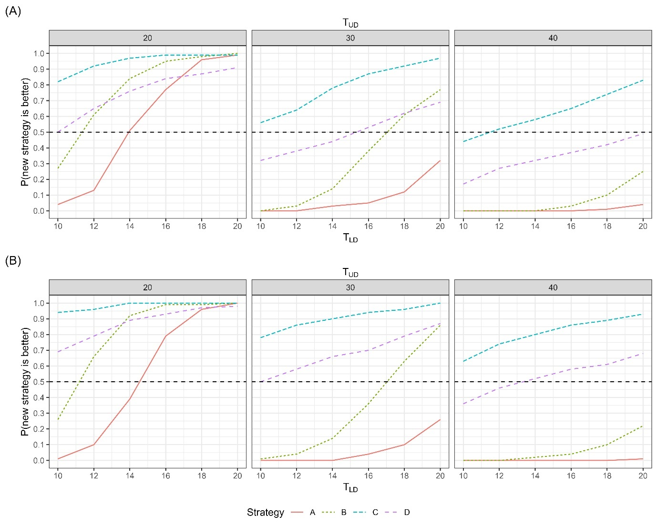
Men
Very strong preference to avoid under-threshold donations;
low preference to avoid deferrals
Women

Slide 14
Real-world study
Data from current + PDT testing from each centre
4 x
4-month blocks
Stepped intro for PDT
Starting
Oct 2025
3 donation centres
~75,000 donations
 | Oct 25 – Jan 26 | Feb 26 – May 26 | Jun 26 – Sept 26 | Oct 26 – Jan 27
Centre 1 | Current | PDT | PDT | PDT
Centre 2 | Current | Current | PDT | PDT
Centre 3 | Current | Current | Current | PDT

Slide 15
With thanks to:
Hongchao Qi (University of Cambridge)
And colleagues at NHSBT:
David Roberts
Gina Morton
Stephen Thomas
Mick Duley
Lian Wea Chia
Annabel Smith
DOI: 10.1111/trf.18165

