Slide 1
Session 6 New data sources: Opportunity and challenges
First approach to gender and trade statistics in Mexico: The Profile of Export Manufacturing Enterprises by sex
28th Meeting of the Wiesbaden Group on Business Registers
October 2-6, 2023
October 5, 2023

Slide 2
Outline
Introduction and objective
Methodological aspects
Main outcomes
Conclusions and next steps

Slide 3
Introduction and objective

Slide 4
Introduction
Currently there has been an increasing demand for gender statistics, to support the formulation of public policies related to the sustainable development in countries
However, regularly female or male sex is recorded, instead of gender
In this regard, INEGI takes advantage of the available data sources and MDL to produce linked business and trade statistics disaggregated by sex
Since 2022, the Profile of Export Manufacturing Enterprises (PEME) includes the topic on employment in manufacturing enterprises that carry out foreign trade operations, distinguishing the sex of the employees
PEME by sex is a tool for designing, monitoring, and evaluating public policies aimed at reducing the disadvantages faced by women

Slide 5
Objective
The Profile of Export Manufacturing Enterprises (PEME) disaggregated by sex, aims to provide statistics regarding foreign trade flows with the most representative economic variables of manufacturing enterprises, contributing to the measurement of international trade, as well as to the analysis and influence on production and the level of employment, particularly the participation of women and men in trade

Slide 6
Methodological aspects

Slide 7
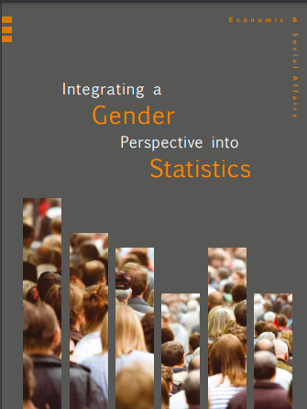
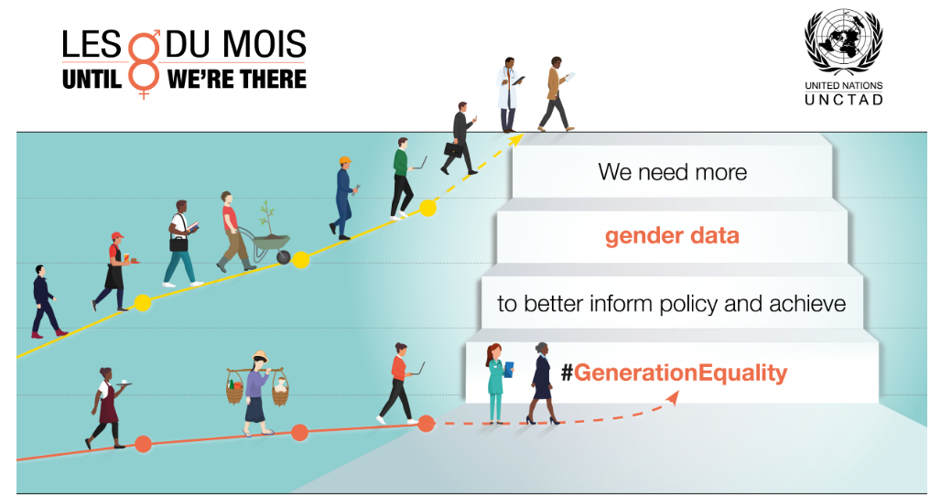
International framework on gender

Slide 8
Microdata linking (MDL) process in Mexico
INEGI has carried out microdata linking among several sources to elaborate new products with different breakdowns by using the SBR (RENEM by its acronym in Spanish)
SBR merges statistical information from economic surveys, and several administrative registers, as well as the economic censuses
Basic statistical unit for linking business and trade is the enterprise
The enterprise which comprises more than one establishment, consolidates all of them under the same legal name, facilitating the linkage to Custom Declarations
For producing subnational statistics (e.g., Exports by State), the consolidated enterprises are disaggregated by establishment
MDL contributes to reducing the response burden to informants

Slide 9
Data sources used to get the characteristics of manufacturing enterprises engaged in international trade in goods
SBR
Economic Censuses
Customs records
Monthly
Quinquennial basis
Manufacturing, Maquila and Export Service Industry (IMMEX)
National Business Surveys
Monthly
Annual and monthly

Slide 10
Main variables of PEME
2018-2021, annual data ^{P/}
Number of Manufacturing Enterprises
Export and Import values
Number of employees by enterprise size
NAICS sector and subsector (2 and 3-digit level)
https://www.inegi.org.mx/temas/empresasman/
^{P/} Preliminary figures

Slide 11
Focus on Manufacturing Enterprises
In 2018 the manufacturing industry accounted 23.9% of the total employee by private sector and public enterprises in Mexico²
The rich detail available in the data sources on manufacturing firms allowed to have a robust enterprise population data set on this activity
Manufacturing is the most relevant activity in Mexican exports. During 2021 represented 88.1% of the total exports¹
¹ IMTS of Mexico, INEGI, 2021. https://www.inegi.org.mx/temas/balanza/
² Economic Censuses 2019. INEGI, 2020. https://www.inegi.org.mx/programas/ce/2019/
Notes:
Incorporar en las notas de presentación According to WTO, during 2021, Mexican exports and imports were at the 12 place, (495 billion dollars and 522 billion dollars respectively)¹ También ocupa el octavo lugar en exportaciones e importaciones manufactureras ¹ WTO, 2022. Global and trade Outlook statistics. https://www.wto.org/english/res_e/booksp_e/wtsr_2022_e.pdf

Slide 12
Enterprise size according to number of employees
Total of employees
Women
Men
Enterprise size | Number of employees
Micro | 1 - 10
Small | 11 - 50
Medium | 51 - 250
Large | 251 - 500
Macro | 501 or more

Slide 13
Employment variables in the Structural Business Statistics
Economic Censuses
Annual Survey of the Manufacturing Industry (EAIM)
Program of Manufacturing Industry, Maquila and Export Services (IMMEX)
Number of employees disaggregated by sex
Number of employees (Total)

Slide 14
Disseminated variables
Main variables disaggregated by sex of the employees:
Total number of manufacturing traders by: Size and NAICS Sector and Subsector
Exporting Enterprises by: Size and NAICS Sector and Subsector
Importing Enterprises by: Size and NAICS Sector and Subsector

Slide 15
Data Validation
CE
EAIM
PEME
VAEGM
IMSS
IMMEX
Economic Censuses
Surveys of the Manufacturing Industry
Internal data sources
(Economic programs of INEGI)
Manufacturing, Maquila and Export Service Industry (IMMEX)
Export Value Added of Global Manufacturing
External administrative records
The Mexican Institute of Social Security

Slide 16
Main Outcomes

Slide 17
Women and men employed by manufacturing traders
2018 – 2021^{P/}
64.3%
63.9%
63.6%
63%
Thousands of employees
35.7%
36.1%
36.4%
37%
^{P/} Preliminary figures

Slide 18
Participation rate in manufacturing traders by sex and size
2021^{P/}
Thousands of employees
4,027
3,204
Large
432
358
32
1
Women
Men
^{P/} Preliminary figures

Slide 19
Distribution of women employed in manufacturing traders
by NAICS subsector, 2021^{P/}
Transportation equipment
Computer and electronics
Food manufacturing
Plastics and rubber products
Electrical Equipment
Apparel manufacturing
Chemical Industry
Machinery
Other
Miscellaneous manufacturing
Metallic
Products
Paper Industry
Furniture
Women (Total) = 1,488 Thousands of employees
^{P/} Preliminary figures

Slide 20
Distribution of men employed in manufacturing traders
by NAICS subsector, 2021^{P/}
Transportation equipment
Food manufacturing
Plastics and rubber products
Metallic
Products
Chemical Industry
Miscellaneous manufacturing
Primary metal
Nonmetallic Mineral
Electrical Equipment
Computer and electronics
Beverage and Tobacco
Apparel manufacturing
Machinery
Other
Paper Industry
Furniture
Men (Total) = 2,539 Thousands of employees
^{P/} Preliminary figures

Slide 21
Participation rate in manufacturing traders by sex and
NAICS subsector, 2021^{P/} (1/2)
Thousands of employees
118
244
392
31
282
34
51
254
1,127
165
70
Total employees: 4,027
^{P/} Preliminary figures

Slide 22
Participation rate in manufacturing traders by sex and
NAICS subsector, 2021^{P/} (2/2)
Thousands of employees
191
394
49
143
103
16
37
111
116
99
Total employees: 4,027
Women
Men
^{P/} Preliminary figures

Slide 23
Average of employees in manufacturing traders
by selected NAICS subsector in 2021^{P/}
Average
^{P/} Preliminary figures

Slide 24
Conclusions and next steps

Slide 25
Conclusions (1 of 2)
The use of MDL has allowed to analyze the participation of women and men in manufacturing enterprises that participate in international trade of goods for the period from 2018 to 2021
This project took advantage of the standardization of concepts previously elaborated under the business statistical programs which facilitated the disaggregation of PEME by sex
In overall, during the period 2018 to 2021 there is a stable participation of women and men in the manufacturing traders, where one of each three employees were women
Slightly more than one half of the total employees were women in the following manufacturing activities: Apparel, Miscellaneous, and computer and electronics

Slide 26
Conclusions (2 of 2)
On the other hand, more than 80 percent of the total employees were men in the manufacturing of Beverage and tobacco, Primary metal, and Nonmetallic Mineral
The average participation by subsector of women is 213 people at the national level. Above the average are 5 subsectors, the most important being 334 Computer and electronic with 573 women, while below the national average are 16 subsectors, the lowest average being the subsector 321 wood product with 33 people
The average participation per subsector for men is 363 people at the national level. Above the average are 9 subsectors, the most important being 324 Petroleum and coal, while below the national average are 12 subsectors, the lowest average being subsector 321 wood product with 125 people
On average at the national level, the participation of men is higher than women

Slide 27
Gerardo Durand
Deputy Director General of Economic Administrative Records
National Institute of Statistics and Geography (INEGI)
gerardo.durand@inegi.org.mx
Thank you!

