Slide 1
Large cases units in EU and EFTA countries
28th meeting of the Wiesbaden Group on business registers
Session 3 – Globalization and large cases units
2-6 October 2023
Eurostat

Slide 2
Table of contents
Introduction
Eurostat’s support for LCUs and better MNE groups’ approach
Activities carried out in LCUs and similarly organised structures
The European network of MNE groups coordinators – MNEnet
Different data sources used in LCUs
IT infrastructure at national level/European level
Dissemination of experimental data on MNE Groups from EuroGroups register (EGR)

Slide 3
Introduction
Large and complex multinational enterprise (MNE) groups are the main reason for the large data asymmetries between countries
During the last few years, the ESS has made considerable progress in bringing together ongoing MNE-related activities, as well as the available technical infrastructure to help resolve inconsistencies in MNE Groups data
The pivotal role of the statistical business registers is also a key point to ensuring consistent MNE group information
the European business statistics Regulation 2019/2152 strengthens further the role of national statistical business registers, the EuroGroups register, in particular their essential infrastructural role as an authoritative source in business statistics

Slide 4
Eurostat’s support
LCUs and similar struct. at national level - financial support through grants
Dedicated training programme to better understand MNE groups
Dedicated wiki on LCUs
MNEnet at European leve)
Secure exchanges with other EU_EFTA on large MNE groups
Early warning system
EuroGrpous Register and European profiling

Slide 5
LCUs and similar organisational structures
At national level, LCUs and similar organisational structures are specialised organisational units in a NSI that observe and analyse large MNE groups operating on national territories. They consist of experts from different statistical domains – BR, SBS, NA,…
Having a specialised unit in the organisational structure of an NSI can bring different benefits:
- significant improvement of the macroeconomic database and provision of consistent and credible statistics to the political, economic and scientific decision- makers
- better understanding of statistical concepts by the reporting officer in an MNE Group
- ensuring that data collected in different statistical processes from and on the largest and most complex MNE groups is consistent

Slide 6
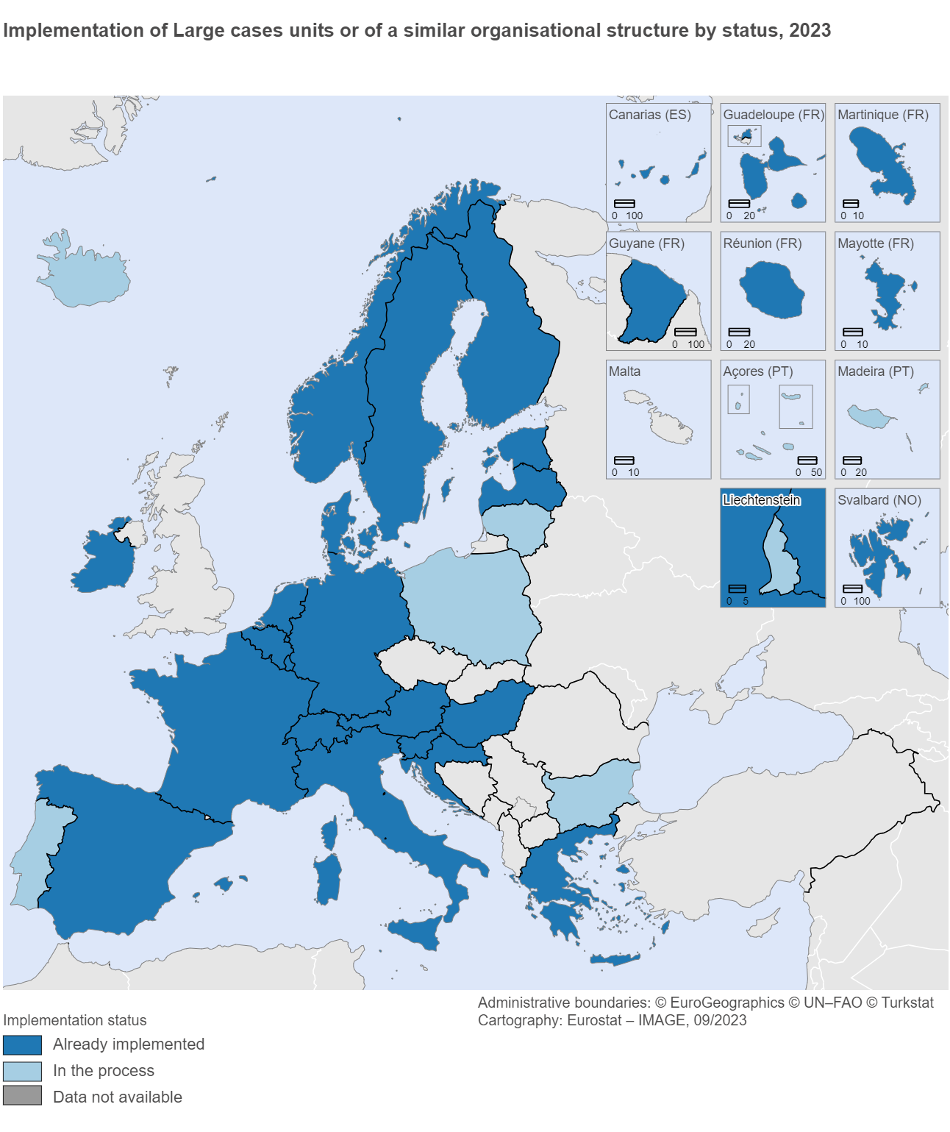
Most of European NSIs have or are in the process to have a LCU

Slide 7
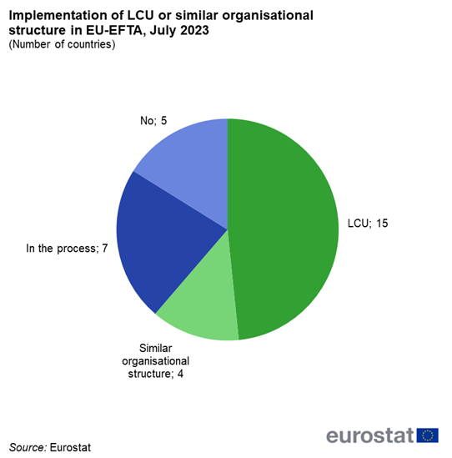

Slide 8
Activities carried out in LCUs and similarly organised structures
- Relations with the largest MNE groups
- Early warning system activities
- Data collection
- Performing consistency checks
- Profiling
- Other tasks
In January 2023, there were all together more than 600 MNE groups under observation of different LCUs across NSIs:
79% of them were controlled from the EU
21% had a non-EU nationality
Out of these 600 MNE groups, more than 10% are closely followed in more than one European LCUs.
So-called top-tier MNEs, i.e. largest and most complex MNE groups, i.e., those with a significant impact on macroeconomic and business statistics, operating in and being controlled by EU and EFTA countries should be checked systematically and followed up allowing higher and assured quality and the creation of the timelier frames consisting of the updated data of the largest MNE groups. According to EGR, they are about 1 600 and cover more than 50% employment of EGR.

Slide 9
The European network of MNE groups coordinators – MNEnet
Established in April 2021, the overall objective is: promote and facilitate a coordinated and consistent treatment of the largest MNE groups’ data across the statistical production chain (statistical business registers, primary statistics and macroeconomic statistics).
it strengthens the cooperation and communication of European MNE experts by creating a network where MNE-related issues and topics can be shared.
The national MNEnet coordinators subsequently ensure that the information gathered is distributed to all statistical domains impacted by MNE groups activities and their restructure
In 2022, the MNEnet took over the coordination role of the early warning system, which is responsible for early identification and reconciliation of significant cross-border, cross domain and inter-temporal inconsistencies, due to MNEs restructurings.

Slide 10
Early Warning System
The EWS is a structured, light (non-legislative) procedure based on voluntary cooperation between national data compilers and Eurostat. It was established in 2017 to detect restructuring events of MNE groups and to prepare for them. Its main objective is to facilitate an early exchange of information on emerging globalisation issues across directly concerned EU Member States.
The most important characteristics for an event to be reported in the EWS:
they have a major impact on figures in one of the affected countries;
they belong to top-tier MNE groups;
they are on the top list of EGR/GNI list;
The ESS is to perform a systematic search of the new cases via the webpages, news, the EWS Secretariat verifies the information with the EGR, the GNI and Profiling colleagues.

Slide 11
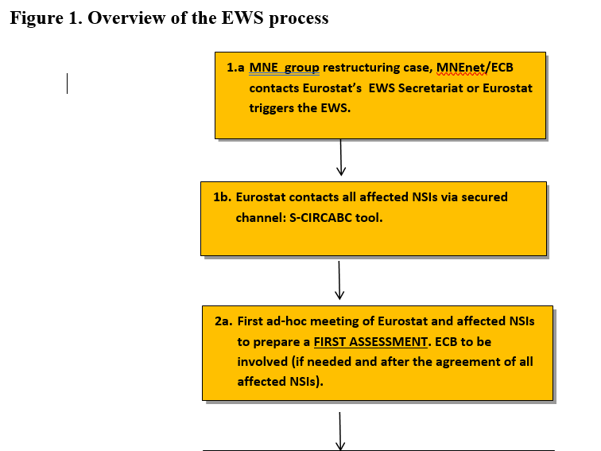
Early Warning System

Slide 12
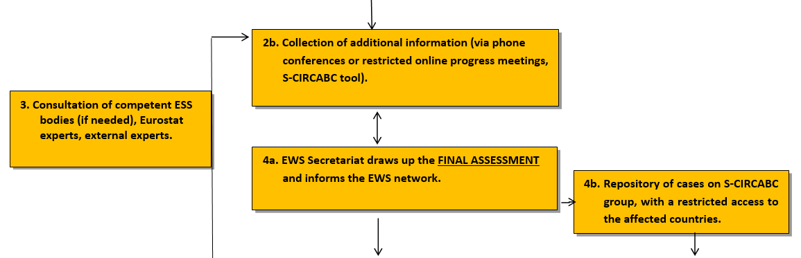
Early Warning System

Slide 13
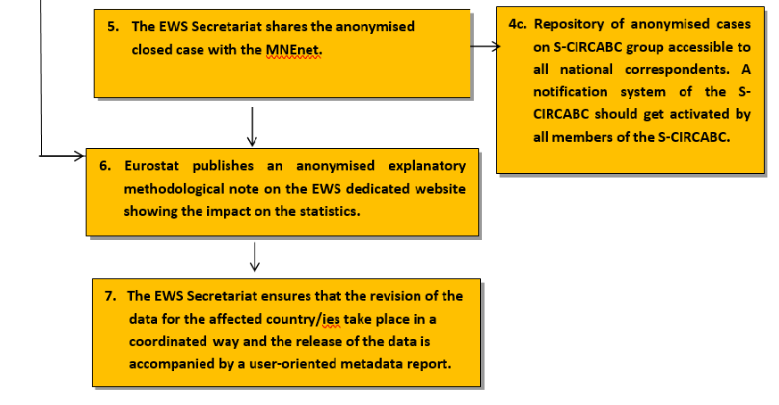
Early Warning System

Slide 14
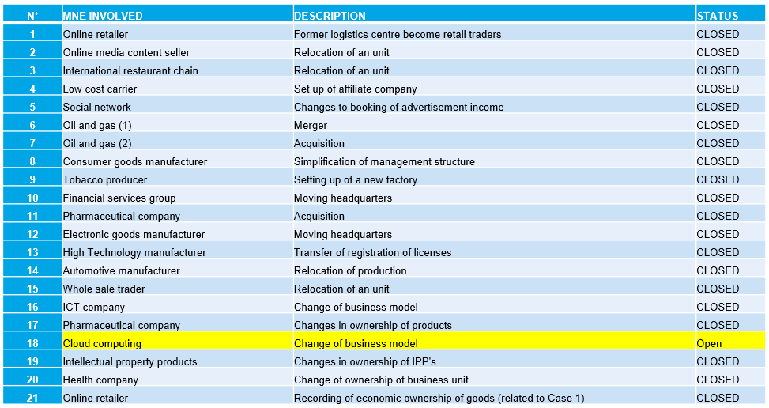
EWS cases overview – since 2017

Slide 15
EWS Cases
All closed EWS cases and the anonymised methodological notes can be found under:
https://ec.europa.eu/eurostat/web/globalisation-businesses/methodology/early-warning-system#Methodological%20summary%20notes
Open case Nr. 18 on cloud computing:
A legal unit specialised in cloud computing services, part of a MNE Group, began selling cloud services to EMEA region in 2018. These services were previously sold from the US.
This MNE Group involved has been already under the lens of the EWS
Two proposals for recording the sale of services directly to the customers in Europe countries were proved unfounded by the latest data in most of the countries involved.

Slide 16
Early Warning System
A new case Nr. 22 regarding a merger under investigation:
The European MNE group X active in 4 business areas reports that the Board of Directors has approved to propose to the General Shareholders' Meeting the merger of the group's parent company with its wholly-owned subsidiary that exists under the law of another EU country.
The merge might affect figures in following domains: Structural Business Statistics (SBS), Trade and Services, the Foreign Trade Statistics of Goods (ITGS, Tax Office), the Survey of International Trade in Services (ITSS), the Outward Foreign Affiliates Statistics (OFATS) and the Inward Foreign Affiliates Statistics (IFATS).
In addition, the group's activity in the national economy and its flows with the rest of the world are also recorded in the National Accounts (NA) and in the Balance of Payments/International Investment Position statistics (BoP/IIP).
- An online meeting to be set up with all involved countries to investigate the case

Slide 17
Different data sources used in LCUs
LCU as a specialised unit can often automatically process and merge data from different statistical sources as well as from different statistical producers
First, the data from several data sources need to be collected and then linked. The main difficulty comes from the fact that the sources have often different unit concepts (e.g., legal units, enterprises/branches, tax groups) and there are no common identifiers available
For concrete validation checks, details of various centralised and decentralised statistics from other statistics producers are often used.
A specialised data analyst responsible for processing data on MNE groups will analyse the data brought together from different sources and clarify discrepancies. These discrepancies are often only noticeable when statisticians look at the MNE group more broadly - i.e. as a coherent entity.

Slide 18
Different data sources used in LCUs
Most EU countries tend to use administrative data sources such as business registers, VAT records or tax registers
Annual reports, financial statements of the companies, structural business statistics surveys and e-invoicing are also frequently used, while consolidated or non-consolidated reports from the International Financial Reporting Standards (IFRS) and web scraping of management or activity reports of MNE groups are gradually introduced
good cooperation with tax authorities allows for a wide and timely access to data
NSIs that play the ‘data stewardship’ role can prove a clear advantage

Slide 19
Different data sources used in LCUs
Data sources often used in the LCU:
statistical business registers, structural business statistics annual surveys of enterprises
monthly and quarterly surveys of enterprises
administrative data of tax authorities
annual reports or financial statements from companies
consolidated or non-consolidated International Financial Reporting Standards reports.
foreign trade statistics, balance of payments statistics, foreign direct statistics

Slide 20
IT infrastructure
National level
A good technical infrastructure at national level, with statistical business registers at the core, can process data from multiple sources.
Robust metadata documentation is a precondition for producing consistent statistics on MNE groups
Several EU countries have already implemented or have been recently developing national tailor-made IT tools to support their LCU work
Automated IT tools enable countries to integrate different data sources and implement automated consistency checks

Slide 21
IT infrastructure
European level
A suitable European IT infrastructure is essential in providing a more systematic, consistent, coordinated and cost-effective approach on the ongoing activities of MNE groups at EU level
The EuroGroups register has been established to serve this purpose
The EuroGroups register is the statistical business register on MNE groups set up by Eurostat. It runs in collaboration with EU Member States and EFTA countries. It has an excellent coverage – estimated at over 95% – of large and medium-sized MNE groups operating in Europe.

Slide 22
IT infrastructure
In 2023, for the reference year 2021, the final frame for the EuroGroups register was made available to NSIs producers working in foreign affiliates statistics, globalisation statistics and other business domains
The EuroGroups register final frame 2021 contains information on over 155 000 MNE groups active in Europe. This comprises 977 000 enterprises and more than 1.4 million legal units
In 2021, MNE groups employed over 45 million people in Europe – around 1 in every 5 people employed in Europe worked for a MNE group
As a next step, the EuroGroups register will integrate more data. For example, data will be made available from public data sources that take advantage of web scraping techniques.

Slide 23
Dissemination of experimental data on MNE Groups from EuroGroups register
On 15 May 2023, Eurostat released the experimental data on MNE groups in its public database for the first time
More data will gradually be released to fulfil user needs. The data source is the EuroGroups register.
Currently, users can explore the data on two main structural indicators:
​Number of multinational enterprise groups by controlling country
Persons employed in the country by a multinational enterprise group

Slide 24
Dissemination of experimental data on MNE Groups from EuroGroups register
In addition, two Statistics Explained articles using data from the EGR were published:
On 30 May 2023, the Statistics Explained article about the structure of MNE groups was released, using data from 2021 as a reference. The article is annually updated using the latest data from the register and can be accessed here:
Structure of MNE groups in the EU
In June 2023, an additional article using data from the register was published with a focus on large MNE groups:
  Employment in large-scale MNE groups
Preparation of additional Statistics Explained articles using data from the EuroGroups register is ongoing.

Slide 25
Dissemination of experimental data on MNE Groups from EuroGroups register
- in 2023, Eurostat has been working on the revamping of its website
- currently, 40 out of the 79 dedicated sections have been reviewed and published in a new user-friendly layout
- the dedicated webpage of the statistical national business registers and the EuroGroups register was published in July 2023 and can be accessed using the following path:

Slide 26

Keep in touch
ec.europa.eu/
europa.eu/
Overview - Statistical business registers - Eurostat (europa.eu)
Notes:
Delete/update as appropriate

Slide 27

Thank you!
© European Union 2020

