Slide 1
Global Initiative on Unique Identifiers for Businesses
Julian Chow, UNSD
28th Meeting of the Wiesbaden Group on Business Registers
2-6 October 2023
Acknowledgement:
Ilaria Di Matteo, Zhiyuan Qian (UNSD), Hank Hermans (CBS),Ricco Dun (GLEIF) and Ivo Havinga (independent expert) for their input in developing the paper underpinning this presentation

Slide 2
International work and guidance on SBRs
United Nations Guidelines on Statistical Business Registers, 2020
United Nations The draft Manual on the Statistical Business Register Maturity Model for Statistical Business Registers ,2022
Eurostat, European business statistics methodological manual for statistical business registers, 2021 edition
Eurostat, European Business Profiling Recommendations Manual, 2020 edition
Eurostat, Business Registers Recommendations Manual (2010)
Eurostat and OECD, Manual on Business Demography Statistics (2007)
UNECE, UNECE, Guidelines on the use of statistical business registers for business demography and entrepreneurship statistics (2018)
UNECE, Guidelines on Statistical Business Registers (2015)
African Development Bank, Guidelines for Building Statistical Business Registers in Africa (2014)
2

Slide 3
Roles of the Statistical Business Registrar
 | Role | Goal
1 | Live Register | Provide the gateway between data from various input sources and statistical units
2 | SBR snapshot and frozen frame | Provide populations of statistical (and possibly administrative) units at fixed points in time
3 | SBR survey frame | Provide a set of statistical units for a survey, valid for a specified reference period, with all characteristics required.
4 | Survey support | Monitor survey response and response burden
5 | SBR Statistics | Produce statistics based directly on the SBR
6 | SBR information source | Provide lists of enterprises, their locations and other characteristics
7 | SBR international data exchange | Facilitate coherence in international statistics
8 | SBR in the modernization of statistical production and services | Promote integration of SBR within the production processes for economic statistics

Slide 4
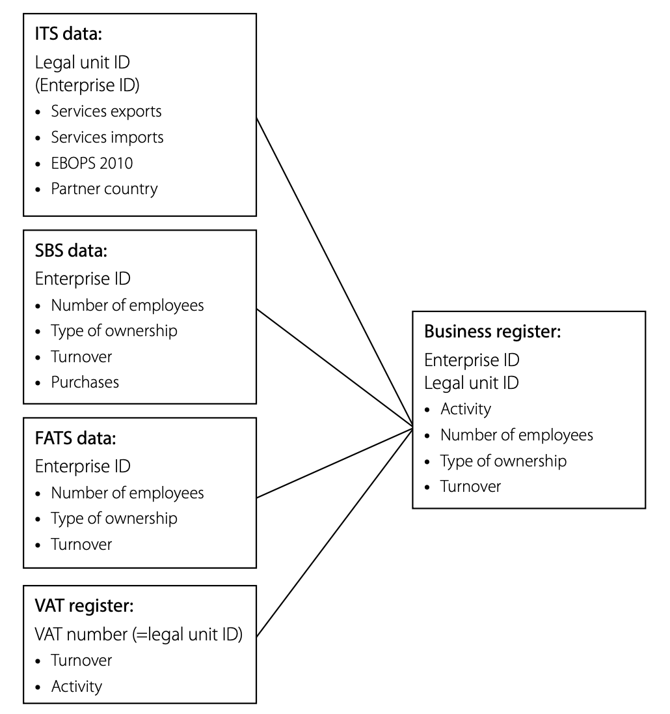
A unique identifier
for enterprises commonly used across sources is essential to conduct the linking
Linking other sources to SBR

Slide 5
Background
One of the main issues in the establishment and improvement of Statistical Business Registers (SBR) in countries is the lack of a unique identifier
The existence of a unique legal identifier is essential for a better use of administrative data in the SBRs and the linking of data from various sources.
UN Guidelines on Statistical Business Registers recommends the adoption and promotion of the use of a unique identifier to link information among different data sources and facilitate the subsequent use of the data in the units in the SBR
Notes:
For example, presentation from the Fiji on 3 Oct also indicate that a lot of administrative data sources information available to link with the current Business Register is a challenge since there is no common identify.

Slide 6
The recommendation on the use of a unique identifier in a country is not only recommended in the statistical guidelines for the establishment of Statistical Business Registers in countries.
The United Nations Commission on International Trade Law (UNCITRAL) developed The Legislative Guide on Key Principles of a Business Registry
Recommendations to facilitate efficient domestic business registration and cooperation among registries in different national jurisdictions to facilitate cross-border access to registries
Notes:
The United Nations Commission on International Trade Law (UNCITRAL) plays a key role in developing that framework in pursuit of its mandate to further the progressive harmonization and modernization of the law of international trade. UNCITRAL does this by preparing and promoting the use and adoption of legislative and non-legislative instruments in a number of key areas of commercial law.

Slide 7
Rationale for this initiative (1)
A holistic approach to SBRs takes into account:
a legal business registration system
an identity management system
a statistical business register (SBR)
a system of demographic and other business statistics derived from SBR
Improving the registration of businesses and the identify management system for businesses greatly facilitates the establishment and the maintenance of Statistical Business Registers
This is a similar approach to Civil Registration, Vital Statistics and population registers
Guidelines on the Legislative Framework for Civil Registration, Vital Statistics and Identity Management (UN 2019)
Handbook on Civil Registration and Vital Statistics Systems: Management, Operation and Maintenance, Revision 1 (UN 2018)

Slide 8
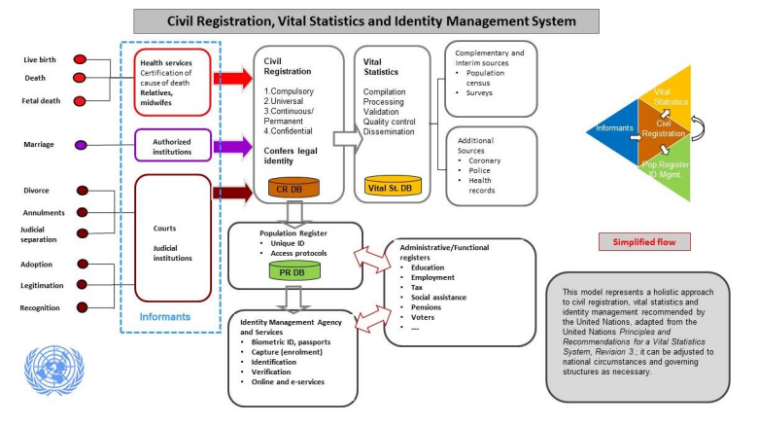
Similarities with Civil Registration and Vital Statistics
United Nations Legal Identity Agenda
Global initiative that was launched as a “One UN” approach to:
establish a common approach to the issue of functional registration and legal identity; and
to support of Member States building holistic, country-owned, sustainable civil registration, vital statistics and identity management systems.
13 UN agencies

Slide 9
Rationale for this initiative (3)
One of the main issues in the establishment and improvement of Statistical Business Registers (SBR) in countries is the lack of a unique identifier and a well-functioning business registration system, greatly hampering the use of administrative data for business statistics
The registration of companies and businesses, the availability of unique business identifiers, and access to and sharing of administrative data for SBRs are essential elements for effective national business registration systems

Slide 10
Rationale for this initiative (4)
To better understand globalization and facilitate the establishment and maintenance of global registers detailing the legal structure of multinationals, it is also critical to be able to link the unique national identifiers of multinational organizations to a global unique identifier
The availability of a global legal entity identifier enables linkage across data sources, reduces manual efforts to reconcile different local identifiers, provides information on company ownership and can facilitate the process of integrating information on cross-border transactions (e.g., international flows of goods and taxes).
The use of a global unique identifier also benefits the development of global registers, such as the Multination Information Platform developed by UNSD and OECD.

Slide 11
Global Initiative on Unique Identifiers for Businesses
Initiative aimed to:
strengthen the transparency on businesses in countries by improving their registration
improve the availability of unique business identifiers in administrative data sources in countries
promote access to and sharing of administrative data for statistical business registers
demonstrate the importance and benefit of linking national identifiers with global identifiers, such as the LEI.
It is intended to bring together interested international/regional organizations active in the domain of SBRs and business registration and statistical legislation to support countries seeking to improve their statistical business registers and business registration systems
Notes:
The conversation started with GLEIF in December 2020 on how to strengthen business registration and establishment of unique identifiers in countries in order to benefit SBRs and also the establishment of global registers
4th UNCEBTS meeting in June 2021discussed the initial proposal and there was a general support for the initiative
53rd session of the UNSC in March 2022:
The UNSC “Supported the development of a global initiative aimed at improving the availability of unique business identifiers in administrative data sources, considered essential to help countries in strengthening statistical business registers and better understanding globalization; and requested the Committee to further elaborate the initiative and to report to the Commission at its fifty-fourth session, in 2023.”
Further discussion took place with during the period June-July 2022 with the UNCEBTS Chair, Task team leads, Eurostat, GLEIF
outcome of the discussion at the joint meeting of the task team on Exhaustive Business Register and Capacity building in August 2022

Slide 12
Process
It is the outcome of a consultation process that started in 2020 between UNSD, UN Committee of Experts on Business and Trade Statistics (UNCEBTS) and the Global Legal Entity Identifier Foundation (GLEIF)
53rd session of the UNSC in March 2022: The UNSC “Supported the development of a global initiative aimed at improving the availability of unique business identifiers in administrative data sources, considered essential to help countries in strengthening statistical business registers and better understanding globalization; and requested the Committee to further elaborate the initiative and to report to the Commission at its fifty-fourth session, in 2023.”
54th session of the UNSC in March 2023: endorsed the global initiative on unique identifiers for businesses, supported its main elements as described in the background document, and encouraged countries and relevant organizations to coordinate their activities in this area in an effort to provide solid infrastructure for statistical business registers”
Notes:
The conversation started with GLEIF in December 2020 on how to strengthen business registration and establishment of unique identifiers in countries in order to benefit SBRs and also the establishment of global registers
4th UNCEBTS meeting in June 2021discussed the initial proposal and there was a general support for the initiative
53rd session of the UNSC in March 2022:
The UNSC “Supported the development of a global initiative aimed at improving the availability of unique business identifiers in administrative data sources, considered essential to help countries in strengthening statistical business registers and better understanding globalization; and requested the Committee to further elaborate the initiative and to report to the Commission at its fifty-fourth session, in 2023.”
Further discussion took place with during the period June-July 2022 with the UNCEBTS Chair, Task team leads, Eurostat, GLEIF
outcome of the discussion at the joint meeting of the task team on Exhaustive Business Register and Capacity building in August 2022

Slide 13
Webinar series on the Global Initiative
A webinar series is being organized by UNSD in collaboration with the United Nations Committee of Experts on Business and Trade Statistics (UNCEBTS) and the Global Legal Entity Identifier Foundation (GLEIF) to:
Create awareness of the Global Initiative on Unique Identifiers for Businesses and establish a collaborative environment for countries and international organizations to strengthen the registration system in countries
Identify possible pilot projects to demonstrate the importance of a sound registration system to improve Statistical Business Registers and the benefits of mapping to a global unique identifier (LEI) and their use to jump start their national systems of unique business identifiers
Elaborate a work plan to further guide this initiative by seeking synergies between the business registers and civil registration registers

Slide 14
Webinar series on the Global Initiative
Three webinars are planned for the following dates:
11 October 2023, 7am – 930am (NY time)
7 November 2023, 7am – 930 am (NY time)
19 December 2023, 7am – 930 am (NY time)
It will bring together various stakeholders such as National Statistical Offices, Central Banks, Regulatory authorities, international organizations active in business registration and statistical business register, and LEI issuing organizations
For more details, please visit: https://unstats.un.org/unsd/business-stat/webinar-unique-businessID
Also, if interested, please contact business_stat@un.org
Notes:
The first webinar will provide an overview of the global initiative and underscore the importance of this initiative for the different stakeholders, such as National Statistical Offices, regulatory authorities, and international organizations active in business registration and statistical business registers.
The second webinar will bring together regulatory authorities, national statistical offices and users of national and global unique identifiers for businesses with the objective to identify concrete ways to strengthen the legal registration of businesses and the management of unique identifiers.
The third webinar will provide a platform for business registration stakeholders and the national statistical offices to consider a concrete set of actions to strengthen the management of national unique identifiers for businesses in countries, the mapping to globally unique identifiers, and the access for statistical purposes to this information by National Statistical Offices for developing and maintaining Statistical Business Registers.

Slide 15
Thank you!

