Slide 1


Session 5 – Workshop SBR Maturity Model
Parallel session 3 – Advanced country presentations
Assessing the IT environments of SBRs according to the Maturity Model
Mr. Péter Pálosi
Hungarian Central Statistical Office
Statistics Directorate
Business Statistics Department
28th Meeting of the Wiesbaden Group
The Hague, 2-6 October 2023

Slide 2
Contents
History of the Hungarian SBR
The IT environment of the Hungarian SBR
The assessment of the IT environment
Challenges
Summary and conclusions

Slide 3
History of the Hungarian SBR
Created in the 1970’s running on IBM mainframe computers
  Records were stored in a file based database
Migration to a Relational Database Management System in 1997
  Implementation of the single window systems: live connection with administrative sources
  History and event log tables
  Automatic creation of frozen frames
  Full coverage of resident LEUs
From 2011 the following registers have been implemented:
  LEU relationship register
  Register of foreign LEUs
  Enterprise register
  Enterprise group register
The SBR is embedded in the public administration system – statistical number

Slide 4
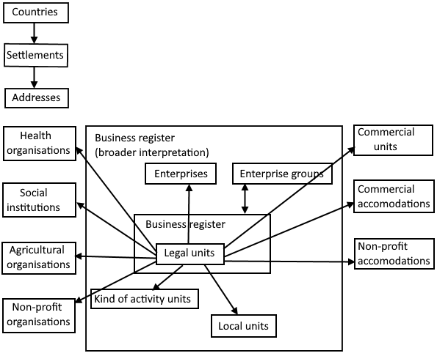
The SBR at the Hungarian Central Statistical Office

Slide 5
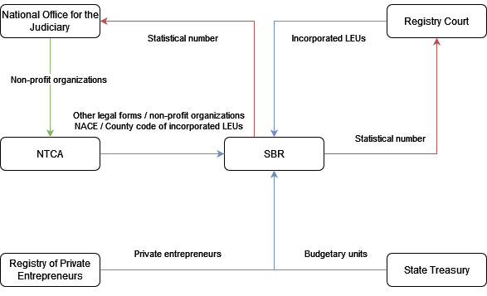
The single-window system

Slide 6
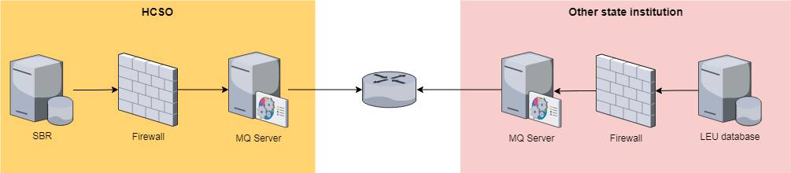
The IT environment of the SBR
The infrastructure layer consists of the RDBMS and the messaging (MQ) systems.
Asynchronous communication.
Data exchange in XML format.

Slide 7
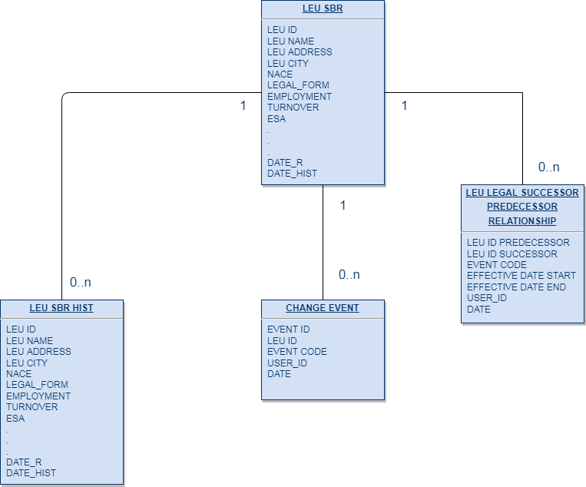
The physical data model of the SBR

Slide 8
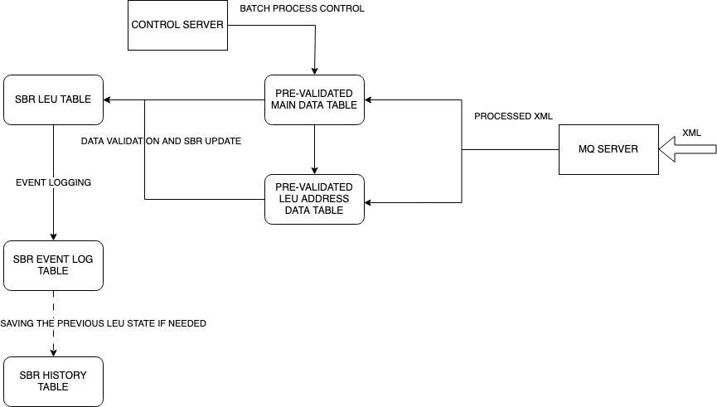
The update mechanism of the SBR

Slide 9
Batch data processing
Data can arrive anytime during the day.
It gets loaded into the RDBMS after pre-validation done by MQ.
A scheduled job starts the PL/SQL scripts which processes the records arrived the previous day from each source.
The jobs run overnight between 2:30 AM and 6:30 AM, it is the time window when the SBR is updated by the batch processes.
The processed records in the pre-validation tables are marked depending on the result.
The logfile of the process is sent automatically by email.
In case of unsuccessful processing manual investigation is required.

Slide 10
The assessment of the IT environment of the SBR
The maturity level of the IT environment of the Hungarian SBR can be considered as mature:
  Based on RDBMS with user access control.
  Automated updating of records.
  Data import.
  Data validation.
  Historical data management.
Additional features and techniques such as web scraping, big data and the usage of graph databases are not yet implemented, therefore the SBR is not in the advanced stage.

Slide 11
Challenges
Using proprietary software such as Oracle RDBMS and IBM MQ can be expensive, and requires specialized knowledge.
New colleagues may face a steep learning curve, especially with PL/SQL as universities tend to teach other environments such as MySQL, R and Python in computer and data science courses.
The data model of the Hungarian SBR does not follow the spine data model, it is essentially a large table with many attributes.
Changing the IT environment requires a serious investment of resources.

Slide 12
Summary and conclusions
The IT environment of the Hungarian SBR is mature, as it supports the majority of the tasks a modern SBR demands.
New technologies (web scraping, big data) are yet to be explored.
Main issues:
  Heavy use of proprietary software and environment.
  Steep learning curve for new colleagues (PL/SQL).
  Bloated database tables.
Possible solutions:
  Move into an open source environment (PostgreSQL).
  Refactor the program code into a more widely used language such as Java.
  Redesign the tables and processes according to the spine data model.

Slide 13
Summary and conclusions
Expected outcome:
  Redesigned data model.
  Cleaner code, improved maintainability.
  Open source solution.
  More resources remain to explore and implement new technologies.

Slide 14
Thank you for your attention!
Peter.Palosi@ksh.hu
www.ksh.hu

