Slide 1
Similarity metric for comparison of enterprise groups
28th Meeting of the Wiesbaden Group on Business Registers
The Hague, 03rd October 2023
Session 3: Globalisation and Large Case Units
Simon Rommelspacher, Adrian Urban

Slide 2
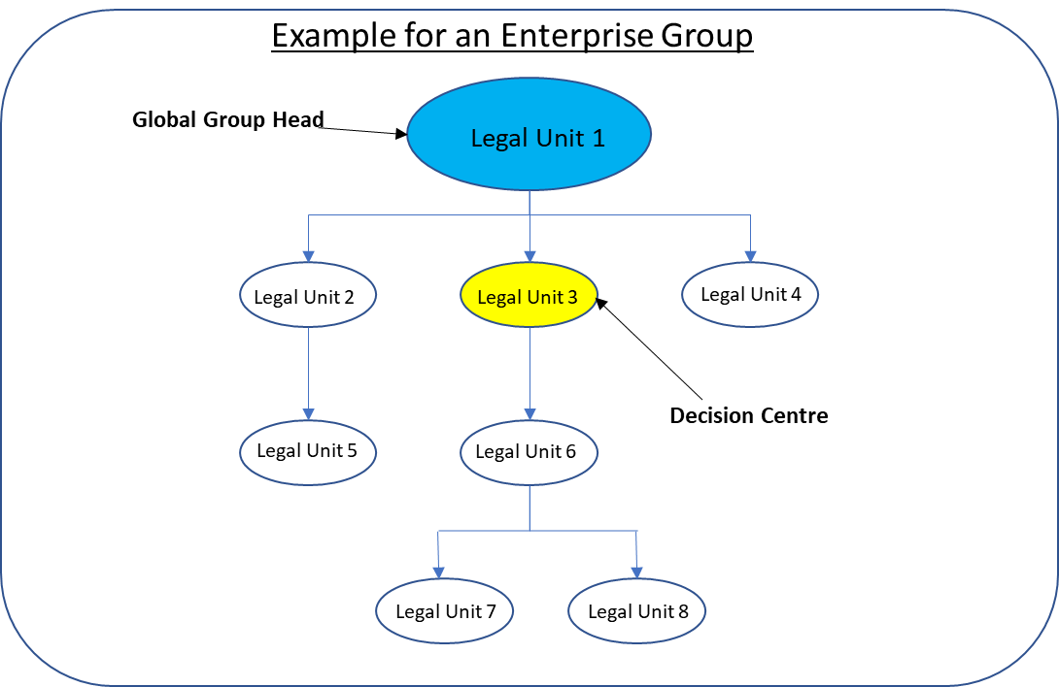
Enterprise Groups in Business Registers
Similarity metric for comparison of enterprise groups | Rommelspacher, Urban

Slide 3
Enterprise Groups
Similarity metric for comparison of enterprise groups | Rommelspacher, Urban
More than 290 000 enterprise groups in the German Business Register
More than 150 000 multinational enterprise groups in the EuroGroups Register (EGR)
Annual processing
Various sources of information are used
Administrative data
Commercial data
Other sources (e.g. annual reports, websites)

Slide 4
Enterprise Groups
Similarity metric for comparison of enterprise groups | Rommelspacher, Urban
At what change is an enterprise group still the same enterprise group?
How can enterprise groups from two sources be compared?
How can similarity be measured?
Manual quality checks are foreseen for the most significant enterprise groups

Slide 5
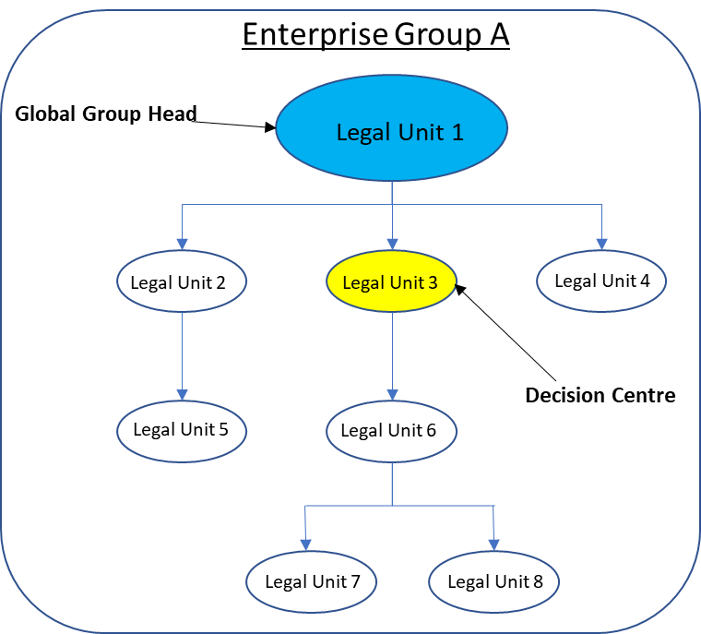
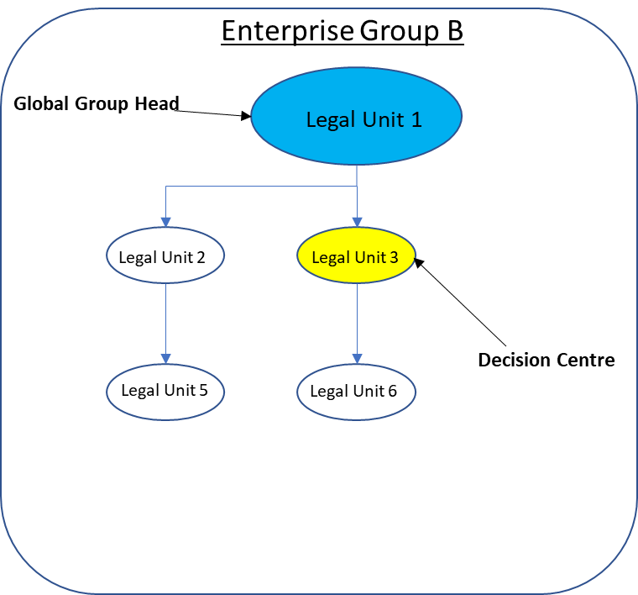
Comparison of Enterprise Groups
Similarity metric for comparison of enterprise groups | Rommelspacher, Urban

Slide 6
Comparison of Enterprise Groups
Similarity metric for comparison of enterprise groups | Rommelspacher, Urban
What characteristics can be taken into account to assess whether two enterprise groups are similar or the same?
Comparison of related legal units (LEU)
Comparison of economic characteristics
Comparison of relationships between legal units
Comparison of the Global Group Head or Decision Centre

Slide 7
Idea of a similarity metric
Similarity metric for comparison of enterprise groups | Rommelspacher, Urban
For more or less complex objects, there are a variety of similarity and distance metrics:
String comparison
Comparison of plants
Comparison of genes
Comparison of faces
…
How can similarity be quantified?

Slide 8
Idea of a similarity metric
Similarity metric for comparison of enterprise groups | Rommelspacher, Urban
Distance metric d(x, y)
What is the distance from object x to object y?
How much change do I have to make to x to get y?
d(x, y) = 0 for identical objects
Normalised distance metric: 0 ≤ d(x, y) ≤ 1
Normalised similarity metric: 0 ≤ s(x, y) ≤ 1 and s(x, y) = 1 - d(x, y)
If x and y have no similarity, then s(x, y) = 0
If x and y are identical, then s(x, y) = 1

Slide 9
Development of a similarity metric for enterprise groups
Similarity metric for comparison of enterprise groups | Rommelspacher, Urban
Similarity of legal units (LEU) of groups A and B:
$$Similarity\left(A(LEU),B(LEU)\right)=0.5∗\frac{A(LEU)∩B(LEU)}{A(LEU)}+0.5∗\frac{A\left(LEU\right)∩B\left(LEU\right)}{B\left(LEU\right)}$$
Example 1:
Group A:
Group B:
LEU1
LEU 1
$Similarity\left(A(LEU),B(LEU)\right)=0.5∗\frac{2}{5}+0.5∗\frac{2}{3}≈$0.53
LEU 2
LEU 2
LEU 3
LEU 6
LEU 4
LEU 5
Example 2:
Group A:
Group B:
LEU 1
LEU 1
$Similarity\left(A(LEU),B(LEU)\right)=0.5∗\frac{2}{5}+0.5∗\frac{2}{4}≈$0.45
LEU 2
LEU 2
LEU 3
LEU 6
LEU 4
LEU 7
LEU 5

Slide 10
Development of a similarity metric for enterprise groups
Similarity metric for comparison of enterprise groups | Rommelspacher, Urban
Example 3:
Group A:
Group B:
LEU 1 900 EMPL
LEU 1 900 EMPL
$Similarity\left(A(LEU),B(LEU)\right)=0.5∗\frac{2}{5}+0.5∗\frac{2}{3}≈$0.53
LEU 2 700 EMPL
LEU 2 700 EMPL
LEU 3 1 EMPL
LEU 6 50 EMPL
LEU 4 0 EMPL
LEU 5 10 EMPL
Group C:
LEU 3 1 EMPL
$Similarity\left(A(LEU),C(LEU)\right)=0.5∗\frac{2}{5}+0.5∗\frac{3}{3}≈$0.7
LEU 4 0 EMPL
LEU 5 10 EMPL
Similarity (A, C) > Similarity (A, B) although more employees (EMPL) are part of group B
Employees should be considered in the calculation of the similarity

Slide 11
Rommelspacher-Urban Metric for the Similarity
Similarity metric for comparison of enterprise groups | Rommelspacher, Urban
$$RUMS\left(A,B\right)=\left\{\begin{aligned}a∗\frac{\left|A\left(LEU\right)∩B\left(LEU\right)\right|}{\left|A\left(LEU\right)\right|}+b∗\frac{\left|A\left(LEU\right)∩B\left(LEU\right)\right|}{\left|B\left(LEU\right)\right|}+c∗\frac{\sum{Employees\left(A\left(LEU\right)∩B\left(LEU\right)\right)}}{\sum{Employees\left(A\right)}}+d∗\frac{\sum{Employees\left(A\left(LEU\right)∩B\left(LEU\right)\right)}}{\sum{Employees\left(B\right)}} ,\sum{Employees\left(A\right)}>0 and\sum{Employees\left(B\right)}>0 \\ 2a∗\frac{\left|A\left(LEU\right)∩B\left(LEU\right)\right|}{\left|A\left(LEU\right)\right|}+2b∗\frac{\left|A\left(LEU\right)∩B\left(LEU\right)\right|}{\left|B\left(LEU\right)\right|} , \sum{Employees\left(A\right)}=0 or\sum{Employees\left(B\right)}=0\end{aligned}\right.$$
$Under the constraints: a+b+c+d=1$ und $2a+2b=1$
Overlapping legal units and employees are considered in the calculation of RUMS
Parameters a, b, c and d can be adjusted flexibly for a different weighting

Slide 12
Rommelspacher-Urban Metric for the Similarity
Similarity metric for comparison of enterprise groups | Rommelspacher, Urban
Example 3:
Group A:
Group B:
LEU 1 900 EMPL
LEU 1 900 EMPL
$RUMS\left(A,B\right)=0.25∗\frac{2}{5}+0.25∗\frac{2}{3}+0.25∗\frac{1600}{1611}+0.25∗\frac{1600}{1650}≈$0.76
LEU 2 700 EMPL
LEU 2 700 EMPL
LEU 3 1 EMPL
LEU 6 50 EMPL
LEU 4 0 EMPL
LEU 5 10 EMPL
Group C:
LEU 3 1 EMPL
$RUMS\left(A,C\right)=0.25∗\frac{2}{5}+0.25∗\frac{3}{3}+0.25∗\frac{11}{1611}+0.25∗\frac{11}{1650}≈$0.35
LEU 4 0 EMPL
LEU 5 10 EMPL
RUMS(A, B) is significantly higher than RUMS(A, C) → Group B contains the legal units with the most employees

Slide 13
Use Case 1: two reference years
Similarity metric for comparison of enterprise groups | Rommelspacher, Urban
Annual process of maintaining and updating data on enterprise groups in the German Statistical Business Register
Which enterprise groups have changed a lot between two reference years?
Can be a real change or an indication for differences in quality of data between reference years → manual quality checks necessary
Are there new Enterprise groups or groups that do not exist anymore?
Which enterprise groups should be continued with which identifier?

Slide 14
Use Case 1: two reference years
Similarity metric for comparison of enterprise groups | Rommelspacher, Urban
Enterprise groups in T
Enterprise groups in T-1
Identical enterprise groups (RUMS=1)
Enterprise groups with 0<RUMS<1
Enterpise groups with RUMS=0
Enterpise groups with RUMS=0

Slide 15
Use Case 2: two sources
Similarity metric for comparison of enterprise groups | Rommelspacher, Urban
Comparison of enterprise groups between German Business Register and EuroGroups Register
EuroGroups Register collects and processes the global data on multinational enterprise groups
To what extent do enterprise groups differ between both registers? Why do they differ?
New information on group structures can be identified
Possible detection of errors in the transmission of the data
Focus manual quality checks on the most relevant groups

Slide 16
Outlook
Similarity metric for comparison of enterprise groups | Rommelspacher, Urban
By using RUMS, the processing of enterprise groups in business registers can become more efficient
Rules can be defined for automated processes on a quantitative basis
Manual quality checks can be more targeted and data errors more easily detected
Further opportunities for development of the RUMS
Comparison of enterprise groups with no overlapping legal units, e.g. with respect to their structure or their economic characteristics
Are enterprise groups from specific industries often structured similarly?
Time series analysis: Are there noticeable structural changes in many enterprise groups in certain reference years?

Slide 17
Discussion
Similarity metric for comparison of enterprise groups | Rommelspacher, Urban
Do you have other approaches for comparing data on enterprise groups?
Do you have use cases for a similarity metric for enterprise groups in your business register?

Slide 18
Contact
Statistisches Bundesamt 65180 Wiesbaden
Germany
Contact Persons: Simon Rommelspacher simon.rommelspacher@destatis.de Phone +49 611 75-3471
Adrian Urban adrian.urban@destatis.de Phone +49 611 75-4813
www.destatis.de
www.destatis.de/kontakt

