Slide 1
UK Large Cases Unit
Sarah Eaton / Andrew Allen
Office for National Statistics

Slide 2
The Team
LCU is a Multi Disciplined Team made :
LCU Lead
Qualified Accountant
2 Senior Account Managers
2 Data Analysts – Utilising data from the company and other sources to identify inconsistencies.
2 Data Compilers

Slide 3
OrganisationalLocation
Located within Business Statistics Transformation Division (Business Stats)
Within the Business Registers Area.
Close relationship to Business Profiling Team
Outside of National Accounts and Balance of Payments

Slide 4
Aims of LCU
To ensure that ONS is appropriately capturing the impact of globalisation through the collection of data from our business surveys and administrative data.
To take responsibility for the collection, consistency and coherence checking of all micro-data collated from the largest MNEs Groups across all economic surveys.
Build stronger working relationships with respondents from key UK MNE groups.

Slide 5
LARGE CASES UNIT (LCU)
Works with a small number of large and important Multi-National businesses (MNE’s) to….
Improve the quality of data collected from MNEs for our National Accounts.
Better understand complex business structures and impacts of Globalisation on data collected.
Bring efficiencies to both the business and ONS by providing an account management approach to data collection.
Explore, test and implement improved ways of collating data from complex MNE’s. (tailored collection, API, direct Data Feeds).
Support research for survey development and collect Big Business Insights.
Core part of the Business Survey Strategy.

Slide 6
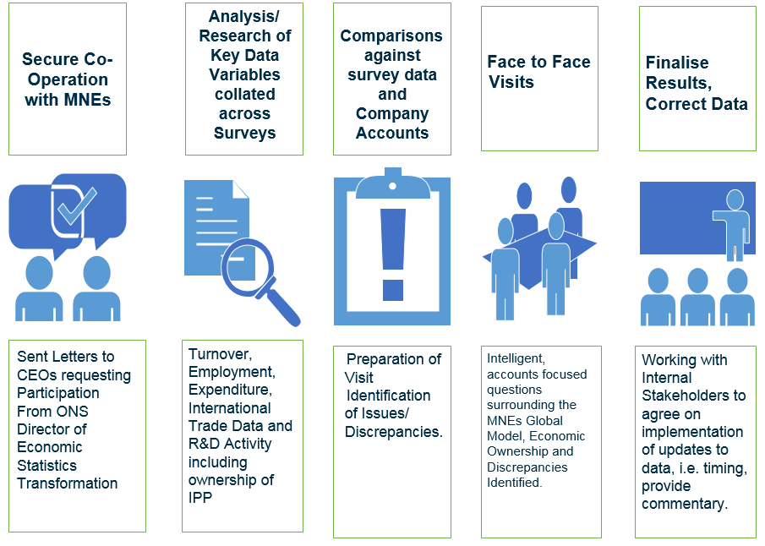
How do we work?

Slide 7
Benefits
Improvements to the quality of the data collated from important large and complex businesses which feed a wide range of economic statistics.
Identify all data inconsistencies from ONS key businesses at the earliest stage of the statistical production process.
Improved data collection efficiency by account management.
Reduce administration burden on the business.
More proactive response to the restructuring of large businesses, taking into consideration future changes in legal regulations (such as tax and accountancy regulations)

Slide 8
Globalisation Issues to be tackled by LCU
Factory-less goods production
Merchanting of goods and services;
Contract manufacturing;
Toll processing;
Transfer pricing
Cross-border use of intellectual property; and
Special Purpose Entity (SPE) activity.

Slide 9
Progress so far
Researched over 30 MNEs
Identified all types of globalisation Issues.
Resolved data discrepancies and collected missing data.
Account Manage 7 very large MNEs (collection and validation of the data).
Built strong working relationships with MNEs Monthly and Quarterly Regular meetings
Covid-19 Impact and Brexit implications
Tailored Data Collection
Produced tailored data collection spreadsheets for 4 businesses.

Slide 10
Challenges
Diverse set of skills and experience required.
Current Organisation creates difficulties for analysis and comparisons of data.
Very Challenging Work
Given size and complexity of the groups and level of detailed required to fully analyse and understand them.
Very Small Team.
Complexity of the Subject matter
Resource Intensive Work

Slide 11
Impact
Work very closely with National Accounts to implement changes.
National Accounts team coordinate data changes arising from LCU.
Published a summary of the impact on 25 September
Measuring globalisation in the UK national accounts: Blue Book 2023 - Office for National Statistics (ons.gov.uk)

Slide 12
Future
Developing new Business Statistics Strategy
LCU is core to the strategy
Aim will be to expand LCU cases
Bidding for resources

Slide 13
Thank You
Do you have any questions?

