Slide 1
NATIONAL BUREAU OF STATISTICS
28th Meeting of the Wiesbaden Group on Business Registers International Roundtable on Business Survey Frames 2 – 6 October 2023, Statistics Netherlands, The Hague, Netherlands
Author: William H. Matee
Organization: National Bureau of Statistics Tanzania

Slide 2
Outline
Introduction
What is Maturity Model
Statistical Business Register Maturity Model
Dimensions and Stages/Levels of SBR Maturity model
Conceptual visualization of the Maturity Model
Country Situation on SBR Maturity Model
Way forward

Slide 3
Introduction
The SBR Maturity Model as an instrument which provides Statisticians a framework to assess the current status of SBR in the Country, like any other countries Tanzania is inclusive.
It helps to detect the stage of SBR for several Dimensions
Despite of the dimensions, there are stages which provide an insight of the maturity status of the respective dimensions.
The stages include Preliminary stage, Early Stage, Maturity stage and Advanced stage.

Slide 4
Why Maturity Model
Set realistic Key performance Indicators (KPIs) and Improvement goals
Tool to assess the stage of implementation of SBR in the country and identify possible areas for improvement
Help teams determine next steps or process changes
A maturity model is a tool that helps people assess the current effectiveness of a person or group and supports figuring out what capabilities they need to acquire next in order to improve their performance.

Slide 5
SBR Maturity model aims to be a tools for :-
D
S
share knowledge and best practices
determine the current state of your SBR
determine possible next steps for development
find help and guidelines to actually be able to take those steps
F
D

Slide 6
Dimensions of SBR Maturity Model
1
Legal and Institutional framework
2
Data sources of SBR
3
Maintenance and Update of SBR
Dimensions
4
Coverage of SBR
5
Use of SBR
6
IT environment
1
7
Interoperability

Slide 7
Stages or Levels of SBR Maturity model
Advanced Stage
Mature stage
Early Stage
Preliminary stage

Slide 8
Conceptual visualization of the Maturity Model¹
Improvement Measures
4. Advanced
3. Mature
2. Early
1.Preliminary
Characteristics & Requirements
¹ https://unstats.un.org/unsd/statcom/53rd-session/documents/BG-3p-SBR-Maturity-Model-E.pdf

Slide 9
Country Situation on SBR Maturity Model and Dimensions versa stages

Slide 10
DIMENSION 1
LEGAL INSTITUTIONAL
FRAME WORK
Framework relevant for establishing and maintaining the SBR
There is Statistics Act, which allow to Conduct Census and Surveys.
MoU signed with MDAs to access Administrative data Sources, i.e. Tanzania Revenue Authority, Ministry of Education, Ministry of Health and Ministry of Trade and industry etc
Signed MoUs on processes
Advanced Stage
Mature Stage
Early Stage
Preliminary stage
Standard Statistics law allows the dissemination of SBR
MoU entailing NBS to collect some SBR variables from MDAs
Provision mandating NBS to Collect data in Statistical Law or MoU
No Statistical Act, Even Memorandum of Understanding (MoU)

Slide 11
DIMENSION 2
Preliminary stage
Data sources for SBR
Various Data sources NBS used to build and maintaining the SBR.
Currently, main data source is Administrative sources from Revenue Authority.
Complemented by Feedback from surveys, Economic Census and Surveys and Physical Investigations
Data Confidentiality
Data are limited of irregular
Early Stage
Economic Census and Survey used to establish SBR
Mature Stage
SBR maintenance based on Administrative data sources, Mainly Tanzania Revenue Authority (TRA) i.e. income Tax unit
Advanced Stage
Uses More than one administrative data sources in maintenance and update SBR i.e Surveys and Census

Slide 12
DIMENSION 3
MAINTENANCE AND UPDATE OF SBR
Maintenance and update procedures for the SBR Constant update of the SBR in terms of both coverage and content
Dynamics of administrative units i.e. units can die, change location, change activity etc.
Updating procedures incorporate rules identifying the types of legal and administrative signals that result in the birth, death, or continuation of an establishment or enterprise
Advanced Stage
Mature Stage
Early Stage
Preliminary stage
Procedures adjusted continuously, Government unique identifier driven and profiling of Enterprises
Procedures, Methods and documentations.
No regular validation
Updating procedures and methods are being developed
SBR not maintained or updated, or is updated irregularly without formal procedures

Slide 13
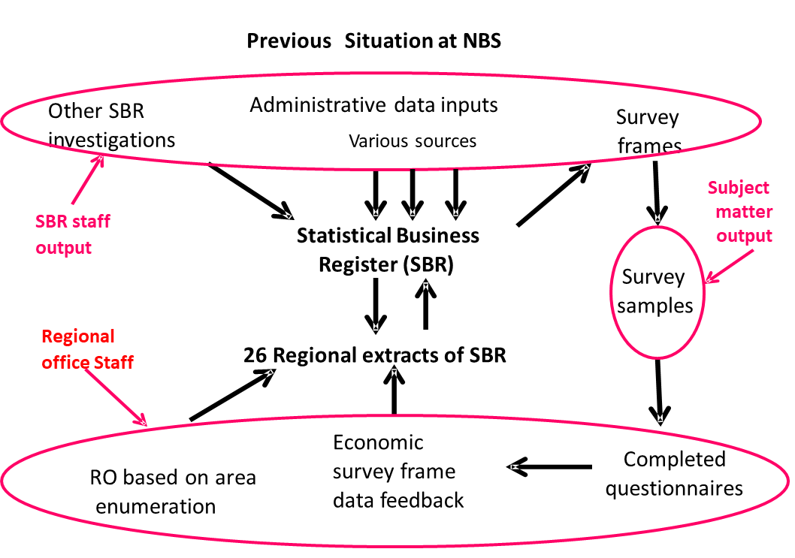
Dimension 3…
cont.
Regional Offices (RO) update SBR through area investigations confined to improvement of content and not coverage.

Slide 14
Dimension 3…cont.
Proposed Situation at NBS
Administrative data inputs
NGUVU KAZI KWA JINSI
Specify
Survey
investigations
Primary
Selected
frames
source
sources
26 Regional Statistics Offices use administrative data sources to improve the content of the units in SBR,
Business Register
Survey
samples
26 Regional extracts
of SBR
RO investigations
Economic
Completed
to improve content
survey frame
questionnaires
not coverage
data feedback

Slide 15
DIMENSION 4
COVERAGE OF AN SBR
Constitute SBR coverage - The type of statistical unit (for example enterprise) and the particular population of these units that constitute the survey frame.
Content- data items or variables or indicators that measure the counts or characteristics (attributes) of the population of units together with the reference period
Completeness- the SBR includes all institutional units within the 2008 SNA production boundary
Advanced Stage
Mature Stage
Early Stage
Preliminary stage
Effort to expand content to includes GIS Coordinates for SBR statistical units
Administrative sources provide partial coverage, the variables attached to each unit follow international recommendations.
Remarkable Institutional sectors, Minium Content, cover units in the sources of data, checking coverage is limited because of limited resources.
Limited institutional sectors

Slide 16
DIMENSION 5
Preliminary stage
Use of SBR
Providing Sampling Frames
Within NBS and
Other organizations
enabling measurement of respondent burden
Facilitate application of Standards such as ISIC Rev.4 to units
Frame development process is not standardized in the process of economic programs
Early Stage
The users of the SBR have limited involvement in the SBR development and maintenance.
Mature Stage
The SBR can support monitoring of survey response and burden.
Advanced Stage

Slide 17
DIMENSION 6
IT ENVIRONMENT
Supports the data storage, maintenance, update, dissemination and Archiving of SBRs microdata.
SBR receive data from administrative sources manually i.e (excel sheet)
No defined simple database structure for SBR
No Special web portals to support companies to update their information in the SBR
DIMENSION
Advanced Stage
Mature Stage
Early Stage
Preliminary stage
Limited organization of IT infrastructure
No integrated SBR database,
Uses excel spreadsheets

Slide 18
Dimension 7
PRELIMINARY STAGE
No Consideration of interoperability with other registers
No Consideration of interoperability with other registers
Interoperability
ability of an SBR to communicate and exchange standardized data with other registers.(National and international)
Not yet done
ADVANCED STAGE
EARLY STAGE
No Consideration of interoperability with other registers
No Consideration of interoperability with other registers
MATURE
STAGE

Slide 19
COUNTRY SITUATION ON SBR MATURITY MODEL
Assessments of SBR have not yet being done
Why?
Awareness
Knowledge

Slide 20
WAY FORWARD
In order to facilitate the use of Maturity model, Tanzania have not yet developed tools for monitoring their stages for improvement their SBR. But some dimensions are followed without known.
What should be done?
Learn best practices from other countries
Adopt different guidelines for development, maintenance and update of an SBR
Acquires consultancy services for improving SBR

Slide 21
REFERENCE
1
Guideline for Building Statistical business Register in Africa (AfDB)
2
ESS Business Register Recommendations Manual
3
Statistical Business Register Maturity,2020
4
Draft Manual on the Statistical Business Register Maturity Model for Statistical Business Registers, 2021

Slide 22
NATIONAL BUREAU OF STATISTICS
THANK YOU FOR LISTENING
ASANTE SANA

