Slide 1
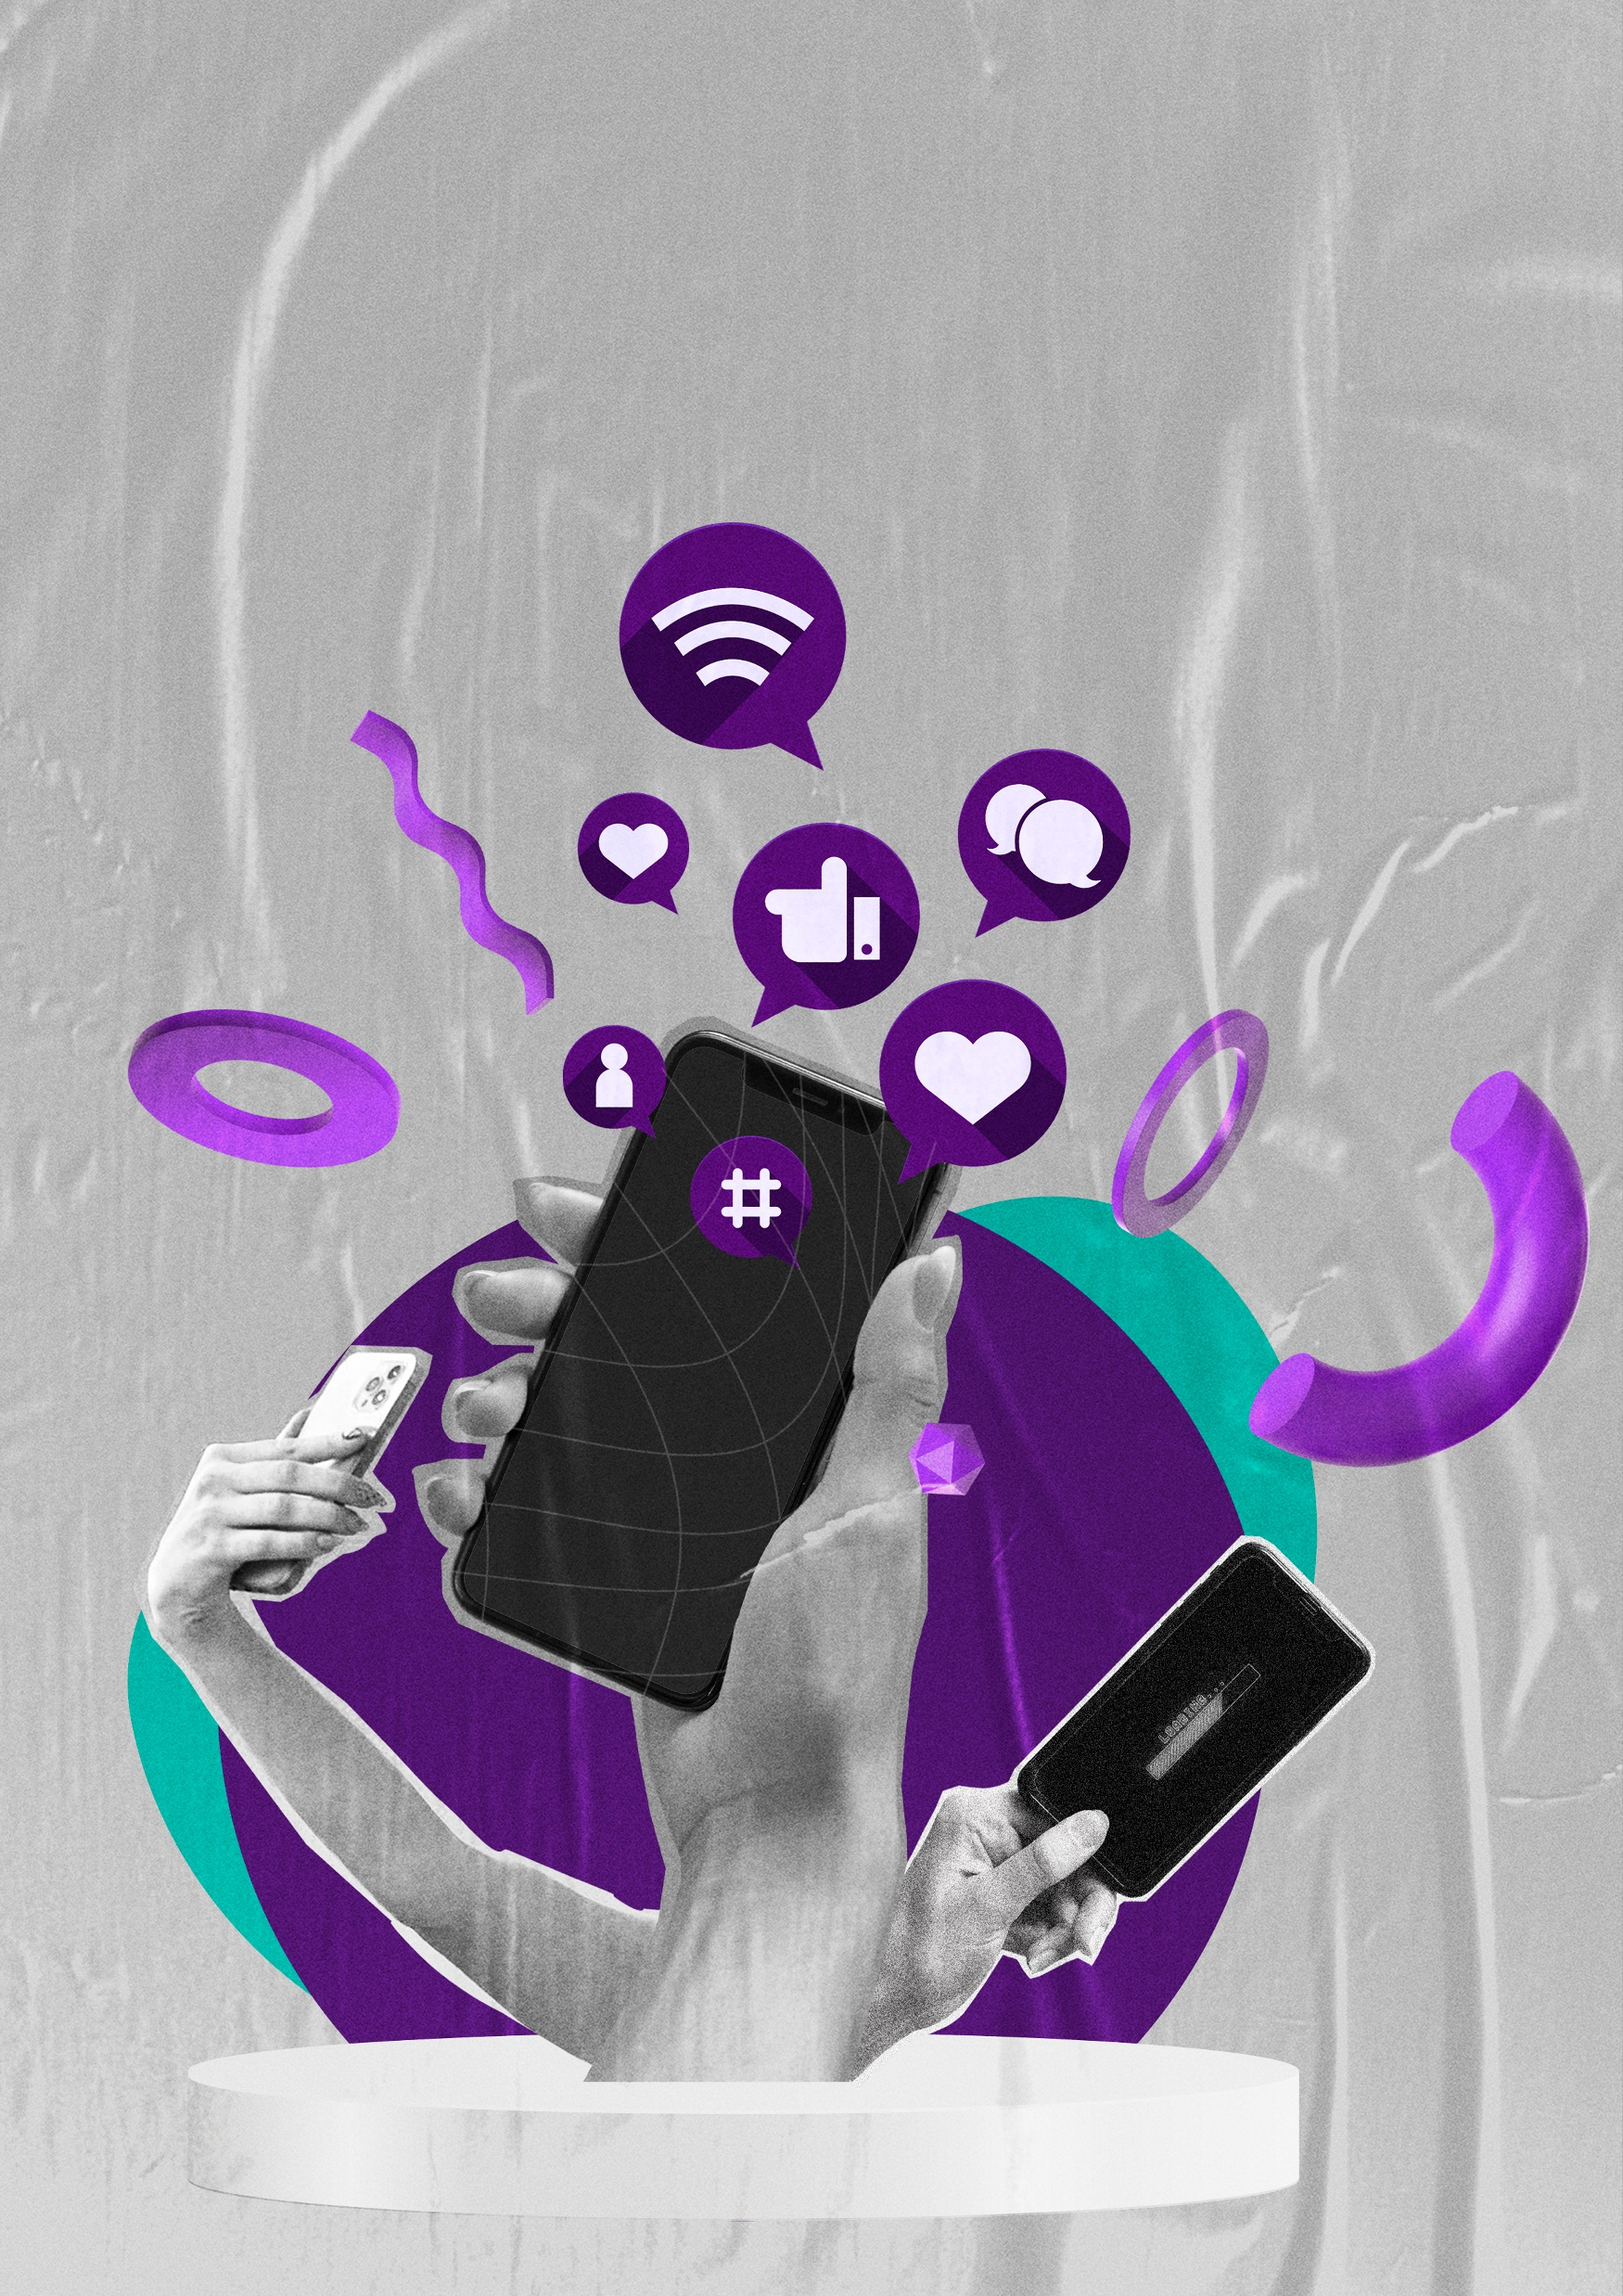
#BloodDonation
How European Blood Banks Use Social Media to Reach Donors and Non-Donors
PhD student: Alexandra Ciaușescu
Supervisors:
Prof. dr. Eva-Maria Merz
Prof. dr. Rene Bekkers
Dr. Arjen de Wit
Sanquin Blood Supply Foundation, Dept Research & Lab Services, Donor Studies
Center of Philanthropic Studies, Vrije Universiteit Amsterdam
Collaborators:
Jamie de Jong
Lisanne Jansen
Notes:
General introduction- introduce yourself
Talk about the importance of social media

Slide 2
No conflict of interests to declare

Slide 3
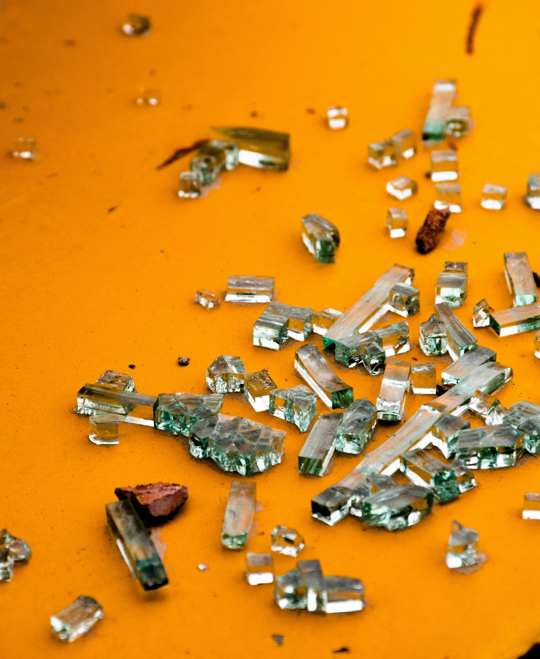
3
Current status of Research
Focus on only one platform
Focus on only one country
Focus on only recruitment and retention
Brady Park, L., Sano, L., Shields, B., Okonofua, S., Tak, M., Jamalifar, R., Wen, A., Farahbakhsh, F., Pires, K., Nisbett, K., Barboza, K., Pavlenkova, A., Pedram, S., Fattouh, R., Gélinas, A., Bah, B., Rochon, C., Duong, M., & Fingrut, W. (2021). Development and evaluation of a library of TikToks to support recruitment of committed hematopoietic stem cell donors from needed demographic groups. Blood, 138(Supplement 1), 4025. https://doi.org/10.1182/blood-2021-153165
Ramondt S., Kerkhof P.& Merz EM (2024). Persuading People to Do Good: Effects of Facebook Status Updates on Blood Donation Attitudes and Behavior. JMIR Preprints.10.2196/preprints.64740
Harrell, S., Simons, A.M. & Clasen, P. (2022). Promoting blood donation through social media: Evidence from Brazil, India and the USA. Social science & Medicine, 315,115485. https://doi.org/10.1016/j.socscimed.2022.115485
Notes:
Scattered

Slide 4

Focus Areas
What objectives do blood-banks aim to achieve through social media?
What specific strategies do they employ?
What kind of content do they share?
How they measure the effectiveness of their social media presence?

Slide 5
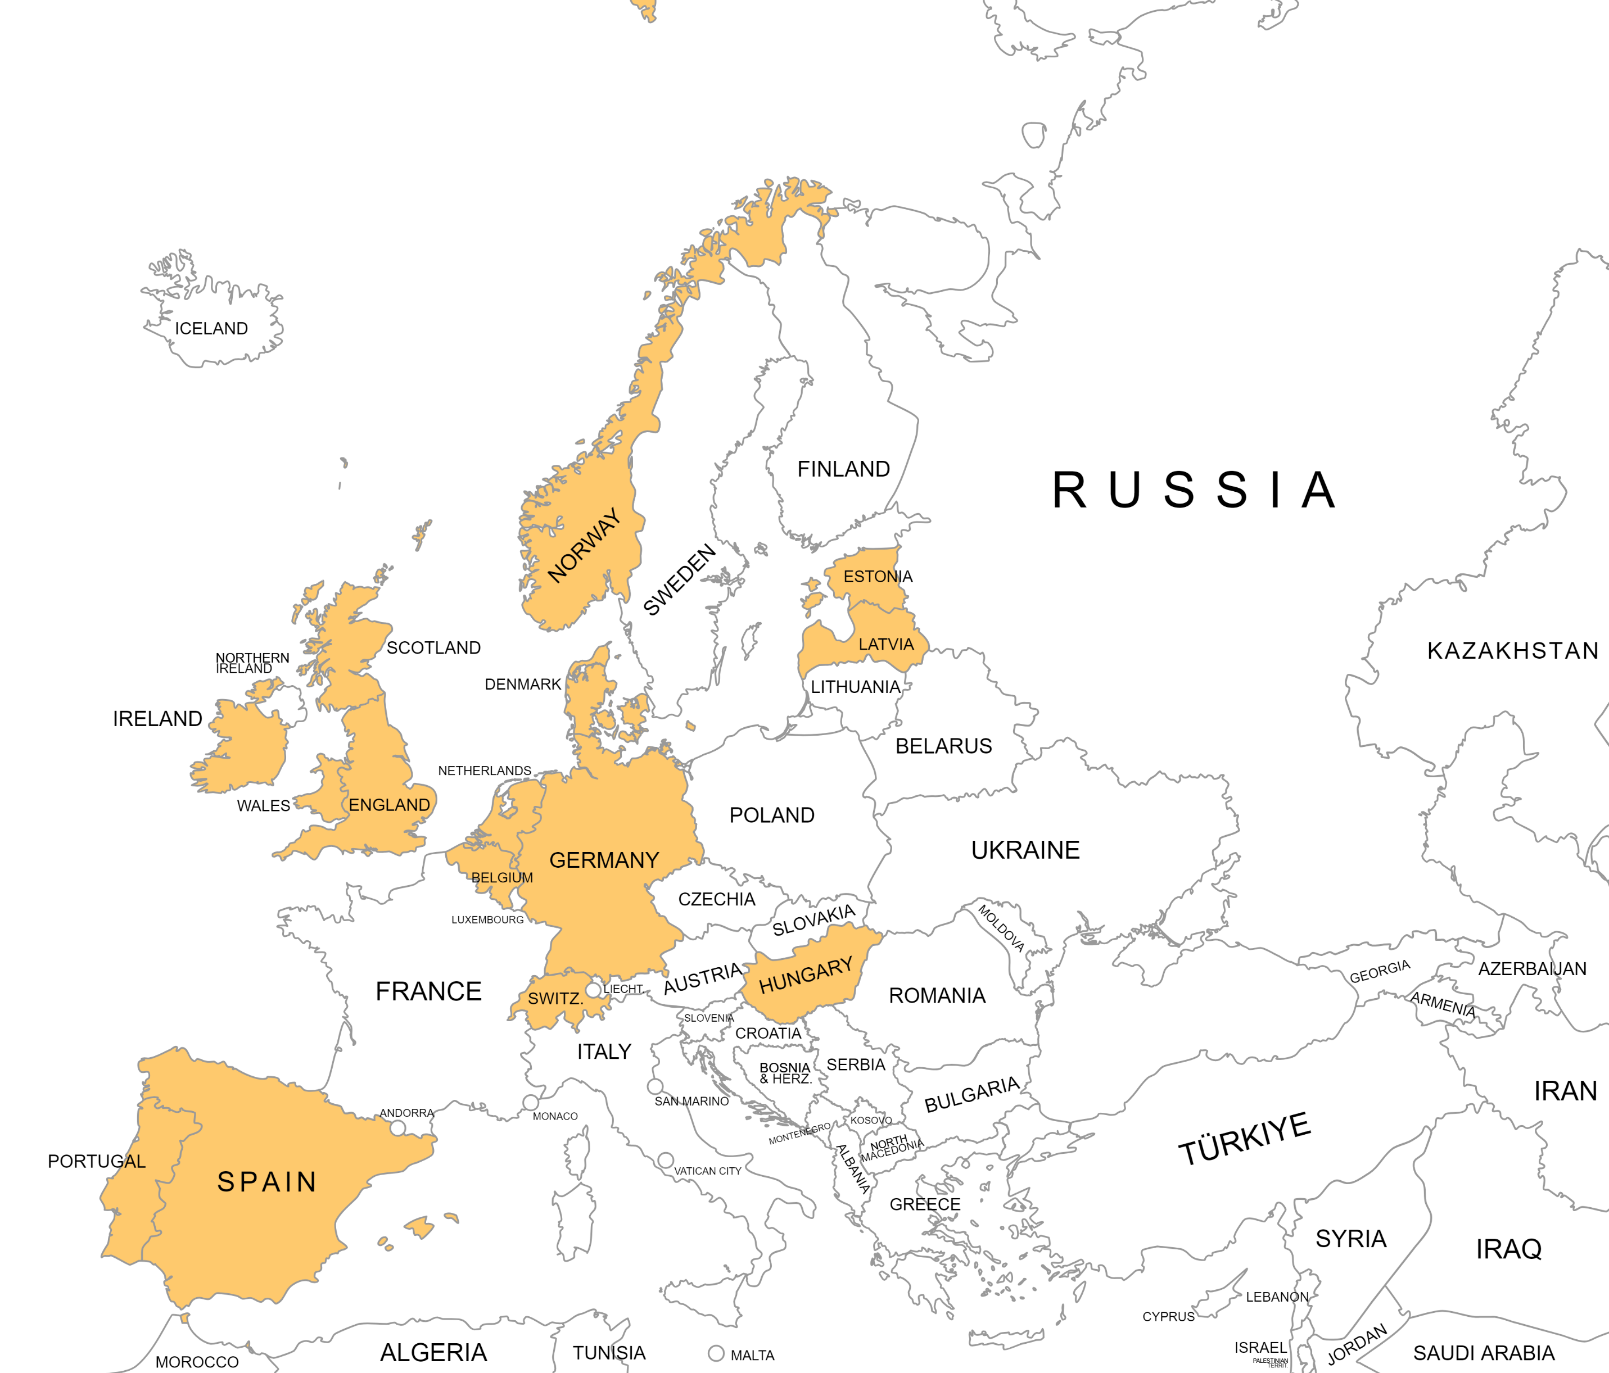
Methodology
Approach: 22 semi-structured interviews with marketing and communication specialists from 13 blood banks around Europe
Period: May-July 2023
Data Analysis:
307 transcribed pages
2 rounds of coding & 2 coders
Inductive and deductive approach
Notes:
Methods: We conducted 22 semi-structured interviews with marketing specialists from 13 blood banks in Europe (May-July 2023). To analyze the data, we employed both inductive thematic coding and deductive coding. Two rounds of coding were conducted to ensure the consistency and reliability of the identified themes. Additionally, a second coder independently reviewed a sample of the interviews.
Deductive coding: based on our research questions we looked for certain patterns in the data so we knew for example that an objective would be to recruit donors but inductive as we for example found educating donors is important

Slide 6
Platforms and Formats
Notes:
Before diving in the results and what are the objectives, strategies, content types and ways of measuring performance we need to look before at platforms and formats, the background of which all the social media activity is

Slide 7
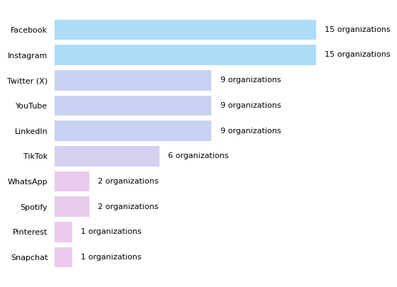
Distribution of platform adoption across organizations
“We’ve never had a TikTok account, and, after all these scandals, we definitely never will” (I.19).
Notes:
Traditional platforms: LinkedIn, Facebook, Twitter (X) and Instagram
Emerging ones: TikTok, Snapchat, streaming platforms ← tik tok
Also adoption of new formats: static photos but also dimamic videos reels, stories, podcasts or playlists.
Emerging of short and interactive formats

Slide 8
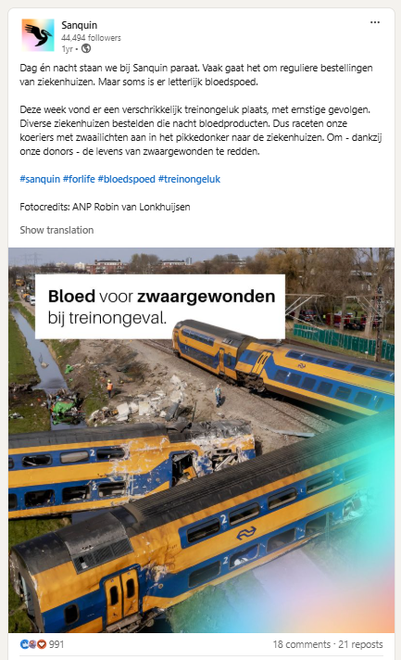
More is not always better: message-platform congruency
“on Instagram there was a very negative reaction to it. [people saying] are you going to abuse an accident like that to promote your own name, we don’t think that is right.” (I.3).

Slide 9
Communication Objectives
Strategies
Content Types

Slide 10
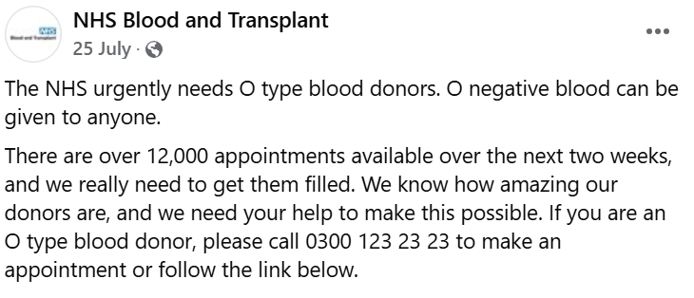
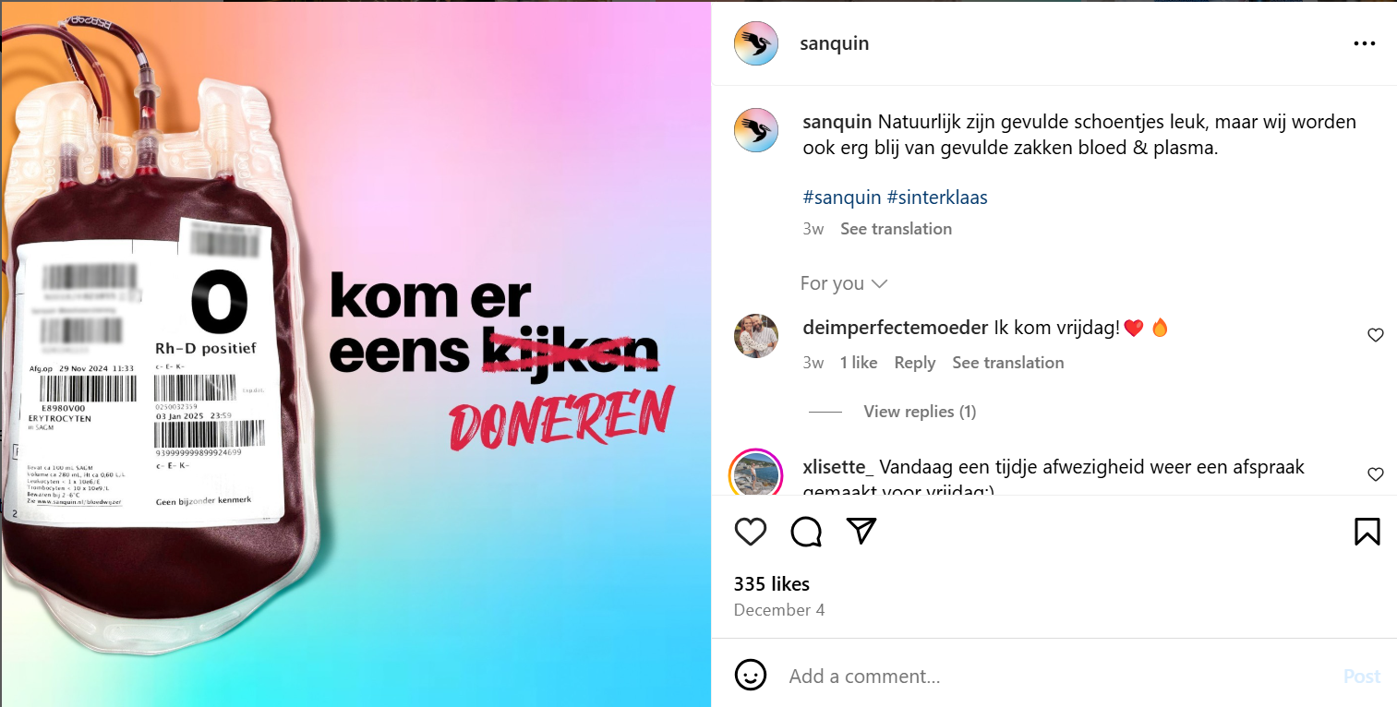
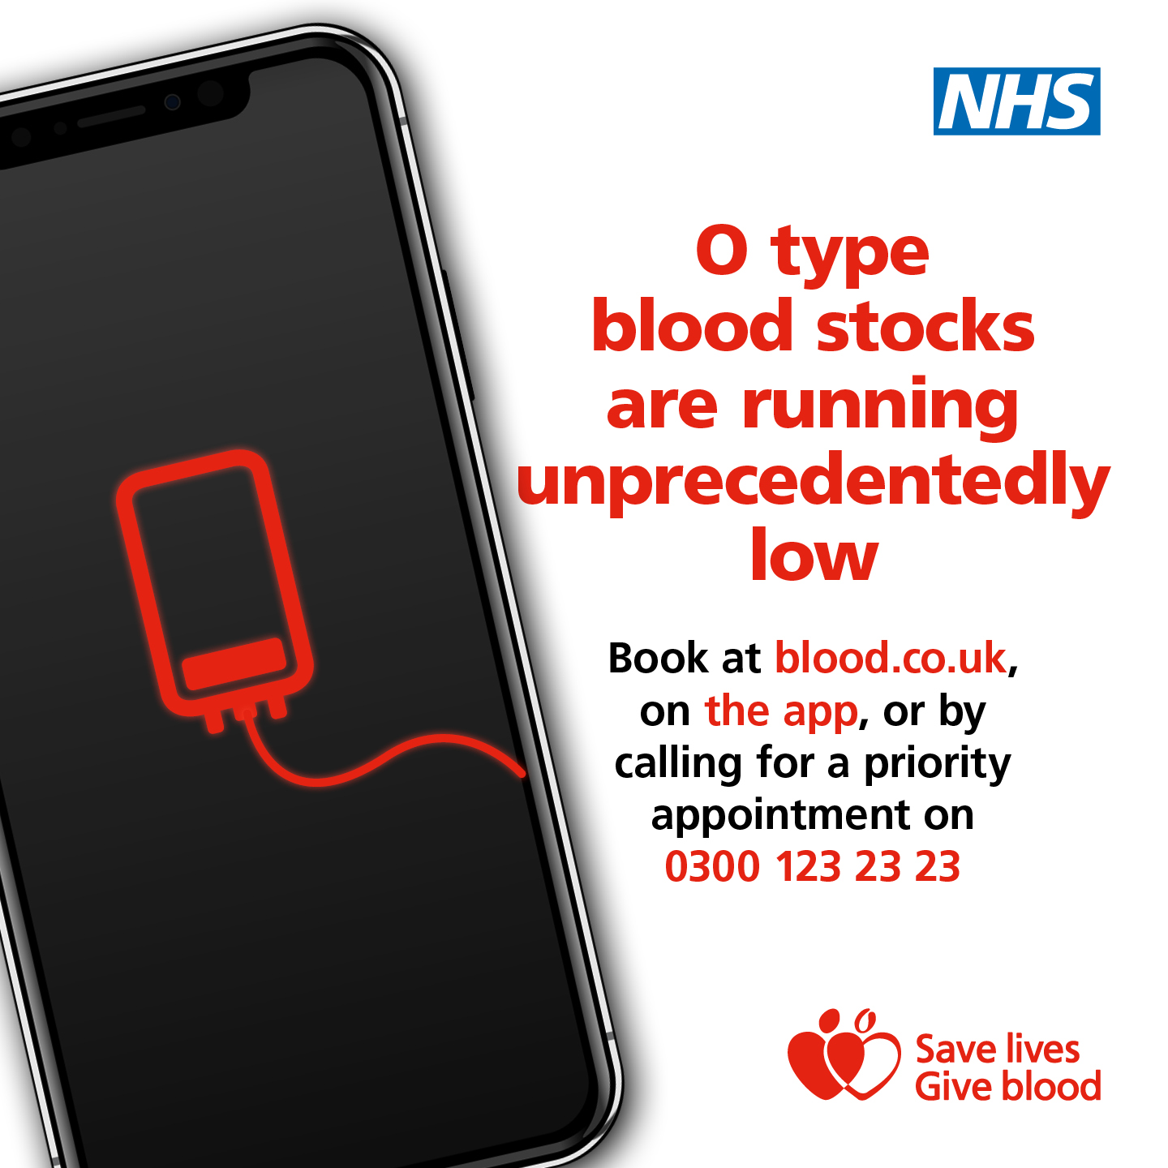
Recruitment & Retention
Notes:
Important but not the only objective

Slide 11
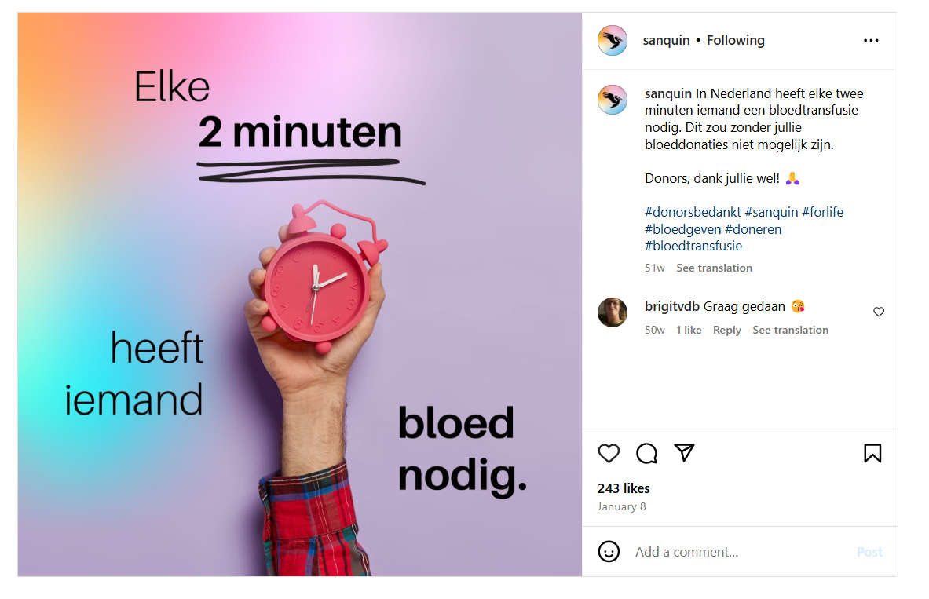
Education & Awareness
“We are bombarded with so much information every day that there are countless things we could do but don’t because they haven’t even crossed our minds. So, we strive to be present and visible so that those who could donate would consider it”. (I.19)
Notes:
While people might know about blood donation the topic might not actively cross their minds
Gentle reminders of the need
Tips and triks to preapare for the donation

Slide 12
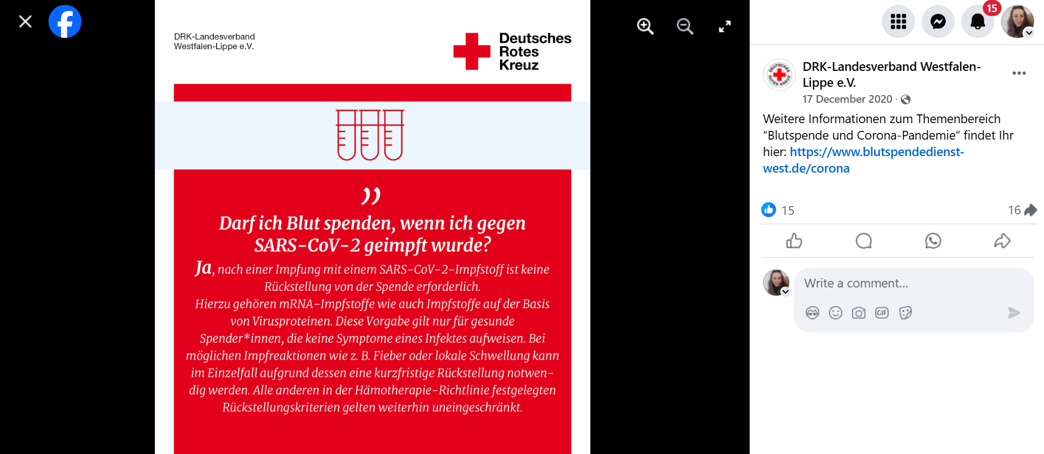
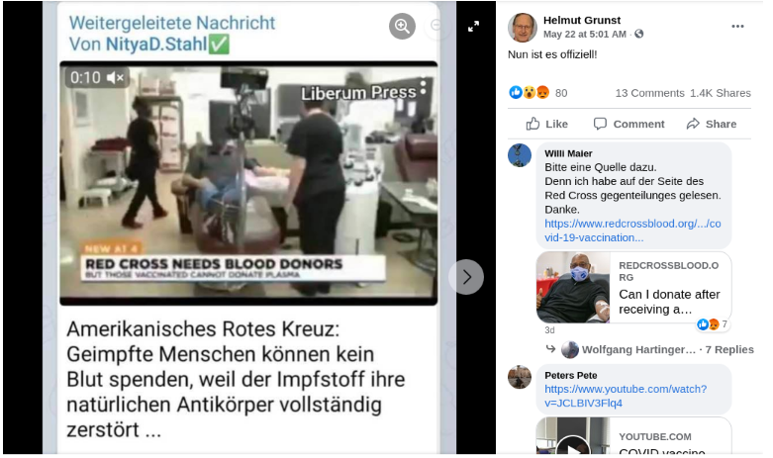
Combatting misinformation
“Some people still commented under our posts asking if it was true, so we want to be the ones to say no, it’s not true. We keep the dialogue open with donors, informing them about what is fake news and what is not”. (I. 20)

Slide 13
Communication Objective 3: Declinicalization of blood donation
Declinicalization of blood donation
The process of normalizing blood donation by fostering a sense of relatedness and belonging among potential and existing donors. This involves presenting blood donation as a normal day-to-day activity rather than an extraordinary or clinical event.

Slide 14
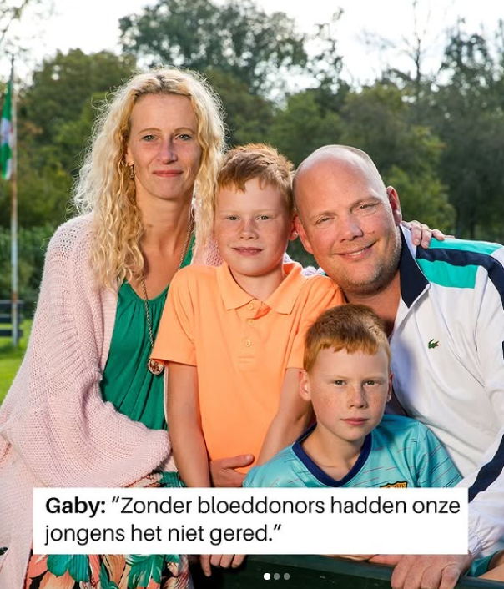
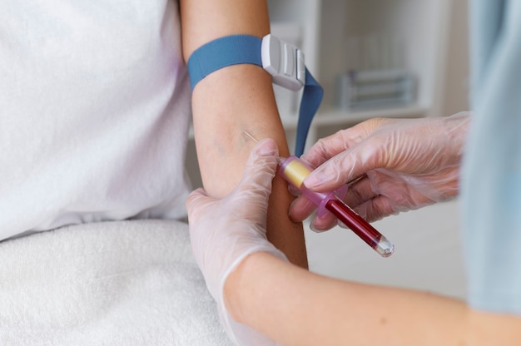


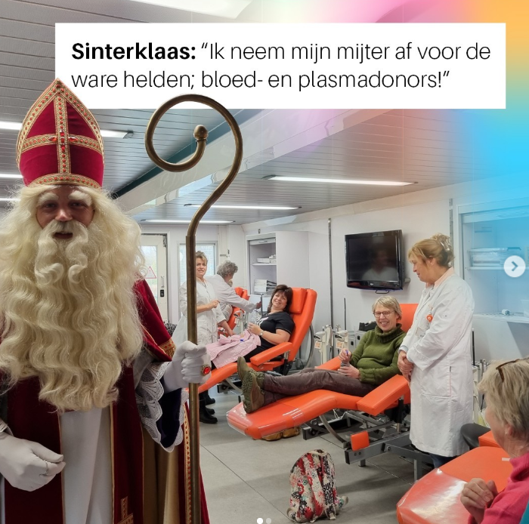

Communication Objective 3: Declinicalization of blood donation
Notes:
From this to this

Slide 15
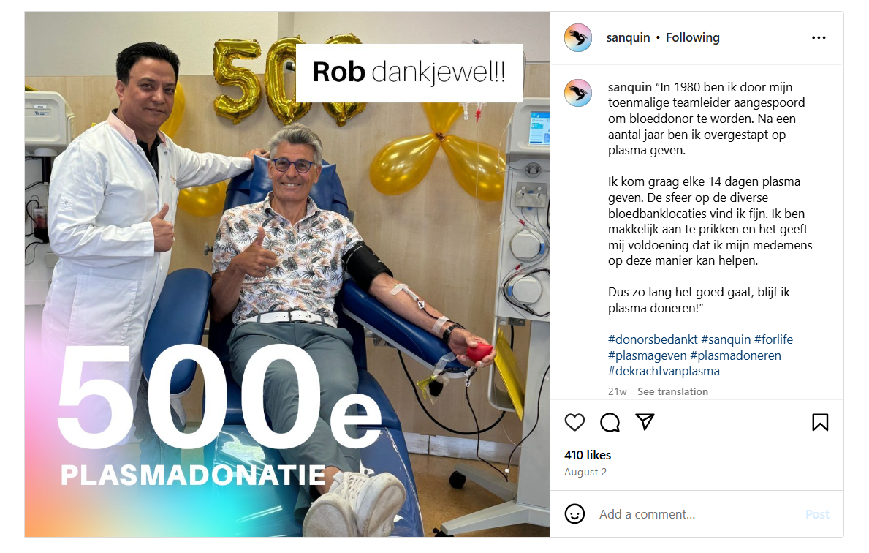
Communication Objective 3: Declinicalization of blood donation
Celebrating donors & creating a sense of belonging

Slide 16
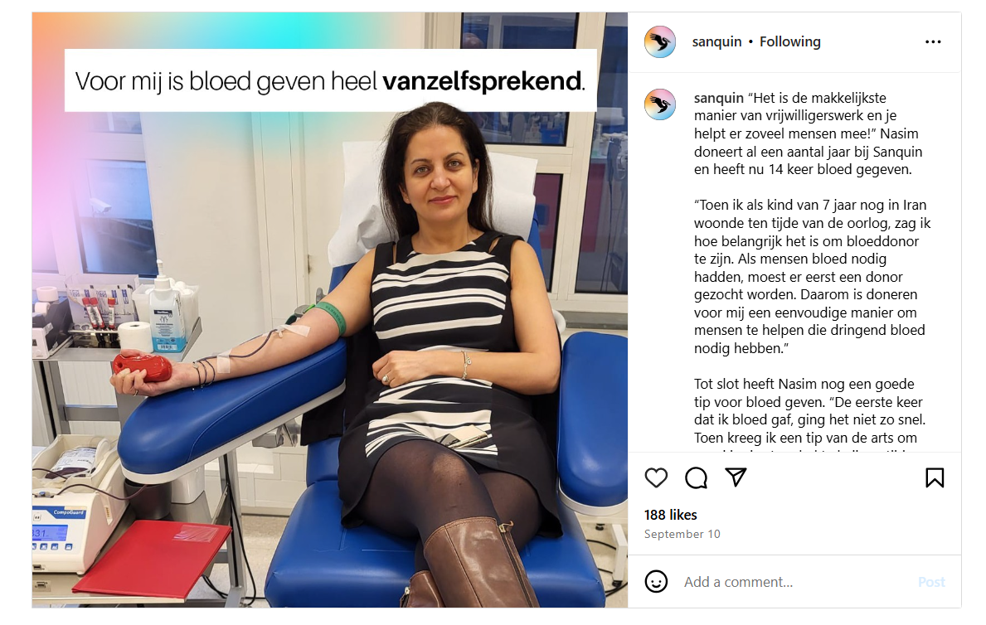
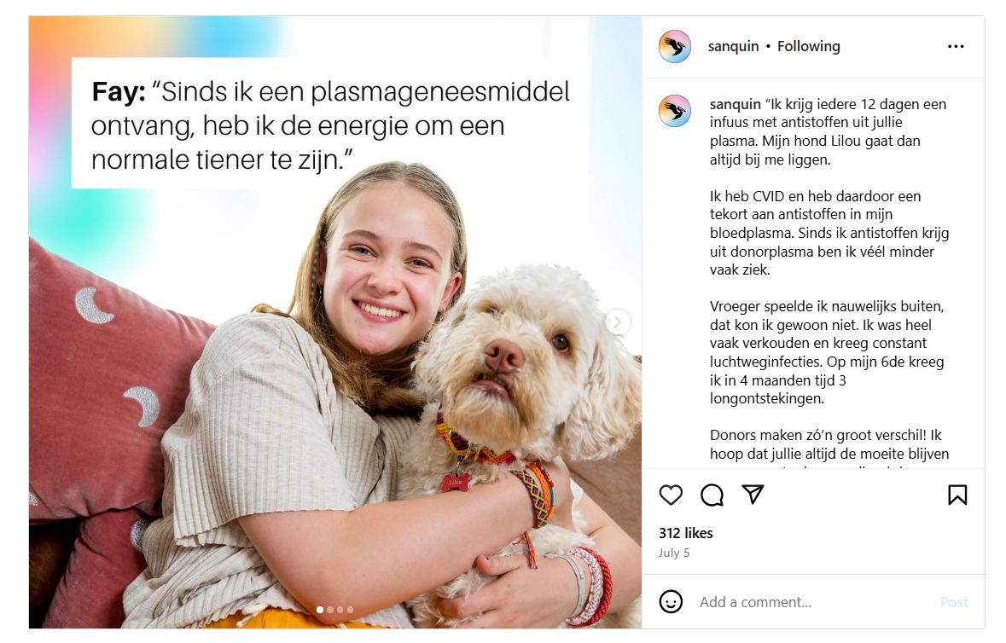
Communication Objective 3: Declinicalization of blood donation
Donor & patient stories

Slide 17
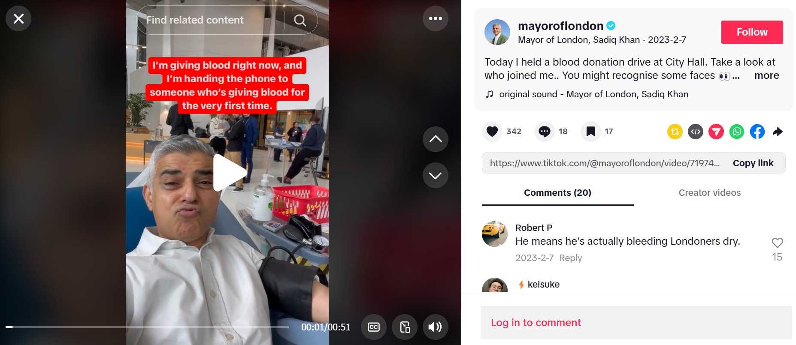
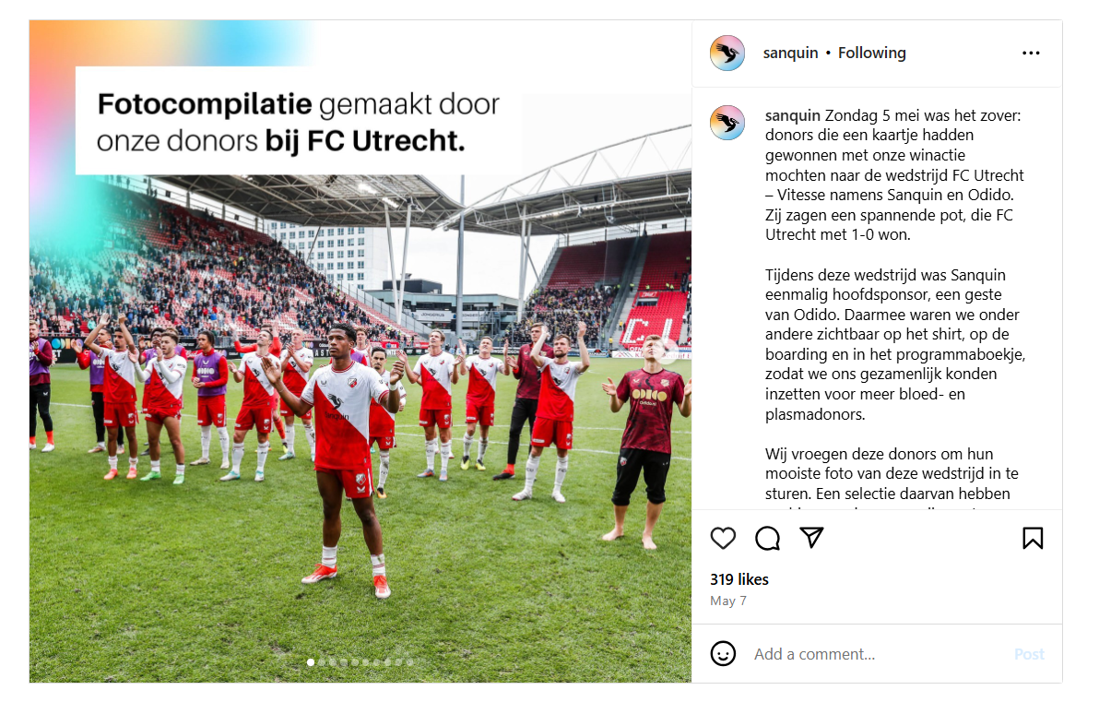
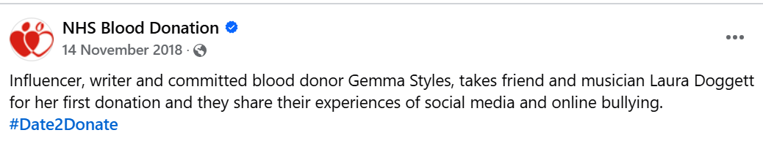
Communication Objective 3: Declinicalization of blood donation
Collaborating with public figures
Notes:
To archive this blood banks use of relatable content such as memes, patient stories, collaborations with public figures, and other strategies that evoke emotions and create social connections.

Slide 18
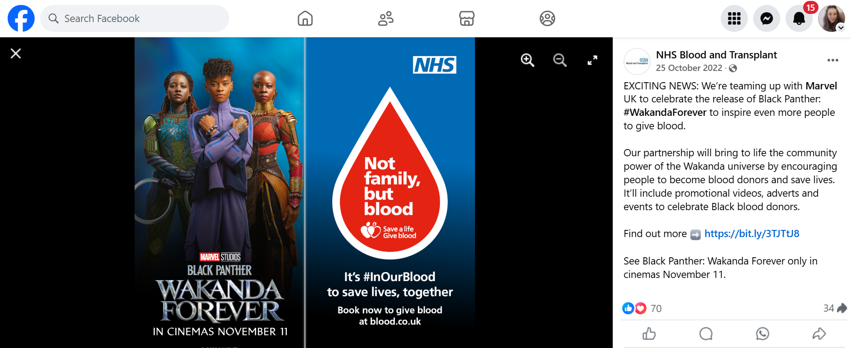
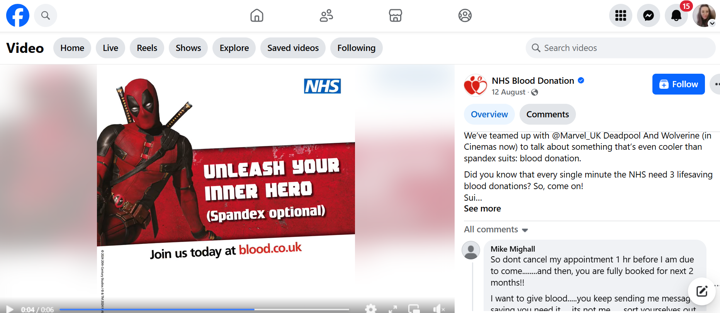
Communication Objective 3: Declinicalization of blood donation
Using humor and pop-culture references
Notes:
To archive this blood banks use of relatable content such as memes, patient stories, collaborations with public figures, and other strategies that evoke emotions and create social connections.

Slide 19

Measuring effectiveness on social media
Measuring effectiveness
Effective content
emotional and relatable stories from patients and donors
concise and engaging videos
interactive elements like quizzes
Less effective content
content that does not align with the platform's typical use (e.g., personal stories on professional networks)
content that appears opportunistic
content that is overly complex or lengthy
Notes:
Behavior in platform can be easily monitored by tracking interactions such as clicks, likes, comments, shares, and the number of viewers. However measuring behaviour outside of the platform is often challenging due to the complex behavior of donors. Content performance can be unpredictable; sometimes, a simple homemade video may perform better than highly polished professional content.

Slide 20
#BloodDonation
How European Blood Banks Use Social Media to Reach Donors and Non-Donors
Notes:
Social media is an increasingly important space for identity formation, information gathering, and in general socialization. In the last minutes I showed to you how European blood banks use the platforms to reach numerous goals, not only recruitment and retention and how they employ a large spectrum of, approaches, and strategies to achieve this.
The main idea behind this study was to create a beige. Firstly it aimed to over a more comprehensive perspective over a rather fragmented field of research. For researchers, our study provides a foundation to design future studies and interventions that are both theoretically sound and pragmatically valuable. For communication professionals, it delivers a theoretical framework to guide tailored decisions, enabling more impactful and efficient strategies. By aligning academic research with real-world practices, we hope to contribute to meaningful and lasting improvements in how blood banks communicate and connect with their audiences.

Slide 21
