Slide 1
Efforts for Further Development and Enhancement of Statistical Business Register in Japan
- Improvement of Update Frequency -
KUREMATSU Ryosuke,
TANABE Tatsuya
Statistical Business Register Management Division, Statistics Bureau,
Ministry of Internal Affairs and Communications
Government of Japan

Slide 2
Contents
Introduction
1st Effort: Corporate Number & Coverage Expansion of JSBR
2nd Effort: Improvement of Update Frequency of JSBR from 2023
Schedule

Slide 3
Brief Introduction to JSBR
2013
2019
2023
1st Effort
2nd Effort
Start of JSBR
Coverage Expansion of JSBR using Administrative Data
Improvement of Update Frequency of JSBR

Slide 4



Brief Introduction to JSBR
Japanese Statistical Business Register
(JSBR)
Data Source of JSBR
Survey Results
Governments
・Economic Census for Business Frame
(EC-BF)
・Economic Census for Business Activity
(EC-BA)
・Annual Business Survey
(ABS)
*Profiling Activity: At the National Statistics Center, dedicated personnel assigned to each major 5,000 companies regularly grasp corporate information and support the above surveys.
Items
・Name
・Location
・Number of Employees
・Industry Type
・Capital Amounts
・Sales, etc.
Conducting
Surveys
Establishment / Enterprise Inquiry (EEI)
Producing
Statistics
Grasping New Establishments and Closing Establishments with Administrative data（Labor Insurance Data, Commercial and Corporation Registration）

Slide 5
Data Source: Economic Census
Economic Census
Business Frame (EC-BF)
Gathering information about the business frame for conducting various business statistics surveys.
Focusing on the number of establishments, enterprises, employees, etc.
Business Activity (EC-BA)
Identifying the details of economic activities of businesses.
Focusing on the amounts of sales, costs, value added, etc.

Slide 6
Data Source: Annual Business Survey (ABS)
For the years in which the EC-BA is not conducted, we conduct Annual Business Survey (ABS) .
This survey covers all enterprises above a certain scale in all industries.
a five-year cycle.
2019 2020 2021 2022 2023 2024 2025 2026
EC-BF
EC-BA
EC-BF
EC-BA
ABS
ABS

Slide 7
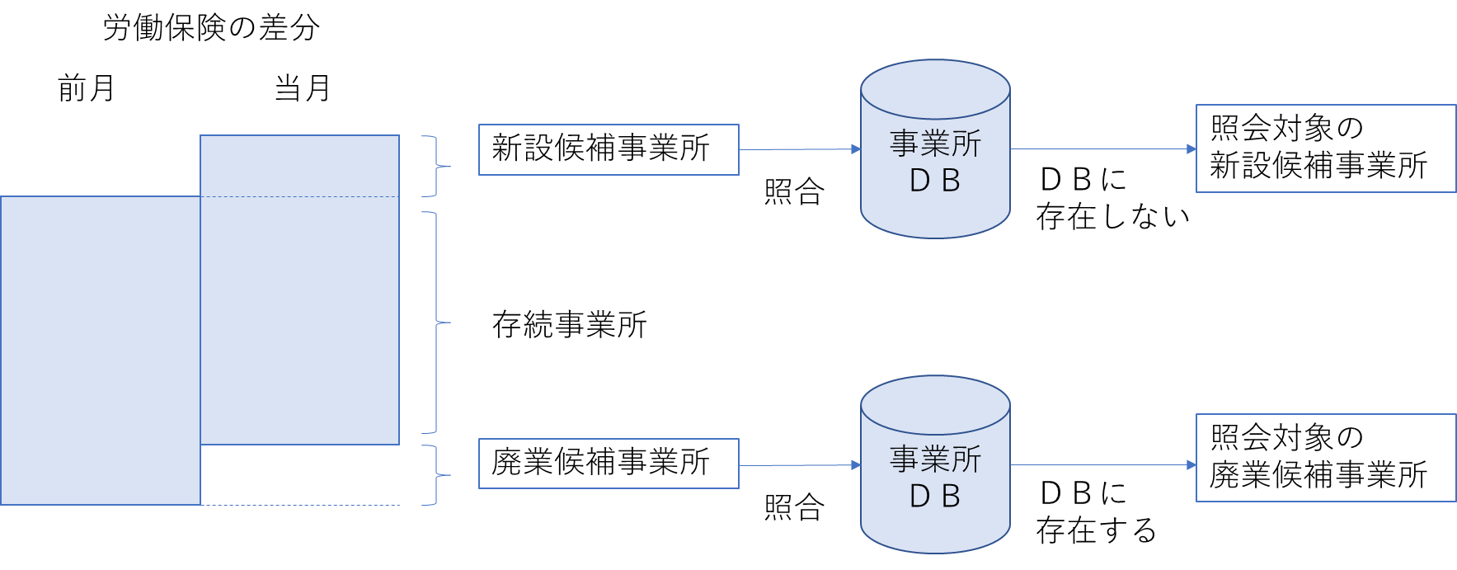
Data Source: Establishment / Enterprise Inquiry (EEI)
We find the clue of newly started or closed business establishments with the administrative data, "Labor Insurance Data" and "Commercial and Corporate Registration.“
We conduct the EEI targeting the newly started business establishments to grasp the status of business activities and basic items.
We conduct the EEI targeting the closed business establishments to grasp the status of business activities.
eg. the EEI using Labor Insurance Data
The difference of “Labor Insurance Data” between last month and this month
last month
this month
Conduct the EEI targeting the establishments
Newly started establishments
JSBR
Not exist
in JSBR
Existing establishments
Closed establishments
Conduct the EEI targeting the establishments
JSBR
Exist
in JSBR

Slide 8
Contents
Introduction
1st Effort: Corporate Number & Coverage Expansion of JSBR
2nd Effort: Improvement of Update Frequency of JSBR from 2023
Schedule

Slide 9
New Data Source: Corporate Number
The National Tax Agency in Japan publishes the “Corporate Number” on its website with the name and the location of the head office or principal office of corporations.
“Corporate Number” is a 13-digit number, which is freely available to anyone.
1st Effort
In 2019, we compared corporations in JSBR with the ones in the Corporate Number website.
We added 1.6 million corporations to JSBR.
We conducted 2019 EC-BF to capture the activity of the 1.6 million corporations.
We confirmed the status of 1.0 million corporations, which results in expanding the coverage of JSBR.

Slide 10
Contents
Introduction
1st Effort: Corporate Number & Coverage Expansion of JSBR
2nd Effort: Improvement of Update Frequency of JSBR from 2023
Schedule

Slide 11
New Data Source: New Establishment / Enterprise Inquiry
We regularly update the basic items of the enterprises of the top 80% of sales in the JSBR with the combination of the ABS and the EEI in the interim years.
From 2023, in addition to the EEI for new or closed establishments, we also started to conduct the new EEI targeting the existing enterprises having multiple establishments.
This results in updating the basic items of the enterprises of the top 90% of sales in the JSBR with the combination of the ABS and the new EEI.

Slide 12
New Data Source: 2024 Economic Census for Business Frame
Taking the cost effectiveness and alleviating the burden on local governments into account, we decided to exclude unincorporated enterprises without employees which accounts for only 0.4% of total sales in JSBR.
We still grasp the basic items of the top 99.6% of sales in JSBR.

Slide 13
The Relationship between the Area of the Surveys and Updated Area of JSBR
ABS（Interim Years：Every Year）
EC-BA（EC Year：Every Five Year）
New EEI（Interim Years：Years other than EC-BF）
EC-BF（Interim Years：Every Five Year）
Corporations
【Top 80% of Sales】
Top 80% of sales
Top 90% of sales
Top 99.6% of sales
Corporations other than
the above with
multiple establishments
Single Office Corporations other than the above
Unincorporated Enterprise with employees
Unincorporated Enterprise without employees

Slide 14
Contents
Introduction
1st Effort: Corporate Number & Coverage Expansion of JSBR
2nd Effort: Improvement of Update Frequency of JSBR from 2023
Schedule

Slide 15
Schedule
The Cycle of Surveys Used to Update the JSBR
Base Year | Interim Years |  |  |  | Base Year
2021 （Result） | 2022 （Result） | 2023 （Result） | 2024 （Plan） | 2025 （Plan） | 2026 （Plan）
・EC-BA | ・ABS ・EEI | ・ABS ・New EEI | ・ABS ・EC-BF | ・ABS ・New EEI | ・EC-BA
(100%)*
(80%)
(90%)
(99.7%)
(90%)
(100%)
* The coverage of JSBR

Slide 16
Summary
The primary data source of JSBR is the survey results of Economic Census and Annual Business Survey.
1st effort: we expanded the coverage of JSBR using administrative data: Corporate Number.
2nd effort: we developed the EEI and the EC-BF to improve the update frequency of JSBR as new data sources.

Slide 17
Thank you for your attention!
Statistics Bureau,
the second government office of the Ministry of Internal Affairs and Communications,
19-1, Wakamatsu-cho, Shinjuku-ku, Tokyo 162-8668

