Slide 1


Preventing iron deficiency by model guided donation frequencies
Mart Pothast, Yared Paalvast & Mart Janssen
11/9/2025 ECDHM
m.pothast@sanquin.nl

Slide 2
Disclosure of Conflict of Interest slide
None

Slide 3
Whole-blood donors lose iron
Quite a lot: ~250 mg = 25-50% of total iron storage
Sanquin monitors ferritin at every 5th donation
6 months deferral for ferritin <= 30 ng/mL
12 months deferral for ferritin < 15 ng/mL
Evaluation of this policy¹:
Prevents donors from developing iron deficiency (ferritin < 15 ng/mL)
Reduces Hb deferrals
¹Meulenbeld et al. 2025, The Lancet

Slide 4
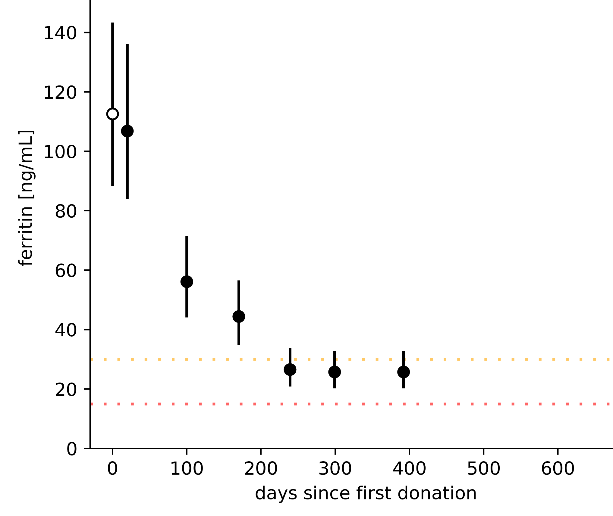
Typical ferritin history for male donor
Ferritin at intake 113 ng/mL
But after 5 donations, ferritin is ≤ 30 ng/mL
6 month deferral limit
12 month deferral limit
Donor example from FIND+ study, Moazzen et al. 2022
Notes:
<15 ng/mL: 8% and 12%

Slide 5
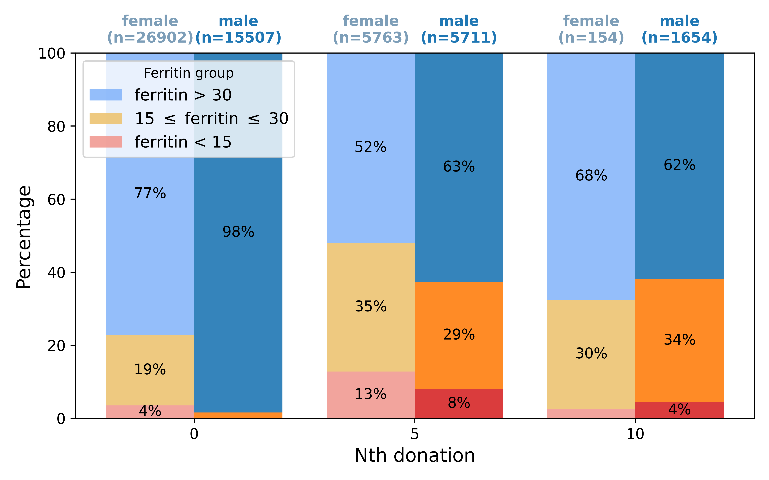
Many donors have low ferritin after donating
>40% of all donors will be deferred for 6-12 months after 5/10 donations
From whole-blood donors that started in 2021 and made at least 1 donation

Slide 6
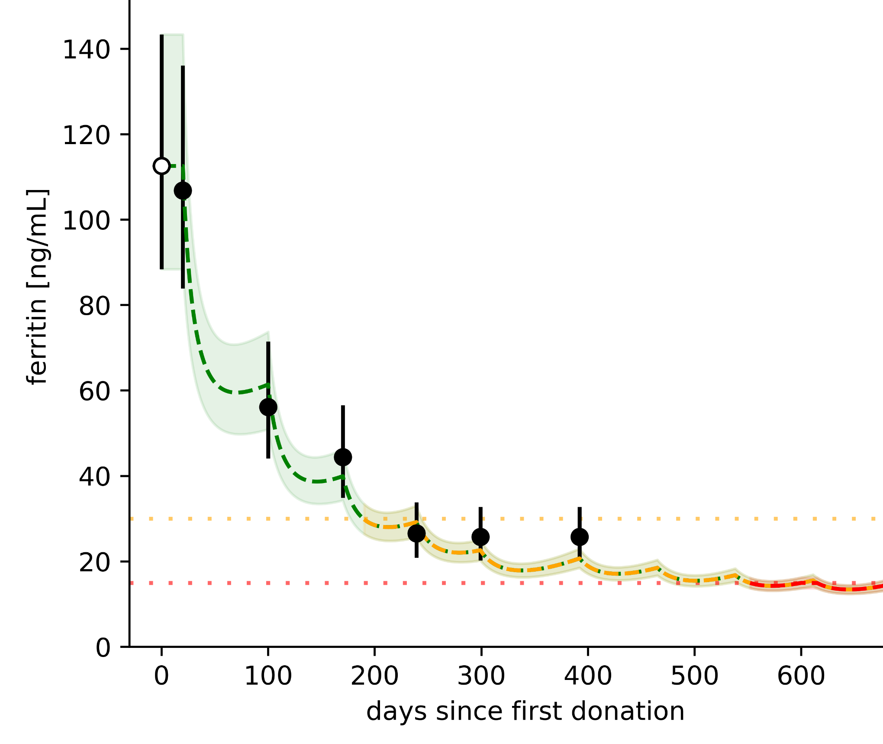
Ferritin drop is very predictable
Model uses ferritin at intake
accurately predicts that ferritin will be below 30 ng/mL at 5th donation
Model prediction + uncertainty estimation
If this donor would continue to donate
(5 times per year) he will have ferritin < 15 ng/mL
6 month deferral limit
12 month deferral limit
Notes:
<15 ng/mL: 8% and 12%

Slide 7
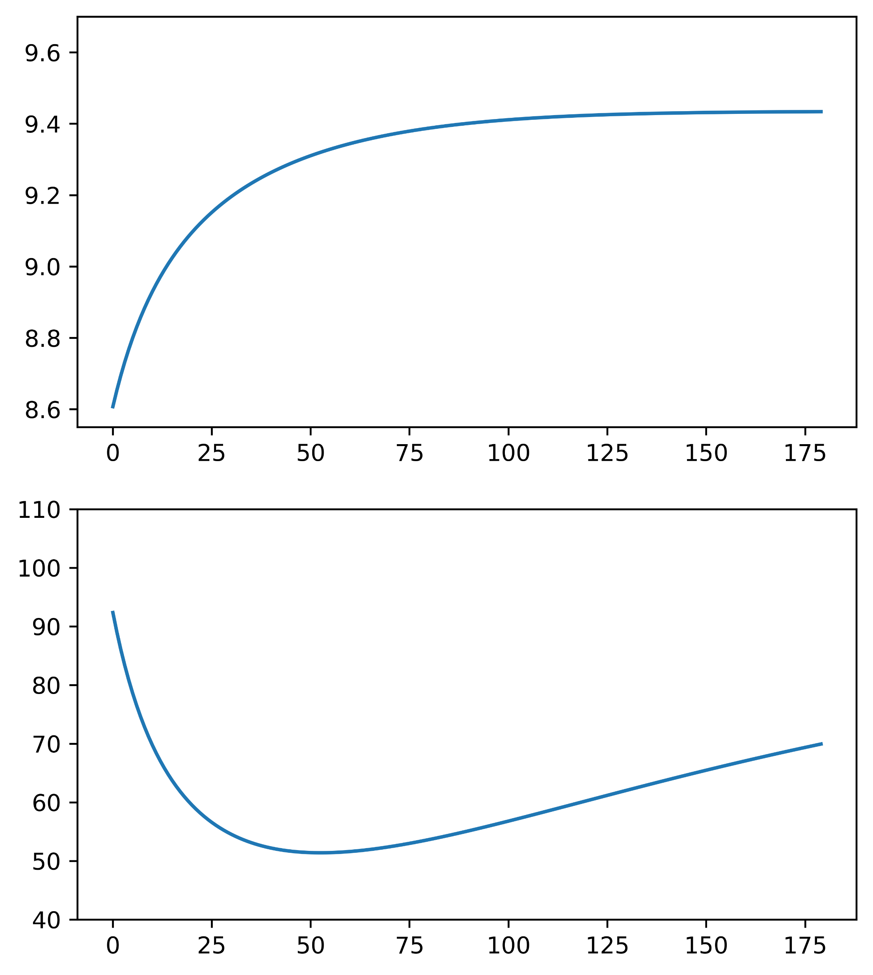

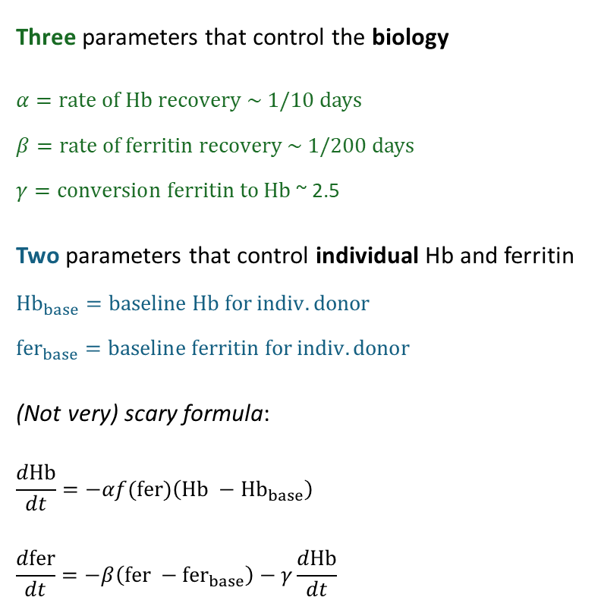
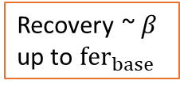


Biological prediction model
Hb and ferritin after donation
Three parameters that control the biology
$α=rate of Hb recovery$ ~ 1/10 days $β=rate of ferritin recovery$ ~ 1/200 days $γ=conversion ferritin to Hb$~ 2.5
Two parameters that control individual Hb and ferritin $$Hb_{base}=baseline Hb for indiv. donor \\ fer_{base}=baseline ferritin for indiv. donor$$
(Not very) scary formula:
$$\frac{dHb}{dt}=−αf(fer)\left(Hb −Hb_{base}\right) \\ \frac{dfer}{dt}=−β\left(fer −{fer}_{base}\right)−γ\frac{dHb}{dt}$$
At donation:
Hb loss = Hb*(1-Vloss/V)
Recovery up to $Hb_{base}$
Hb
[mmol/L]
Increase with $α$
Ferritin loss = $γ\frac{dHb}{dt}$
Recovery ~ $β$ up to $fer_{base}$
Ferritin [ng/mL]
Days since donation

Slide 8
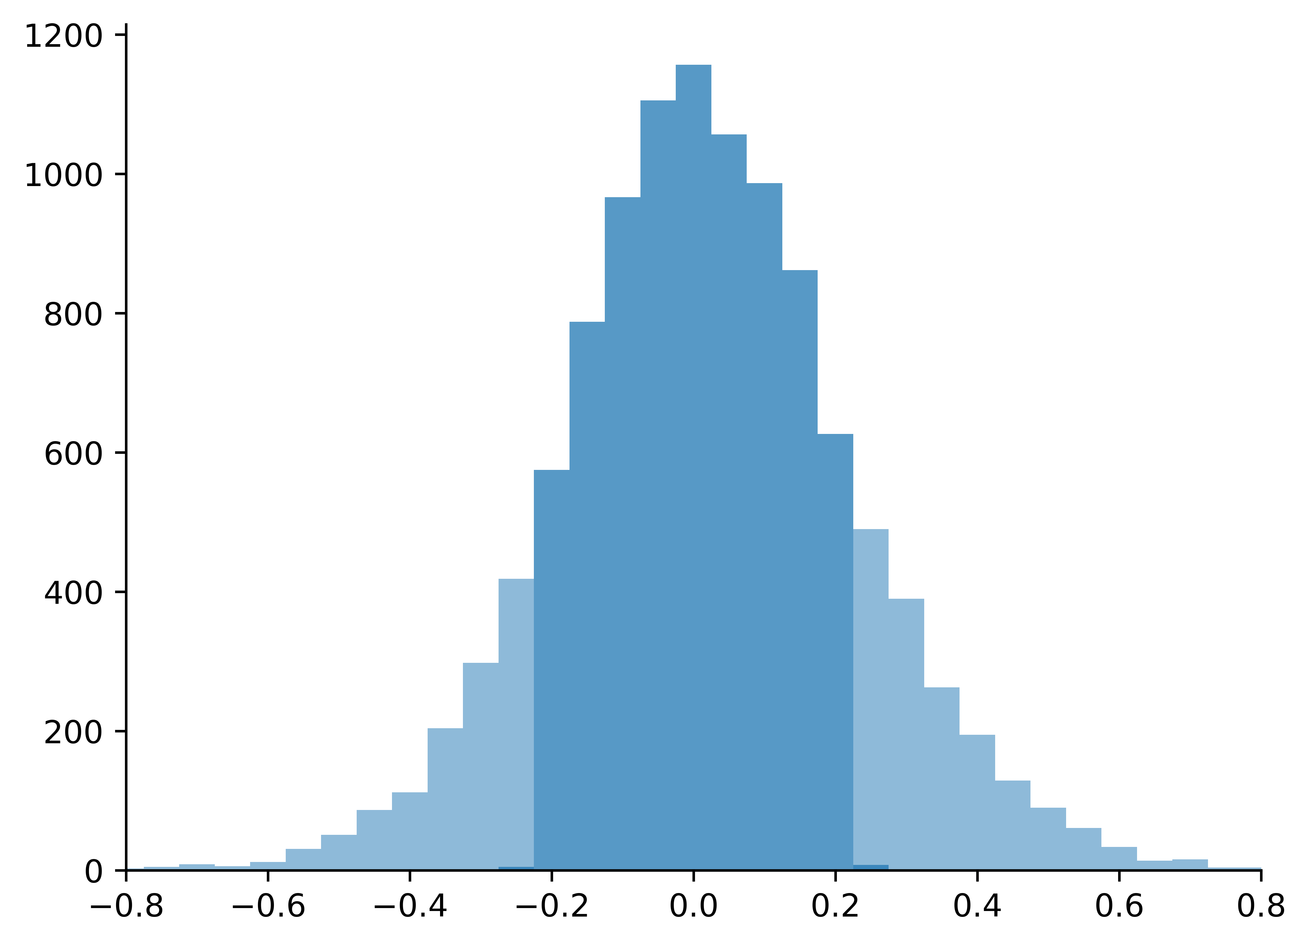
Accuracy of the ferritin model predictions
Difference between the log of the measurement and the prediction
New donors that started in 2021
At 5th donation
74% of ferritin predictions* are within the 95% CI of the measurement
Males are more predictable: 79% vs 68% for females
80% of predictions < 30 ng/mL are measured as < 30 ng/mL (precision) at a sensitivity of 75%
Number of donors
74% inside 95% CI
Log(Ferritin measurement) – Log(Model prediction)
*The model parameters (alpha, beta, gamma) are fitted to data from the FIND+ study: 300 donors with ferritin and Hb at every donation.
The measurement uncertainty is ~0.11 on log10 scale

Slide 9
Proactive ferritin guided donation intervals
Donations per year
Start ferritin | 1 | 2 | 3 | 4 | 5
20 | 16 | 10 | 7 | 6 | 5
25 | 20 | 12 | 9 | 7 | 6
30 | 25 | 15 | 10 | 8 | 6
40 | 33 | 19 | 12 | 9 | 7
50 | 41 | 23 | 15 | 11 | 8
60 | 49 | 27 | 17 | 12 | 9
70 | 58 | 32 | 19 | 13 | 10
80 | 66 | 36 | 21 | 14 | 11
90 | 74 | 40 | 23 | 15 | 11
100 | 82 | 44 | 25 | 16 | 12
125 | 102 | 53 | 29 | 19 | 14
150 | 121 | 63 | 34 | 21 | 15
175 | 141 | 72 | 38 | 23 | 16
200 | 160 | 81 | 42 | 25 | 17
250 | 198 | 97 | 49 | 29 | 19
300 | 235 | 113 | 56 | 32 | 21
Using the model, we determine the donation frequency for individual donors that keeps ferritin above a certain threshold.
This is mostly determined by the start ferritin at intake.
We determine start ferritin thresholds that demand that ferritin > 20 ng/mL after 2 years of donating:
Start ferritin [ng/mL] | Max # donations per year
<50 | 1
<80 | 2
<150 | 3
<300 | 4
>=300 | 5
To stay above 20
Ferritin levels after 2 years

Slide 10
By implementing model guided personalized donation frequencies:
We keep donors’ ferritin levels at sufficient levels
We reduce the number of ferritin deferrals
And possibly also Hb deferrals*
By implementing this policy for new whole-blood donors we lose at most 3% of whole-blood donations per year (see my poster for details)
By reducing the number of deferrals, we probably* retain more donors
*Future studies to estimate this more precisely. The implementation will be evaluated after 2 years

Slide 11
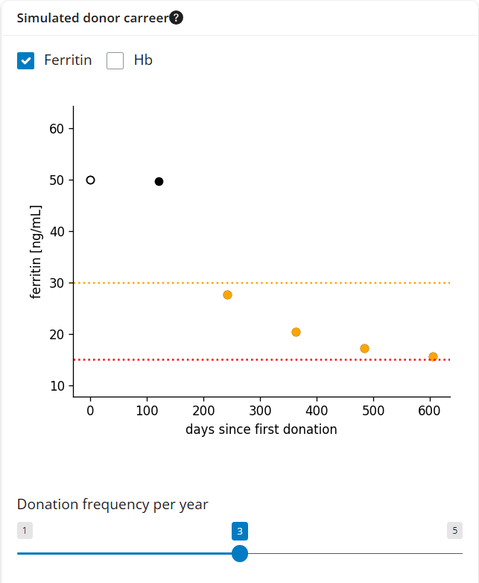
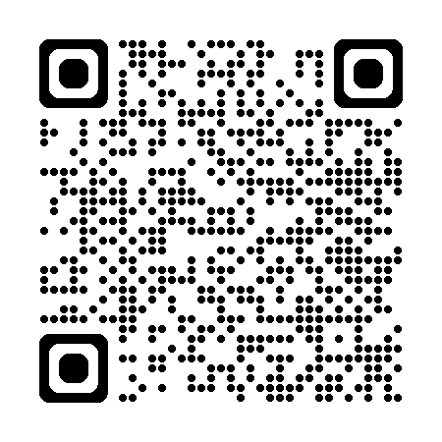
Checkout the model in our webapp

Slide 12
Backup

Slide 13
Males
Start ferritin | 1 | 2 | 3 | 4 | 5
20 | 17 | 11 | 8 | 7 | 5
25 | 21 | 14 | 10 | 8 | 6
30 | 25 | 17 | 12 | 9 | 7
40 | 34 | 22 | 15 | 11 | 8
50 | 42 | 27 | 18 | 13 | 10
60 | 50 | 32 | 21 | 14 | 11
70 | 58 | 37 | 24 | 16 | 12
80 | 66 | 42 | 26 | 18 | 13
90 | 74 | 46 | 29 | 19 | 14
100 | 82 | 51 | 32 | 21 | 15
125 | 101 | 62 | 38 | 25 | 17
150 | 120 | 72 | 44 | 28 | 19
175 | 139 | 83 | 50 | 31 | 21
200 | 158 | 92 | 55 | 35 | 23
250 | 194 | 111 | 65 | 40 | 26
300 | 230 | 129 | 75 | 45 | 29
Start ferritin [ng/mL] | Max # donations per year
<40 (50) | 1
<60 (80) | 2
<100 (150) | 3
<175 (300) | 4
>=175 (300) | 5

Slide 14
After 5 years
Start ferritin | 1 | 2 | 3 | 4 | 5
20 | 15 | 9 | 7 | 5 | 4
25 | 19 | 11 | 8 | 6 | 5
30 | 24 | 14 | 9 | 7 | 6
40 | 32 | 18 | 11 | 8 | 6
50 | 40 | 22 | 13 | 9 | 7
60 | 48 | 26 | 15 | 11 | 8
70 | 56 | 30 | 17 | 12 | 9
80 | 64 | 34 | 19 | 13 | 10
90 | 71 | 37 | 21 | 14 | 10
100 | 79 | 41 | 23 | 15 | 11
125 | 98 | 50 | 27 | 17 | 12
150 | 117 | 59 | 31 | 19 | 13
175 | 136 | 68 | 35 | 21 | 15
200 | 155 | 76 | 39 | 23 | 16
250 | 191 | 92 | 45 | 26 | 17
300 | 227 | 107 | 52 | 29 | 19
Start ferritin [ng/mL] | Max # donations per year
<50 (50) | 1
<90 (80) | 2
<175 (150) | 3
<300 (300) | 4
>=300 (300) | 5

Slide 15
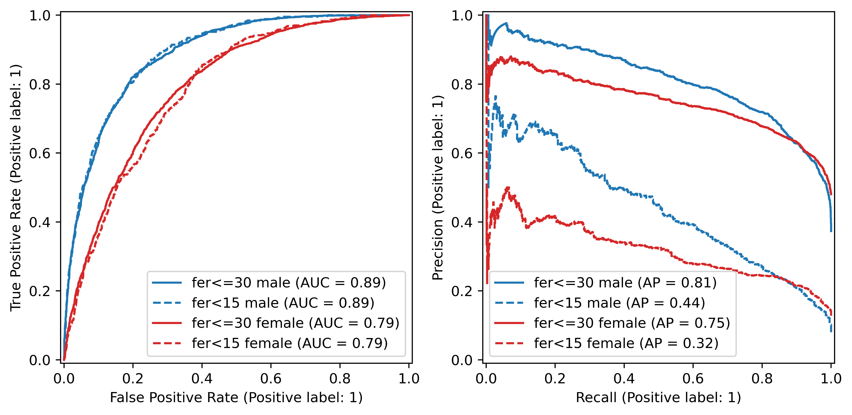
ROC and PR curves for the model

