Slide 1
Linking data to the Business Register
Jessica Wellwood
U.S. Census Bureau
October 2, 2023
28th Meeting of the Wiesbaden Group
Note: Any opinions and conclusions expressed herein are those of the author and do not reflect the views of the U.S. Census Bureau. The Census Bureau has reviewed this data product to ensure appropriate access, use, and disclosure avoidance protection of the confidential source data (Disclosure Review Board (DRB) approval number: CBDRB-FY23-ESMD002-031).
Notes:
Thank you for attending our panel on the Enterprise Frames where we will discuss how we are modernizing the Census Bureau’s statistical foundation. Any opinions and conclusions expressed are my own and do not reflect the views of the Census Bureau.

Slide 2



Transformation at the Census Bureau
PROBLEM
Declining Response Rates
Shrinking
Budgets
Increased demand for data
SOLUTION: Modernize our Statistical Foundation through Enterprise Frames Program
To create Enterprise-wide frames linkable in nature, agile in structure, accessible for production or research on a need-to-know basis, and that adhere to best practices in terms of technology usage, data management, and methodology.

Slide 3



Transformation at the Census Bureau
SOLUTION
Leverage existing data
Promote Innovation
Simplify Processes
To create Enterprise-wide frames linkable in nature, agile in structure, accessible for production or research on a need-to-know basis, and that adhere to best practices in terms of technology usage, data management, and methodology.

Slide 4



Transformation at the Census Bureau
VISION
To create Enterprise-wide frames that are…
Linkable in nature
Agile in Structure
Accessible for research or production
To create Enterprise-wide frames linkable in nature, agile in structure, accessible for production or research on a need-to-know basis, and that adhere to best practices in terms of technology usage, data management, and methodology.

Slide 5
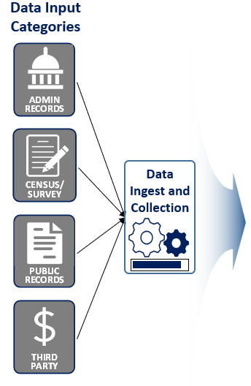
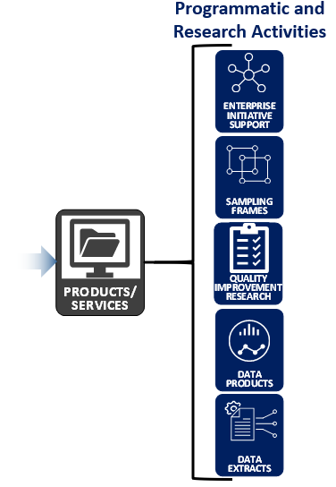

Creating an Infrastructure to Modernize the Census Bureau’s Statistical Foundation
Frames Program
ENTERPRISE FRAMES
List of Addresses and their attributes (i.e., address has a non-residential use)
Linkage Infrastructure
List of Businesses and their attributes (i.e., business has employees)
List of People and their attributes (i.e., person is a worker)
Notes:
So, what will this linked data infrastructure look like?
On this slide, I’ll show you a conceptual diagram that depicts the vision of the Frames Program. Although this is a future state vision, some aspects of this diagram already exist or are underway. [advance slide]
This first column shows that the four frames are developed from administrative record data, survey and census data, public records, and other third-party commercial data. These data inputs will be collected and ingested through processes at either the enterprise or program level. The data will flow into a data repository maintained by another Census Bureau group, Data Ingest and Collection for the Enterprise. [advance slide]
After ingest into the enterprise, the Frames Program accesses the source data and constructs the Geospatial, Business, Job, and Demographic Frames. Data within the frames will be linked and accessible by, within, and across the individual frames by unique identifiers; this is shown on the diagram by the lines labeled “linkage infrastructure.” This infrastructure will also support linking auxiliary datasets to the Enterprise Frames. For example, auxiliary data may be paradata or some other data necessary for a user to carry out their work, but not necessarily a source that would be maintained and curated by the Frames Program. [advance slide]
and products and services will be generated from data in the frames to support programmatic and research activities, including things like sampling frames and data products.
Talking point before advancing slide:
Lastly, I’d like to note that currently, the Enterprise Frames are internal-use only. The Frames Program sits at the center of the Census Bureau’s overall vision for how we will transform the way we conduct our work and how we manage, use, and reuse the foundational data underpinning our work and enabling us to carry out our mission.

Slide 6
What is the Business Frame?
Third party
Business Register
Survey Data
Third Party Data
Admin Data
Public Data
And More!
Collection of Data across multiple sources
Survey
Admin
Public Data
Harmonized
and linked
to the BR
Stored in a central location
  Collection of auxiliary data, harmonized business across multiple sources, integrated together, and stored in a central location

Slide 7
Business Frame
What?
Why?
How?
Collection of rich, harmonized business data across multiple sources, linked to BR, and stored in a central location
TO FACILITATE THE DEVELOPMENT OF NEW AND IMPROVED DATA PRODUCTS
Create a relational database that links data together, utilizing probabilistic matching
Notes:
The vision of the Frames Program is to establish enterprise-wide frames that are linkable in nature, agile in structure, accessible for production or research on a need-to-know basis and that adhere to best practices in terms of technology usage, data management, and methodology.
By linkable in nature, we mean that each frame will include the necessary unique identifiers and keys for linkage to other frames. For example… [examples on slide]
The overarching goals of increasing utility and efficiency while minimizing burden on respondents drive the future-state vision.
These goals will be achieved in coordination with other enterprise efforts, such as the Data Ingest and Collection for the Enterprise (DICE) and the Enterprise Data Lake (EDL) , to modernize current systems, improve access to Census Bureau data, and ultimately increase the value of products to customers and stakeholders.

Slide 8
The Business Frame is NOT the Business Register!
Business FRAME
Business REGISTER
Collection of auxiliary data, harmonized business data across multiple sources, integrated together, and stored in a central location
  In-depth data specific to a defined sub-population of Business Entities*
  Linkages across data sources and time (LBD)
  Data owned by designated data provider
  All data sources welcome!
Master list of businesses with associated core attributes
  Full Coverage of business population
  Linkages between BR statistical units (e.g. Establishments, Enterprises)
  Updated from administrative data (IRS, SSA, BLS) and select census programs
  Data are owned by Business Register Staff
*Examples of Business Entities are governments, publicly traded companies, records in a specific NAICS
Business Register

Slide 9
Scope the Work – Phase 1: Prototype
Goal: Leverage existing data more effectively
Objective: Demonstrate link-ability and utility
Can we link data to the Business Register in a reliable and useful way?
Acceptance Criteria: We have database, with all data loaded and connected in a meaningful way.

Slide 10
How are we going to do this?
Select the Data
Develop & Apply Methodology
Design the Architecture
Construct the database

Slide 11
Select the Data Sources
Point-of-sale data provided by Third Party*
Longitudinal Business Database (LBD)
What: Monthly credit card transactions aggregated to the product level for select retailers
Why: Timeliness of data (more current than BR), new level of granularity
What: Links BR establishments over time,
calculates firm age and size
Why: Longitudinal dimension for use in
sampling parameter, measuring
business dynamism
Non-Employer Statistics by Demographics (NES-D)
Governments Master Address File (GMAF)
What: Administrative data product assigning business level demographic characteristics to non-employer companies
Why: Demographic dimension to business data,
Linking mechanism to Demographic Frame
What: List of state & local governments, and
core attributes
Why: Known overlap with BR, share/validate coverage, classification, financial data
and contact information
*Data purchased from Circana, a private sector market research company

Slide 12
Develop Methodology
Common Identifier
Match records based on a shared identifier in both data sets
High Accuracy, Minimal Resources
Probabilistic Matching
Utilizes machine learning to conduct pair-wise matching
Varied Accuracy, High Learning Curve
Analyst Review
Analyst matches records between data sources
High Accuracy, Resource Intensive
123=123
ABC=ABC
5XY=5XY

Slide 13
Apply Methodology
Point-of-sale data provided by Third Party*
Longitudinal Business Database (LBD)
What: monthly credit card transactions aggregated to the product level for select retailers
Why: Timeliness of data (more current than BR), new level of granularity
What: Links BR establishments over time,
calculates firm age and size
Why: Longitudinal dimension for use in
sampling parameter, measuring
business dynamism
Common Identifier
Analyst Review
Non-Employer Statistics by Demographics (NES-D)
Governments Master Address File (GMAF)
What: Administrative data product assigning business level demographic characteristics to non-employer companies
Why: Demographic dimension to business data,
Linking mechanism to Demographic Frame
What: List of state & local governments, and
core attributes
Why: Known overlap with BR, share/validate coverage, classification, financial data
and contact information
Common Identifier
Probabilistic Matching
*Data purchased from Cirana, a private sector market research company

Slide 14
Design the Data Architecture
Expandable Adaptable Sustainable
What does every data source have in common?
UNITS & DATA

Slide 15
Design the Data Architecture
DATA TABLES
UNIT TABLE
UNIT TABLE
DATA TABLES
DATA TABLES
DATA TABLES
DATA TABLES
DATA TABLES

Slide 16
Design the Data Architecture
Point-of-sale data provided by Third Party*
Longitudinal Business Database (LBD)
Point of Sale Data
THIRD PARTY UNIT
LBD
UNIT
LBD DATA
Common Identifier
Analyst Review
BR UNITS
Non-Employer Statistics by Demographics
(NES-D)
Governments Master Address File
(GMAF)
Common Identifier
GMAF
UNIT
GMAF DATA
NESD DATA
NES-D
UNIT
Probabilistic Matching
*Data purchased from Cirana, a private sector market research company

Slide 17
Business Frame Conceptual Data Architecture

Slide 18
Construct the Database
5 Data
Sources
43 Tables
1141
Columns
CIRCANA
CIRCANA TOTALS
Employer Unit Address
Employer ADDRESS
Employer Units
PK,FK1
PK,FK2
PK,FK1
PK,FK1
PK
PK,FK1
PK
PK
PK,FK1
EIN to EIN
Employer to Employer
PK
PK,FK1
PK
LBD2020
PK,FK1
PK,FK2
PK
PK,FK2
PK,FK1
PK,FK1
PK,FK1
PK
PK
PK
PK
FK1
PK
....
BR_GMAF_CROSSWALK
EIN UNITS
FK2
....
PK,FK1
PK
PK,FK2
EIN ADDRESS
Employer Unit Annual Data
PK,FK1
EMP_EIN
PK,FK1
PK,FK2
Employer unit Contact Info
PK,FK2
PK
EIN UNIT_Sample Info
PK,FK1
PK
SSN UNITS
PK,FK1
PK,FK3
PK,FK1
...
PK,FK2
PK
PK
....
PK
...
PK,FK1
...
PK
FIRM DEMOGRAPHICS (NES
SSNUNITS_NONEMPLOYER
-
D)
...
PK,FK1
EIN UNIT IRS PAYROLL
PK
PK,FK1
PK,FK1
Employer Unit – Multi Unit Data
PK,FK1
PK,FK1
PK,FK2
...
EIN UNIT IRS Data
...
PK,FK2
PK,FK1
PK,FK1
SSN ADDRESS
PK,FK2
...
PK,FK2
EINUNIT to NONEMPLOYER
...
PK,FK1
PK,FK1
PK,FK1
PK,FK1
PK,FK2
PK
PK
-
...
-
-
AUDIT_LOG
EEIN Unit IRS Income Data
PK,FK1
PK,FK2
...
REFERENCE_PERIODS
PK
...

Slide 19
Assessing the Challenges
Tangible
Differences between data sources
  Physical differences between files
  Conceptual differences in definitions
Laws and regulations vary across data sources
Managing data access
Non-Tangible
Maintaining Data Integrity
Ensuring data is used responsibility

Slide 20

Questions
Jessica.L.Wellwood@census.gov
301-763-7211

