Slide 1


Memorandum Of Understanding between Statistics Netherlands and
De Nederlandsche Bank
WBG Session 5: 04-10-2023
Session 5: Workshop SBR Maturity Model (SMM)
Rico Konen
Floris Statema
The views expressed in this presentation are solely from the authors.

Slide 2
Contents
Characteristics of a mature SBR
Cooperation
Legislation
Information shared
Communication and governance
Example 1: Anacredit
Example 2: Unified SBR for S.12
Rico Konen
Floris Statema

Slide 3
Characteristics of a mature SBR
Appropriate Legislation
Cooperation with external organisations
Agreements and understandings
Alligned processes
MOU
Rico Konen
Floris Statema

Slide 4
Cooperation
Drivers for cooperation
Efficiency in terms of costs
Coordination of statistical processes
Coherence in Statistics
Requirements for cooperation
Legislation
Mutual understanding
Governance structure
MOU
Rico Konen
Floris Statema

Slide 5
Legislation
SN: Statistics Netherlands Act
SN: EU-regulation 2019/2152 on European business statistics
DNB: The ‘Wet Financiële betrekkingen buitenland (Wfbb)’ provides rules relevant to the compilation of the Dutch balance of payments
DNB: The Financial Supervising Act (Wft) regulates supervision of almost the entire financial sector in the Netherlands.
DNB: ECB Regulation on AnaCredit
Rico Konen
Floris Statema

Slide 6
Information shared
Information on
Cross-Border Transactions and Positions
Pension Funds
Banks and Insurers
Analytical Credit Datasets (Anacredit)
Counterpart Reference Data (Anacredit)
Financial institutions maintained in the SBR (Sector S12)
Rico Konen
Floris Statema

Slide 7
Communication and governance
Project Leaders Forum
SN-DNB Chain Forum
Escalation
Quality
Questions and Explanations on Deliveries
Data Communication
Rico Konen
Floris Statema

Slide 8
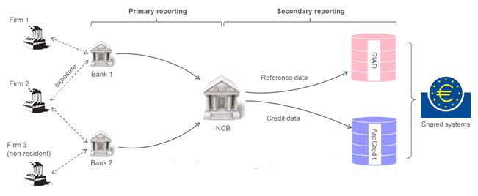
Example 1: AnaCredit
Rico Konen
Floris Statema

Slide 9
Anacredit - Counterpart Reference Data SBR
National identifier (legal unit)
Name
Address
Legal form
Institutional sector
Economic activity
Status of legal proceedings
Date of initiation of legal proceedings
Enterprise size
Date of enterprise size
Number of employees
Balance sheet total
Annual turnover
Drivers for cooperation
Efficiency in terms of costs
Coordination of statistical processes
Coherence in Statistics
Sources CRD on legal units provided by the NCB:
Statistical Business Register SN
Value Added Tax on turnover
Corporate tax on balance sheet totals
NUTS3 level on location
Quality checks by NCB
Data model checks, Variable formats, Plausibility checks
Information on ‘not linked’ legal units
Rico Konen
Floris Statema

Slide 10
Example 2: Unified SBR for S.12
SN and DNB both produce their own statistics
A unified register to prevent double or missing observations
Exchanging data to reduce the administrative burden
Improve the quality of the unified register by using input from both SN and DNB
Rico Konen
Floris Statema

Slide 11
Rico Konen
Floris Statema

Slide 12
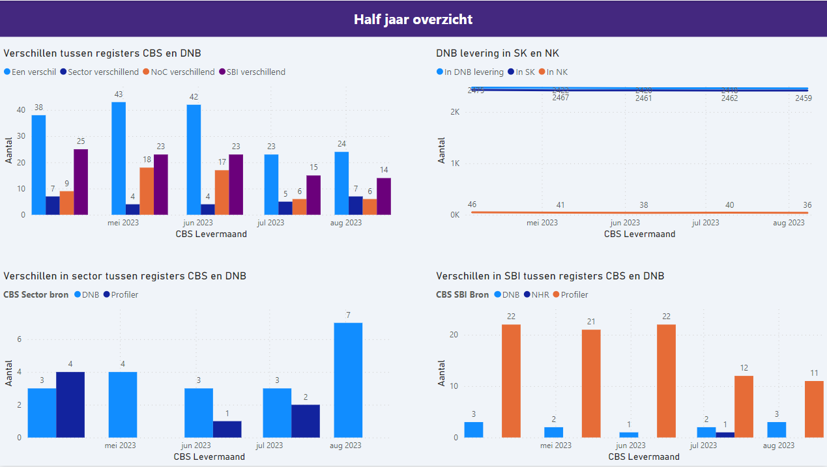

Slide 13
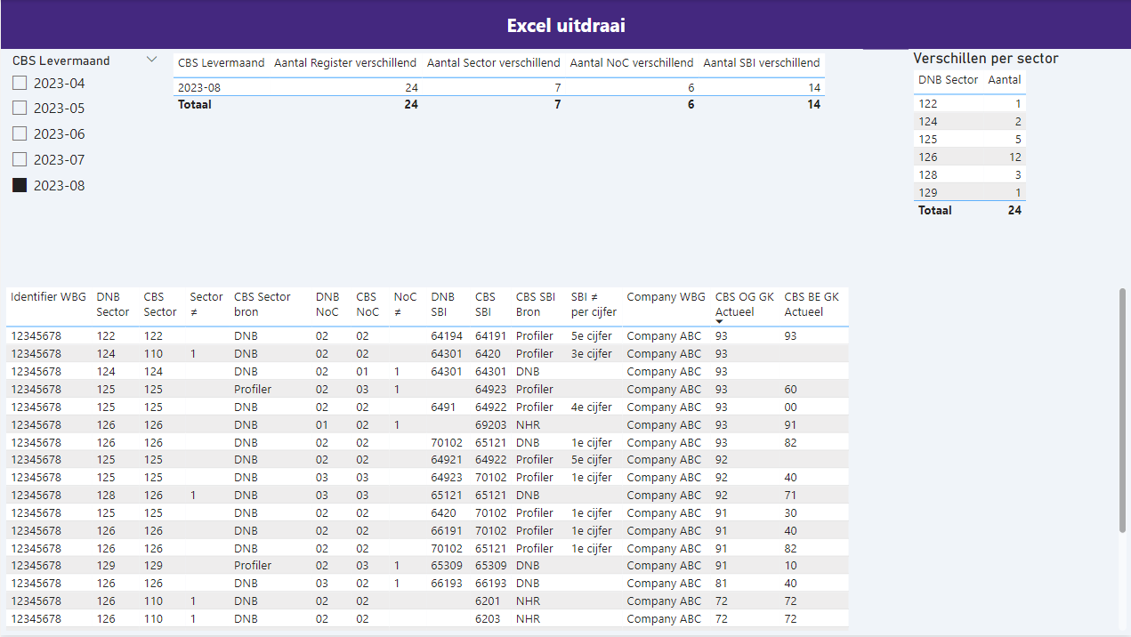

Slide 14
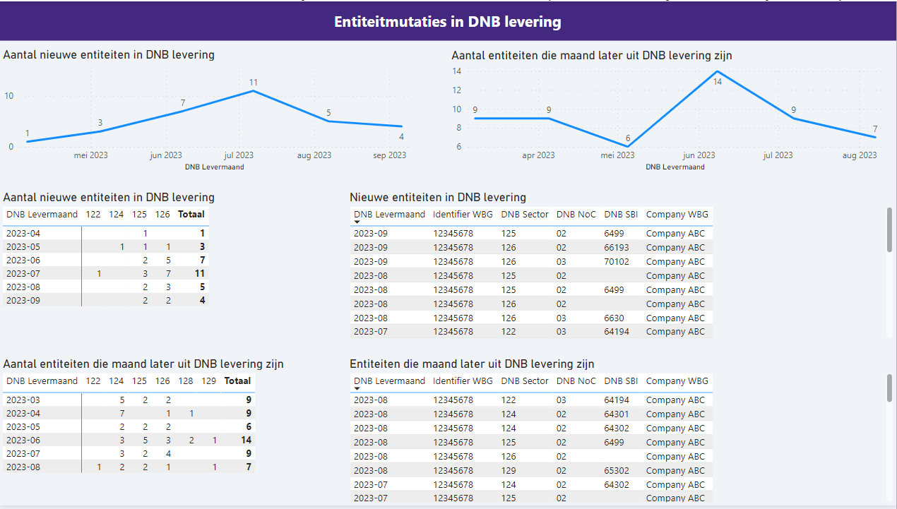

Slide 15
Thank you for your attention
Rico Konen: hj.konen@cbs.nl
Floris Statema: f.statema@dnb.nl
Rico Konen
Floris Statema

