Slide 1
Are US Source Plasma Donors Healthy?
A Cross-Sectional Examination of Donation Frequencies, Health Effects, and Reasons for Lapsing
Michelle Fransen, MPH
Director, Study Management, PPTA
12 September 2025
ECDHM, The Netherlands

Slide 2
Conflict of Interest
Employee of PPTA

Slide 3


Background
ECDHM, The Netherlands, 2025
Plasma-derived medicinal products (PDMPs) are essential, life-saving medicines manufactured from plasma donated by healthy human volunteers.
PDMPs are used to treat a range of rare, serious, and chronic conditions, often genetic in origin.
Globally, Source Plasma (SP), or plasma used for further manufacturing, is the starting material for 87% of PDMPs, especially Immunoglobulins.
While there is no evidence that frequent SP donation poses a serious health risk, other countries have lower limits on donation volume and frequency. Considering the global need for SP and PDMPs, it is critical to maintain the health of frequent donors.
Study Aims
The hypothesis is that US SP donation frequency does not impair donor self-reported functional health and well-being.
This study explores SP donors’ self-reported reasons for a lapse in donating.

Slide 4

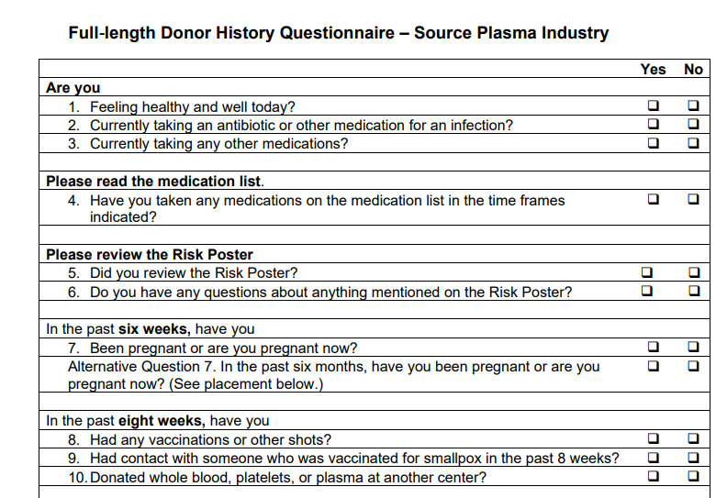
General Donor Eligibility Requirements
ECDHM, The Netherlands, 2025
For US SP donors, FDA regulations state: “… collection shall not occur less than 2 days apart or more frequently than twice in a 7-day period”
To determine eligibility, a donor must have a pre-donation screening consisting of:
Completing the Donor History Questionnaire
Proof of identity and postal address
Providing Informed Consent
Having a physical exam performed by Physician Substitute
Food and Drug Administration (FDA)

Slide 5
General Donor Eligibility Requirements
ECDHM, The Netherlands, 2025
For US SP donors, FDA regulations state: “… collection shall not occur less than 2 days apart or more frequently than twice in a 7-day period”
To determine eligibility, a donor must have a pre-donation screening consisting of:
General health
Phlebotomy site free from infection, inflammation and lesions
Arms free of punctures and scars indicative of injected drug abuse
Infectious disease risks
Routine exam includes
Food and Drug Administration (FDA)

Slide 6
General Donor Eligibility Requirements
ECDHM, The Netherlands, 2025
Systolic Blood Pressure (90-180 mmHg)
Hematocrit (≥38% females; ≥39% males)
Pulse (regular rhythm, 50-100 bpm)
Weight (≥50 kg)
Total Protein (6.0-9.0 g/dL)
Diastolic Blood Pressure (50-100 mmHg)
Temperature (<37.5°C)
Performed at each donation

Slide 7
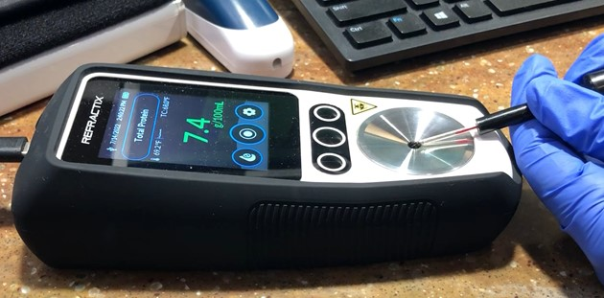
General Donor Eligibility Requirements
ECDHM, The Netherlands, 2025
Alpha₁ Alpha₂
Serum Protein Electrophoresis (SPE)
Beta Gamma (IgG)
Albumin
Not every individual that is interested in donating is eligible.
Total Plasma Protein (TP) by Refractometry
SPE tested at initial donation with TP and at least every four months

Slide 8

Donor Health and Safety
ECDHM, The Netherlands, 2025
Throughout the plasmapheresis procedure, there are several safety measures to protect the donor’s health:
Donor education on importance of healthy lifestyle (fluid intake, nutrition, rest, etc.).
The plasmapheresis process is monitored by trained phlebotomists.
Red blood cells are returned with each cycle and at the end of the procedure.
Industry standard of at least 250 mL (500mL in the US) of saline is administered at the end of the procedure to return blood cells and enhance return of intravascular fluid balance.

Slide 9
Methods

Slide 10
Study Participants
ECDHM, The Netherlands, 2025
5608 SP donors from 14 US SP centers were enrolled between October 2019 and May 2020
By sex, donors were assigned to one of four groups, according to their frequency of SP donation in the 12 months before enrollment:
New Donors (ND): donors with no previous donation history or who had no documented donations in the previous 12 months
Low Frequency Donors (LFD): 1 – 24 donations,
High Frequency Donors (HFD): 25 – 69 donations, and
Very High Frequency Donors (VHFD): 70 – 104 donations.
1448 SP donors who lapsed in donating during six months or greater during the study follow-up were asked to complete a survey noting why they stopped
Protocol was approved by Sterling Institutional Review Board

Slide 11
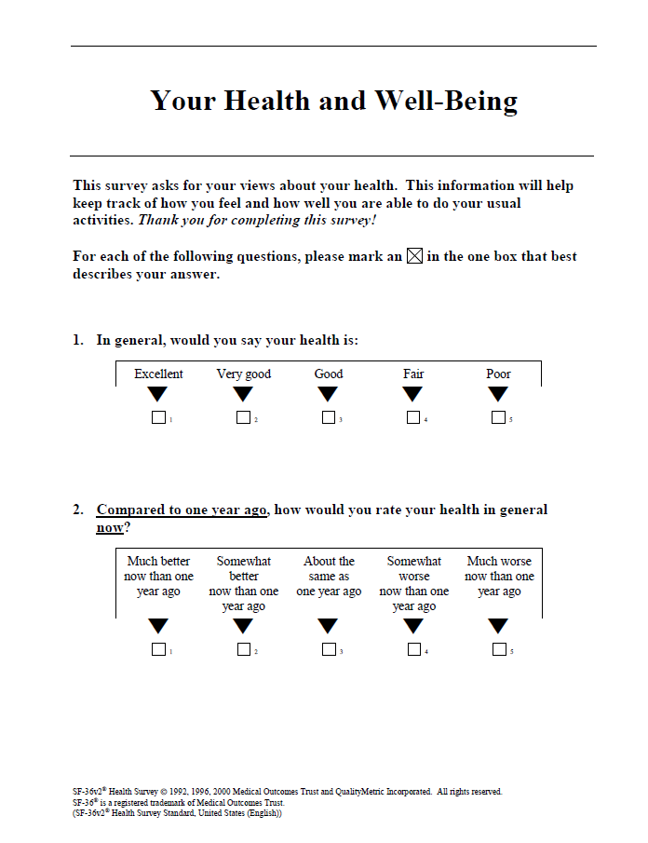
Study Instruments: SF-36v2® Health Survey (SF-36v2)
ECDHM, The Netherlands, 2025
Multipurpose, short-form health related quality of life (HRQoL) survey measuring with 36 questions that yields an 8-scale profile of functional health and well-being, as well as 2 psychometrically based physical and mental health utility index
Generic measure of health status, as opposed to one that targets a specific age, disease, or treatment group
Validated tool, proven useful for conducting surveys of general and specific populations

Slide 12
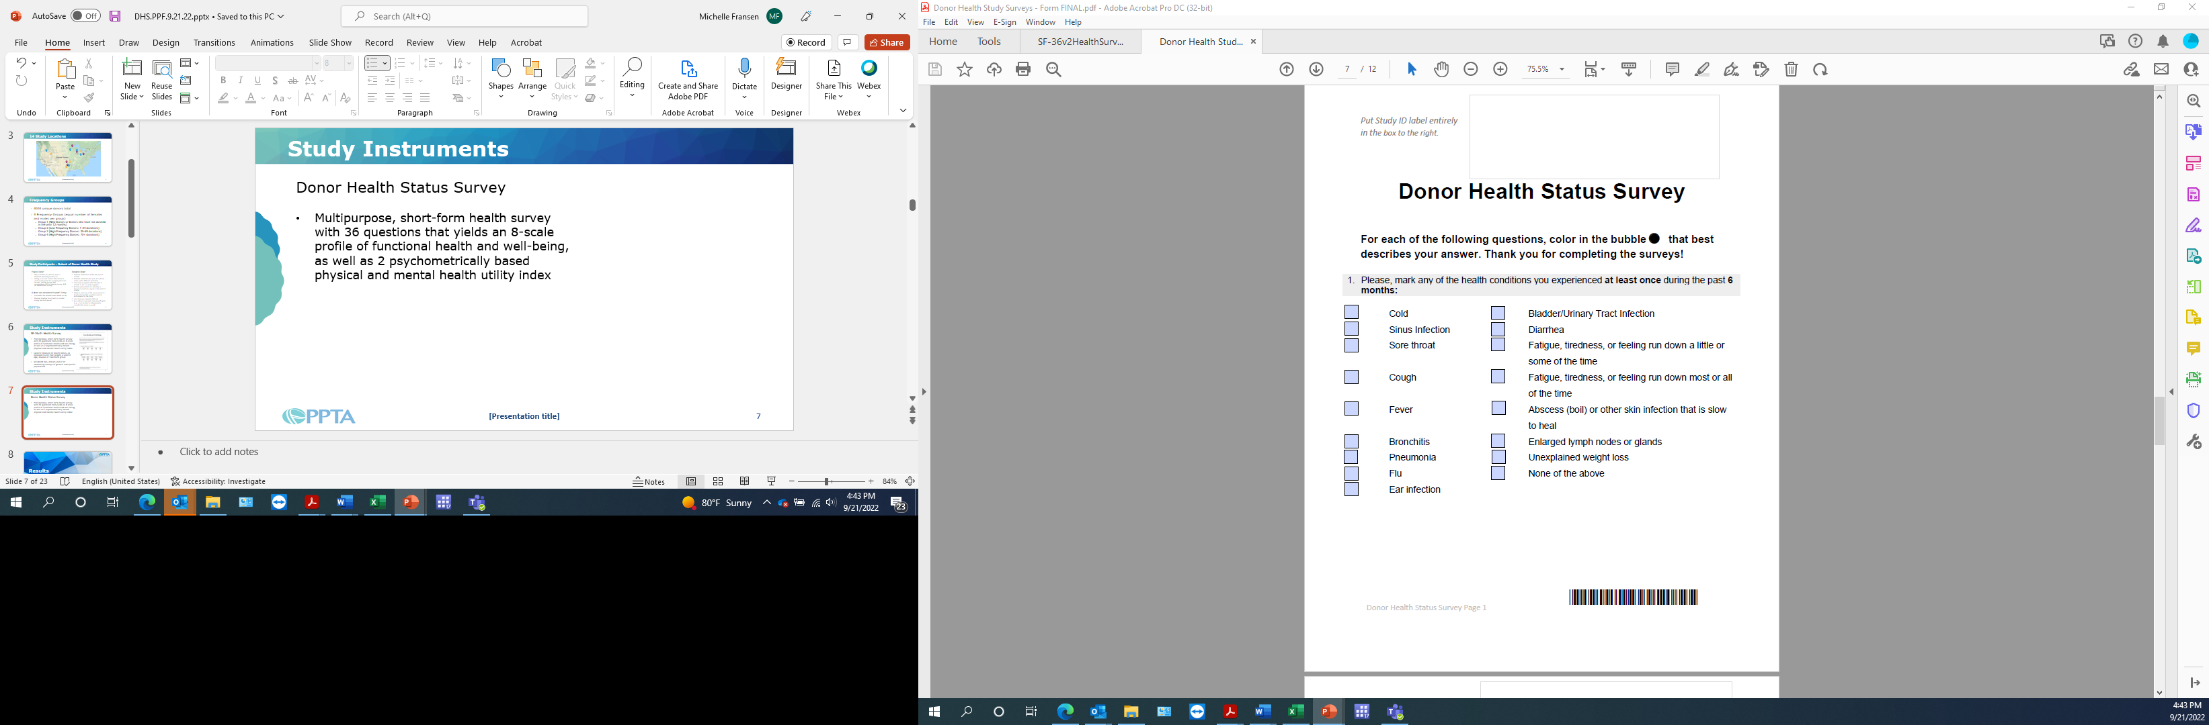
Study Instruments: Donor Health Status Survey
ECDHM, The Netherlands, 2025
Short, 14 question survey asks donors about health conditions, which are possibly associated with immune system function due to reduced levels of immunoglobulins, that they may have over different time periods:
At least once in past 6 months
  Conditions which improved without prescription medications
  Conditions which medical care was sought
Conditions experienced 1, 2, 3, or constantly in the past 6 months
Basic demographics, including employment status, smoking history and race/ethnicity
Donors received $5 after completing the surveys

Slide 13
Study Instruments: Lapsed Donor Survey
ECDHM, The Netherlands, 2025
When did you first donate at this plasma center?
Prior to your last donation, on average, how often did you donate plasma at this center?
Why did you donate plasma?
Why did you stop donating plasma at this center? Rank your top 5 reasons.
Reasons for “Why did you stop donating plasma?” (Multiple Responses Allowed)
I had schedule conflicts/a lack of time | I was told by the plasma center I could not donate plasma again
The compensation was not enough | I had sex with another man (Male Donors)
I got a tattoo | I was deferred multiple times during the screening process
The donation process took too long | I had a surgery, accident, or injury in the past 6 months
I moved out of the local area | I was told I had low or abnormal protein levels
I was concerned about my health | It took too much time to get to the center
I found donating plasma was too painful | I decided to donate plasma at another center
I no longer needed the extra income | I did not like the changes in center operations due to COVID-19
I did not feel well after donating plasma | I had an unexpected reaction donating plasma
I lost interest in donating plasma | A health care provider told me to stop donating
Issues with phlebotomy or veins | I experienced unpleasant personnel/poor customer service
I became pregnant (Female Donors) | I decided to donate blood at the Red Cross or other blood bank
I became ill with COVID-19 | I started donating COVID-19 convalescent plasma at another collection site
I had difficulty getting transportation | I was concerned about exposure to COVID-19 while in public or at the donor center
I had difficulty getting childcare | I developed an illness or health condition unrelated to plasma donation or COVID-19
Other
Donors received $10 after completing the survey

Slide 14
The SF-36v2® Health Survey (SF-36v2) Scoring
ECDHM, The Netherlands, 2025
Physical Health (PH)
Physical Functioning (PF)
Bodily Pain (BP)
General Health (GH)
Role Physical (RP)
Physical Component Summary (PCS) Measure
Health Domain Scales
Mental Health (MH)
Vitality (VT)
Social Functioning (SF)
Role-Emotional (RE)
Mental Health (MH)
Mental Component Summary (MCS) Measure
Health Domain Scales

Slide 15
Results

Slide 16
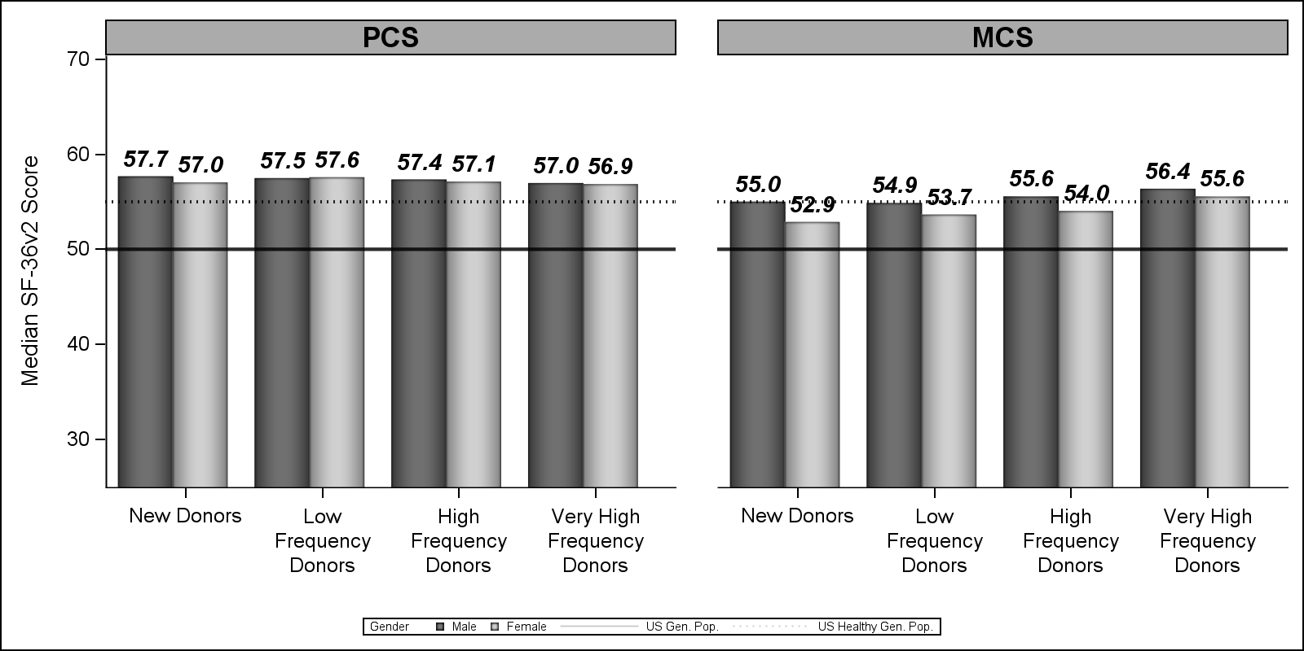
Median SF-36v2 Physical Component Summary (PCS) and Mental Component Summary (MCS) Scores by Donation Frequency Groups and Sex Relative to External Benchmarks
ECDHM, The Netherlands, 2025
With the 3434 survey respondents (61.3% response rate), there were no statistically significant differences in SF-36v2 scores between any of the donor frequency groups, compared to new donors, after controlling for potential confounding and accounting for multiple comparisons among males and females.

Slide 17
Conditions experienced at least once and 3 or more times in the past 6 months by sex and donation frequency (in %)
ECDHM, The Netherlands, 2025
Temporary conditions such as cough, cold, occasional fatigue, and sore throat were the most reported health conditions or symptoms, but there was no clear difference among sex or frequency groups.

Slide 18
Category results of “Why did you stop donating plasma” by sex (in %)
ECDHM, The Netherlands, 2025
545 survey respondents (37.6% response rate)

Slide 19
Category results of “Why did you stop donating plasma” by sex (in %)
ECDHM, The Netherlands, 2025
#1 Reason: Convenience (69.1%)
Includes:
schedule conflicts (30.2%)
stating the donation process took too long (13.2%)

Slide 20
Category results of “Why did you stop donating plasma” by sex (in %)
ECDHM, The Netherlands, 2025
#2 Reason: Concerns about health possibly related to or unable to determine a relationship to plasmapheresis (45.5%)
Includes:
having multiple deferrals during screening (14.3%)
concerns about health (9.9%)
not feeling well after donating plasma (7.7%)

Slide 21
Category results of “Why did you stop donating plasma” by sex (in %)
ECDHM, The Netherlands, 2025
#3 Reason: Personal (29.7%)
Includes:
experiencing unpleasant personnel in the plasma center (9.0%)

Slide 22
Category results of “Why did you stop donating plasma” by sex (in %)
ECDHM, The Netherlands, 2025
#4 Reason: Economic (22.4%)
Includes:
compensation was not enough (14.7%)

Slide 23
Conclusions
ECDHM, The Netherlands, 2025
The self-reported data in this study support the hypothesis that compensated donations at US FDA permitted frequencies and volumes are consistent with maintaining donor health.
SP donors have comparable or better self-reported HRQoL than the general US population, better physical health compared to the US ‘healthy’ general population, and VHFD have better mental health compared to the US ‘healthy’ general population.
Self-reported health concerns were less frequent but present in all frequency groups.
The top factor reported by US SP donors to discontinue participation was for convenience reasons.
1
2
3
4

Slide 24






Study Investigators
ECDHM, The Netherlands, 2025
Toby Simon, Co-Investigator
Mark Becker, Co-Investigator
Janet Hershman, Co-Investigator
James Lenart, Co-Investigator
Alexandra Parfitt, Statistician
Lisa Weissfeld, Statistician
Guang Song, Data Analysist
Michelle Fransen, Investigator

Slide 25

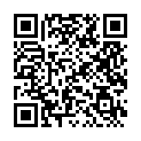
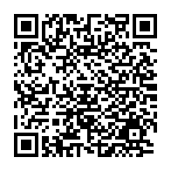
Thank you
mfransen@pptaglobal.org
Donor Health
Lapsed Donor
References:
Fransen M, Becker M, Hershman J, Lenart J, Simon T, McCausland K, Parfitt A, Weissfeld L. Effects of donation frequency on U.S. source plasma donor health. Transfusion. 2023 Oct;63(10):1885-1903.
Fransen M, Becker M, Hershman J, Lenart J, Simon TL. Why do US source plasma donors stop donating? Transfusion. 2023 Oct;63(10):1904-1915.

