Slide 1
Van Wilderode Sandrine
Docent verloskunde
Université Libre de Bruxelles

Slide 2
Project:
Pan-European Obstetric Emergencies Management using Simulation Enhanced Training
Interprofessioneel serious game
Studenten gezondheidswetenschappen
Niet technische vaardigheden CRM
Persoonsgerichte zorg PCC
Timing van het project :
November 2021 – Oktober 2024

Slide 4
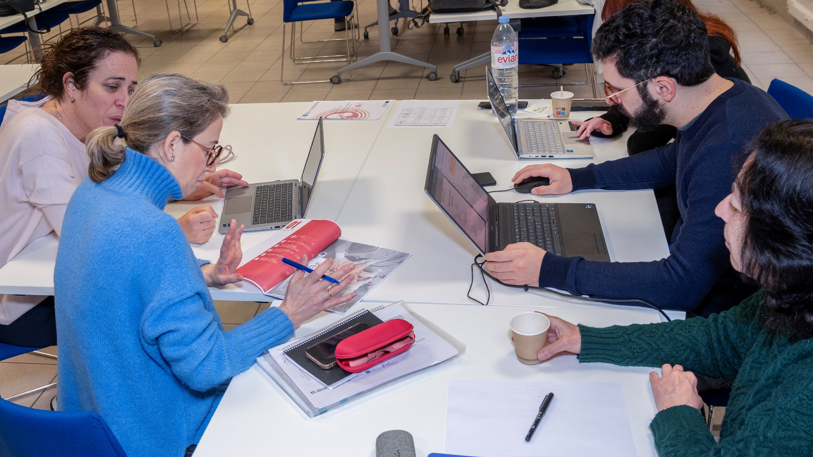
3 scenarios :
Rokende zwangere
Psychoemotioneelmanagement
Onvoorziene bevalling
Observatieroosters :
PETRA
NURSE
SPIKE
ITEM
DASH

Slide 5
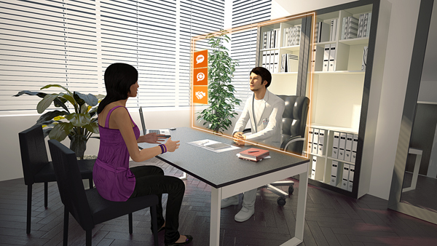
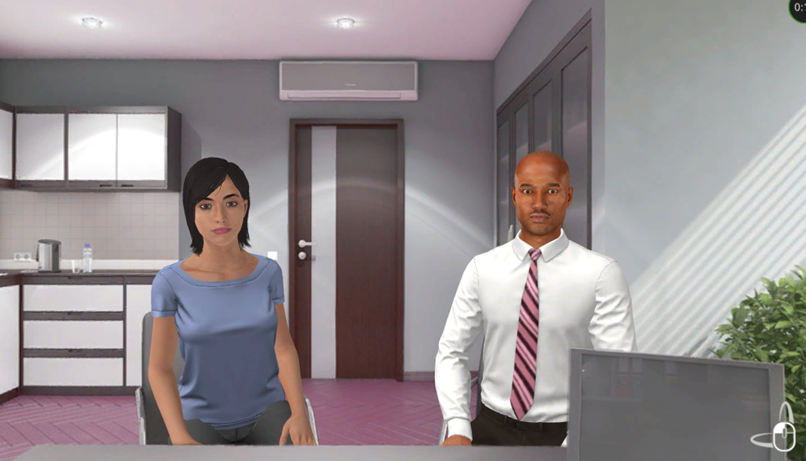
https://www.youtube.com/watch?v=CGY2A8sFFMs
https://ineferna.github.io/POEMSET_Scenario2_EN_ES_17nov/

Slide 6
Verschillende groepen :
Enkel COIL
COIL en scenario
COIL, scenario en serious game
COIL en serious game
Feedback docenten tijdens summercamp

Slide 7
Collaborative Online International Learning
Presentaties
Hoorcolleges
Ontmoetingen
videos
Quiz
Kick off mei 2024

Slide 8
Juni 2023 Brussel
April 2024 Parijs
Docenten verpleegkunde, verloskunde en
geneeskunde
3 dagen :
Testing scenarios en serious game
September 2023 Brussel
September 2024 Parijs
Studenten verpleegkunde, verloskunde
en geneeskunde
Spanje, Frankrijk en België
27 deelnemers – 2 dagen
Deelname COIL vooraf

Slide 9
Year 1
Year 2
Year 3
WP1: adapting methodology
Adapting scenarios for on-site simulation
Working on the methodology
Summer camp
Summer camp
Summer camp
WP2: serious game
3D environment creation
Implementing the 1st scenario into the serious game
Implementing the 2nd and 3rd scenario into the serious game
Online training on
VTS
The 1st serious game is delivered.
The complete serious game is delivered.
WP3: relevance blended-training course
Creation of the evaluation protocol
-Group control: on-site simulation only
-Group test: serious game + on-site simulation in each partner university
-Group control: on-site simulation only
-Group test: serious game + on-site simulation in each partner university
WP4: strengthen interpro for students
COIL
COIL
COIL
Summer school
Summer school

Slide 10
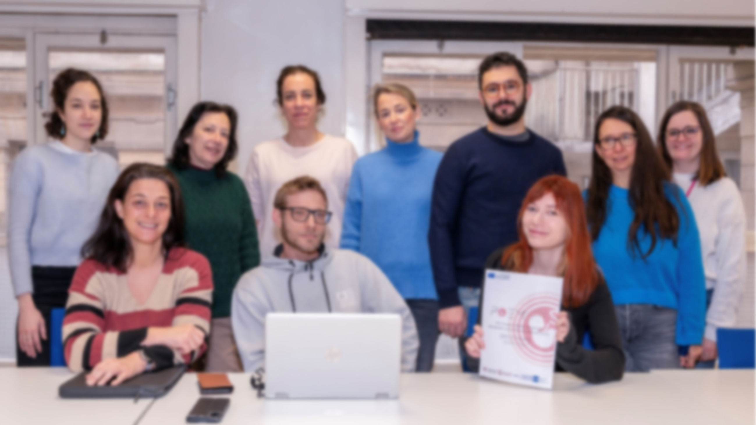
POEM-SET
team:
Castillo-Ocaña Almudena, Universidad de Navarra
Fernández-Vallejo Inés, Universidad Carlos III de Madrid
Holmström Emilia, Université de Paris
Ibáñez-Espiga María Blanca, Universidad Carlos III de Madrid
La Rosa Salas Virginia, Universidad de Navarra
Lizarbe -Chocarro Marta, Universidad de Navarra
Pereira-Sánchez Miriam, Universidad de Navarra
Sand Renaud, Université Libre de Bruxelles
Van Wilderode Sandrine, Université Libre de Bruxelles
Vérot Christèle, Université de Paris

Slide 11
Sandrine.vanwilderode@helb-prigogine.be
Vragen ?

