Slide 1
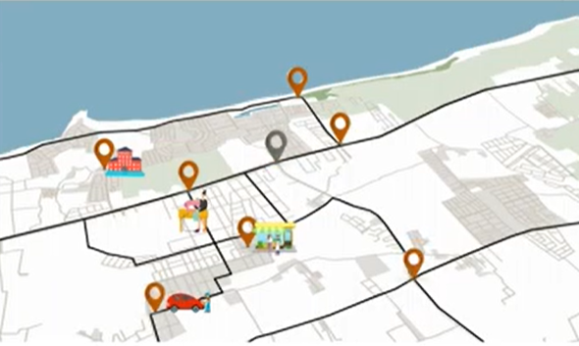
28th Meeting of the Wiesbaden Group on Business Registers
Session N° 5
Workshop SBR Maturity Model
Integration of geospatial data in Morocco's Statistical Business Register (MSBR)
Mourad Feddouli
Nada Edrissi
Abdelkader Choqiri
High Commission for Planning Morocco

Slide 2
About Us
Mourad Feddouli
Nada Edrissi
Abdelkader choqiri
Head of the economic census and establishment surveys division- HCP
Head of the economic census and SBR units HCP
Head of the business surveys units
HCP

Slide 3
Content
MSBR Coverage
MSBR Data sources
Integrating geospatial data into the MSB
The 2023 Economic Establishments Mapping (EEM)
The anticipated outcomes of integrating geospatial data into the MSBR
Future perspectives

Slide 4
MSBR coverage
Businesses operating across industrial, service, construction and commercial sectors.
excludes the agricultural sector: divisions 01, 02, and 03 of the Moroccan activity classification.
“Enterprise” : independent economic structure classified as profit making. and are registered with tax authorities.

Slide 5
Data sources for the MSBR
Economic Census
Administrative sources
2001-2002: the HCP conducted the first economic census in Morocco.
From June 2023 to May 2024, the HCP will conduct a second census: the economic establishment mapping.
2009 : An agreement with the National Social Security Fund (CNSS)
Contract to acquire annual accounting data from the Moroccan Industrial and Commercial Property Office (OMPIC)
2023: the HCP is negotiating a permanent data exchange agreement with the Tax Authority.
Statistical surveys
Other sources
Quarterly Business Surveys
Annual Business Surveys
Structural Business Surveys
the official websites of professional federations
Business directories
Company press releases

Slide 6
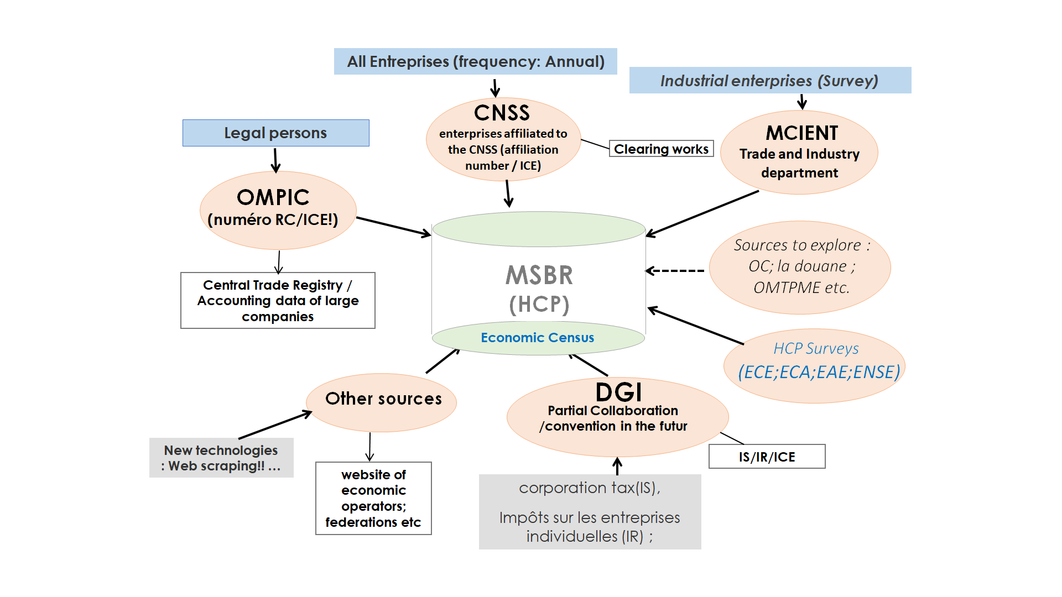
Data sources for the MSBR

Slide 7
Integrating geospatial data into the MSBR (1)
Morocco is conducting the national economic census using new technologies and employing specific approaches to the mapping of economic establishments, with the objective of exhaustive geo-referencing of all local units.
the HCP has deployed significant resources to initially geo-locate the buildings containing economic units and residential units. Then, data collection from the economic units began.

Slide 8
Integrating geospatial data into the MSBR (2)
The 2023 Economic Establishments Mapping
Provide a complete update of the business register.
Provide an updated picture of the productive tissue.
Objectives
Establish a geospatial database of enterprises and their local units.
Conduct detailed spatial analyses of economic activities.
Establish a new sampling framework for economic surveys.

Slide 9
Integrating geospatial data into the MSBR (3)
The 2023 Economic Establishments Mapping
The local unit: a business or part of a business located in a geographically identified area and which engages in productive activity by one person or more.
Statistical units

Slide 10
Integrating geospatial data into the MSBR (5)
The 2023 Economic Establishments Mapping
Methodology & Approach
The method adopted for this census is based on new mapping techniques using a platform integrated into the mobile geographic information system GIS, usually called nomadic cartography.
This approach allows for capturing and updating a wide range of vector-based and descriptive data in the field, using tablets equipped with GPS, internet and loaded with satellite images.
Improved cartographic quality
Enriched geographical data with detailed geocoding
Remote fieldwork monitoring
Reduced complexities of traditional mapping

Slide 11
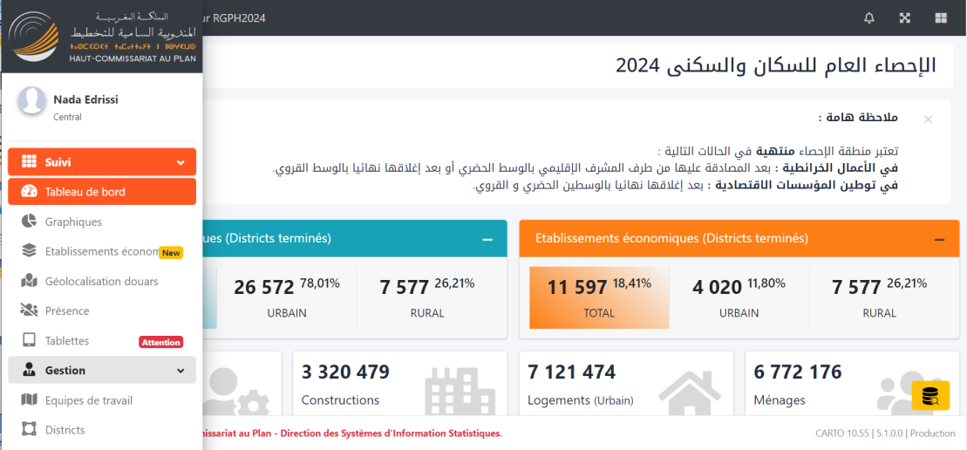
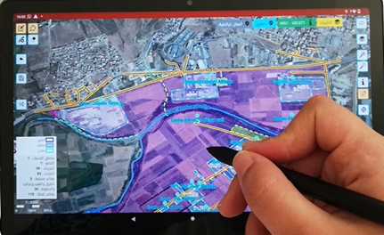
Integrating geospatial data into the MSBR (6)
The 2023 Economic Establishments Mapping
Exclusively HCP’s experts developed the system. Three types of profiles were involved in the project: IT engineers, statistical engineers and geomaticians
Data collection is gathered using a mobile software application CAPI. This app is set up on an Android tablet, designed specifically for cartographers and EEM enumerators and can operates in offline mode.
An online web application for fieldwork management and monitoring. Each user has access to a personalized space according to their profile, allowing them to perform the tasks assigned to them.

Slide 12
Integrating geospatial data into the MSBR (7)
The 2023 Economic Establishments Mapping
the HCP has procured satellite images from Morocco's Royal Center for Remote Sensing (CRTS): the national institution responsible for the promotion, use and development of remote sensing applications in Morocco.
Fieldwork methodology: After the cartographer has geolocated the buildings and gathered preliminary information within a census tract, such as the presence or absence of commercial activities, The EEM enumerator examines each building, progressing block by block, and collects data of all local units.
→ To support this effort, a GIS team, part of the HCP staff, was formed with the task of updating roadways, as well as shapes and positions of urban blocks.

Slide 13
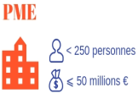
Integrating geospatial data into the MSBR (_8)
The 2023 Economic Establishments Mapping
We distinguish three types of economic activity:
Profit-making activities
Associative activities
Public services.
Questionnaire
The questionnaire predominantly touches upon:
Geographical location
Identifying attributes
Main characteristics (Activity and Employment)

Slide 14
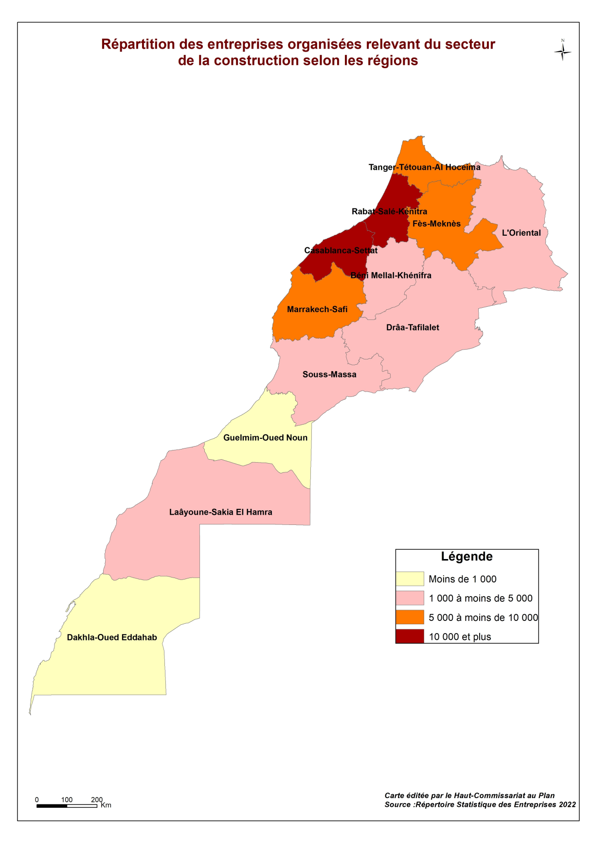
DEVELOPMENT OF THEMATIC MAPS:
The anticipated outcomes of integrating geospatial data into the MSBR
By integrating geospatial data into the MSBR, thematic maps will be produced, transforming complex data into clear visuals. This pivotal step advances data visualization, offering stakeholders actionable insights for informed decision-making.

Slide 15
IMPROVED STAKEHOLDER COLLABORATION
The integration of geospatial data into the MSBR fosters enhanced collaboration among stakeholders. Geographic insights provide a common ground for discussions and decision making, enabling diverse groups, to work more cohesively towards shared goals.
EFFICIENCY IN DATA COLLECTION
Geospatial data can streamline the data collection process. Enumerators can plan their routes better, minimizing the time and resources spent on data gathering.

Slide 16
Future perspectives
Nationally, the expected outcomes of this initiative will provide invaluable tools for a variety of stakeholders, including policy makers, business leaders, economists, and researchers. They will benefit from the ability to analyze spatial distributions and monitor the dynamics of production units.
At the international level, by adopting the methodology and practical methods for integrating geographic data, HCP will be positioned to align with the national practices of countries that have successfully integrated information and geospatial statistics. This will further enrich and serve as a regional benchmark, fostering discussions within the international community.

Slide 17
Contact :
+212 662161351 m.feddouli@hcp.ma
+212 660679859 n.edrissi@hcp.ma
+212 661154924 a.choqiri@hcp.ma
www.hcp.ma

