Slide 1
Introduction to Ecosystem Services (ES)
Jane Doe CzechGlobe

Slide 2
Core Concept
Direct and indirect contributions of ecosystems to human well-being.
They represent the bridge between biological processes and the socio-economic benefits that sustain modern civilization.
Key Components:
Natural Capital: Ecosystems act as a stock that yields a flow of valuable goods and services over time.
Human-Centric Approach: The framework translates ecological functions into value-based outcomes for society.
Sustainability Nexus: Maintaining the flow of ES is essential for climate resilience and economic stability.
Millennium Ecosystem Assessment (2005). Ecosystems and Human Well-being: Synthesis. Island Press, Washington, DC. Available at: millenniumassessment.org

Slide 3
Classification of Ecosystem Services
4 distinct functional groups based on the type of benefit they provide to society.
Functional Categories:
Provisioning Services: Material outputs directly harvested from nature (e.g., food, raw materials, fresh water).
Regulating Services: Benefits obtained from the regulation of ecosystem processes (e.g., carbon sequestration, waste decomposition, flood control).
Cultural Services: Non-material benefits that contribute to the spiritual and cognitive development of humans (e.g., recreation, aesthetic values, mental health).
Supporting Services: Fundamental processes necessary for the production of all other services (e.g., nutrient cycling, photosynthesis).
TEEB (2010). The Economics of Ecosystems and Biodiversity: Mainstreaming the Economics of Nature. Earthscan, London and Washington.

Slide 4
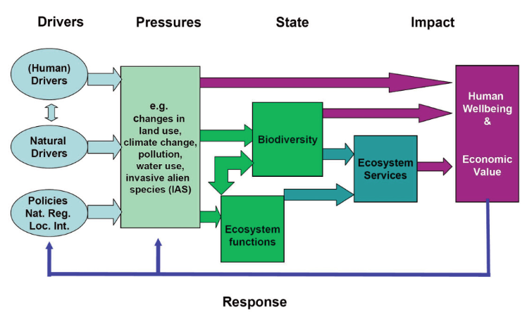
The DPSIR Framework & Ecosystem Services
Core Concept: The Socio-Ecological Loop
Human-Nature Link: Demonstrates how anthropogenic activities directly alter natural systems.
Feedback Mechanism: Illustrates how environmental changes cycle back to impact human wellbeing.
Value Impact: Maps the flow from ecosystem degradation to the loss of socio-economic benefits.
TEEB (2010). The Economics of Ecosystems and Biodiversity: Mainstreaming the Economics of Nature. Earthscan, London and Washington.

Slide 5
Thank you!
Jane Doe CzechGlobe jean.doe@email.com

